Slide 1
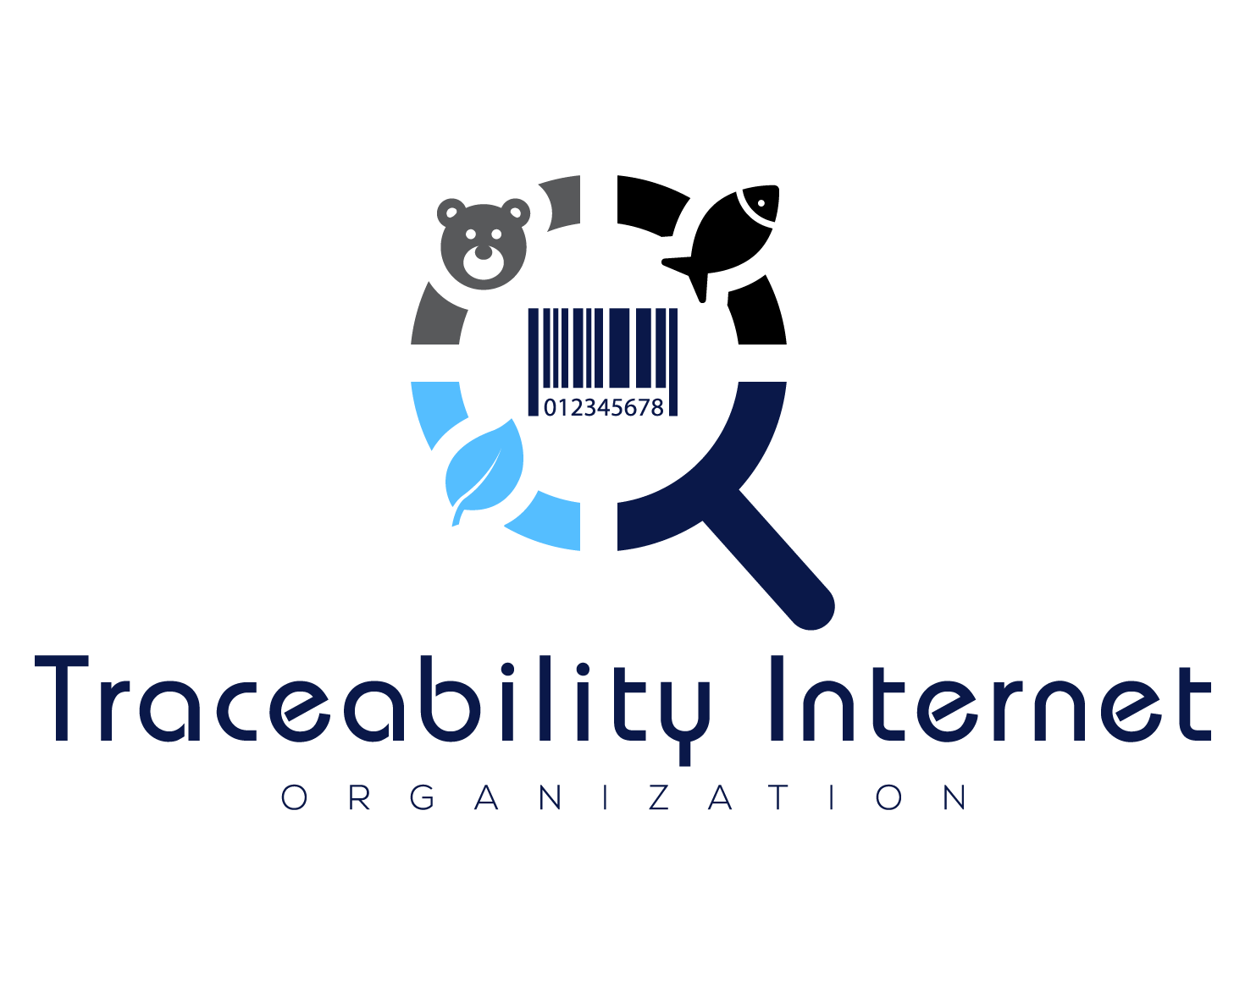
FDA Traceability Challenge Submission
Developed by: Philip L. Heggelund With help from John Heggelund and special thanks to Thomas Burke

Slide 2


Entrant
The Traceability Driver was developed to reduce the cost of interoperability. It’s an addon service that can be installed onto existing traceability solutions with minimum work and enables any traceability solution to interoperate with all other traceability solutions that install the Traceability Driver.
“The GDST supports free open-source solutions, like the Traceability Driver, that utilize creative solutions to reduce the cost of interoperability. We see tools such as the Traceability Driver accelerating not only GDST implementation, but also driving traceability across other commodities and use cases.”

Slide 3
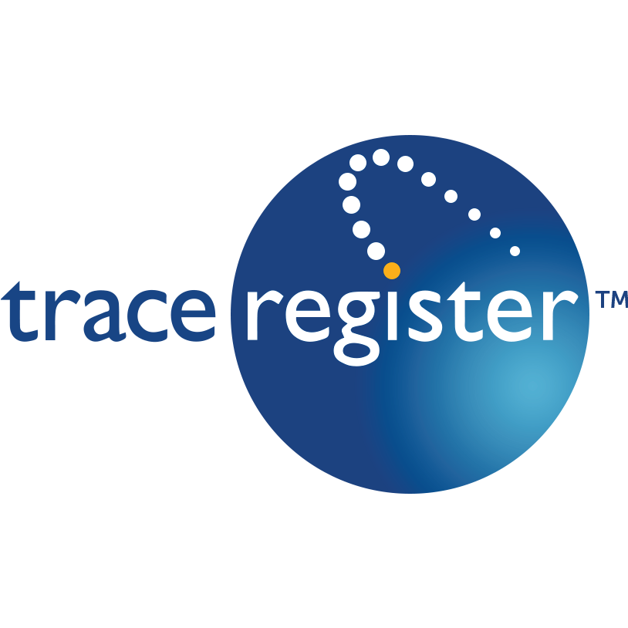

Summary of Concept
A software tool that can be used to make an existing traceability solution interoperable using the GDST and GS1 standards.
There are great standards for enabling interoperability such as GDST and GS1, this tool is meant to reduce development costs in implementing these standards.
Sometimes these standards are interpreted differently by solution providers implementing them, leading to inconsistencies in how they are implemented. This tool would assist in ensuring the standards are implemented consistently.
Each traceability solution that implements the Traceability Driver will be interoperable with every other traceability solution that implements the Traceability Driver.
Each traceability solution writes a mapper between the common data models in the Traceability Driver and their data models.
When TS #1 wants to exchange data with TS #2, they TS #1 uses their mapper to map to the common data model. Then the common data model is sent to TS #2 using their Traceability Driver. Then TS #2 uses their mapper to map to their local format.
Think wheel and spoke approach.
TS = Traceability Solution
The tool is installed as an addon to any existing traceability solution.
Cross Platform and available on Linux, Windows, and Mac.
The Traceability Driver does not store any of the data that is communicated through it and the Traceability Internet Organization cannot see any data communicated through the Traceability Driver. Each solution provider would host their own instance of the Traceability Driver and would have full control over it.
Below are companies that have already implemented or are currently working to implement the Traceability Driver…

Slide 4
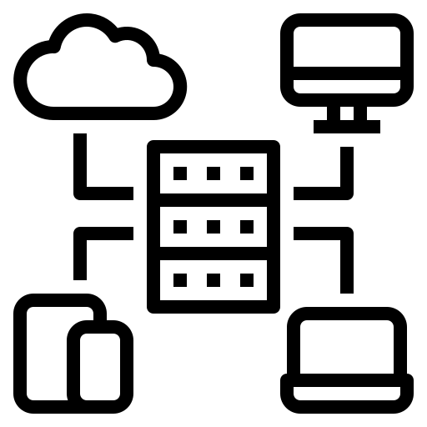
Description of Technical Design
Traceability Driver
Traceability Driver
Solution Provider
Solution Provider
GS1 Digital Link
GS1 Digital Link
EPCIS Interface
EPCIS Interface
Master Data API
Master Data API
Traceability Driver
Traceability Driver
Solution Provider
Solution Provider
GS1 Digital Link
GS1 Digital Link
EPCIS Interface
EPCIS Interface
Master Data API
Master Data API
Please see Appendix 1 and Appendix 2 for more details.

Slide 5
Evaluation Criterion #1: Needs-based
A lack of interoperability among traceability solution providers has inflated the cost of traceability and reduced data quality for years.
Without interoperability, supply chains are being forced to enter data into multiple buyer portals or adopt traceability solutions that their buyers use even though that traceability solution may not be a good fit or affordable for them.
What works for a retailer, will not work for a processor. By enabling interoperability, our solution allows each link in the supply chain to choose the solution that works best for them.
There already exists dozens, if not hundreds of traceability solutions. The industry is not lacking the perfect traceability solution. The biggest hurdle to end-to-end traceability is interoperability.
Currently most traceability solutions try to take a “one size fits all approach”.
There exists many great standards for interoperability such as GDST and EPCIS, however there is a need for software tools to assist in implementing these standards for traceability solution providers.

Slide 6
Evaluation Criterion #2: Innovation
Food companies are drowning in traceability solution options but are starving for interoperability.
Increases data quality and end-to-end traceability without introducing another standard or another traceability solution.
The Traceability Driver is a cross-platform that can easily be installed into any solution providers environment.
Utilizes existing data format and communication standards.
Secured with HTTPS, internal checks, and Public/Private Key Encryption.
HTTPS to ensure communication is secured.
Allows permissions of data on a Trading Party by Trading Party basis.
Public / Private Key using Decentralized Identifiers (DID)
Network effect creates exponential value for traceability solutions who implement the Traceability Driver.
Think social media like Facebook.
Every time someone implements the Traceability Driver, it makes the network more valuable for them, and for all the previous traceability solutions who implemented the driver.

Slide 7
Evaluation Criterion #3: Usability
The service is easily installed as a webservice and is compatible with Mac, Windows, and Linux.
Traceability Solution Providers just need to make a mapping between their local data model and the common data model provided.
The Traceability Driver dramatically reduces the effort to becoming interoperable while also increasing the consistency in which the interoperable standards are implemented.

Slide 8
Evaluation Criterion #4: Affordability
The Traceability Driver Service is open source and free to use.
Reduces the development costs of interoperability for solution providers.
Interoperability helps reduce costs for Food Companies
Development cost savings of interoperability for solution providers can be passed onto the food companies.
They don’t need to pay for solutions that don’t fit their needs that are pushed onto them by their buyer.
Reduces data-entry since they don’t need to enter data into multiple portals, they just enter data into their solution and their solution can now share that data with other solutions.

Slide 9
Evaluation Criterion #5: Scalability and Interoperability
Built on GS1 Standards
EPCIS
GS1 Digital Link
GS1 Web Vocab
The Traceability Driver enables any solution provider to become interoperable.
Compatible with Mac, Linux, and Windows.
Open Source and Free

Slide 10
Future Plans
We plan to continue assisting the industry in enabling interoperability by providing software and programming APIs that reduce the cost of implementing standards while also increasing the consistency in which those standards are implemented.
We believe having a standardized interface to query for traceability data for across numerous applications will allow for the development of analytics tools that can be built to talk to platforms storing traceability data through the Trace Driver. We plan on working with data scientists to help develop tools for the industry.

Slide 11
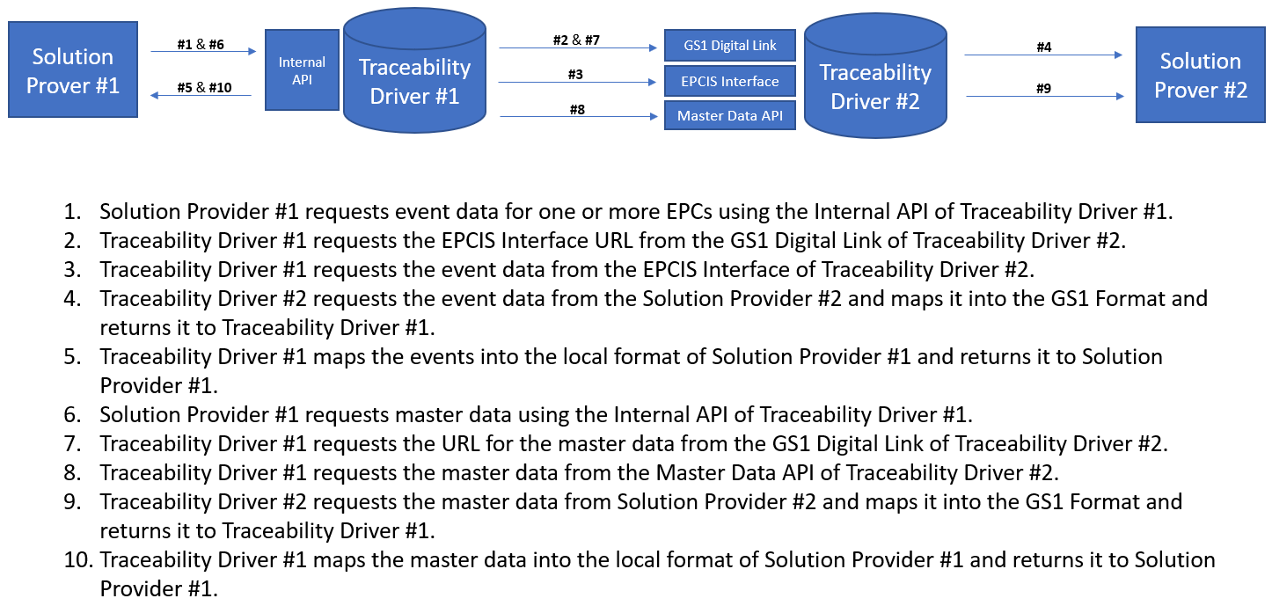
Appendix 1

Slide 12
Wheel and Spoke Data Mapping Approach
Appendix 2
Solution Provider #1 Data Model
Solution Provider #1 Data Model
Mapping
Mapping
Solution Provider #5 Data Model
Traceability Driver Common Data Model
Solution Provider #2 Data Model
Mapping
Mapping
Mapping
Mapping
Solution Provider #4 Data Model
Solution Provider #3 Data Model

