Slide 1

Weather analysis
... Findings relationships among in temp, humidity, cloudiness and wind-speed vs. Latitudes

Slide 2
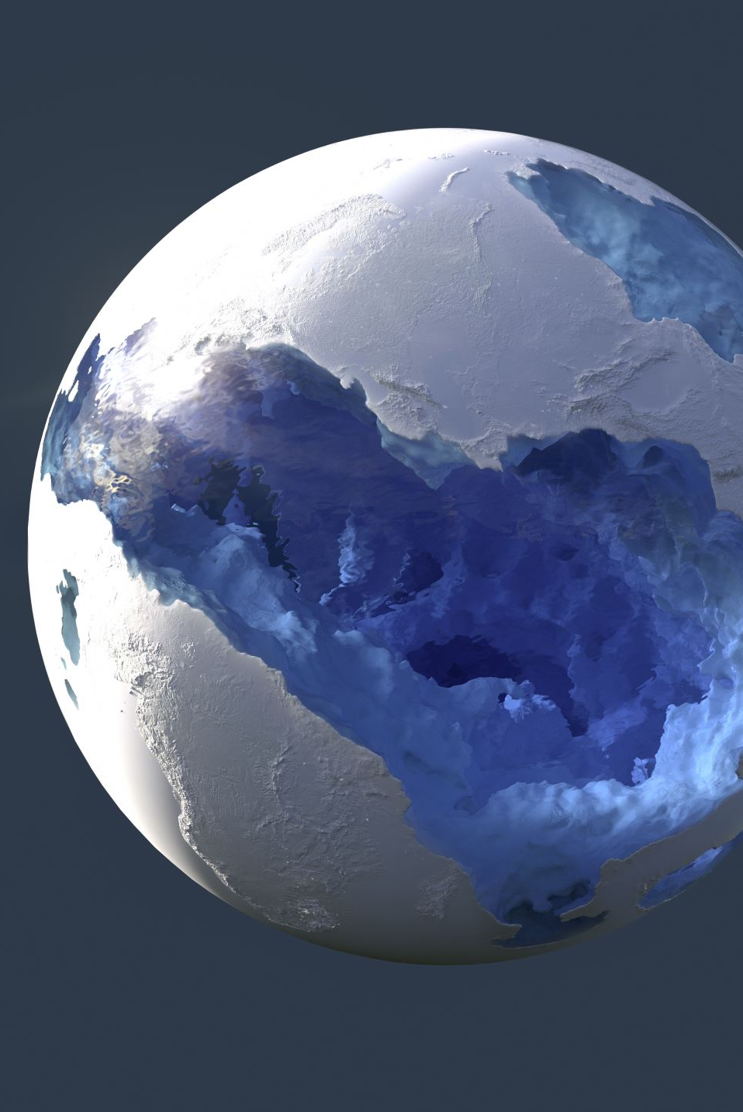
Table of content
Comparison between Latitudes and:
Temperature
Humidity
Cloudiness
Wind-speed
Analsysis the above specifically in the North | South Hemisphere
Vacation plan

Slide 3
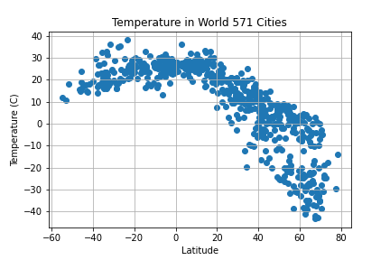
Latitudes vs. Temperature
For total 571 cities found in the json file, the scatter plot shows a not-so-close relationship between Latitudes and Temperature.
However, the correlation bt Latitudes and Temperature is : -0.75 which shows a negative correlation between the variables, we may say, the higher the latitudes, the lower the temperature. But yet as mentioned above, the -0.75 is not close relationship between these two factors

Slide 4
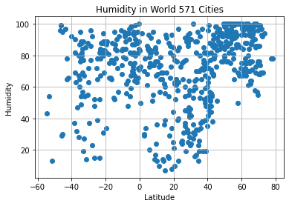
Latitudes vs. humidity
there is no correlation between the two variables: Latitudes and Humidity

Slide 5
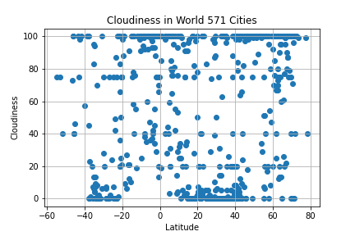
Latitudes vs. cloudiness
there is no correlation between the two variables: Latitudes and Cloudiness

Slide 6
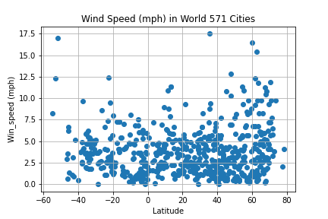
Latitudes vs. wind speed
there is no correlation between the two variables: Latitudes and Wind speed

Slide 7
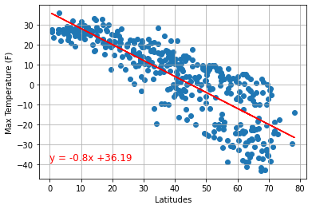
in the North Hemisphere
As analyse in the slide #3, there is a negative correlation between the temperature and Latitudes.
We can see the negative regression with equation: y = -0.8x + 36.19
The relationship seems to be closer when we zoom-in to the North Hemisphere.

Slide 8
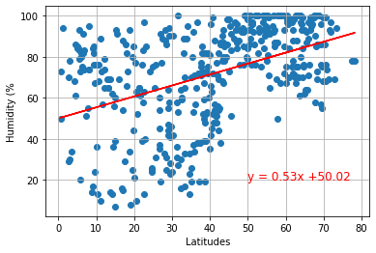
in the North Hemisphere
The relationship between the Humidity and latitude is not closed, however, in this North Hemisphere, it likely has a positive correlation between them but again, not so closed.
The closer the equator, the higher the humidity.

Slide 9
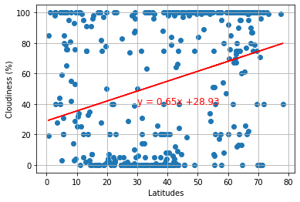
in the North Hemisphere
Even though the regressive linear show positive but it’s likely no correlation between the latitude and the cloudiness in the North Hemisphere

Slide 10
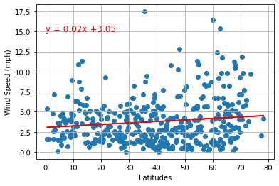
in the North Hemisphere
Same with the cloudiness analysis, there is no correlation between latitude and wind speed in the North Hemisphere.
Likely the wind speed are from 1mph to 10 mph mostly in this North half of the earth.

Slide 11
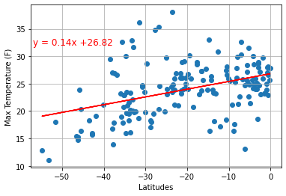
in the south Hemisphere
The correlation is 0.406 that shows lower than the minimum 0.5 and up to 1.
The relationship between the temperature and latitude in the South Hemisphere is not closed, however, in this North Hemisphere, it likely has a positive correlation between.
In the South Hemisphere, whereas closer to the equator, the higher the temperature there.

Slide 12
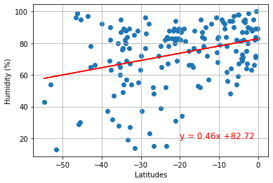
in the south Hemisphere
No closed relationship here between the latitude and the humidity in the South Hemisphere.
However, the positive linear let us may say, the closer to the equator, the higher the humidity.

Slide 13
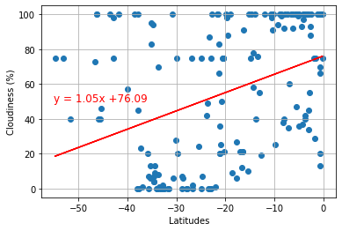
in the south Hemisphere
No correlation between the latitude and the cloudiness in this South Hemisphere

Slide 14
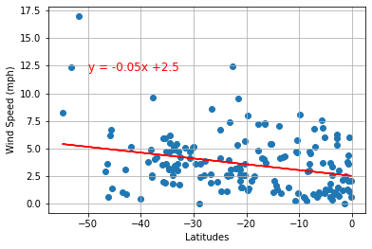
in the south Hemisphere
Look likely no correlation between the latitude and the wind speed in the South Hemisphere even though the linear show negative regression.

Slide 15


Vacation plan
...for a family loving peaceful and cool places in the US...

Slide 16
What are our criteria
Cool place with temp from 18 to 25 Celcius
Zero cloudiness
Low humidity: below 40
Domestic only

Slide 17
Cities to visit...
San Patricio
Leon Valley
Lawton
Pineville
Stephenville

Slide 18
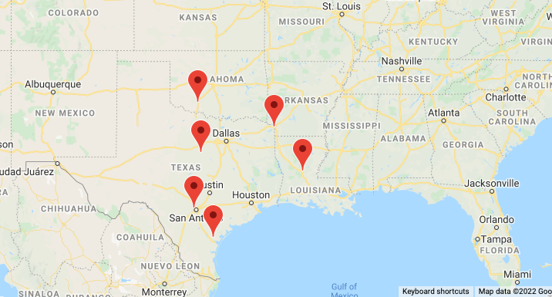

Slide 19
Thank you
...anything I could make this analysis better, you’re welcome to share...

