Slide 1

ENTERPRISE CASE & HISTORICAL OPERATIONS
ECHO AI
Research before action
Find the right path before creating, routing, or duplicating work.
Pitch for a focused operational pilot

Slide 2
ECHO AI
Ticket volume is often a knowledge problem
Teams create work when the answer already exists—but is buried across systems or never became a ticket.
What happens today
What ECHO changes
• Search Jira, docs, and release notes separately • Miss fixes completed outside the ticket process • Open duplicate or avoidable tickets • Escalate before the available history is understood
• Begin with one research question • Compare ticket, documentation, release, and operational history • Surface evidence and confidence together • Recommend the safest next action before work is created
02

Slide 3
ECHO AI
Four histories become one decision
Each source answers a different part of the investigation.
Jira
Confluence
Has this issue already been reported, linked, fixed, or left unresolved?
Is there a runbook, workaround, support article, or documentation gap?
Release Notes
Momentum Logs
Which version introduced, fixed, patched, or documented the behavior?
What action actually resolved the symptom—even when no ticket was created?
03

Slide 4
ECHO AI
Answer the question before work is created
01
Ask
02
Retrieve
Paste a draft ticket, symptom, error, version, or incoming request.
Search the selected histories and bring relevant evidence into one view.
03
Assess
04
Recommend
Classify the issue, explain confidence, and expose uncertainty.
Link, resolve, self-serve, document, route, escalate—or create a ticket.
04

Slide 5
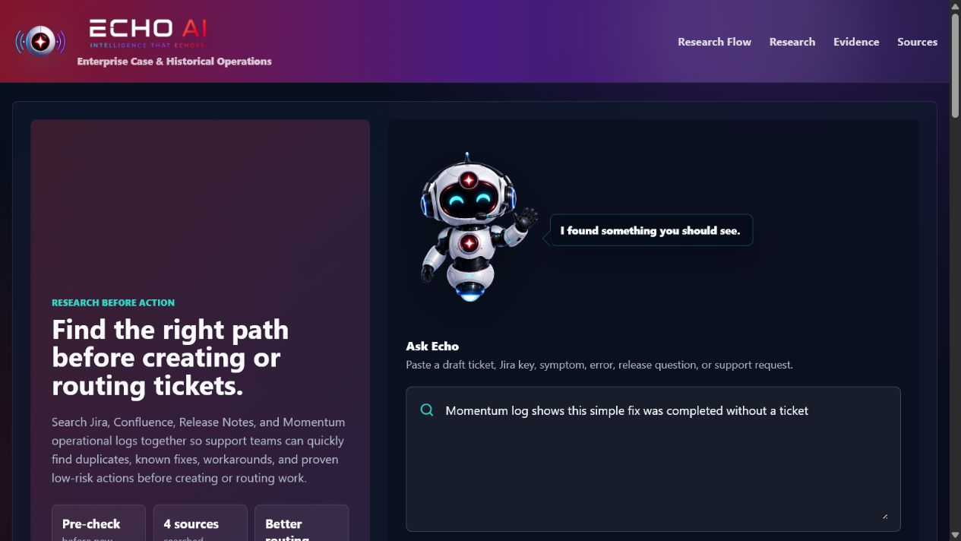
ECHO AI
The prototype now has a live local brain
Live today
qwen2.5:3b through Ollama Model-generated classifications, confidence, summaries, recommendations, and follow-up answers Local processing with no cloud API key
Source evidence is still prototype data; live connectors come next.
05

Slide 6
ECHO AI
Momentum reveals the history tickets miss
Operational logs can show how work was resolved when no Jira record exists.
Observe
Validate
Decide
A completed action restored service without creating a ticket.
Confirm approval, permissions, risk, repeatability, and matching conditions.
Self-serve when safe. Otherwise review, document, route, or create a ticket.
Guardrail: logs show what someone did—not automatically what everyone should do.
06

Slide 7
ECHO AI
Guardrails keep speed from becoming guesswork
Evidence stays visible
Permissions still matter
Every conclusion remains tied to source records, IDs, or documented excerpts.
A successful past action is not recommended when the current user lacks approval or access.
No-ticket is conditional
Analysts retain ownership
Self-service requires an approved, low-risk, repeatable procedure with matching conditions.
ECHO narrows the path; people make the final operational decision.
07

Slide 8
ECHO AI
Start local. Expand by connector.
The architecture separates private source access from the intelligence and decision layers.
SOURCE LAYER
LOCAL INTELLIGENCE
DECISION EXPERIENCE
Jira cases Confluence runbooks Release notes Momentum logs
Search orchestration Ranking and classification Ollama model Evidence-aware prompts
Related history Confidence and rationale Recommended next action Follow-up questions
→
→
Current state: intelligence layer live; source connectors remain to be integrated.
08

Slide 9
ECHO AI
Prove value with one focused pilot
TODAY
PILOT
SCALE
Working prototype
Connect one workflow
Expand from evidence
Live local AI Four-source experience Momentum no-ticket logic Evidence and safety guardrails
Choose one support team Integrate one source path Test real investigations Capture analyst feedback
Add prioritized connectors Formalize runbook candidates Tune ranking and prompts Broaden approved use cases
09

Slide 10
ECHO AI
Approve one focused pilot
Choose one team, one Momentum log path, and one ticket category.
Measure what matters
Decision requested
Research time Avoided duplicate work Safe no-ticket resolutions Documentation gaps surfaced
Authorize the pilot workflow and the minimum read-only access needed to test it.

