Slide 1
TRACK YOUR PARLIAMENT
Laila Melkas, Petteri Seppälä, and Leevi Lehtonen

Slide 2
Image source: https://yle.fi/uutiset/osasto/news/voting_in_finlands_general_election_try_yles_election_compass_first/10687631

Slide 3
Problem
How to choose your party?
Candidate search engines
News media
Campaign events

Slide 4
Solution
Web application to
Overview the last term

Slide 5
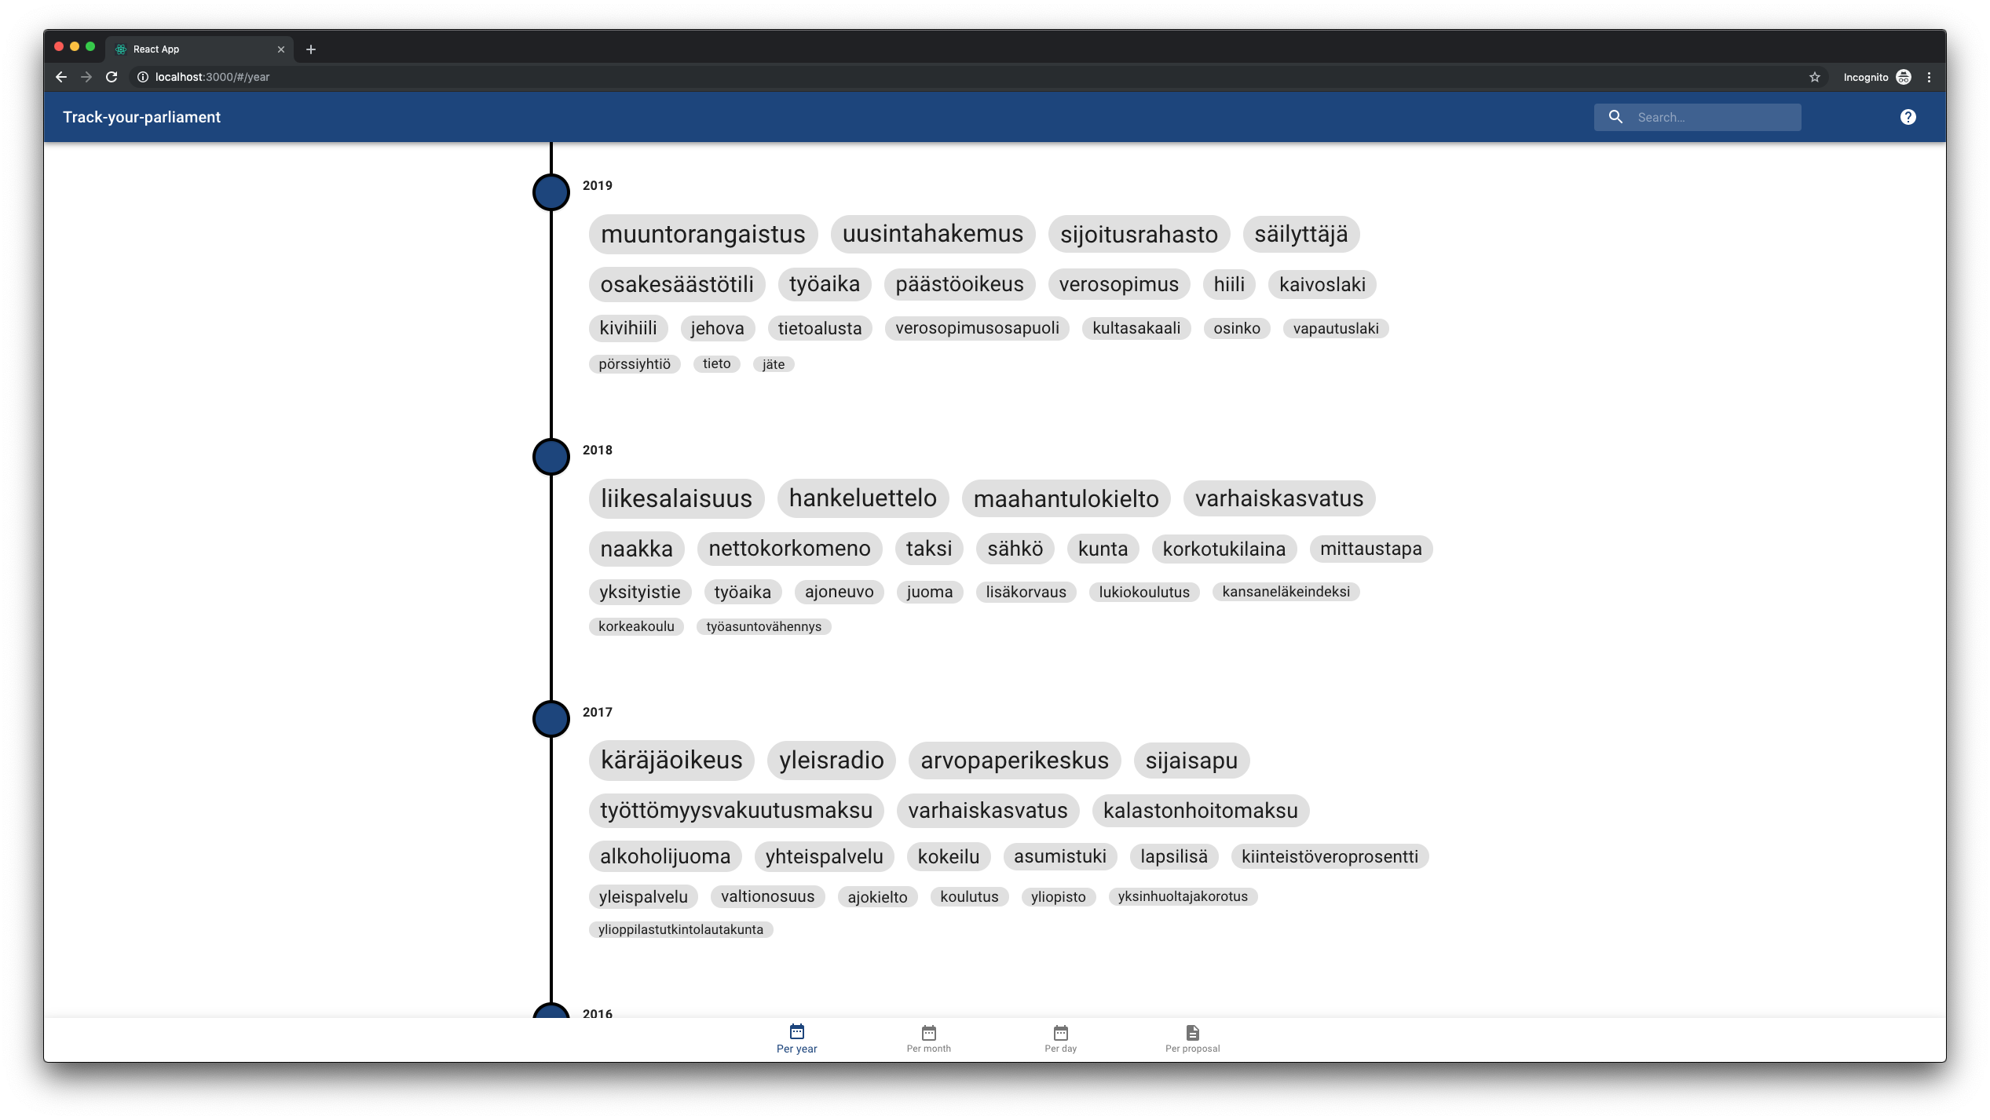

Slide 6
Solution
Web application to
Overview the last term
Search topics of your interest

Slide 7
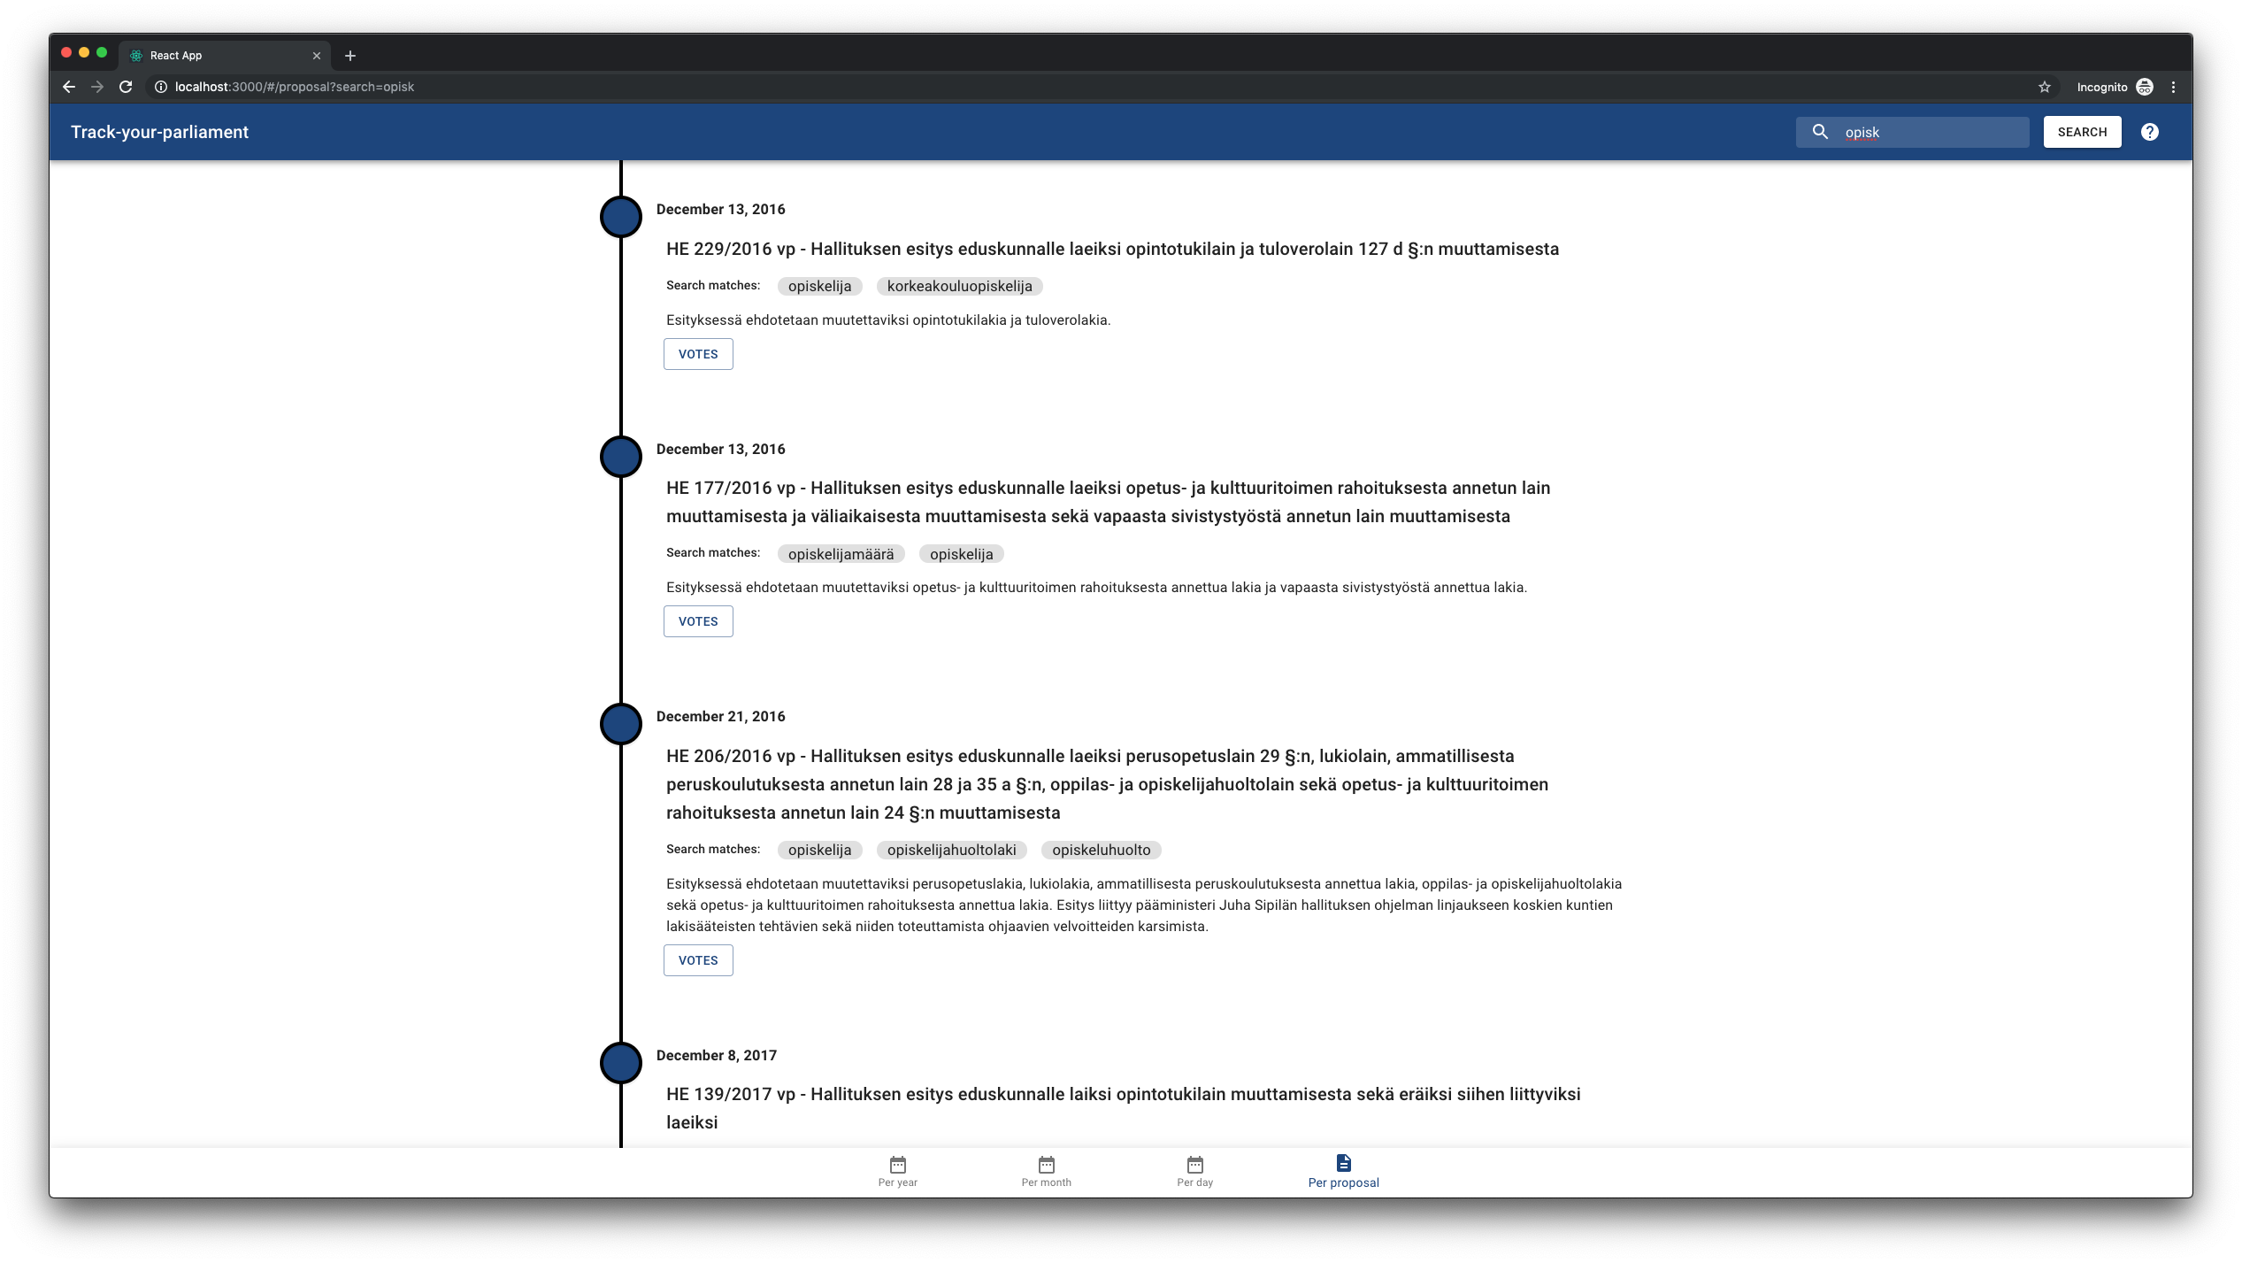


Slide 8
Solution
Web application to
Overview the last term
Search topics of your interest
See how parties voted

Slide 9
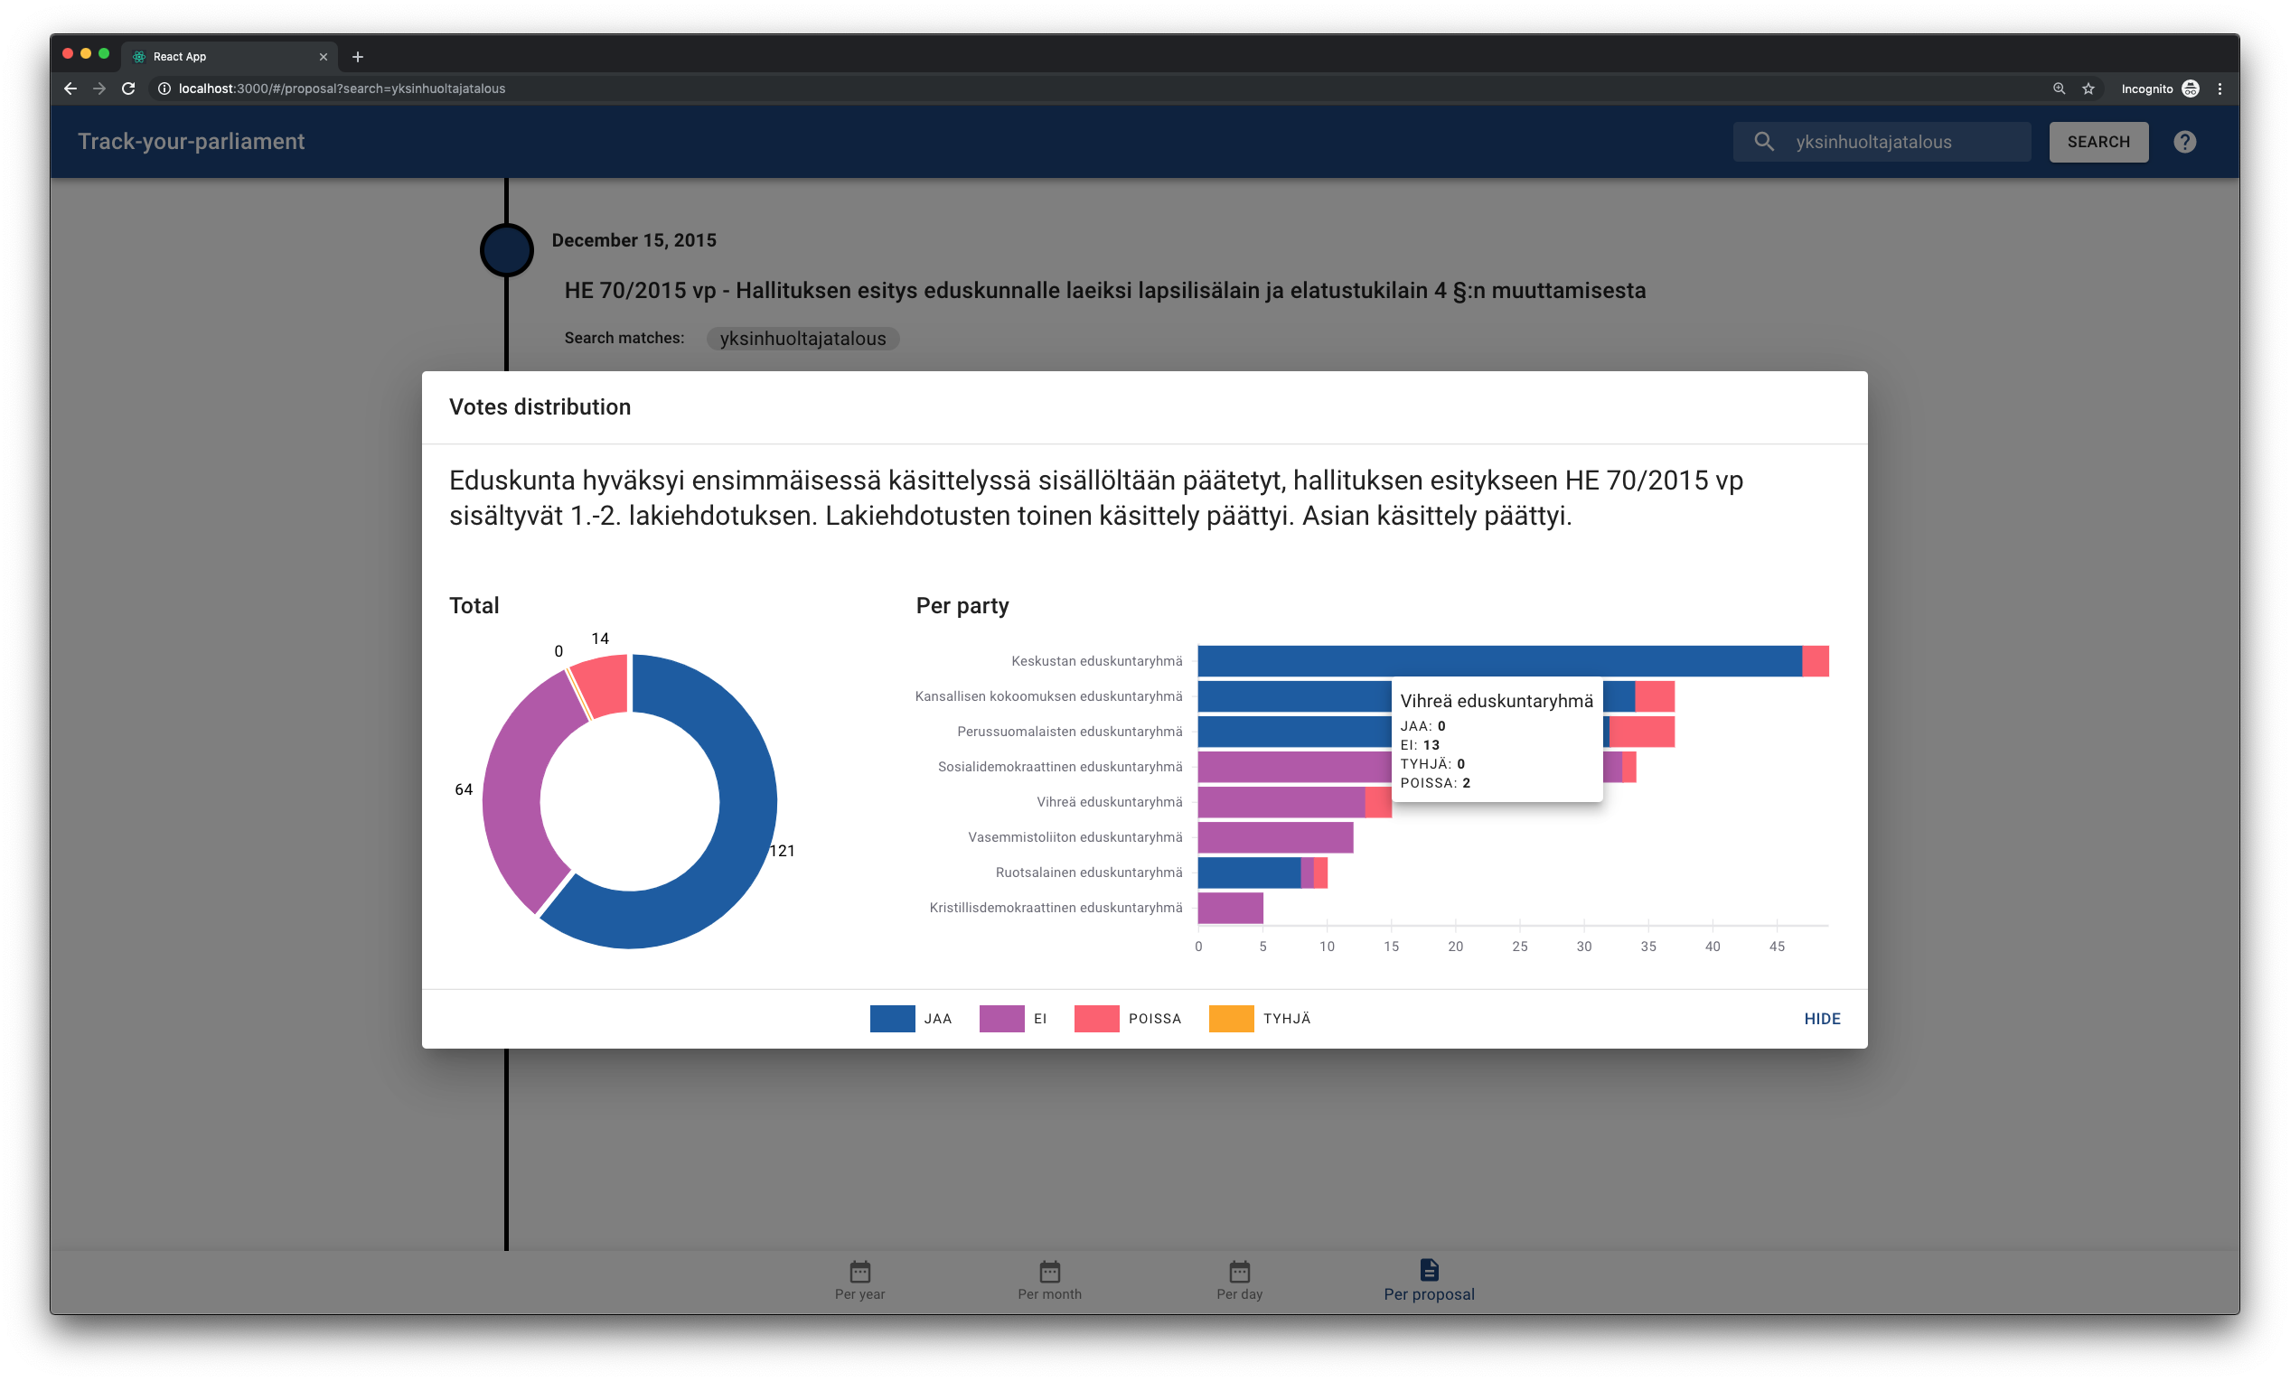

Slide 10
Goals
To increase
Transparency of the parliament
Importance of campaign promises
Voter turnout

Slide 11
THANK YOU

