Slide 1
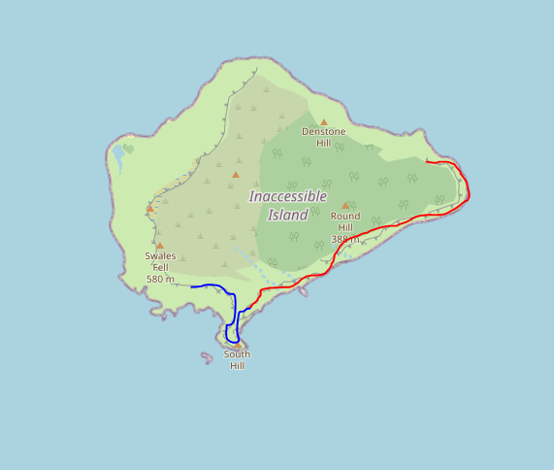
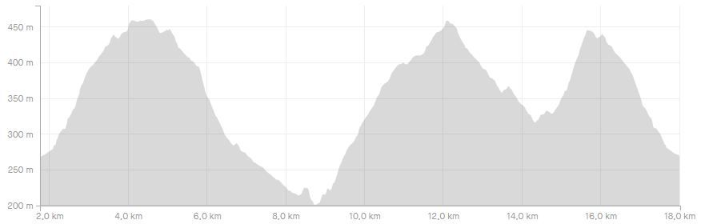
Notes:
V00.00
Display map and elevation
Compute best zoom

Slide 2
Notes:
V00.01
Basic menu
File
Load track
Exit

Slide 3
Notes:
V00.02
Zoom management
File
Load track
Exit
+
-

Slide 4
Notes:
V00.03
File options
File
Load track
Load session
New session
Save
Exit
+
-

