Slide 1
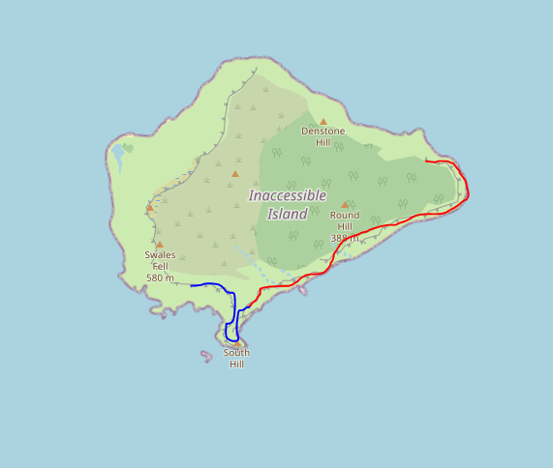
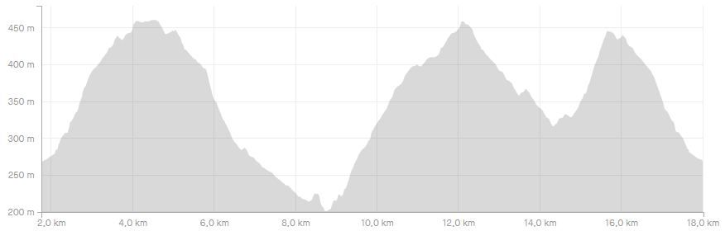

Notes:
V00.00
Display map and elevation
Compute best zoom

Slide 2
Notes:
V00.01
Basic menu
File
Load track
Exit

Slide 3
Notes:
V00.02
Load multiple tracks
Refactor GUI
Check duplicated files
File
Load track
Exit

Slide 4
Notes:
V00.03
File options
File
Load track
Load session
New session
Save session
Exit

Slide 5
Notes:
V00.04
Summary of full track in table and single segments
File
Load track
Load session
New session
Save session
Exit
Total distance
Uphill elevation
Downhill elevation

Slide 6
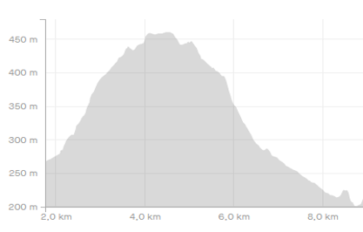

Notes:
V00.05
When selecting a line in the plot:
its thickness is increased
Elevation of that segment is displayed
Information table for that single segment in bold
File
Load track
Load session
New session
Save session
Exit
Total distance
Uphill elevation
Downhill elevation
+
-

Slide 7
Notes:
V00.06
Save gpx file
File
Load track
Load session
New session
Save session
Save gpx
Total distance
Uphill elevation
Downhill elevation
Exit

Slide 8
Notes:
V00.07
Zoom management (+/- buttons or scroll_event matplotlib connection) ✖
Matplotlib bar ✔
Fixed aspect ratio ✔
Add extra tiles to allow exploration (or a exploration mode with mplleaflet?) ✖
Reduce number of displayed points ✔
Enlarge max_zoom constant ✔
File
Load track
Load session
New session
Save session
Save gpx
Exit
+
-

Slide 9

Notes:
V00.07b
Zoom management (+/- buttons or scroll_event matplotlib connection) ?
Add extra tiles to allow exploration (or a exploration mode with mplleaflet?) ?
Zoom on selected segment ?
Distance to select segment change with tiling (click_distance) ?
Add arrow to segments
File
Load track
Load session
New session
Save session
Save gpx
Exit
+
-

Slide 10
Notes:
V00.08
Edit menu ✔
Refactor to have a different class for each menu ✔
Refactor directory structure (src, dsg, bin, test) ✔
File
Edit
Load track
Cut
Load session
Reverse
New session
Insert time
Save session
Correct elevation
Save gpx
Split
Exit
Total distance
Uphill elevation
Downhill elevation
+
-

Slide 11
Notes:
V00.09
Remove ✔
Reverse ✔
Split ✔
Insert time ✔
Fix elevation ✔
Segments order ✔
Track time in info table
File
Edit
Load track
Cut
Load session
Reverse
New session
Insert time
Save session
Correct elevation
Save gpx
Split
Exit
Change order
Total distance
Uphill elevation
Downhill elevation
Start/end Time
+
-

Slide 12
Notes:
V00.10
Bug corrections
Review unit tests
Implement missing tests
File
Edit
Load track
Cut
Load session
Reverse
New session
Insert time
Save session
Correct elevation
Save gpx
Split
Exit
Total distance
Uphill elevation
Downhill elevation
+
-

Slide 13
Notes:
V01.00
All file and edit menus working
Unit tests updated and passed (or under control)
File
Edit
Load track
Cut
Load session
Reverse
New session
Insert time
Save session
Correct elevation
Save gpx
Split
Total distance
Uphill elevation
Downhill elevation
Exit
+
-

Slide 14
Useful links
Tkinter course: https://pythonprogramming.net/tkinter-depth-tutorial-making-actual-program/ https://www.youtube.com/playlist?list=PLQVvvaa0QuDclKx-QpC9wntnURXVJqLyk
Tkinter organization:
https://stackoverflow.com/questions/17466561/best-way-to-structure-a-tk-application
https://stackoverflow.com/questions/3520494/class-menu-in-tkinter-gui
https://stackoverflow.com/questions/33646605/how-to-access-variables-from-different-classes-in-tkinter
https://www.oreilly.com/content/5-reasons-you-need-to-learn-to-write-python-decorators/

