Slide 1
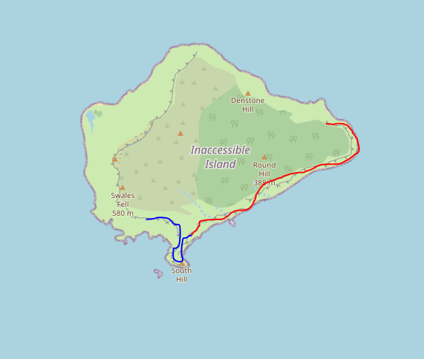
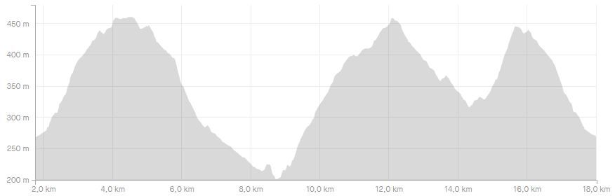

Notes:
V00.00
Display map and elevation
Compute best zoom

Slide 2
Notes:
V00.01
Basic menu
File
Load track
Exit

Slide 3

Notes:
V00.02
Load multiple tracks
Refactor GUI
File
Load track
Exit
+
-

Slide 4
Notes:
V00.03
Zoom management
File
Load track
Exit
+
-

Slide 5
Notes:
V00.04
File options
File
Load track
Load session
New session
Save
Exit
+
-

