Slide 1
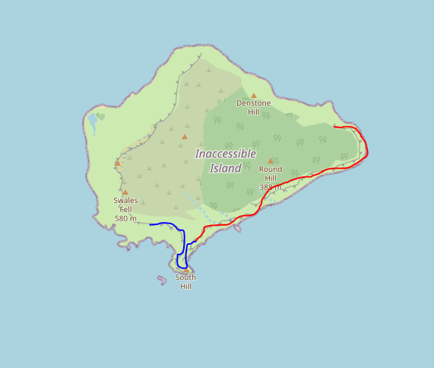
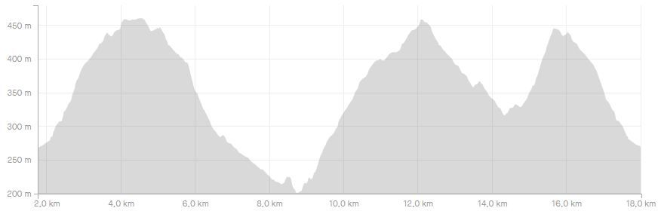

Notes:
V00.00
Display map and elevation
Compute best zoom

Slide 2
Notes:
V00.01
Basic menu
File
Load track
Exit

Slide 3
Notes:
V00.02
Load multiple tracks
Refactor GUI
Check duplicated files
File
Load track
Exit

Slide 4
Notes:
V00.03
File options
File
Load track
Load session
New session
Save session
Exit
+
-

Slide 5

Notes:
V00.04
Zoom management
Matplotlib bar ✔
Fixed aspect ratio
Add extra tiles to allow exploration
File
Load track
Load session
New session
Save session
Exit
+
-

Slide 6
Notes:
V00.05
Summary of full track in table and single segments
File
Load track
Load session
New session
Save session
Exit
Total distance
Uphill elevation
Downhill elevation
+
-

Slide 7
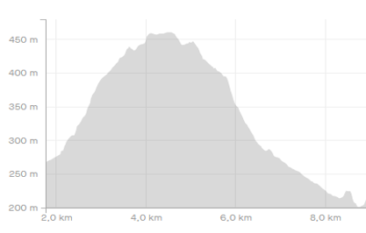

Notes:
V00.06
When selecting a line in the plot:
its thickness is increased
Elevation of that segment is displayd
Information table for that single segment in bold
File
Load track
Load session
New session
Save session
Exit
Total distance
Uphill elevation
Downhill elevation
+
-

Slide 8
Notes:
V00.07
Save gpx file
File
Load track
Load session
New session
Save session
Save gpx
Total distance
Uphill elevation
Downhill elevation
Exit
+
-

Slide 9
Notes:
V00.08
Edit menu
File
Edit
Load track
Cut
Load session
Reverse
New session
Insert time
Save session
Correct elevation
Save gpx
Split
Total distance
Uphill elevation
Downhill elevation
Exit
+
-

Slide 10
Notes:
V01.00
All edit features
Working unit tests
Refactor directory structure (src, dsg, bin, test)
File
Edit
Load track
Cut
Load session
Reverse
New session
Insert time
Save session
Correct elevation
Save gpx
Split
Total distance
Uphill elevation
Downhill elevation
Exit
+
-

Slide 11
Useful links
Tkinter course: https://pythonprogramming.net/tkinter-depth-tutorial-making-actual-program/ https://www.youtube.com/playlist?list=PLQVvvaa0QuDclKx-QpC9wntnURXVJqLyk
Tkinter organization: https://stackoverflow.com/questions/17466561/best-way-to-structure-a-tk-application

Slide 13
