Slide 1
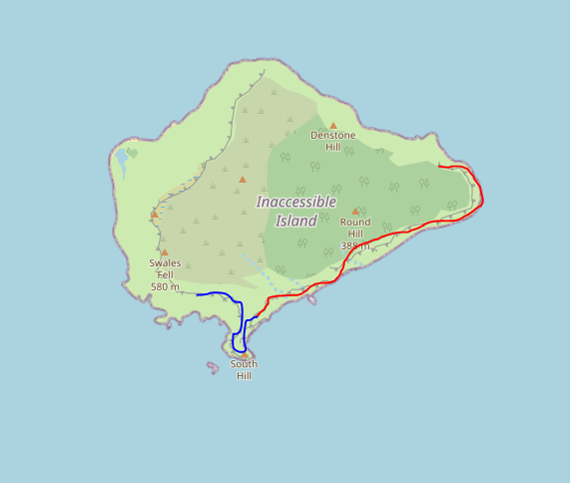
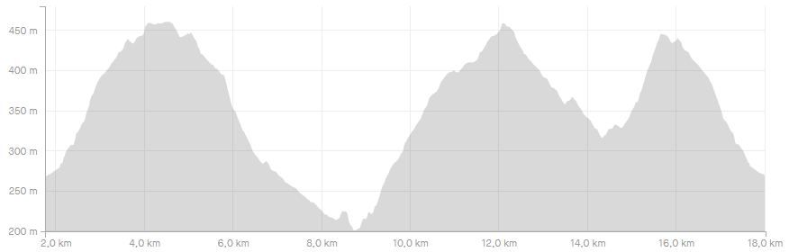

Notes:
V00.00
Display map and elevation
Compute best zoom

Slide 2
Notes:
V00.01
Basic menu
File
Load track
Exit

Slide 3
Notes:
V00.02
Load multiple tracks
Refactor GUI
Check duplicated files
File
Load track
Exit

Slide 4

Notes:
V00.03
Zoom management
File
Load track
Exit
+
-

Slide 5
Notes:
V00.04
File options
File
Load track
Load session
New session
Save
Exit
+
-

Slide 6
Useful links
Tkinter course: https://pythonprogramming.net/tkinter-depth-tutorial-making-actual-program/ https://www.youtube.com/playlist?list=PLQVvvaa0QuDclKx-QpC9wntnURXVJqLyk
Tkinter organization: https://stackoverflow.com/questions/17466561/best-way-to-structure-a-tk-application

