Slide 1
Distance-Based Analysis of Functional Connectivity Data for ADHD Classification
Tracy Chen
Collaborator: Aiden Hai

Slide 2
Research Questions
Primary research question:
Does using distance-based representations improve prediction performance compared to directly using high-dimensional connectivity features?
Secondary research question 1:
After MDS embedding, which classification model performs better: Logistic Regression or Random Forest, and how does hyperparameter tuning with GridSearchCV affect their performance?
Secondary research question 2:
How does the choice of distance matrix influence model accuracy and overall performance?
Notes:
In this project, I worked with functional connectivity data from an ADHD dataset.
Each participant has around twenty thousand connectivity features, which makes direct analysis very hard.
So instead of working with the original features, I used a distance-based approach.
I asked three main questions.
First, can distance matrices capture useful structure for ADHD prediction?
Second, after MDS embedding, which model works better, Logistic Regression or Random Forest?
Third, does the type of distance matrix affect performance?

Slide 3
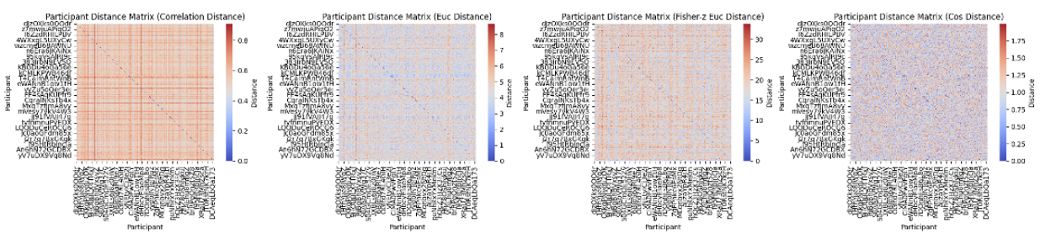
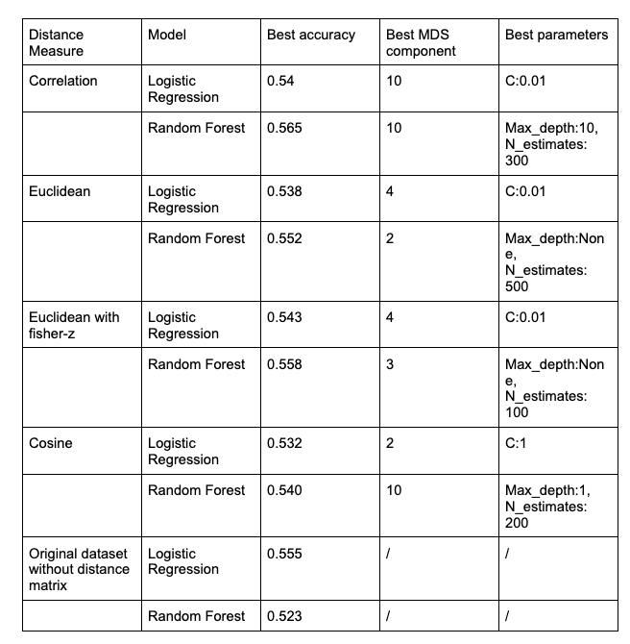
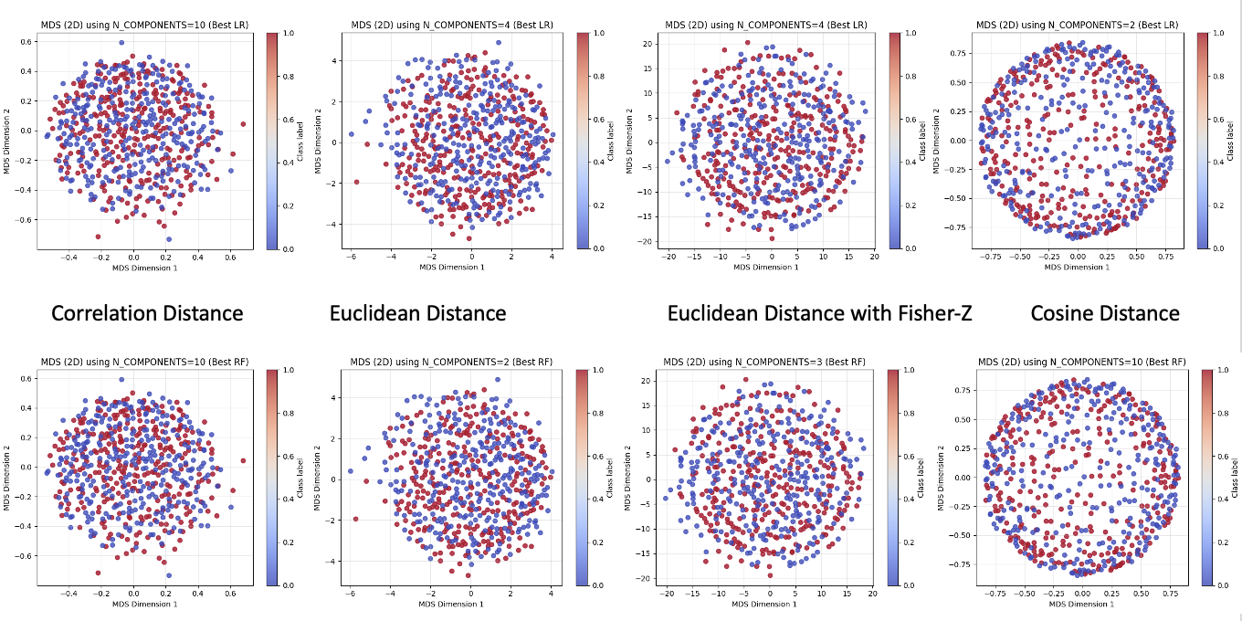
Figure 1. Distance matrix heatmap
Table 1. Classification Results
Figure 2. MDS's first two-dimensional visualization
Notes:
For each distance measure, I followed the same pipeline.
I first visualized the distance matrix, then used MDS to project participants into two dimensions,
and finally tested Logistic Regression and Random Forest using cross-validation.
Across all distances, the MDS plots show strong overlap between ADHD and non-ADHD participants.
There is some local structure, but no clear separation.
In terms of prediction, all models perform slightly better than random guessing.
The best accuracy is around fifty-five to fifty-six percent.
Random Forest usually performs a bit better than Logistic Regression.
Among all distance measures, Euclidean distance with Fisher z transformation gives the best results.

Slide 4
What did this analysis teach us?
Distance matrices are a simple way to summarize very large data sets
Different distances highlight different aspects of similarity
Model performance depends on how similarity is defined
Cross-validation helps judge how stable results really are
Big-picture conclusion：
Similar brain patterns slightly increase the chance of sharing the same ADHD label
But brain connectivity alone is not enough for strong prediction
Why this matters：
Distance-based analysis is useful for exploration
It helps choose better representations before building complex models
Best used together with other features, not alone
Takeaway：
Distance-based methods are good for understanding structure, but ADHD prediction needs more information.
Notes:
From this project, I learned that distance matrices are a simple and useful way
to summarize very high-dimensional brain data.
I also learned that different distance measures capture different aspects of similarity,
such as pattern similarity or feature magnitude, and this choice affects both visualization and model performance.
Overall, the predictive signal in functional connectivity alone is weak.
Model choice has a small effect, while distance choice has a clearer impact.
This suggests that distance-based methods are most useful for exploratory analysis.
In a lab or company setting, they can help choose stable representations
before building more complex models or adding other types of features.

