Slide 1
Understanding and Predicting Income Using Census Data
Tracy Chen
Collaborator: Aiden Hai

Slide 2
Research Questions
Can we predict whether a person earns more than $50,000 per year using basic census information?
Which personal and work-related factors matter most for income?
Even without income labels, does the data show natural groupings of people?
Notes:
In this project, I studied the Adult Census Income dataset.
My main goal was to see whether income can be predicted using demographic and work-related features, such as age, education, work hours, and marital status.
I also wanted to understand which factors are most important, and whether the data has any natural structure even without using income labels.

Slide 3
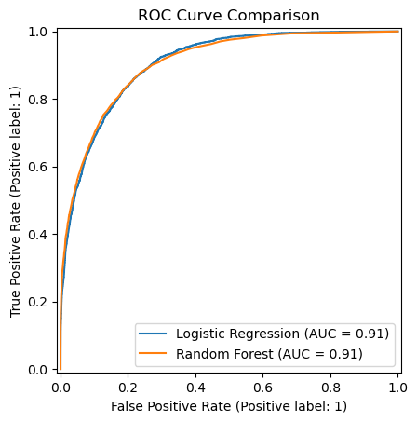
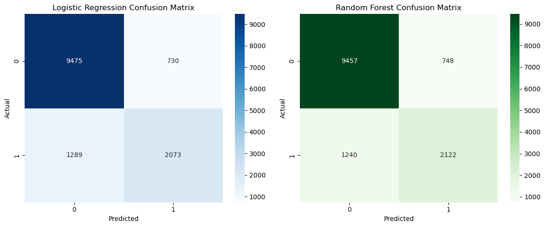
Key Results from Prediction and Exploration
Main results
Prediction performance
  Logistic Regression accuracy: 85%
  Random Forest accuracy: 85.3%
  Both models achieve ROC-AUC ≈ 0.91
Important factors
  Higher income is linked to education, age, work hours, marital status, and capital gains
Unsupervised structure
  One cluster contains about 45% high-income earners
  Other clusters contain less than 8%
Notes:
Both models performed well, with accuracy around 85 percent and strong ROC-AUC scores.
Random Forest performed slightly better, but the difference was small.
From both supervised and unsupervised results, we consistently see that a small group of people accounts for a much higher proportion of high income earners.

Slide 4
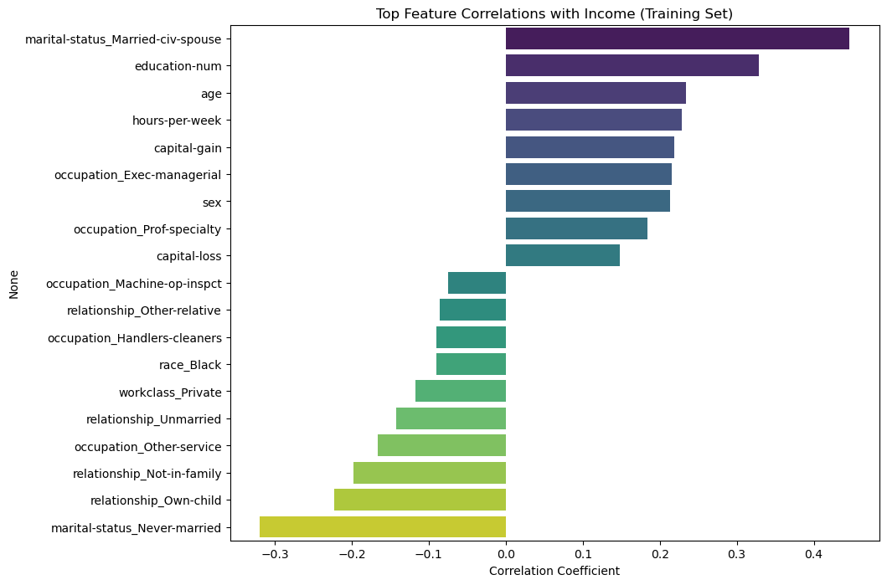
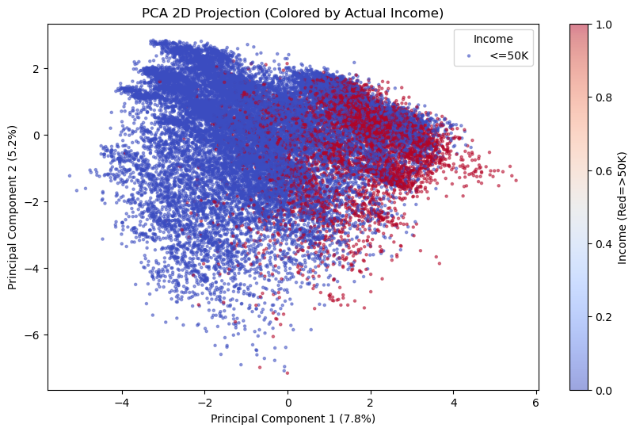
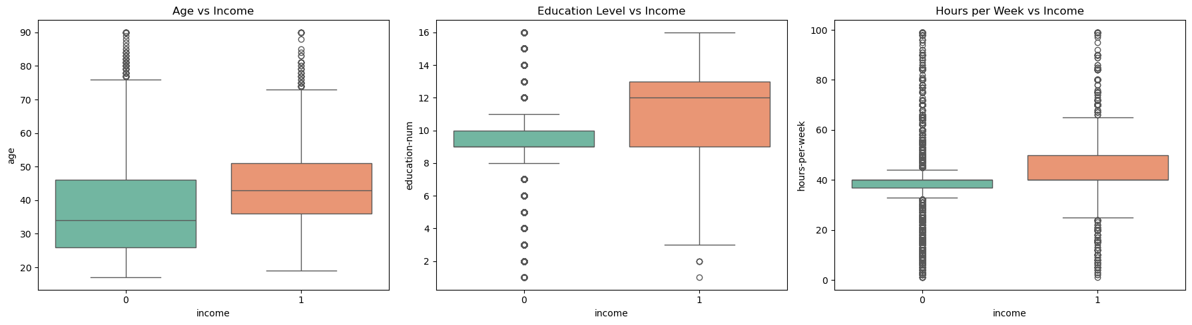
What We Learned
Income can be predicted fairly well, but high-income cases are harder to identify
Education and work effort are the strongest and most consistent drivers of income
Different models agree on what matters, even if they work differently
The data naturally forms a high-achiever group, even without labels
Notes:
Overall, this project shows that income is closely related to education, age, and sustained work effort.
While no single model is perfect, using multiple approaches gives a more complete picture.
A simple takeaway is that education and long-term work commitment play a central role in income outcomes.

