Slide 1
Early Spoilage Detection System
Student Name: Uwase Tracy
Student ID: 27105
Group: A
Institution: Adventist University of Central Africa (AUCA)
Date: December 4, 2025

Slide 2
The Challenge: Unnoticed Crop Spoilage
Issue: Warehouses suffer significant financial losses due to undetected spoilage and environmental fluctuations.
Context: Lack of real-time monitoring leads to delayed responses and wasted inventory.
Current State: Manual checks are inefficient and prone to human error.
Target Users: Farmers, Agronomists, and Warehouse Managers.

Slide 3
Proposed Solution: Early Spoilage System
Objective: Automate the monitoring of temperature and humidity to predict spoilage risks accurately.
Core Scope:
  Sensor management & tracking
  Automated risk calculation (PL/SQL)
  Instant alert generation
Key Features: Real-time auditing, Business rule enforcement (No Holiday Ops), and Executive BI Dashboard.

Slide 4
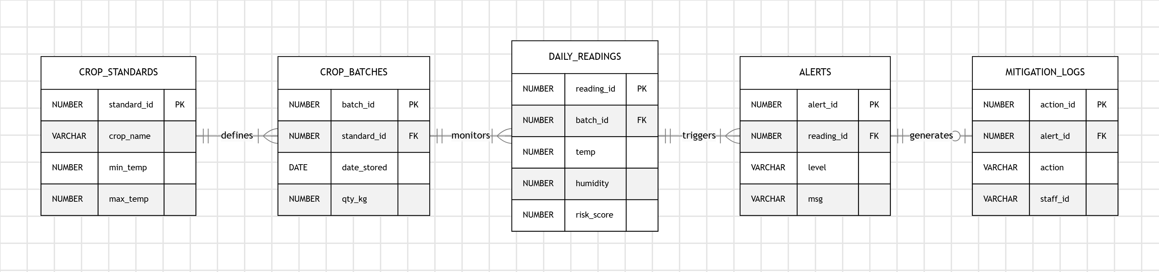
Logical Database Design (ERD)

Slide 5
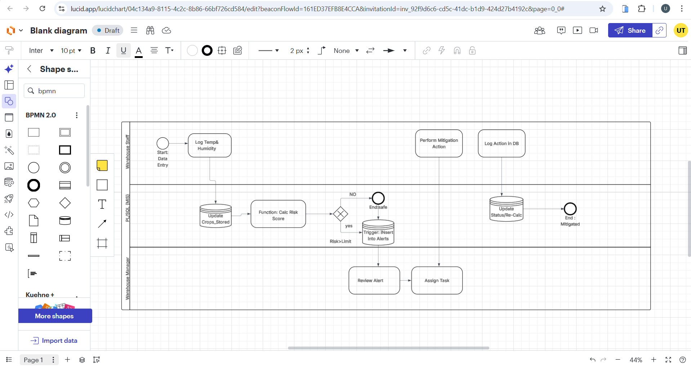
Operational Workflow (BPMN)

Slide 6
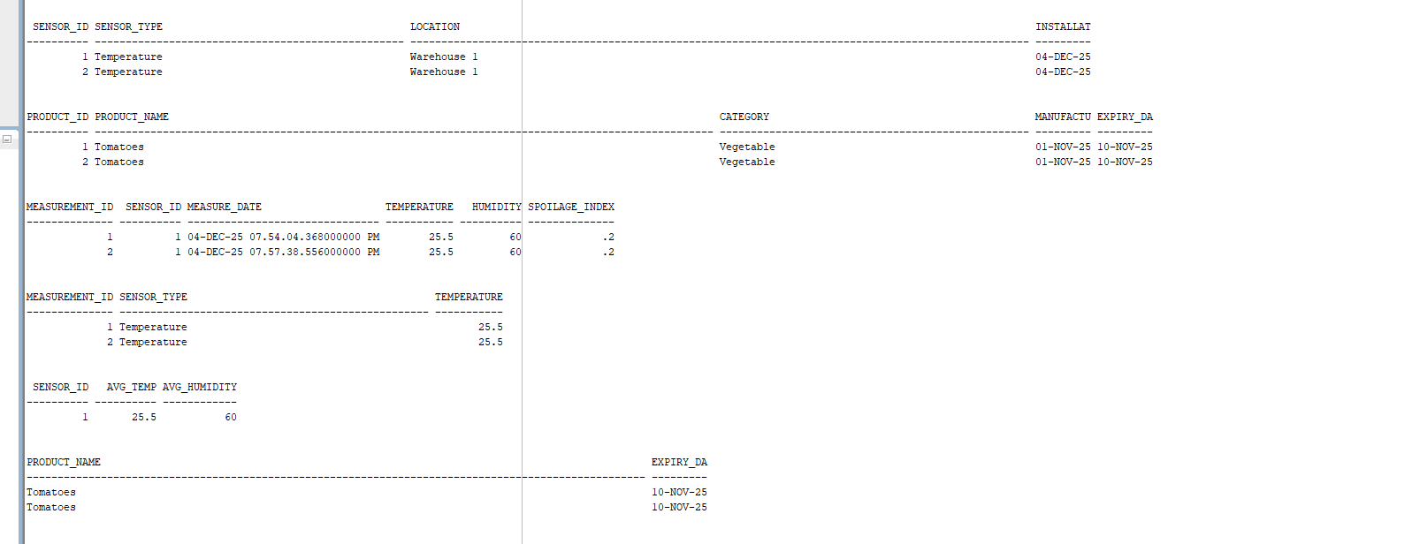
Technical Implementation: PL/SQL
Procedures: Automated tasks like add_sensor and update_expiry.
Functions: calc_spoilage_index dynamically computes risk scores (see output below).

Slide 7
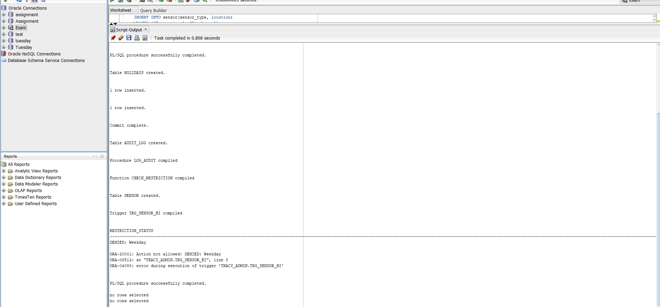
Advanced Features: Security & Auditing

Slide 8
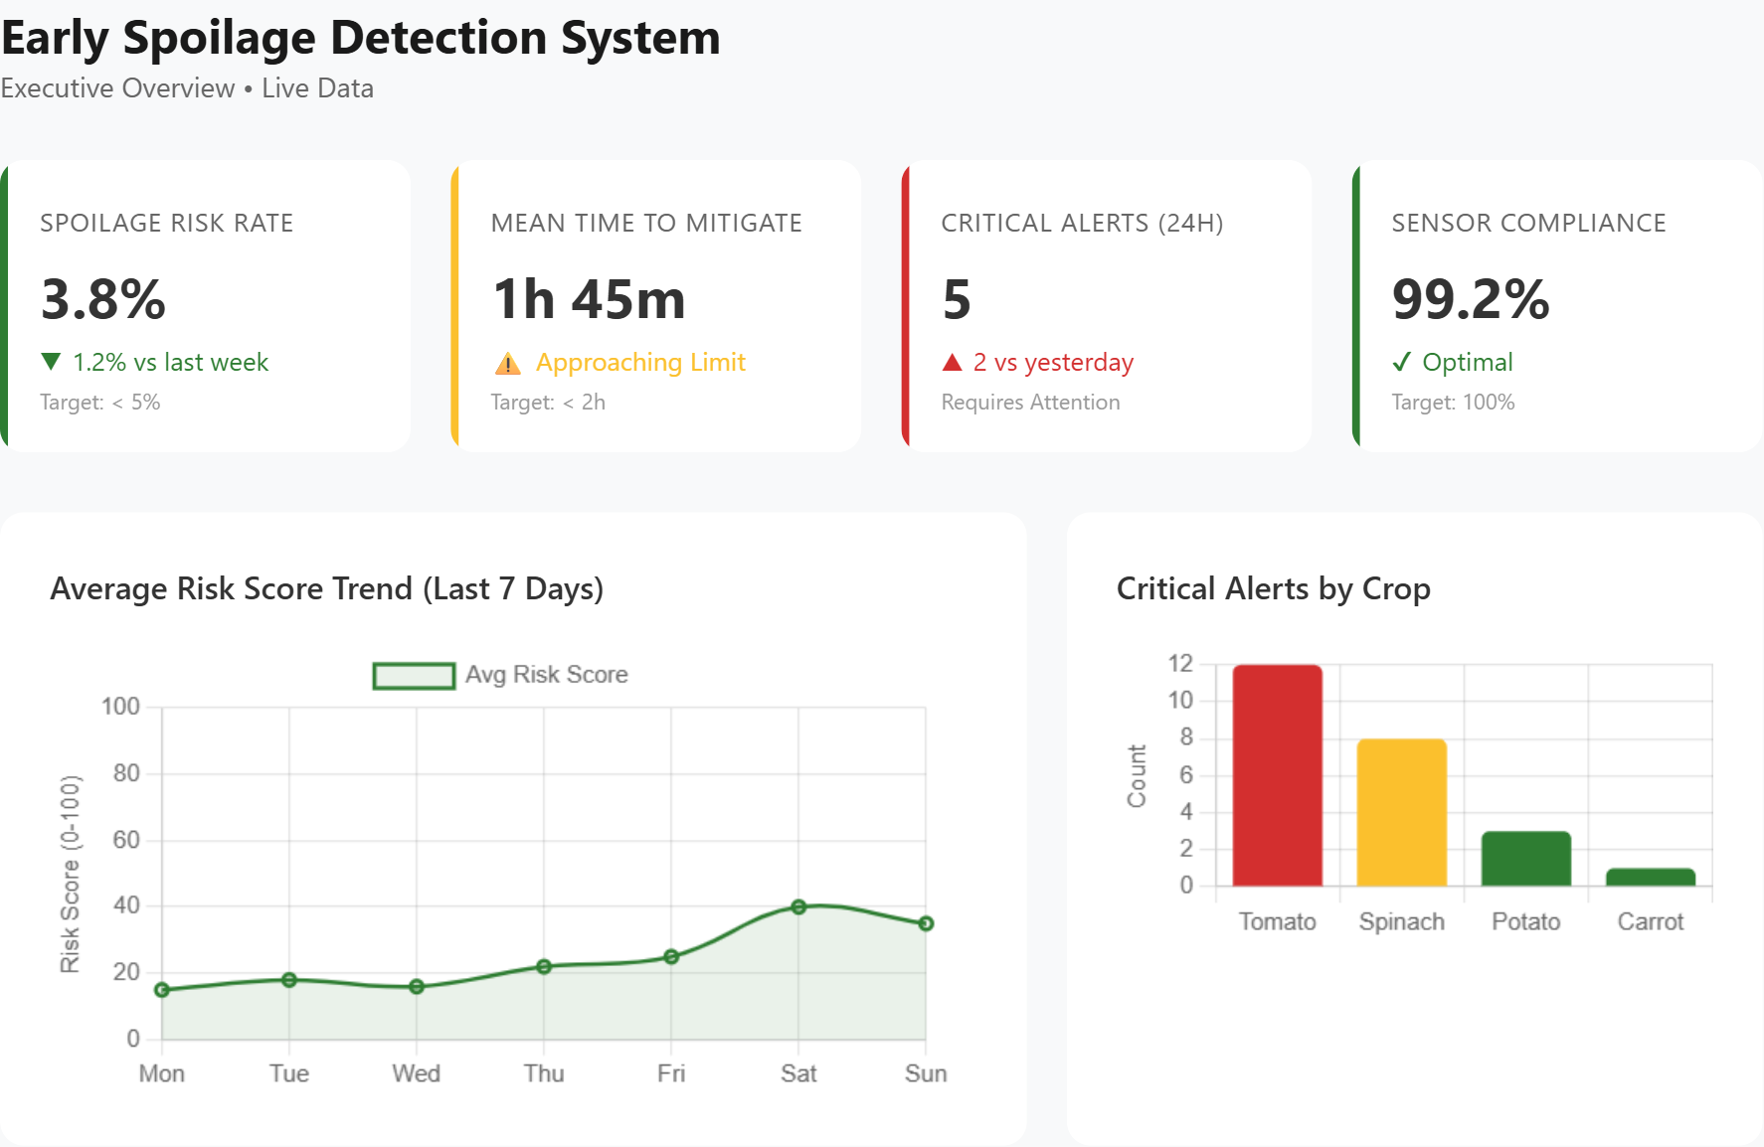
Executive BI Dashboard

Slide 9
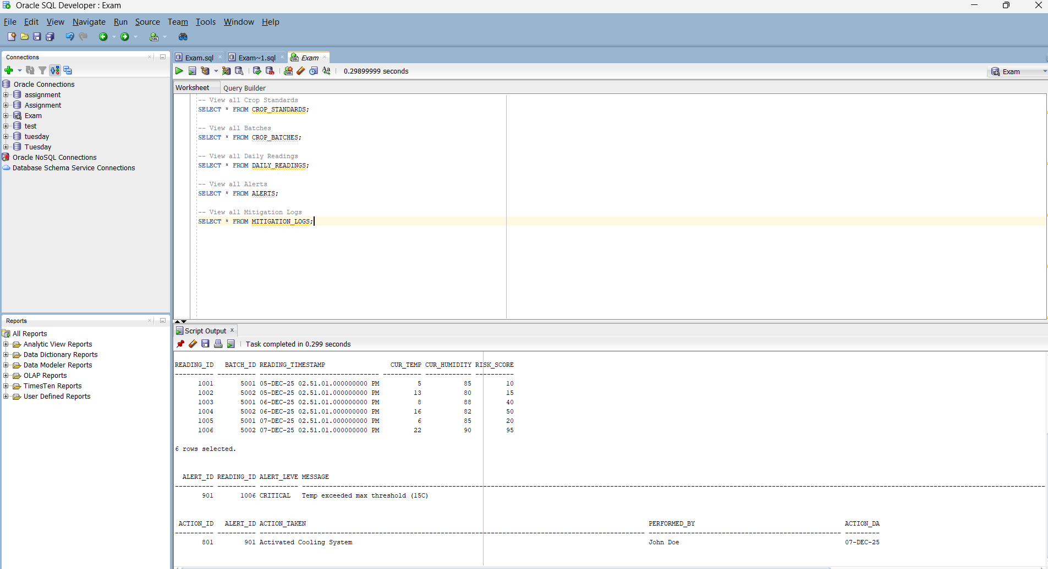
Project Results & Outcomes

Slide 10
Conclusion
Achievements: Delivered a fully functional, secure, and audited database system.
Lessons Learned: The critical importance of PL/SQL automation for data integrity.
Future Work: Integration with IoT hardware for live field data.
“Whatever you do, work at it with all your heart.” - Colossians 3:23

