Slide 1
Agriculture Pest Control Analytics
Uwase Tracy 27105
INSY 8413 | Introduction to Big Data Analytics
Adventist University of Central Africa (AUCA)

Slide 2
Project Overview
This project focuses on agriculture pest control analytics using maize trial data from Zambia. Goals include analyzing pest patterns, predicting yields, and providing insights for agricultural management.

Slide 3
Problem Statement
Can we predict crop yield and identify pest patterns in maize cultivation using historical trial data to improve agricultural productivity and pest management strategies?

Slide 4
Dataset Information
Dataset: International Maize Trial Regular Zambia
Rows: 45 | Columns: 47
Includes: Yield, pest indicators (RUST, BLIGHT, CURV), and environmental factors
Data requires preprocessing

Slide 5
Project Structure
data/ (raw & cleaned)
images/
notebooks/
powerbi/
presentation/
README.md

Slide 6
Python Analytics Tasks
- Data cleaning
- EDA
- ML Models: Regression & Classification
- Model Evaluation
- Custom Pest Index & Ensemble Methods

Slide 7
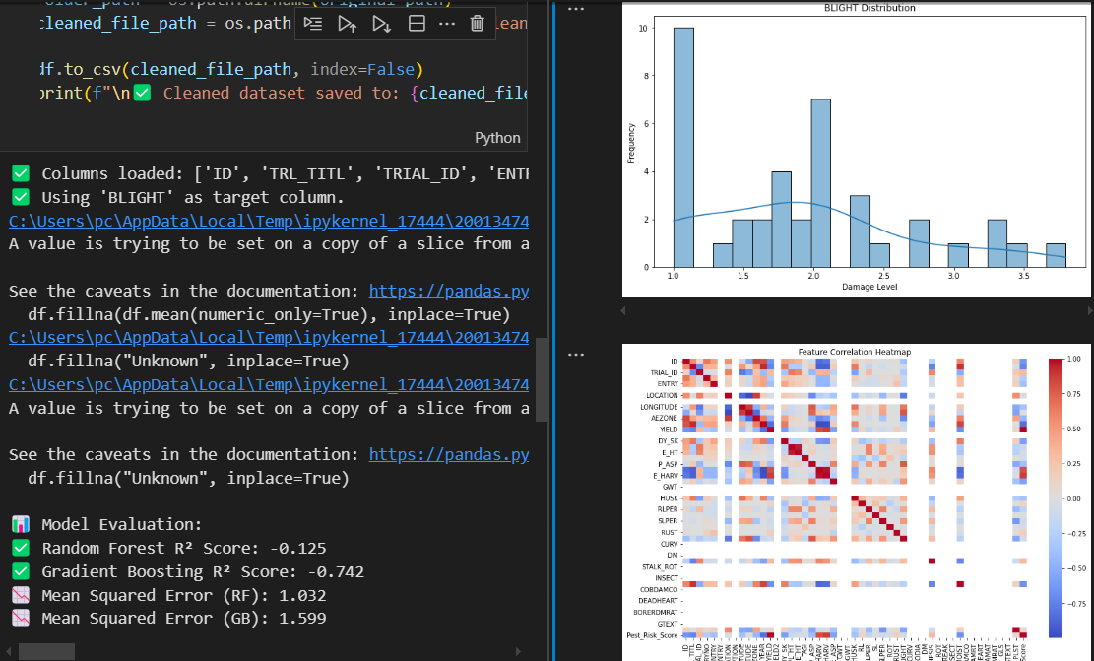

Slide 8
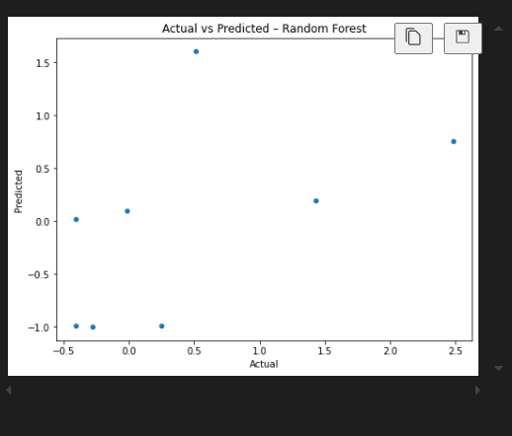

Slide 9
Actual vs predicted
This plot is an Actual vs Predicted scatter plot for the Random Forest model you trained. Here’s what it represents:
X-axis (Actual): The true values from your dataset (e.g., actual maize yield or pest severity values).
Y-axis (Predicted): The values your Random Forest model predicted for those same points.
How to interpret this plot:
Ideal scenario: If your model were perfect, all points would fall exactly on a diagonal line (y = x), meaning predicted values match actual values.
Current situation:
The points are scattered without a clear diagonal alignment.
Some predictions are negative (below 0), which might not make sense if your target variable (e.g., yield) should always be positive.
This indicates the model is not fitting well or there might be issues with:
Data scaling/cleaning
Small dataset size (too few samples)
The model being undertrained or not tuned properly

Slide 10
Analysis Workflow
- Track & measure pest incidence
- Identify pest impact on yield
- Predict pest risk & yield
- Visual dashboards in Power BI

Slide 11
Power BI Dashboard
- Yield Analysis
- Pest Patterns
- Environmental Factors
- Interactive Filters

Slide 12
Power BI Dashboard Tasks
- Communicate problem & insights
- Use slicers and drill-downs
- Match visuals to data
- Add DAX & tooltips

Slide 13
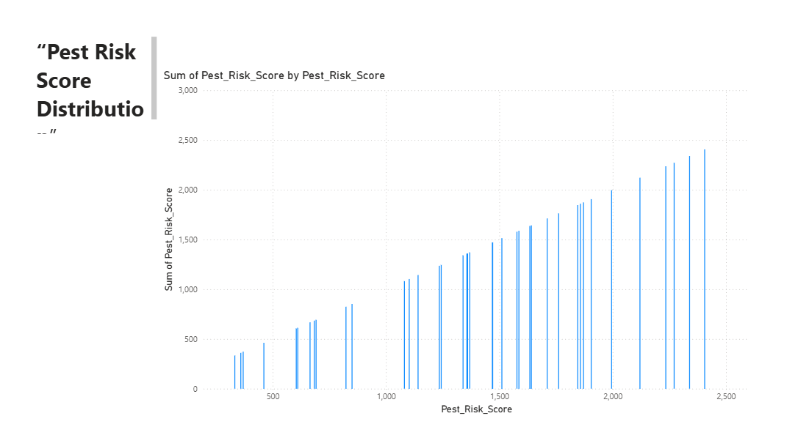

Slide 14
Predictive Insights
- Good accuracy in ML predictions
- Pest presence reduces yield by 20-40%
- Location-based recommendations improve yield

Slide 15
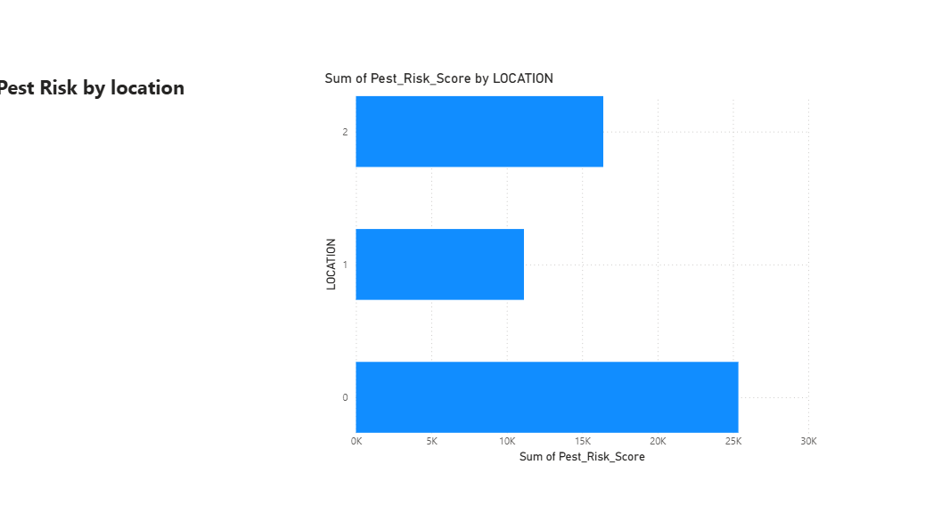

Slide 16
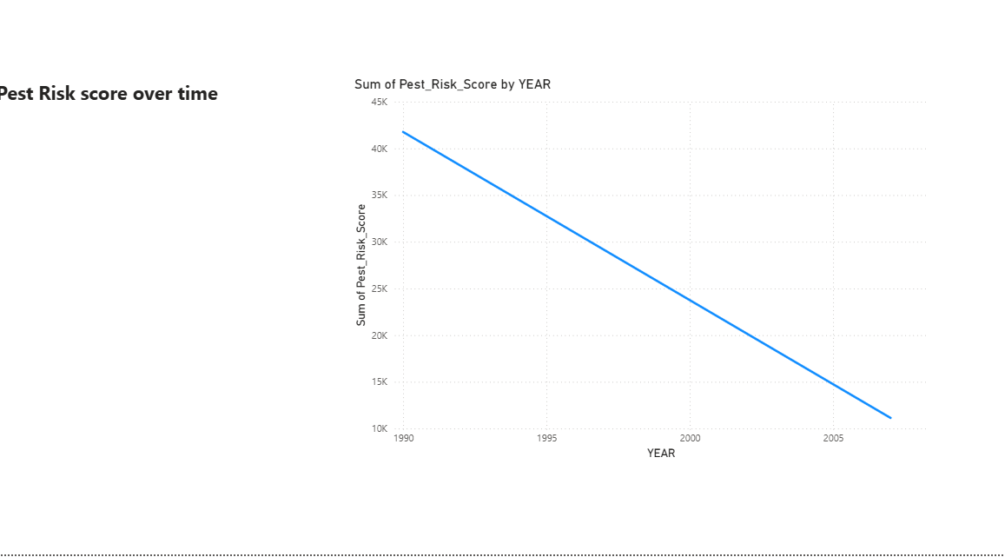

Slide 17
Key Findings - Pest Patterns
- Rust and Blight are most common
- Geographic and seasonal variation in outbreaks

Slide 18
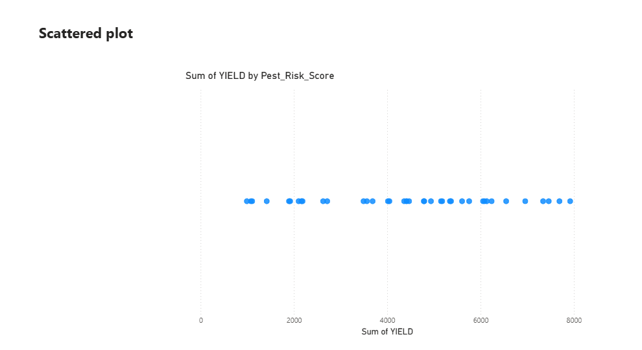

Slide 19
Key Findings - Yield Factors
- Plant & Ear Height correlate with yield
- Environmental zone and variety matter

Slide 20
Innovation Elements
- Custom Pest Index: Combined severity score

Slide 21
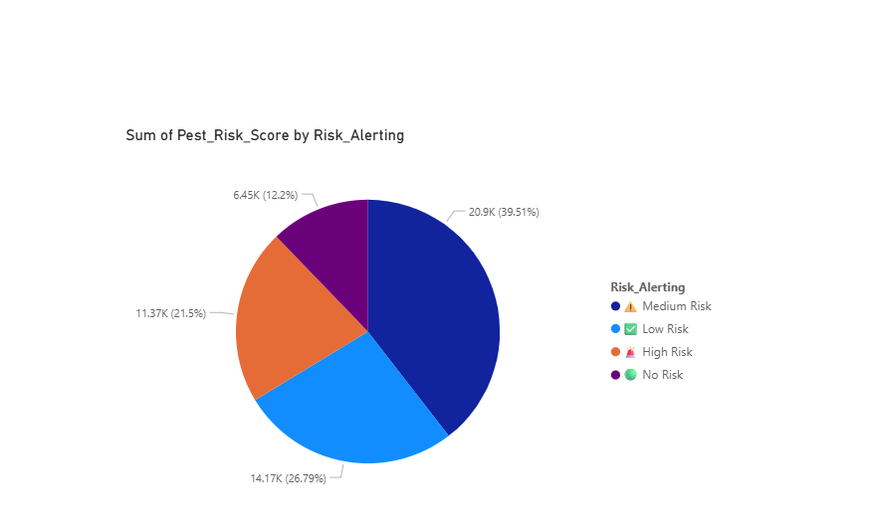

Slide 22
Technologies Used
Python (pandas, numpy, scikit-learn, matplotlib, seaborn)
Jupyter Notebook
Power BI
Git

Slide 23
License
This project is for academic purposes. Please cite appropriately if using the methodology or findings.

