Slide 1
Intro to GAN
What is generative models?
Why GAN?
How GAN works.
Frontier research around GAN.

Slide 2
Generative Models
A generative model is a model for generating all values for a phenomenon, both those that can be observed in the world and "target" variables that can only be computed from those observed.
Discriminative models infer outputs based on inputs.
Generative models generate both inputs and outputs, typically given some hidden parameters.
https://blog.openai.com/generative-models/
http://freemind.pluskid.org/machine-learning/discriminative-modeling-vs-generative-modeling/

Slide 3
Types of GM
Gaussian mixture model and other types of mixture model
Hidden Markov model
Probabilistic context-free grammar
Naive Bayes
Averaged one-dependence estimators
Latent Dirichlet allocation
Restricted Boltzmann machine
Generative adversarial networks

Slide 4
Why study generative modeling
Generative models try to represent and manipulate high-dimensional probability distributions.
Generative models can be incorporated into reinforcement learning.
Can be trained with missing data.
Enable multi-modal output.

Slide 5
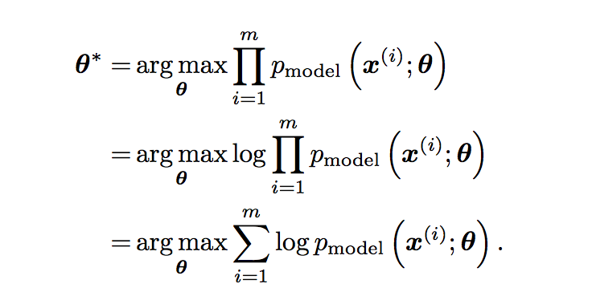
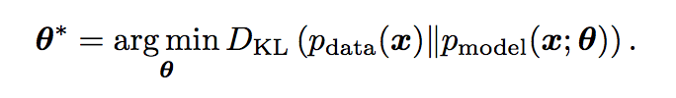
Objective of generative models:
Minimizing the KL divergence between p_data and p_model is equivalent to maximizing the log-likelihood of the training set.

Slide 6
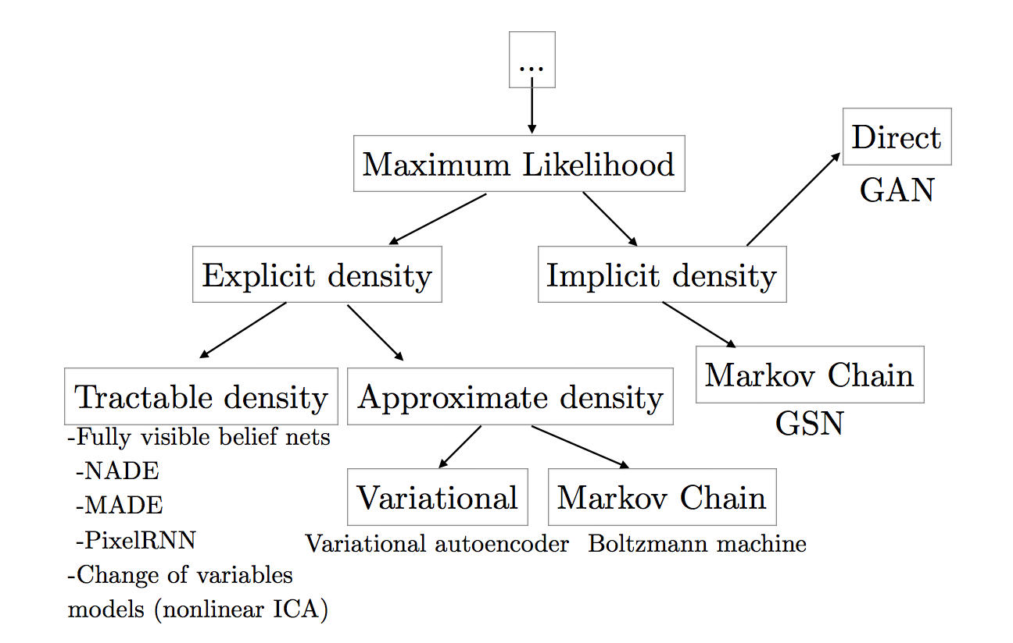
Popular generative models
Tractable explicit models: FVBN, ICA
Approximated explicit models: variational, Markov chain
Implicit density models: generative stochastic network using Markov Chain, GAN

Slide 7
GAN structure
Generator G: takes a random noise vector as input, do transpose convolution to output an image.
Discriminator D: takes the image(sampled from real data or generated data), output a scalar as probability.
G and D form a minimax game:
By training D, we are using supervised learning to estimate the ratio p_data(x)/p_model(x)
D teaches G to generate better images.

Slide 8
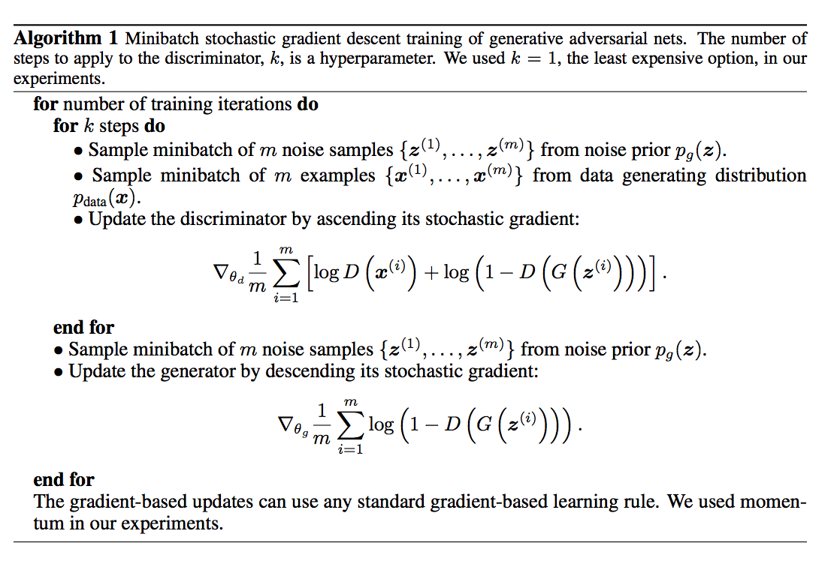
Training Process:

Slide 9
Remaining issues:
Non-convergence: GAN converges if D and G reach an equilibrium. Sometimes two players undo each other’s progress.
Mode collapse: The generator learns to map several different input z values to the same output.

Slide 10
Literature reviews
Going deeper in theory: f-GAN, EBGAN
Use extra information: CGAN, ACGAN, InfoGAN
Structural improvement: CoGAN, LAPGAN, DiscoGAN, CycleGAN
Training tricks: DCGAN

Slide 11


f-GAN
https://arxiv.org/pdf/1606.00709.pdf
GAN is a special case of variational divergence estimation approach.
Any f-divergence can be used for training generative neural samplers.
f-divergence:
Objective function:
Objective function of GAN:

Slide 12


EB-GAN
https://arxiv.org/pdf/1609.03126.pdf
Proposed an energy-based formulation of GAN
An EBGAN framework with auto-encoder architecture as discriminator.
Given a positive margin m, discriminator loss L_D and generator loss L_G:
Discriminator as auto-encoder:

Slide 13
CGAN
https://arxiv.org/pdf/1411.1784.pdf
In unconditioned generative models, there’s no control on modes of the generated data, it’s only learning 1-to-1 mapping.
Feed extra information y into both D and G as additional input layer.
The objective function is:
Trained a conditional adversarial net on MNIST conditioned on class label

Slide 14
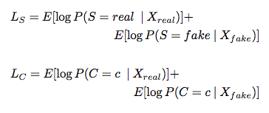
AC-GAN
https://arxiv.org/pdf/1610.09585.pdf
Every generated sample has a class label c~p_c, G uses both c and z to generate images X_fake = G(c, z). Discriminator gives both a probability distribution.
Modify D to contain an auxiliary decoder network that outputs class label.
D is trained to maximize Ls + Lc, G is trained to maximize Lc - Ls.

Slide 15

InfoGAN
https://arxiv.org/pdf/1606.03657.pdf
Able to learn disentangled representation in unsupervised way.
Introduce latent variable c into generator. Mutual information between c and G(z,c) should be high.
Since I(c; G(z,c)) is hard to maximize directly because we don’t know p(c|x), use Q(c|x) to approximate p(c|x) and obtain a lower bound.
For categorial, use softmax nonlinearity as Q(c|x); For continuous, use factored Gaussian as Q(c|x).

Slide 16
DCGAN
https://arxiv.org/pdf/1511.06434.pdf
Replace any pooling layers with strided convolutions (discriminator) and fractional-strided convolutions (generator).
Use batchnorm in both the generator and the discriminator.
Remove fully connected hidden layers for deeper architectures.
Use ReLU activation in generator for all layers except for the output, which uses Tanh.
Use LeakyReLU activation in the discriminator for all layers.

Slide 17
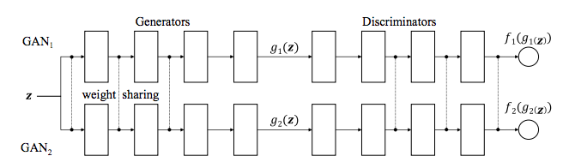
Coupled GAN
https://arxiv.org/pdf/1606.07536.pdf
Learn joint distribution of multi-domain images from data by training separate GAN for each domain and force weight sharing.

Slide 18
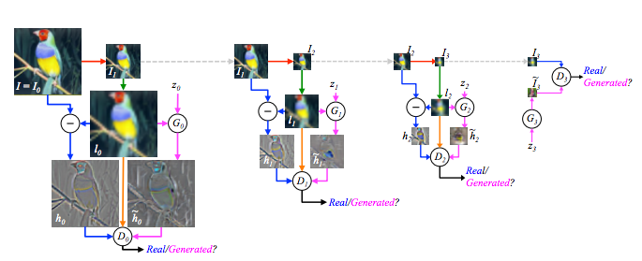
LAPGAN
https://arxiv.org/pdf/1506.05751.pdf
Combined conditional GAN with laplacian pyramid structure.
Break the generation into successive refinement.
Independent training of each level makes it hard to memorize.

Slide 19
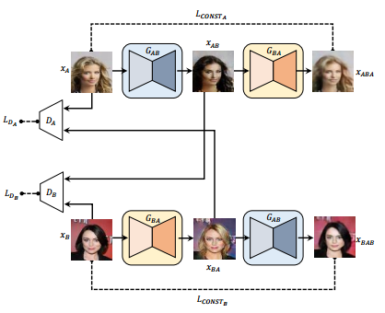
DiscoGAN
https://arxiv.org/pdf/1703.05192.pdf
Discover cross-domain relation using
unpaired data.
Compared standard GAN,
GAN with reconstruction loss
and DiscoGAN.

Slide 20


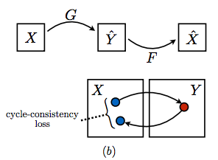

Cycle GAN
https://arxiv.org/pdf/1703.10593.pdf
Introduce cycle consistency loss, which is similar to the construction loss in DiscoGAN.

Slide 21
Further Readings:
Semi-supervised learning with deep generative models
https://arxiv.org/pdf/1406.5298.pdf
Mode regularized GAN
https://arxiv.org/pdf/1612.02136.pdf
Generating images with perceptual similarity metrics
https://arxiv.org/pdf/1602.02644.pdf
Autoencoding beyond pixels using a learned similarity metric
https://arxiv.org/pdf/1512.09300.pdf
Autoencoding variational bayes
https://arxiv.org/pdf/1312.6114.pdf

