Slide 1
Text Classification :
The Naïve Bayes algorithm
Adapted from Lectures by
Prabhakar Raghavan (Yahoo and Stanford) and Christopher Manning (Stanford)
Prasad
L13NaiveBayesClassify
Notes:
Relationship to Relevance feedback; Ad-hoc retrieval (vs filtering); Practical Applications
What is the classification application and classification method (manual vs rule-based vs classifier learning problem)? Useful for: (small dataset, stream, large dataset, resp.)
Probabilistic approach based on Naïve Bayes Rule:
Independence Assumptions for Tractability:->
Conditional Independence of terms : Positional Independence of a term
Smoothening necessary to avoid overfitting (incompleteness in training set)
Estimation details : Multinomial (Bag of words model) vs Bernoulli (Set of words model)
Feature selection (to minimize term vocabulary): Information Gain approach, Chi-squared approach
=====================================================================================
Practical technique with sound theoretical basis: efficient and effective in practice – robust

Slide 2
Relevance feedback revisited
In relevance feedback, the user marks a number of documents as relevant/nonrelevant, that can be used to improve search results.
Suppose we just tried to learn a filter for nonrelevant documents
This is an instance of a text classification problem:
  Two “classes”: relevant, nonrelevant
  For each document, decide whether it is relevant or nonrelevant
The notion of classification is very general and has many applications within and beyond IR.
Prasad
L13NaiveBayesClassify
Notes:
“Query ops” addressed how to better capture info need;
Binary classification Applc. : medical images : EKG, ECG, …,
ultrasound, MRI, CAT scans
Cancerous vs benign, calcification or not, …
Subsequent summarization: Tag cloud; electing labels

Slide 3
Standing queries
The path from information retrieval to text classification:
  You have an information need, say:
    Unrest in the Niger delta region
  You want to rerun an appropriate query periodically to find new news items on this topic
    I.e., it’s classification not ranking
Such queries are called standing queries
  Long used by “information professionals”
  A modern mass instantiation is Google Alerts
Prasad
L13NaiveBayesClassify
13.0
Notes:
Changing dataset fixed query vs fixed dataset changing query

Slide 4
Spam filtering: Another text classification task
From: "" <takworlld@hotmail.com>
Subject: real estate is the only way... gem oalvgkay
Anyone can buy real estate with no money down
Stop paying rent TODAY !
There is no need to spend hundreds or even thousands for similar courses
I am 22 years old and I have already purchased 6 properties using the
methods outlined in this truly INCREDIBLE ebook.
Change your life NOW !
=================================================
Click Below to order:
http://www.wholesaledaily.com/sales/nmd.htm
=================================================
13.0

Slide 5
Text classification:
Naïve Bayes Text Classification
Today:
  Introduction to Text Classification
    Also widely known as “text categorization”.
  Probabilistic Language Models
  Naïve Bayes text classification
    Multinomial
    Bernoulli
  Feature Selection
Prasad
L13NaiveBayesClassify

Slide 6
Categorization/Classification
Given:
  A description of an instance, x ∈ X, where X is the instance language or instance space.
    Issue: how to represent text documents.
  A fixed set of classes:
  C = {c₁, c₂,…, c_{J}}
Determine:
  The category of x: c(x)∈C, where c(x) is a classification function whose domain is X and whose range is C.
    We want to know how to build classification functions (“classifiers”).
Prasad
L13NaiveBayesClassify
13.1
Notes:
Classification application vs classifier learning problem
Machine learning methodology : Learning interpolation/extrapolation function automatically from hand-annotated training dataset

Slide 7
Document Classification
“planning
language
proof
intelligence”
Test
Data:
(AI)
(Programming)
(HCI)
Classes:
ML
Planning
Semantics
Garb.Coll.
Multimedia
GUI
Training
Data:
learning
intelligence
algorithm
reinforcement
network...
planning
temporal
reasoning
plan
language...
programming
semantics
language
proof...
garbage
collection
memory
optimization
region...
...
...
(Note: in real life there is often a hierarchy, not present in the above problem statement; and also, you get papers on ML approaches to Garb. Coll.)
Prasad
13.1
Notes:
From training data, learn significant/discriminating words to enable classification
Multiple overlapping categories -> beyond the scope

Slide 8
More Text Classification Examples:
Many search engine functionalities use classification
Assign labels to each document or web-page:
Labels are most often topics such as Yahoo-categories
e.g., "finance," "sports," "news>world>asia>business"
Labels may be genres
e.g., "editorials" "movie-reviews" "news“
Labels may be opinion on a person/product
e.g., “like”, “hate”, “neutral”
Labels may be domain-specific
e.g., "interesting-to-me" : "not-interesting-to-me”
e.g., “contains adult language” : “doesn’t”
e.g., language identification: English, French, Chinese, …
e.g., search vertical: about Linux versus not
e.g., “link spam” : “not link spam”
Prasad
L13NaiveBayesClassify
Notes:
Spam detection
Technorati – blog subject classification
Sentiment/emotion analysis

Slide 9
Classification Methods (1)
Manual classification
  Used by Yahoo! (originally; now downplayed), Looksmart, about.com, ODP, PubMed
  Very accurate when job is done by experts
  Consistent when the problem size and team is small
  Difficult and expensive to scale
    Means we need automatic classification methods for big problems
Prasad
L13NaiveBayesClassify
13.0
Notes:
Open Directory Project http://www.dmoz.org/
The Open Directory Project is the largest, most comprehensive human-edited directory of the Web. It is constructed and maintained by a vast, global community of volunteer editors.

Slide 10
Classification Methods (2)
Automatic document classification
  Hand-coded rule-based systems
    Used by CS dept’s spam filter, Reuters, CIA, etc.
    Companies (Verity) provide “IDE” for writing such rules
      E.g., assign category if document contains a given boolean combination of words
    Standing queries: Commercial systems have complex query languages (everything in IR query languages + accumulators)
      Accuracy is often very high if a rule has been carefully refined over time by a subject expert
    Building and maintaining these rules is expensive
Prasad
L13NaiveBayesClassify
13.0

Slide 11
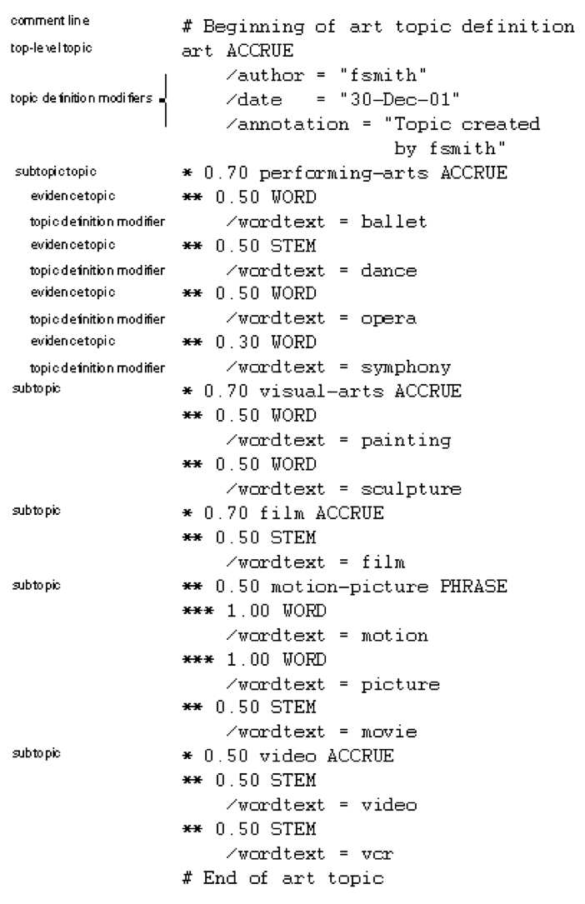
A Verity topic (a complex classification rule)
Note:
  maintenance issues (author, etc.)
  Hand-weighting of terms

Slide 12
Classification Methods (3)
Supervised learning of a document-label assignment function
  Many systems partly rely on machine learning (Autonomy, MSN, Verity, Enkata, Yahoo!, …)
    k-Nearest Neighbors (simple, powerful)
    Naive Bayes (simple, common method)
    Support-vector machines (new, more powerful)
    … plus many other methods
    No free lunch: requires hand-classified training data
    But data can be built up (and refined) by amateurs
Note that many commercial systems use a mixture of methods
Prasad
L13NaiveBayesClassify

Slide 13
Probabilistic relevance feedback
Rather than re-weighting in a vector space…
If user has told us some relevant and some irrelevant documents, then we can proceed to build a probabilistic classifier, such as the Naive Bayes model we will look at today:
  P(t_{k}|R) = |D_{rk}| / |D_{r}|
  P(t_{k}|NR) = |D_{nrk}| / |D_{nr}|
    t_{k} is a term; D_{r} is the set of known relevant documents; D_{rk} is the subset that contain t_{k}; D_{nr} is the set of known irrelevant documents; D_{nrk} is the subset that contain t_{k}.
Prasad
L13NaiveBayesClassify
9.1.2
Notes:
Note that this is an instance of multivariate Bernoulli approach as opposed to multi-nomial approach

Slide 14
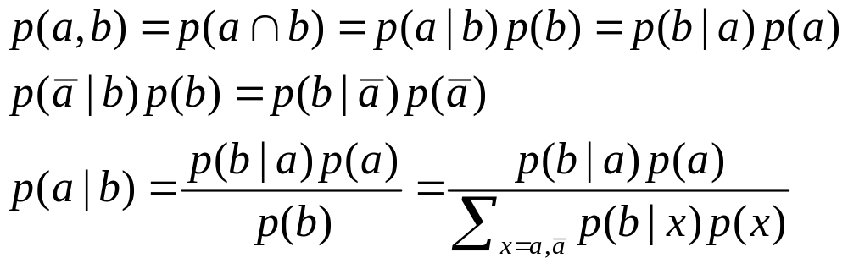
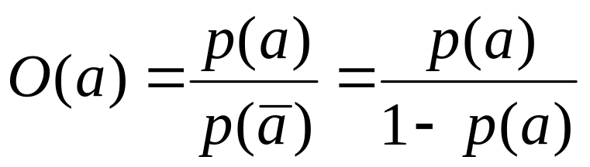
Recall a few probability basics
For events a and b:
Bayes’ Rule
Odds:
Prior
Posterior
Prasad
13.2

Slide 15
Bayesian Methods
Learning and classification methods based on probability theory.
  Bayes theorem plays a critical role in probabilistic learning and classification.
Build a generative model that approximates how data is produced.
Uses prior probability of each category given no information about an item.
Categorization produces a posterior probability distribution over the possible categories given a description of an item (and prior probabilities).
Prasad
L13NaiveBayesClassify
13.2
Notes:
Theoretical foundation is clear – the difficulty is in estimating the relevant parameters for classification
using training set, which can be sparse, not representative, or computationally difficult to handle in general.

Slide 16
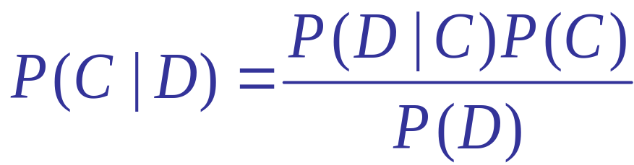
Bayes’ Rule
Prasad
L13NaiveBayesClassify
Notes:
OVERALL APPROACH:
General idea – Bayesian (robustness due to qualitative approach)
multinomial (counts of terms)
multivariate Bernoulli (counts of documents)
Simplifying assumption for computational tractability
conditional independence; positional independence
Dealing with idiosyncracies of training data
smoothening technique
avoid underflow using log
Improving efficiency and generalizability (noise reduction)
feature selection

Slide 17
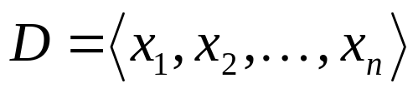
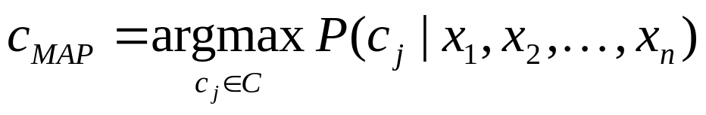
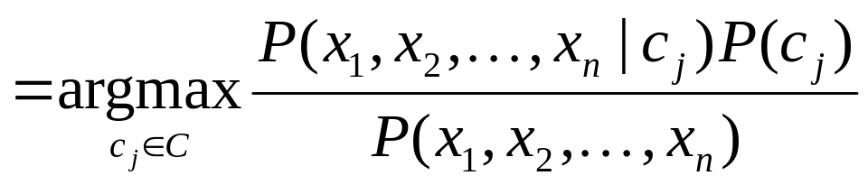
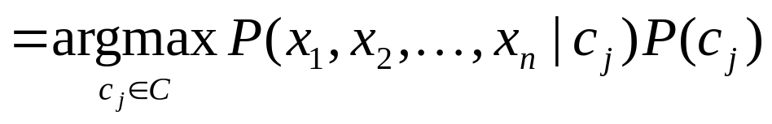
Naive Bayes Classifiers
Task: Classify a new instance D based on a tuple of attribute values into one of the classes c_{j} ∈ C
MAP = Maximum Aposteriori Probability
Prasad
L13NaiveBayesClassify
Notes:
MAP = maximum aposteriori probability
argmax = return the argument value for which the probability expression takes the maximum value
Document is imagined as a sequence of tokens
(Probability of a document is ignored, which may be an approximation,
because occurrence of a document can be a function of its length ---
“short documents are common, while longer documents are rare”)
================================================================
Robust because we want only relative measure

Slide 18
Naïve Bayes Classifier:
Naïve Bayes Assumption
P(c_{j})
  Can be estimated from the frequency of classes in the training examples.
P(x₁,x₂,…,x_{n}|c_{j})
  O(|X|^{n}•|C|) parameters
  Could only be estimated if a very, very large number of training examples was available.
Naïve Bayes Conditional Independence Assumption:
Assume that the probability of observing the conjunction of attributes is equal to the product of the individual probabilities P(x_{i}|c_{j}).
Prasad
L13NaiveBayesClassify
Notes:
From theory to practice …
counter example: barack obama

Slide 19
The Naïve Bayes Classifier
Flu
X₁
X₂
X₃
X₄
X₅
runnynose
sinus
cough
fever
muscle-ache
Conditional Independence Assumption: Features (term presence) are independent of each other given the class:
This model is appropriate for binary variables
  Multivariate Bernoulli model
Prasad
13.3

Slide 20
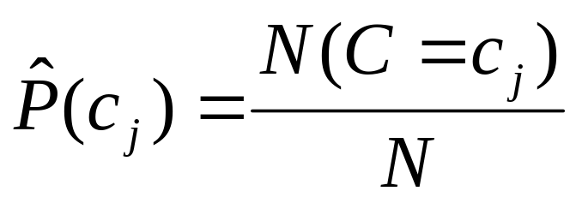
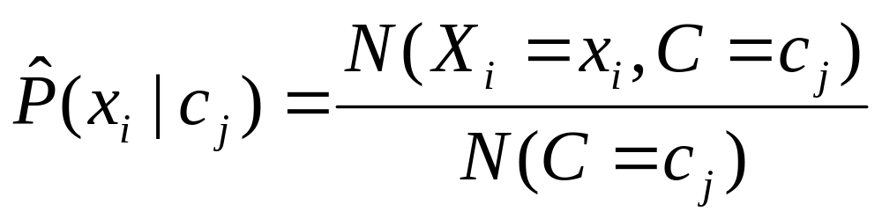
Learning the Model
C
X₁
X₂
X₃
X₄
X₅
X₆
First attempt: maximum likelihood estimates
  simply use the frequencies in the data
Prasad
13.3
Notes:
Estimating the parameters from the training set …

Slide 21
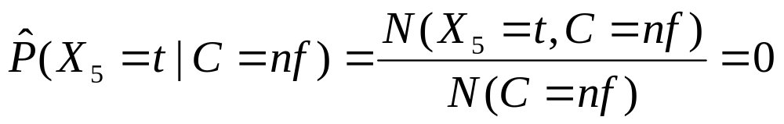
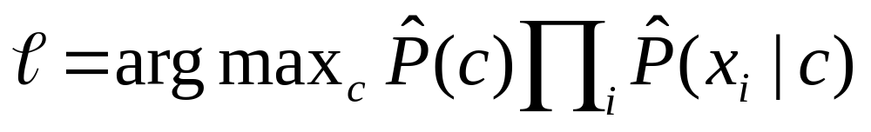
Problem with Max Likelihood
Flu
X₁
X₂
X₃
X₄
X₅
runnynose
sinus
cough
fever
muscle-ache
What if we have seen no training cases where patient had no flu and muscle aches?
Zero probabilities cannot be conditioned away, no matter the other evidence!
Prasad
13.3
Notes:
Even many strong positive evidence cannot help us overcome the absence of relatively insignificant term.
How do we deal with coincidental “incompleteness” that has such disasterous effect on the outcome?
We ran into similar issues when generating and evaluating “cluster label generation” for LexisNexis News Documents. (NLDB-2008 paper)

Slide 22
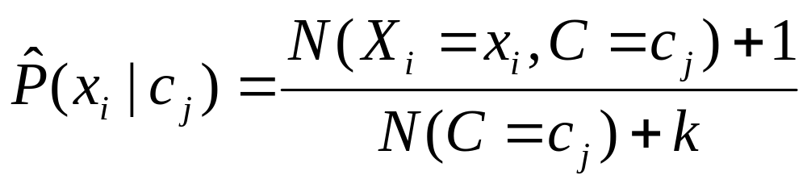
Smoothing to Avoid Overfitting
# of values of X_{i}
Prasad
L13NaiveBayesClassify
Notes:
Laplace smoothing for Bernoulli model
1 for every vocabulary term – k is size of the vocabulary

Slide 23
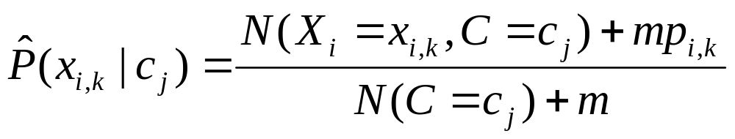
Smoothing to Avoid Overfitting
# of values of X_{i}
overall fraction in data where X_{i}=x_{i,k}
Somewhat more subtle version
extent of
“smoothing”
Prasad
L13NaiveBayesClassify
Notes:
Laplace smoothing for Bernoulli model
1 for every vocabulary term – k is size of the vocabulary

Slide 24
Stochastic Language Models
Models probability of generating strings (each word in turn) in the language (commonly all strings over ∑). E.g., unigram model
Model M
0.2 the
0.1 a
0.01 man
0.01 woman
0.03 said
0.02 likes
…
the
man
likes
the
woman
0.2
0.01
0.02
0.2
0.01
multiply
P(s | M) = 0.00000008
Prasad
L13NaiveBayesClassify
13.2.1
Notes:
Modelling word dependencies for a class of documents : Rubber meets the road
Making explicit the assumptions / approximations …
(expressive power vs efficiency vs real-world effectiveness based on the data and the classification goal)

Slide 25
Stochastic Language Models
Model probability of generating any string
Model M1
Model M2
0.2 the
0.0001 class
0.03 sayst
0.02 pleaseth
0.1 yon
0.01 maiden
0.0001 woman
0.2 the
0.01 class
0.0001 sayst
0.0001 pleaseth
0.0001 yon
0.0005 maiden
0.01 woman
the
class
pleaseth
yon
maiden
0.2
0.01
0.0001
0.0001
0.0005
0.2
0.0001
0.02
0.1
0.01
P(s|M2) > P(s|M1)
13.2.1

Slide 26
Unigram and higher-order models
Unigram Language Models
Bigram (generally, n-gram) Language Models
Other Language Models
  Grammar-based models (PCFGs), etc.
    Probably not the first thing to try in IR
P ( )
= P ( )
P ( | )
P ( | )
P ( | )
Easy.
Effective!
P ( ) P ( ) P ( ) P ( )
P ( ) P ( | ) P ( | ) P ( | )
Prasad
L13NaiveBayesClassify
13.2.1

Slide 27
Naïve Bayes via a class conditional language model = multinomial NB
Cat
w₁
w₂
w₃
w₄
w₅
w₆
Effectively, the probability of each class is done as a class-specific unigram language model
Prasad
L13NaiveBayesClassify

Slide 28
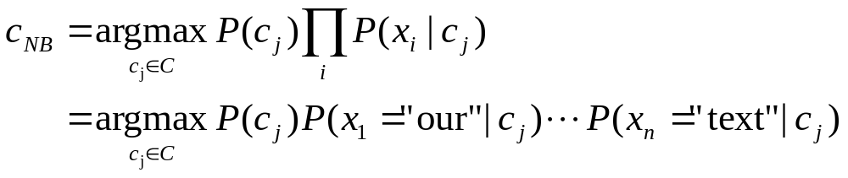
Using Multinomial Naive Bayes Classifiers to Classify Text: Basic method
Attributes are text positions, values are words.
Still too many possibilities
Assume that classification is independent of the positions of the words
  Use same parameters for each position
  Result is bag of words model (over tokens not types)
Prasad
L13NaiveBayesClassify

Slide 29
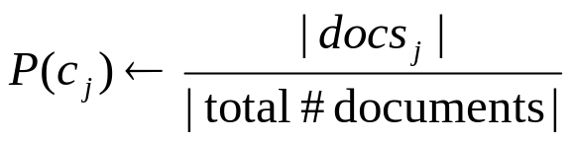
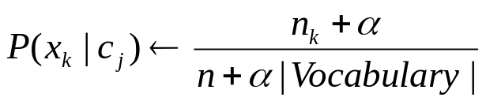
Naïve Bayes: Learning Algorithm
From training corpus, extract Vocabulary
Calculate required P(c_{j}) and P(x_{k} | c_{j}) terms
  For each c_{j} in C do
    docs_{j} ← subset of documents for which the target class is c_{j}
    Text_{j} ← single document containing all docs_{j}
    for each word x_{k} in Vocabulary
      n_{k} ← number of occurrences of x_{k} in Text_{j}
Prasad
L13NaiveBayesClassify
Notes:
n = total number of tokens (alpha is “tuning/smoothing” factor that can be set to 1)
Multinomial Conditional Independence Naïve Bayes: Learning from Training Set

Slide 30
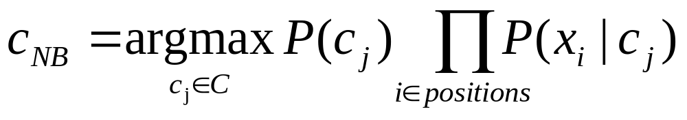
Naïve Bayes: Classifying
positions ← all word positions in current document which contain tokens found in Vocabulary
Return c_{NB}, where
Prasad
L13NaiveBayesClassify
Notes:
Multinomial Conditional Independence Naïve Bayes: Classifying Test document
Real-world setting : very robust because we are seeking only relative information

Slide 31
Naive Bayes: Time Complexity
Training Time: O(|D|L_{d} + |C||V|)) where L_{d} is the average length of a document in D.
  Assumes V and all D_{i} , n_{i}, and n_{ij} pre-computed in O(|D|L_{d}) time during one pass through all of the data.
  Generally just O(|D|L_{d}) since usually |C||V| < |D|L_{d}
Test Time: O(|C| L_{t}) where L_{t} is the average length of a test document.
  Very efficient overall, linearly proportional to the time needed to just read in all the data.
  Plus, robust in practice
Why?
Prasad
L13NaiveBayesClassify
Notes:
|D| Ld = size of training set :: Parsing requires one pass through the documents
|C| |V| = Complexity of computing all probability values (loop over terms and classes)
Testing requires checking test document with each class for membership

Slide 32
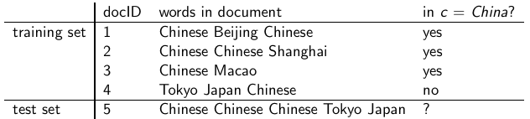
Exercise
  Estimate parameters of Naive Bayes classifier
  Classify test document

Slide 33
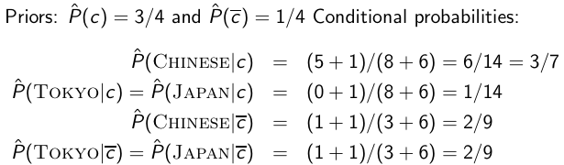
Example: Parameter estimates
The denominators are (8 + 6) and (3 + 6) because the lengths of
text_{c} and are 8 and 3, respectively, and because the constant
B is 6 as the vocabulary consists of six terms.

Slide 34

Example: Classification
Thus, the classifier assigns the test document to c = China. The
reason for this classification decision is that the three occurrences
of the positive indicator CHINESE in d₅ outweigh the occurrences
of the two negative indicators JAPAN and TOKYO.

Slide 35
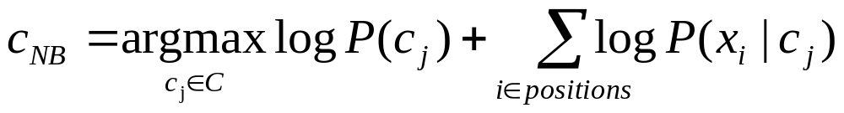
Underflow Prevention: log space
Multiplying lots of probabilities, which are between 0 and 1, can result in floating-point underflow.
Since log(xy) = log(x) + log(y), it is better to perform all computations by summing logs of probabilities rather than multiplying probabilities.
Class with highest final un-normalized log probability score is still the most probable.
Note that model is now just max of sum of weights…
Prasad
L13NaiveBayesClassify
Notes:
Addressing practical computational problems : 10^-3 * 10^-4 = 0.0000001 VS log (10^-3 * 10^-4) = -7

Slide 36
Note: Two Models
Model 1: Multivariate Bernoulli
  One feature X_{w} for each word in dictionary
  X_{w} = true in document d if w appears in d
  Naive Bayes assumption:
    Given the document’s topic, appearance of one word in the document tells us nothing about chances that another word appears
This is the model used in the binary independence model in classic probabilistic relevance feedback in hand-classified data
Prasad
L13NaiveBayesClassify

Slide 37
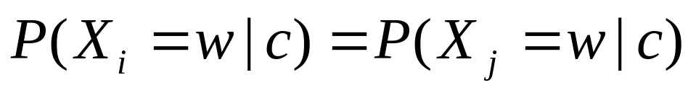
Two Models
Model 2: Multinomial = Class conditional unigram
  One feature X_{i} for each word pos in document
    feature’s values are all words in dictionary
  Value of X_{i} is the word in position i
  Naïve Bayes assumption:
    Given the document’s topic, word in one position in the document tells us nothing about words in other positions
  Second assumption:
    Word appearance does not depend on position
for all positions i,j, word w, and class c
Prasad

Slide 38
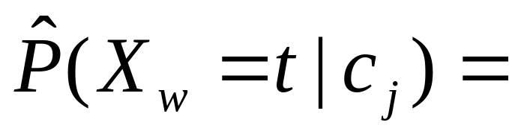
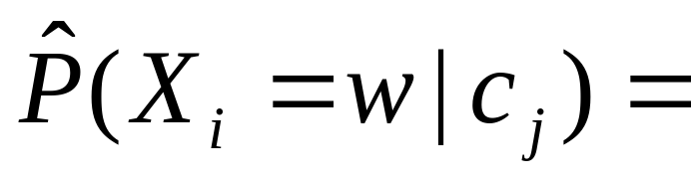
Parameter estimation
Multivariate Bernoulli model:
Multinomial model:
  Can create a mega-document for topic j by concatenating all documents on this topic
  Use frequency of w in mega-document
fraction of documents of topic c_{j}
in which word w appears
fraction of times in which
word w appears
across all documents of topic c_{j}
Prasad
L13NaiveBayesClassify

Slide 39
Classification
Multinomial vs Multivariate Bernoulli?
Multinomial model is almost always more effective in text applications!
See IIR sections 13.2 and 13.3 for worked examples with each model
Prasad
L13NaiveBayesClassify

Slide 40
Feature Selection: Why?
Text collections have a large number of features
  10,000 – 1,000,000 unique words … and more
Feature Selection
  Makes using a particular classifier feasible
    Some classifiers can’t deal with 100,000 of features
  Reduces training time
    Training time for some methods is quadratic or worse in the number of features
  Can improve generalization (performance)
    Eliminates noise features
    Avoids overfitting
Prasad
L13NaiveBayesClassify
13.5

Slide 41
Feature selection: how?
Two ideas:
  Hypothesis testing statistics:
    Are we confident that the value of one categorical variable is associated with the value of another
    Chi-square test (χ²)
  Information theory:
    How much information does the value of one categorical variable give you about the value of another
    Mutual information (MI)
They’re similar, but χ² measures confidence in association, (based on available statistics), while MI measures extent of association (assuming perfect knowledge of probabilities)
Prasad
L13NaiveBayesClassify
13.5
Notes:
correlation

Slide 42
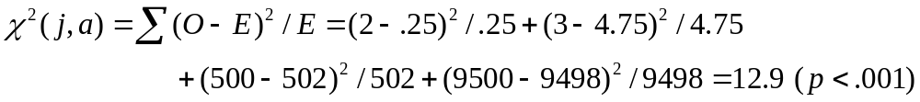
χ² statistic (CHI)
χ2 is interested in (f_{o} – f_{e})²/f_{e} summed over all table entries: is the observed number what you’d expect given the marginals?
The null hypothesis is rejected with confidence .999,
since 12.9 > 10.83 (the value for .999 confidence).
Term = jaguar
Term ≠ jaguar
expected: f_{e}
Class = auto
2
(0.25)
500
(502)
Class ≠ auto
3
(4.75)
9500
(9498)
observed: f_{o}
13.5.2
Notes:
This basically checks for independence of two events (terms and classes) by measuring deviation (of the observed counts)
from the average (conforming to independence assumption (‘Null hypothesis’)).
Larger Chi-squared values implies NOT INDEPENDENT (rejecting the ‘Null hypothesis’).
Note that in the example shown: Jaguar and auto are correlated (2 vs 0.25)
Jaguar and not auto a bit less (3 vs 4.75), while other entries point to independence.
====================================================
Independent means joint probability is product of the individual probabilities
Positive correlation => joint prob > prod. indv. prob.
Negative correlation => joint prob < prod indv. prob.

Slide 43

χ² statistic (CHI)
There is a simpler formula for 2x2 χ²:
A = #(t,c)
C = #(¬t,c)
Yields 1.29?
B = #(t,¬c)
D = #(¬t, ¬c)
N = A + B + C + D
Value for complete independence of term and category?
Notes:
For complete independence: A= t c , B = (1-t) c, C = t (1-c), D = (1-t) (1-c)
A + B + C + D = 1 AD – BC = tc (1-t)(1-c) – (1-t) c t (1-c) = 0
================================================
A=2 B=3 C=500 D=9500 N=1005
Nx(AD-CB)^2 = 1005x(2x9500-500x3)^2
=307781250000
(A+C)x(B+D)x(A+B)x(C+D) = (2+500)x(3+9500)x(2+3)x(500+9500)
=238525300000
chi^2=1.29 (12.9??)

Slide 44
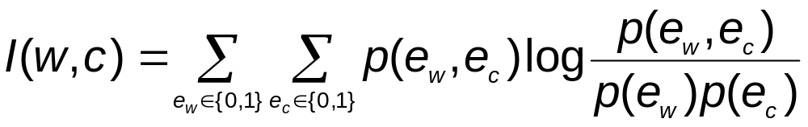
Feature selection via Mutual Information
In training set, choose k words which best discriminate (give most info. on) the categories.
The Mutual Information between a word, class is:
  For each word w and each category c
Prasad
L13NaiveBayesClassify
13.5.1
Notes:
Note that if the term and the class are independent then p(ew,ec) = p(ew)*p(ec)
Thus p(ew,ec) log [ p(ew,ec) / p(ew)p(ec) ] = 0
O/w, if the term and the class are completely dependent then p(ew,ec) = p(ew) = p(ec)
Thus p(ew,ec) log [ p(ew,ec) / p(ew)p(ec) ] > 0 and takes the highest value
(as 0 <= | p(ew,ec)/p(e_) | <= 1)
The weighting of the log term using p(ew,ec) allows us to pick the most promising features
(most bang for the class discriminating features)

Slide 45
Feature selection via MI (contd.)
For each category we build a list of k most discriminating terms.
For example (on 20 Newsgroups):
  sci.electronics: circuit, voltage, amp, ground, copy, battery, electronics, cooling, …
  rec.autos: car, cars, engine, ford, dealer, mustang, oil, collision, autos, tires, toyota, …
Greedy: does not account for correlations between terms
Prasad
L13NaiveBayesClassify

Slide 46
Feature Selection
Mutual Information
  Clear information-theoretic interpretation
  May select rare uninformative terms
Chi-square
  Statistical foundation
  May select very slightly informative frequent terms that are not very useful for classification
Just use the commonest terms?
  No particular foundation
  In practice, this is often 90% as good
Prasad
L13NaiveBayesClassify

Slide 47
Feature selection for NB
In general, feature selection is necessary for multivariate Bernoulli NB.
Otherwise, you suffer from noise, multi-counting
“Feature selection” really means something different for multinomial NB. It means dictionary truncation.
  This “feature selection” normally isn’t needed for multinomial NB, but may help a fraction with quantities that are badly estimated
Prasad
L13NaiveBayesClassify
Notes:
The multinomial NB model only has 1 feature

Slide 48
Evaluating Categorization
Evaluation must be done on test data that are independent of the training data (usually a disjoint set of instances).
Classification accuracy: c/n where n is the total number of test instances and c is the number of test instances correctly classified by the system.
  Adequate if one class per document
  Otherwise F measure for each class
Results can vary based on sampling error due to different training and test sets.
Average results over multiple training and test sets (splits of the overall data) for the best results.
Prasad
L13NaiveBayesClassify
13.6
Notes:
See IIR 13.6 for evaluation on Reuters-21578

Slide 49
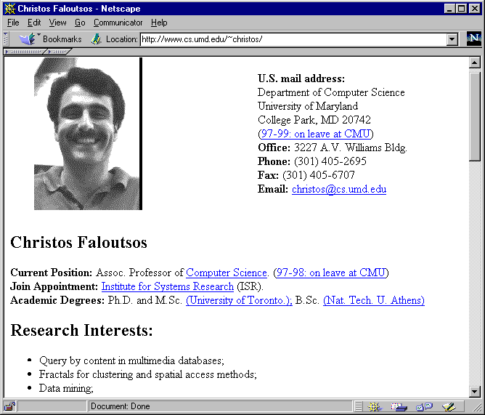
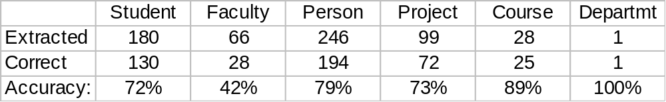
WebKB Experiment (1998)
Classify webpages from CS departments into:
  student, faculty, course,project
Train on ~5,000 hand-labeled web pages
  Cornell, Washington, U.Texas, Wisconsin
Crawl and classify a new site (CMU)
Results:

Slide 50
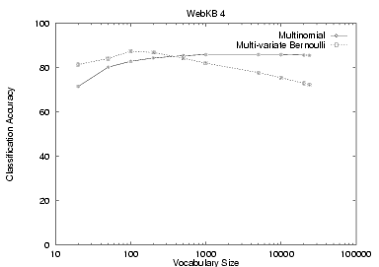
NB Model Comparison: WebKB
Prasad

Slide 51
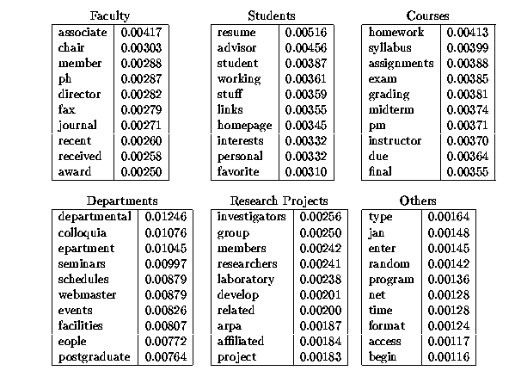
Prasad
L13NaiveBayesClassify

Slide 52
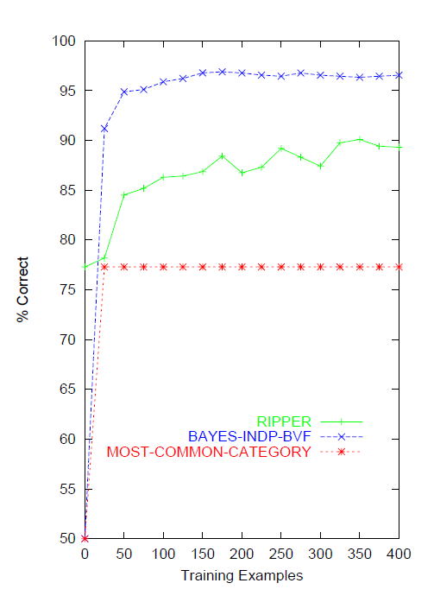
Naïve Bayes on spam email
Prasad
L13NaiveBayesClassify
13.6
Notes:
This graph is from
http://www.cs.utexas.edu/users/jp/research/email.paper.pdf
Naive-Bayes vs. Rule-Learning in Classification of Email
Jefferson Provost, UT Austin

Slide 53
SpamAssassin
Naïve Bayes has found a home in spam filtering
  Paul Graham’s A Plan for Spam
    A mutant with more mutant offspring...
  Naive Bayes-like classifier with weird parameter estimation
  Widely used in spam filters
    Classic Naive Bayes superior when appropriately used
      According to David D. Lewis
  But also many other things: black hole lists, etc.
Many email topic filters also use NB classifiers
Prasad
L13NaiveBayesClassify

Slide 54
Violation of NB Assumptions
Conditional independence
“Positional independence”
Examples?
Prasad
L13NaiveBayesClassify

Slide 55
Example: Sensors
Reality
Raining
Sunny
P(+,+,r) = 3/8
P(-,-,r) = 1/8
P(+,+,s) = 1/8
P(-,-,s) = 3/8
NB Model
NB FACTORS:
P(s) = 1/2
P(+|s) = 1/4
P(+|r) = 3/4
PREDICTIONS:
P(r,+,+) = (½)(¾)(¾)
P(s,+,+) = (½)(¼)(¼)
P(r|+,+) = 9/10
P(s|+,+) = 1/10
Raining?
M1
M2
Prasad
L13NaiveBayesClassify

Slide 56
Naïve Bayes Posterior Probabilities
Classification results of naïve Bayes (the class with maximum posterior probability) are usually fairly accurate.
However, due to the inadequacy of the conditional independence assumption, the actual posterior-probability numerical estimates are not.
  Output probabilities are commonly very close to 0 or 1.
Correct estimation ⇒ accurate prediction, but correct probability estimation is NOT necessary for accurate prediction (just need right ordering of probabilities)
Prasad
L13NaiveBayesClassify

Slide 57
Naive Bayes is Not So Naive
Naïve Bayes: First and Second place in KDD-CUP 97 competition, among 16 (then) state of the art algorithms
  Goal: Financial services industry direct mail response prediction model: Predict if the recipient of mail will actually respond to the advertisement – 750,000 records.
Robust to Irrelevant Features
  Irrelevant Features cancel each other without affecting results
  Instead Decision Trees can heavily suffer from this.
Very good in domains with many equally important features
  Decision Trees suffer from fragmentation in such cases – especially if little data
A good dependable baseline for text classification (but not the best)!
Optimal if the Independence Assumptions hold: If assumed independence is correct, then it is the Bayes Optimal Classifier for problem
Very Fast: Learning with one pass of counting over the data; testing linear in the number of attributes, and document collection size
Low Storage requirements
Prasad
L13NaiveBayesClassify
Notes:
IIR 13
Fabrizio Sebastiani. Machine Learning in Automated Text Categorization. ACM Computing Surveys, 34(1):1-47, 2002.
Yiming Yang & Xin Liu, A re-examination of text categorization methods. Proceedings of SIGIR, 1999.
Andrew McCallum and Kamal Nigam. A Comparison of Event Models for Naive Bayes Text Classification. In AAAI/ICML-98 Workshop on Learning for Text Categorization, pp. 41-48.
Tom Mitchell, Machine Learning. McGraw-Hill, 1997.
Clear simple explanation of Naïve Bayes
Open Calais: Automatic Semantic Tagging
Free (but they can keep your data), provided by Thompson/Reuters
Weka: A data mining software package that includes an implementation of Naive Bayes
Reuters-21578 – the most famous text classification evaluation set and still widely used by lazy people (but now it’s too small for realistic experiments – you should use Reuters RCV1)

