Slide 1
CSCI 3003: Lab5
2/28/2018

Slide 2
Agenda
Review dictionary
Review Functions
Assert statements
Lab5
Finish Part I
Make some progress on Part II
Some pointers

Slide 3
Early semester Feedback Summary
What’s helping?
Answering individual questions; In-person helps
Notes on the board before the class
Barriers?
Learning Curve for programming; material is challenging; sometimes not easy for beginners to understand.
Notes on blackboards: tough to see or understand.

Slide 4
3. Enhancements?
Q/A:
More examples; More resources: will try to give you some materials on moodle.
Longer lab or lecture time; More time to explain things: will take more time, but then will reduce the in-person help time.
Use of the Displays
Technical Issue (solved)
Whiteboard: Is it okay if I ask you guys to come closer?
More TAs, shorter lab assignments
Not possible really.

Slide 5
What you can do?
Absolute beginners
Learning programming the first time is challenging; it will get better with time.
Programming is hands-on learning. Even if it all make sense, don’t be satisfied until you can transform your thoughts into codes.
Don’t feel bad; everyone struggles the first time.
Divide and conquer
Instead of working 6 hours at a time, divide it 2 hours in 3 days.
If you’re really stuck, take a break, come back later and look at it anew.
Ask more questions in the class
About anything.
Go back on your mistakes on previous works, and review that.

Slide 6
Lab5: Focus
Using assert
You shall not pass (if you are false)
assert(1 == 2)
assert(1 == 1)
Using functions.
Input, output parameters; define keyword
Docstring: what does it do? Remember help()
Indentation
Write code and check if it works.
If it does, put it inside a function.
sort() function for list

Slide 7
Lab5: Focus
File I/O
Read, write; strip(), split() etc.
for line in line: vs
readline() vs readlines()
Using dictionaries.
Putting values inside a dictionary;
modifying values.
Access keys and values. (keys(), values(), items())
Say that we have a dictionary named, tmp_dict = {}. If you key is tmp_key = ‘A1BG’, and value is interaction_value = 5, how would you put the value inside tmp_dict, and then how would you print it?

Slide 8
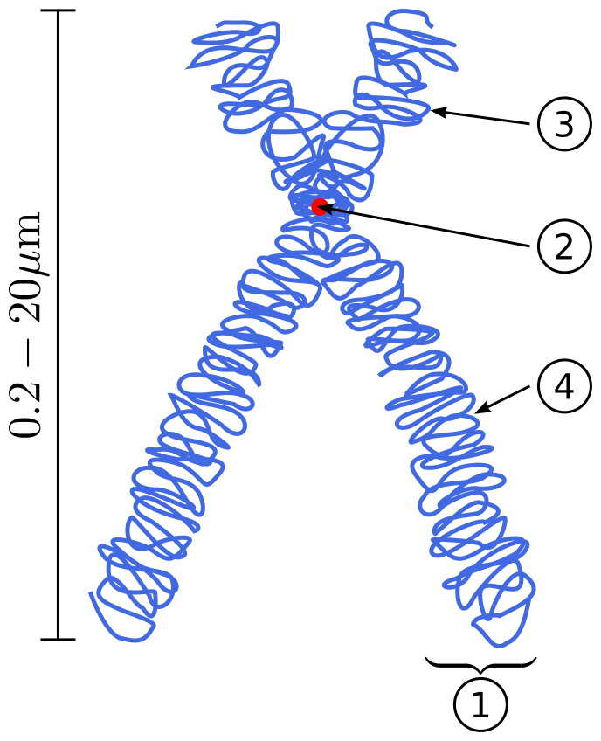
Problem: Part I
Human locus (position on chromosome)
How to denote it in a file?
<Chromosome num> p/q <region> <band> dot <sub-band>
Example: 3p22.1 (No spaces)
(1) Chromatid
(2) Centromere
(3) Short (p) arm
(4) Long (q) arm

Slide 9
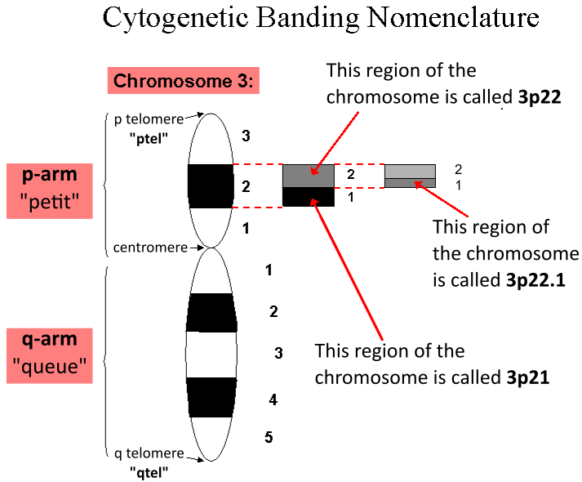
Problem: Part I
<Chromosome num> p/q <region> <band> dot <sub-band>
Example: 3p22.1(String)
Write a function that checks the validity of such a string (return true / false)
Hint: Look for each of the elements (‘p’, ‘.’, and others)
Valid examples: 6p21.3, 11q1.4, 22p11.2 etc.
Invalid examples: 6a2.3, 6p22 etc.

Slide 10
Problem: Part II
Analyze SNPs from two fictitious person (Greg and Lilly).
(a) One file for each of them. Format of the data:
rs3094315chr1-742429(A,A)
rs12562034chr1-758311(A,G)
Parse to:
Rs3094315 1 742429 A A
Rs12562034 1 758311 A G
(b) write a function that will do these and put the output inside a variable (maybe dictionary) and return it.
Use the function to read both files and store the output in variables.

Slide 11
Any Questions ??

