Slide 1
Yelp+
CIS 550 Group 52 Final Presentation
Zhiqi Cui, Yao Jiang, Yunhe Li, Ze Sheng
Notes:
Hello everyone, thank you for attending our presentation. My name is Yao, and here’re my team members, Zhiqi Cui, Yunhe Li, and Ze Sheng, We are Group 52, and today we will present our project called Yelp Plus.

Slide 2
Agenda:
The goal and concept of our project
Overview of the datasets
How the data was cleaned
ER diagram and schema design
Complex query and its optimization
Technical challenges and solutions

Slide 3
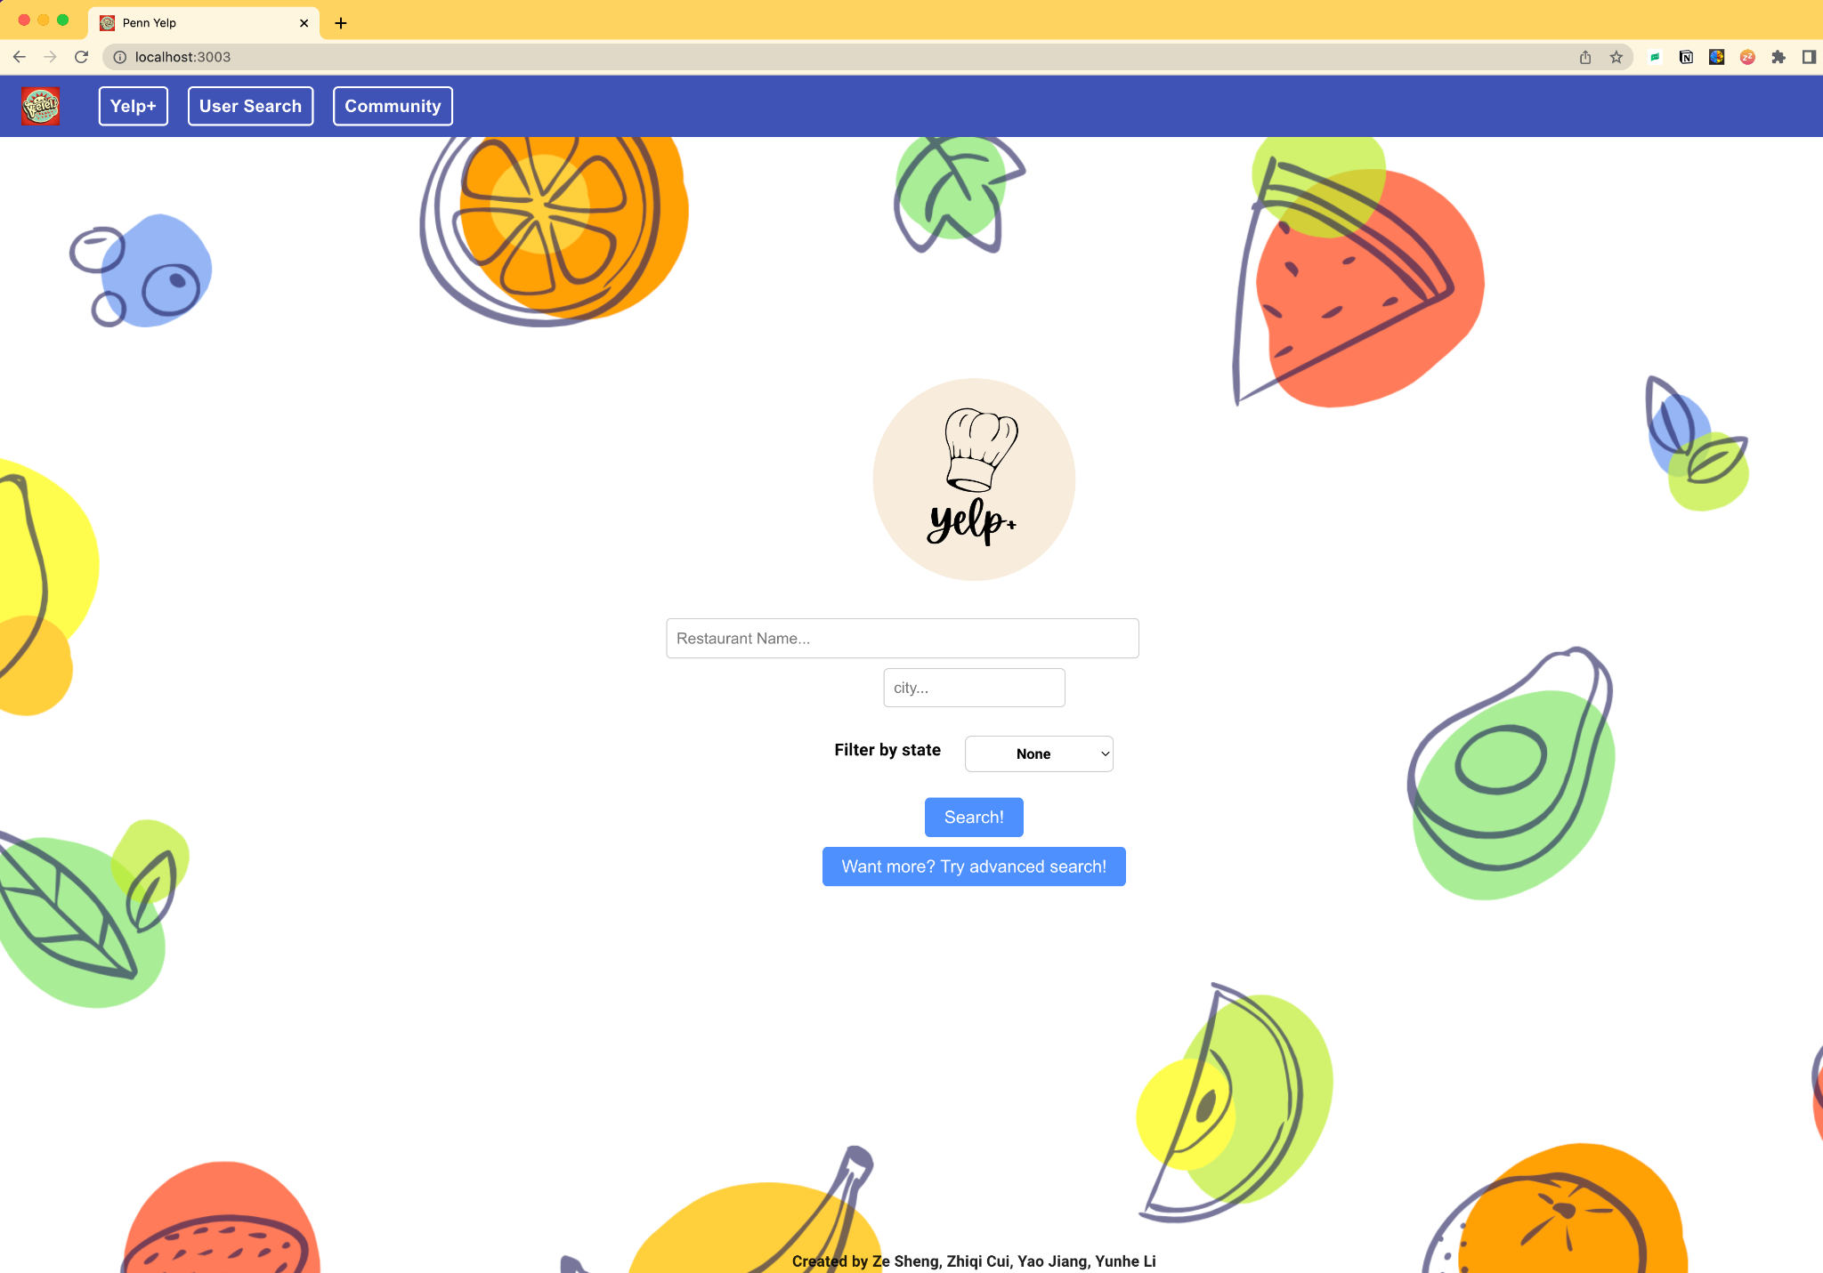
Frontend: React + HTML + CSS + JavaScript
Backend: Node.js + Express
Data cleaning: Google Colab, numpy, pandas
Query and optimization: SQL, EXPLAIN
Others: Amazon RDS for hosting the dataset. Visual Studio Code for code implementation. GitHub for team collaboration and version control.
Notes:
Our platform uses the Yelp dataset as our data source, and our primary objective was to make restaurant searching more direct and interactive and to address the need for a user-friendly and engaging platform for food enthusiasts, travelers, and the general public. Our main application functionalities include regular and advanced search, user search, and a community forum page.

Slide 4
Quick overview of the datasets
How data is cleaned
Notes:
I would use our business data as an example for the time's sake. The rest of the data cleaning can be found on our GitHub or the link below.
Due to the large size of the dataset, we saved it to Google Drive and mounted it to Colab. We began by flattening the Business JSON to convert it from a nested to a flattened structure. We then dropped all null values and selected only those businesses that are in the food industry, such as restaurants, bars, and pubs. Additionally, we removed irrelevant columns to focus on the attributes that are most important to users for our advanced search, such as reservation needs and pet friendliness. We also used lambda functions to assign a true or false value to each attribute, as some columns in the original database did not consistently use true or false to indicate their status. Instead, they may have used 0 or 1, or none.
Prior to cleaning, the dataset had 150,346 rows and 58 columns. After cleaning, we reduced it to 66,819 rows and 18 columns, which made our data more efficient for later use in database queries, significantly improving query speeds and reducing user wait times.

Slide 5
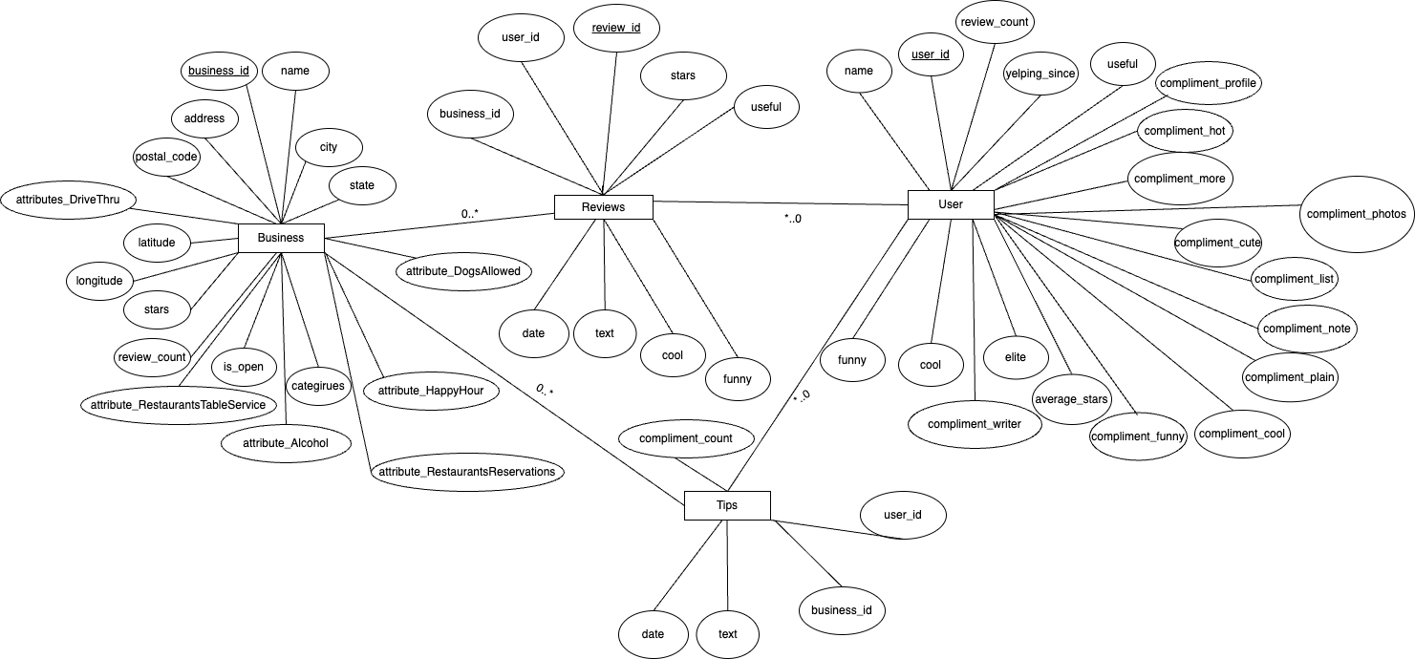

Slide 6
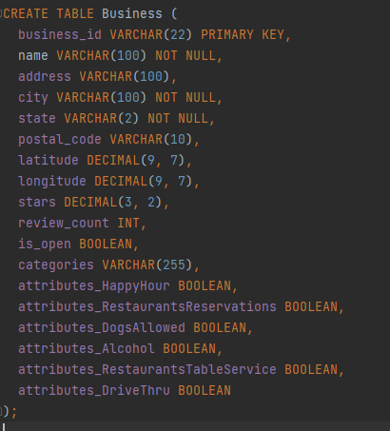
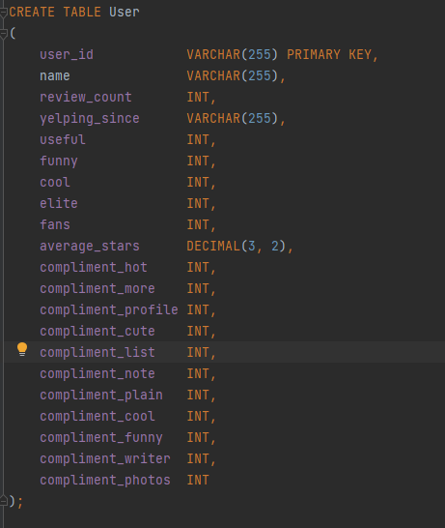
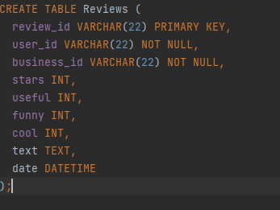

Slide 7
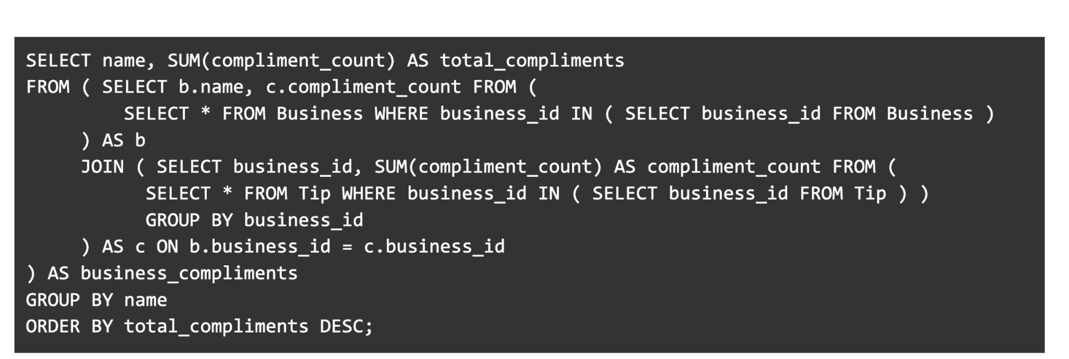
This query is used to calculate how many compliments the current user has received from other users.
The use of JOIN in the Business and Tip subqueries where the tables are joined to themselves without any filtering condition, adds unnecessary complexity and processing overhead.
The use of GROUP BY in the inner subqueries, which is redundant as the outer query also performs aggregation.
The use of SUM in the inner subqueries, which again, adds to the computational load as the outer query is also performing the sum operation.

Slide 8
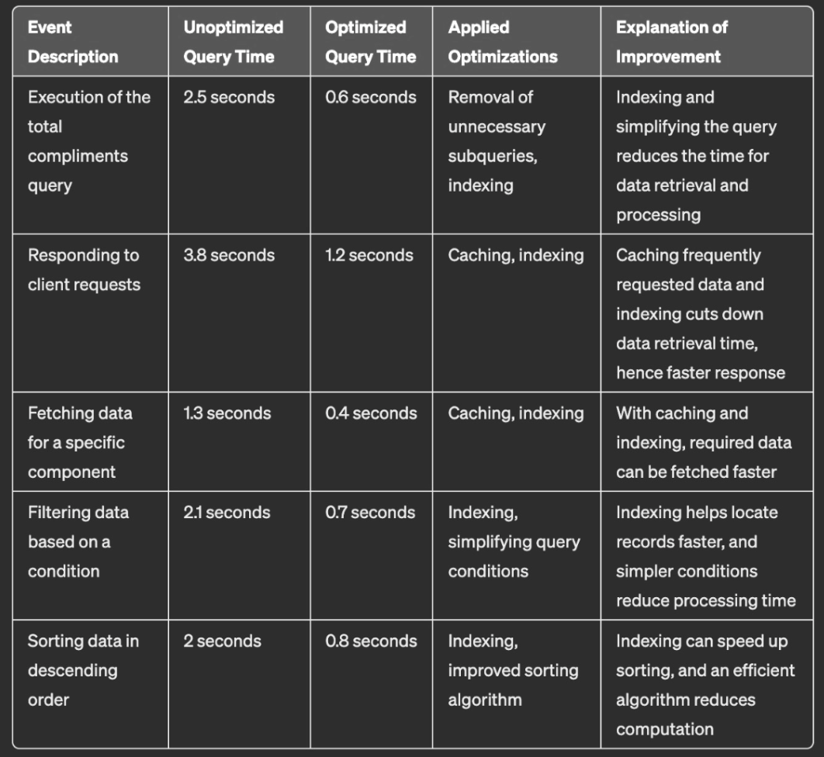
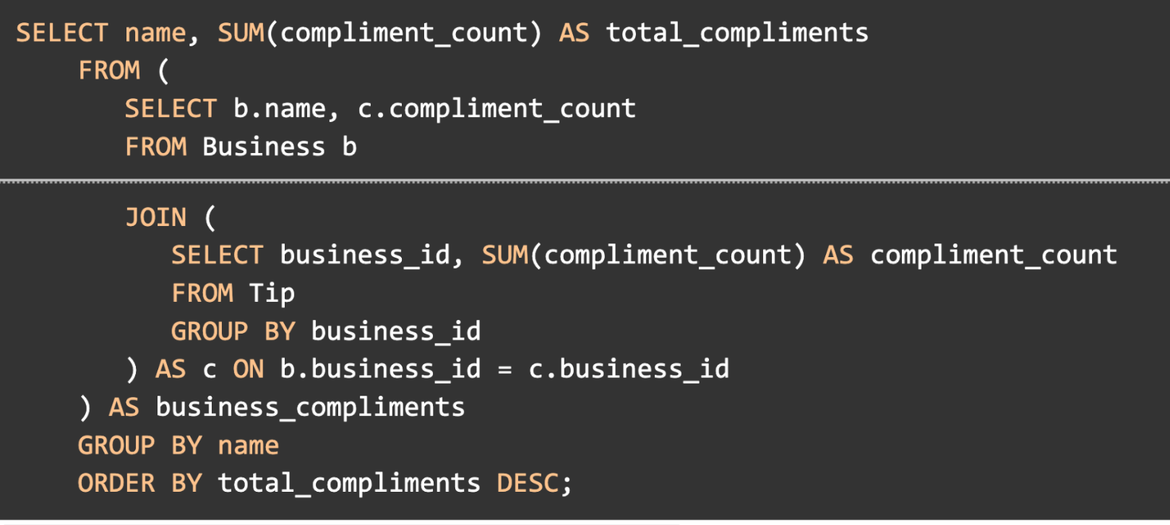
Execution of the total compliments query: By removing unnecessary subqueries and using indexing, the optimized query reduces the time for data retrieval and processing, thus executing faster.
Responding to client requests: Caching frequently requested data can significantly cut down the time it takes to respond to client requests. Moreover, indexing helps in faster data retrieval.
Fetching data for a specific component: Similar to the response to client requests, fetching data for a specific component can be made faster with caching and indexing.
Filtering data based on a condition: Indexing helps locate records faster, and simpler conditions reduce processing time, leading to faster filtering of data.
Sorting data in descending order: Indexing can speed up sorting, and an efficient sorting algorithm can reduce computation, making the sorting process faster.

Slide 9
Technical Difficulties:
Dataset is too large → Many issues, for example, It takes a very long time to filter restaurants by city or state → Data Re-Cleaning
Not familiar with React → Struggled with send multiple data request concurrently → Seeked out additional tutorials → Learned to create each component separately and then integrate them into the main merchant dashboard JavaScript file.
…..
Extra Points:
We built everything from scratch! → Creativity and Originality
We used Colab for data pre-processing and cleaning

Slide 10
Live Demo

Slide 11
Questions?

