Slide 1
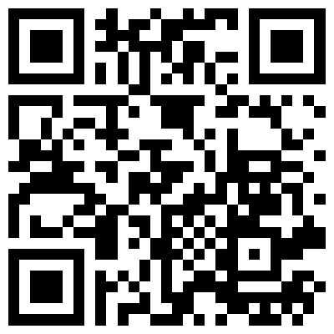
SYMPTOM TRACKER
Laidlaw logo
Papworth logo
A co-produced portable pain-event recorder for accessible symptom communication
LiA poster | SMART outcomes
UNESCO SDG 10 | Reduced Inequalities
Chuqing (Tracy) Tang | Department of Engineering, University of Cambridge | Murray Edwards College
Leadership in Action | July-August 2026 | Supervisor: Vicky Gildersleve (Papworth Trust Cambridge Manager)
1 NEED AND USER RESEARCH
3 SYSTEM OVERVIEW
6 EVALUATION (USABILITY)
Context (Papworth Trust co-production)
Episodic pain is hard to remember and describe later. For many adults with learning disabilities, opening a dense health app and typing during an episode is unrealistic.
Discovery method (Weeks 1-2)
- Joined routine activities; observed recurring support needs
- Spoke with service users, staff, and caregivers
- Field checklist: independence, participation, confidence, safety, staff workload
- Separated isolated incidents from recurring patterns
Design brief: record the moment with a physical squeeze; review it digitally later. Reduce reliance on memory, language load, and complex UI.
Scope: usability and engineering validation. No clinical-efficacy claims.
Protocol
- Day 1 formative: observe first; explain only when needed; log critical / major issues
- Prioritise fixes with a rationale; avoid adding features for every comment
- Day 2: repeat the same core tasks and check clarity / reliability
Questions: minimal instruction? light vs strong presses? short vs long events? BLE workflow? can staff read the history?
Observed split: users needed large targets, few choices, and physical feedback; staff needed time, duration, intensity, patterns, and one trustworthy row per press.
IMAGE: architecture device / BLE / Flutter app
4 HARDWARE AND IMPLEMENTATION
Stack: ESP32, FSR406, vibration motor (transistor + flyback), SOS / REC, status LED, optional INMP441 voice note, TP4056 battery path.
Integration lessons (engineering validity)
- Stripboard copper shorts can couple SOS and REC despite correct firmware
- Motor load needs proper drive and bulk capacitance (battery brownout)
- Silent WAV files: intermittent I2S clock / microphone slot config
- Enclosure deformation can open joints: treat mechanics and electronics as one system
IMAGE: field checklist / needs research
IMAGE: app UI / Accessible Mode / test checklist
7 SMART GOALS TO OUTCOMES
2 ENGINEERING APPROACH
G1 Needs discovery (Weeks 1-2)
S/M: field checklist and a written problem brief (physical record, digital review). Outcome: a focused TEAL brief on discomfort-communication barriers.
G2 Working prototype (Weeks 2-5)
S/M: handheld ESP32 device and Flutter app with curve capture, offline queue, BLE sync, calibration, and Accessible Mode. Outcome: an end-to-end demo loop before the final week.
G3 Validation and sharing (Weeks 5-6)
S/M: Day 1 / fix / Day 2 notes; LiA poster on the Network with SMART and SDG reporting. Outcome: documented feedback and an open repository.
A / R / T: scoped to six weeks with Papworth priorities; milestones tracked from midpoint check-in to the final demo (August 2026).
User research set the architecture, not the reverse.
Sensing and event model (ESP32)
- FSR406 to ADC, with debounce and a press / release state machine
- Stores a pressure-time curve, not only a peak value
- Non-blocking haptic PWM so motor intensity follows force
- Offline event queue on device storage when BLE is absent
BLE sync (final solution)
Queued episodes transfer on reconnect. The app claims each device event key before insert, so one press becomes one timeline row (no duplicate ends).
Calibration (person-specific, practical)
A three-step weak / medium / strong map turns raw ADC into 0-100% relative force for that person, so readings stay meaningful across grip strength and mounting differences.
Hardware path
Breadboard (LED stand-in for motor) to stripboard (driver, diode, power integrity) to SolidWorks enclosure shaped around thumb access and distinct SOS / REC controls.
IMAGE: stripboard / assembled device / CAD
5 ACCESSIBLE MODE
Designed from centre feedback, not added as a theme toggle afterwards.
Service-user layer
- Larger targets and type; Home and Timeline only
- 2 x 2 action grid; four picture tags (meal, exercise, sleep, medication)
- SOS is a long-press, to reduce accidental alerts
Caregiver layer
Full settings remain available: calibration, vibration modes, curves, stats, labels, and Guardian / SOS options.
Principle: people should not have to adapt themselves to an interface that was never designed around their needs.
8 UNESCO SDG 10 REDUCED INEQUALITIES
SDG 10
Inequality is not only whether a service exists, but whether people can access, understand, and benefit from it.
Symptom Tracker targets barriers of memory, language load, and digital confidence in symptom communication, so support and review are more equitable between service users and caregivers.
IMAGE: Accessible Mode UI (Home grid / tags)
Co-produced with Papworth Trust | Murray Edwards College, University of Cambridge | Laidlaw Scholars
Papworth
Laidlaw
Cambridge
Acknowledgements: service users, staff, and caregivers at Papworth Trust. Code: github.com/Tracytang-engi/Symptom_Tracker
GitHub QR

