Slide 1
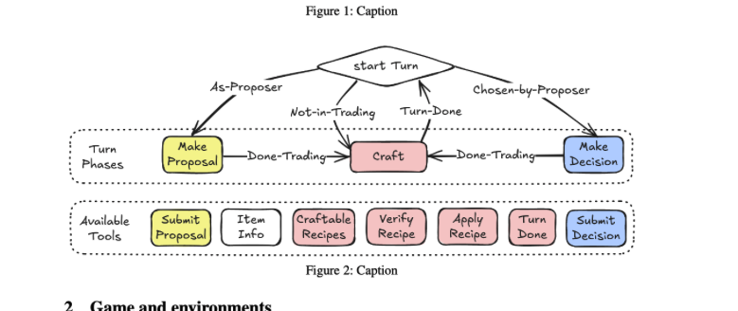
Agent Pool
Environment
Tradecraft Engine
Server Response
Router
Proposer
decision maker
Phase Action
crafter
Tool Action * N
Tool Response * N

Slide 2
Agent Pool
Environment
Tradecraft Engine
Server Response
Router
Proposer
decision maker
Phase Action
crafter
Tool Action * N
Tool Response * N

Slide 3
Environment: Tradecraft Engine
Game Phase: pahse info
proposal phase
Proposer
Router
proposer tool
decision phase
decision maker
History
decision maker tool
craft phase
crafter
crafter tool

Slide 4
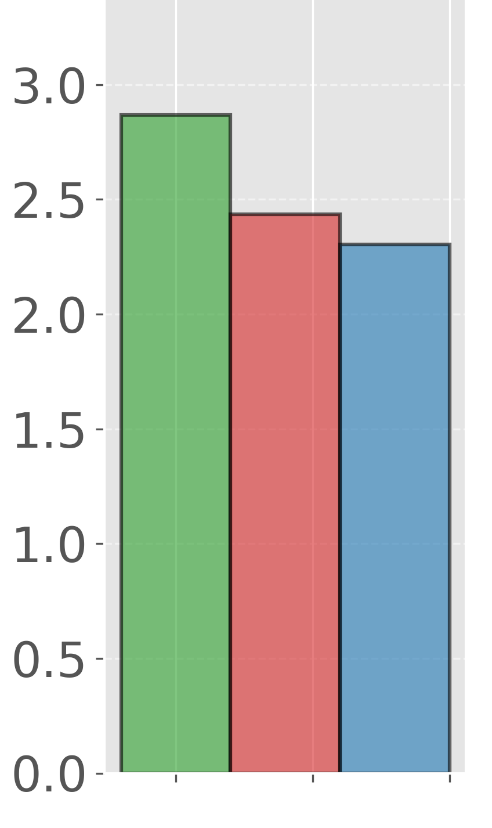
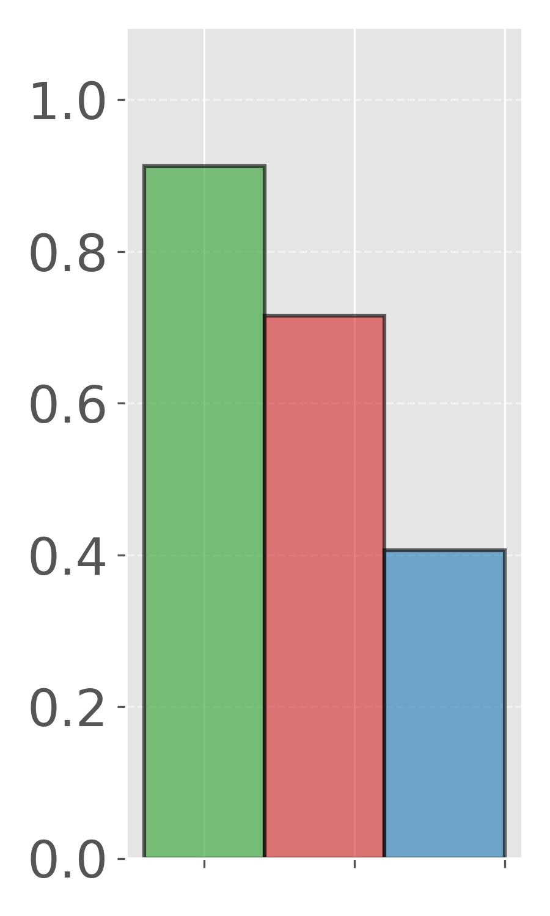
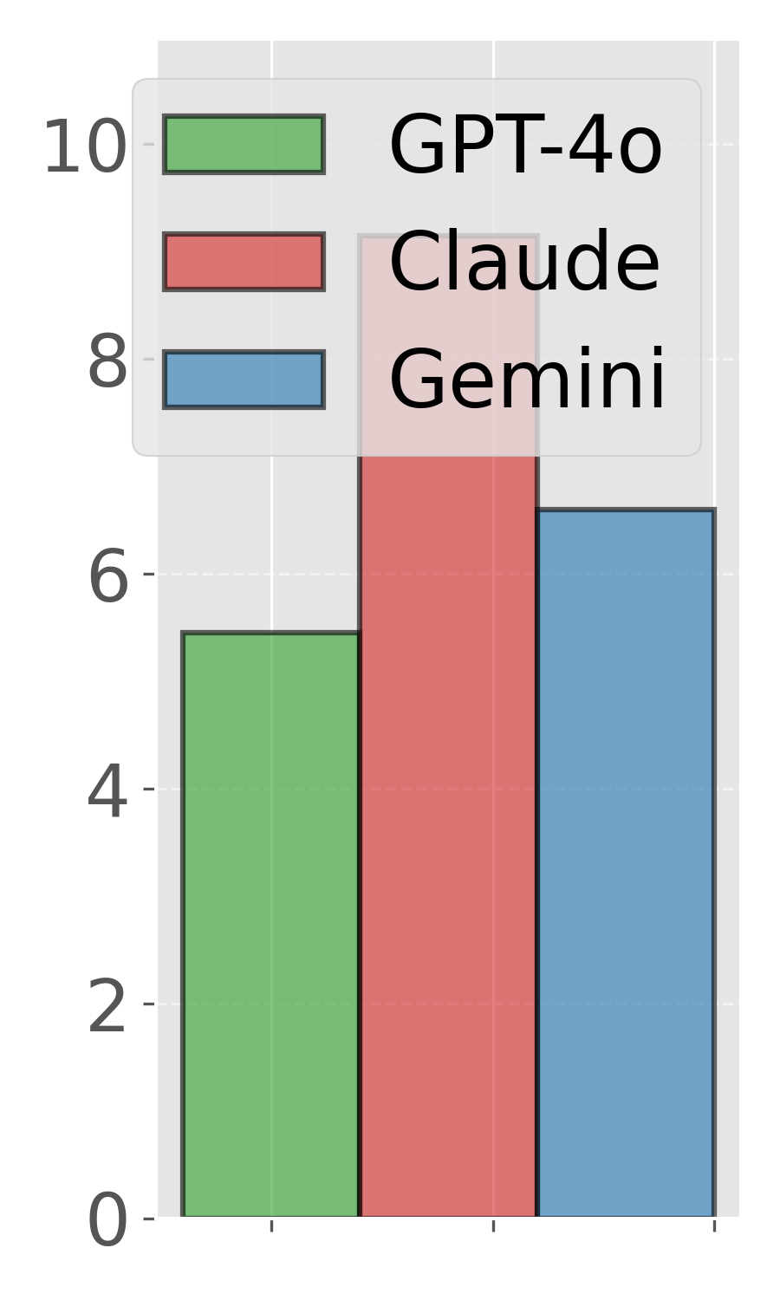
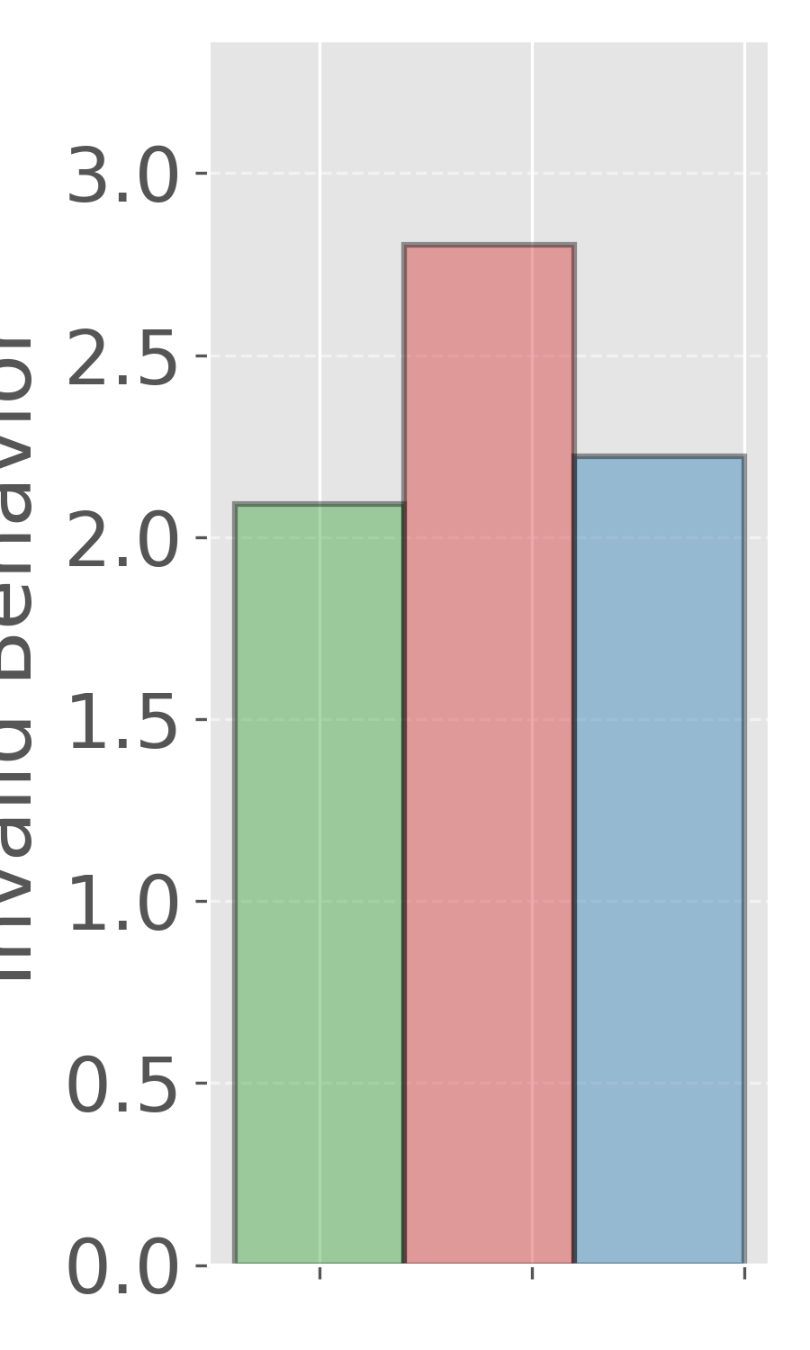
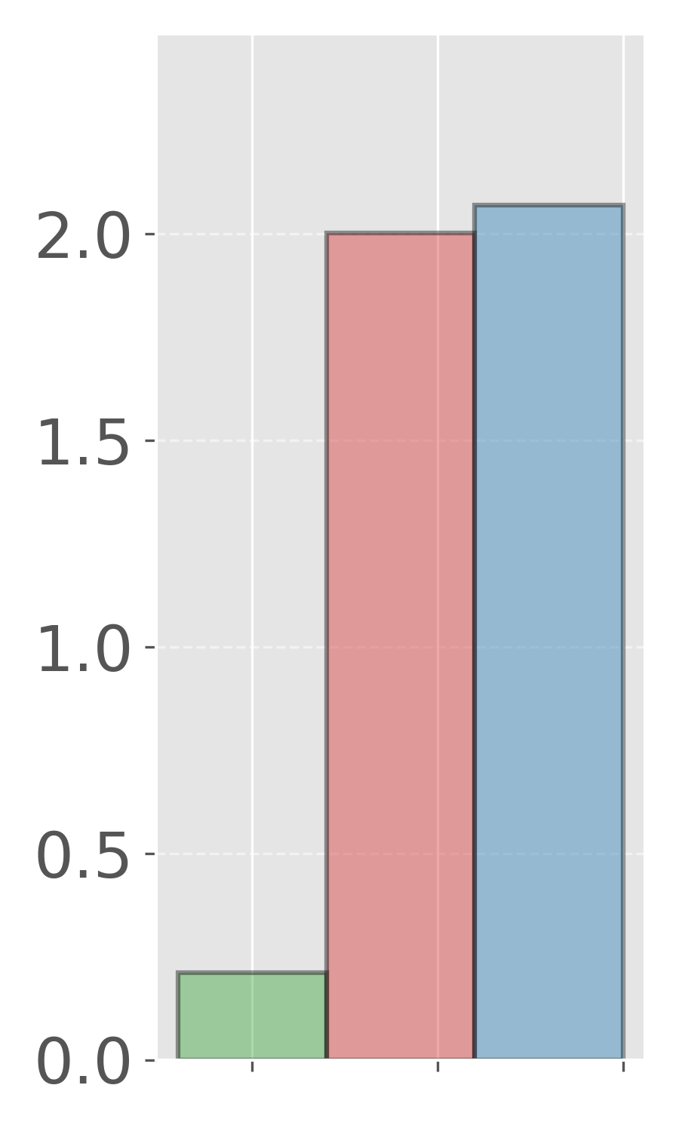
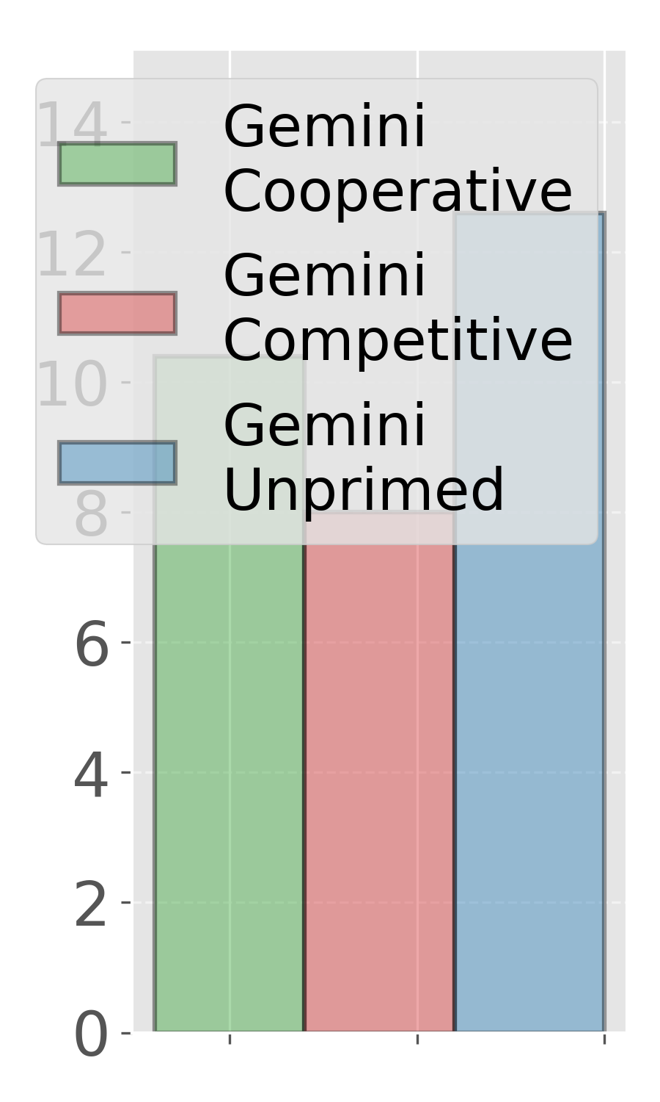
Invalid Behaviors
Proposal Rejection
Average Game Turns
Invalid Behaviors
Proposal Rejection
Average Game Turns

