Slide 1
Machine Learning Model for Video Game Sales Prediction
By: [Your Name]

Slide 2
Problem Statement
- Predict global sales for video games
- Regression problem using game attributes
- Aid budgeting, inventory, marketing strategies

Slide 3
Stakeholders & Business Use Case
- Game Publishers: Revenue forecasting, marketing
- Retailers: Inventory optimization
- Marketing Teams: Promotion strategies
- Developers: Realistic sales targets

Slide 4
Objective & Approach
- Objective: Predict video game sales
- Approach:
• Data Cleaning
• Feature Engineering
• EDA
• Modeling & Evaluation
• Feature Importance Analysis

Slide 5
Data Preparation
- ~16,700 games with 12 features
- Removed redundant sales columns
- Handled missing data and engineered features
- Encoded categorical variables

Slide 6
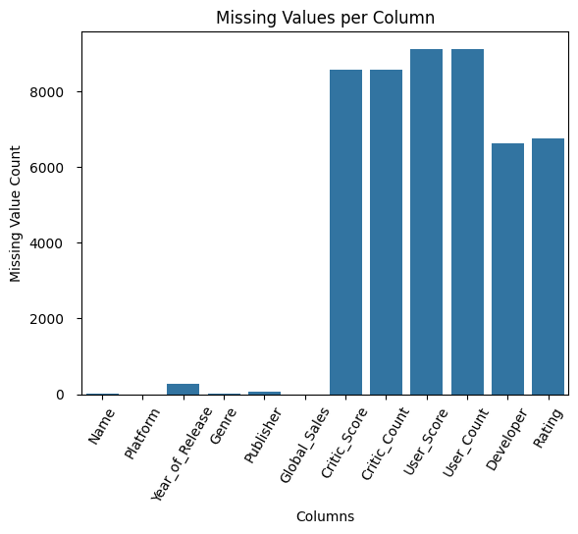
Visual Analysis 1

Slide 7
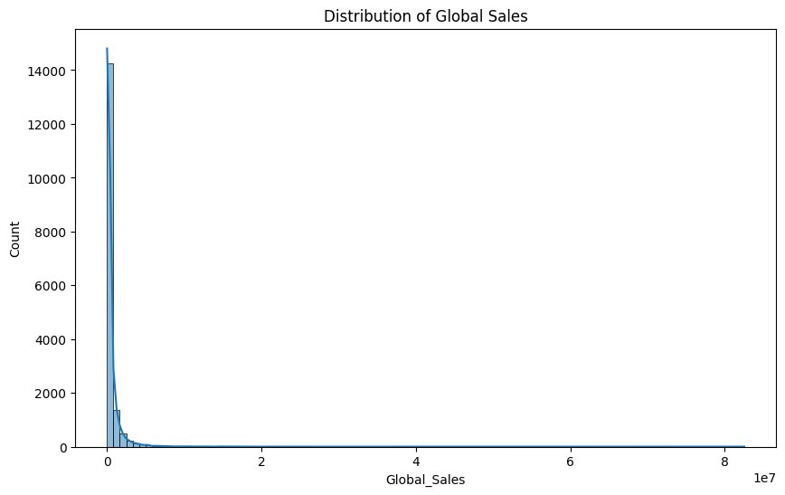
Visual Analysis 2

Slide 8
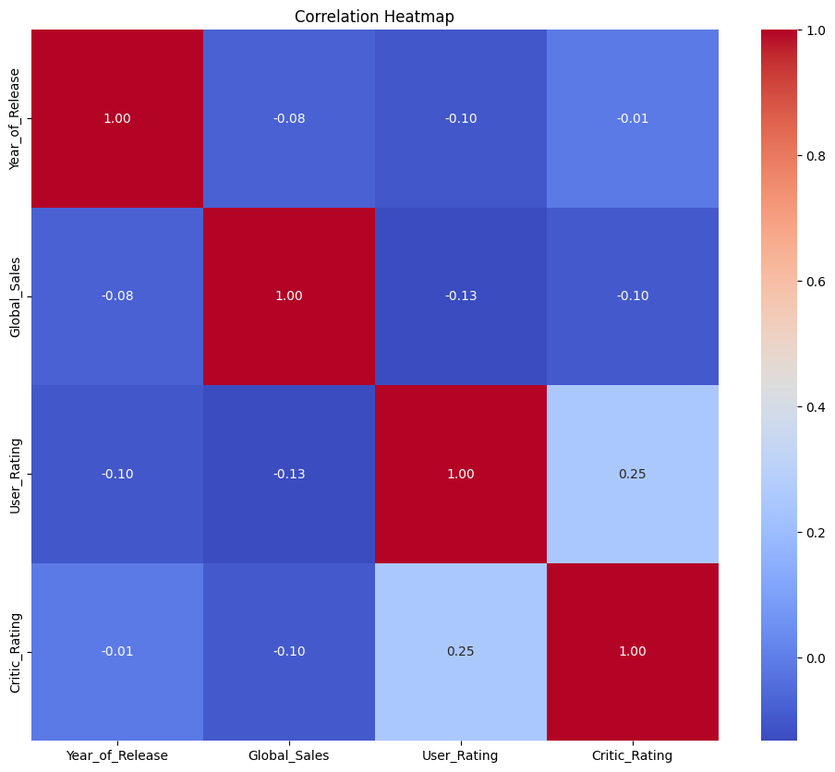
Visual Analysis 3

Slide 9
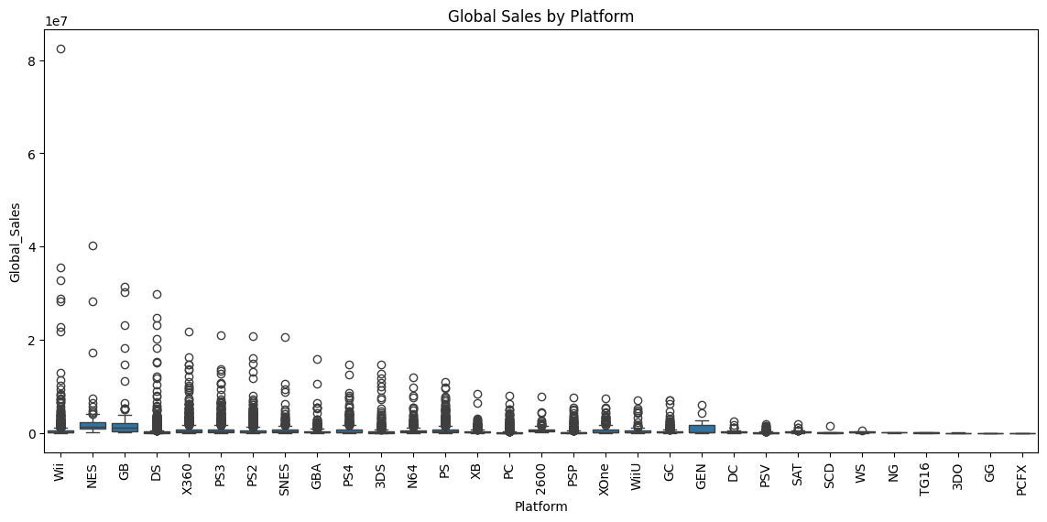
Visual Analysis 4

Slide 10
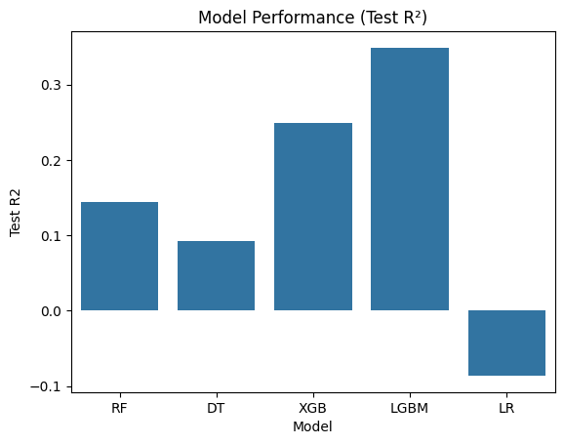
Visual Analysis 5

Slide 11
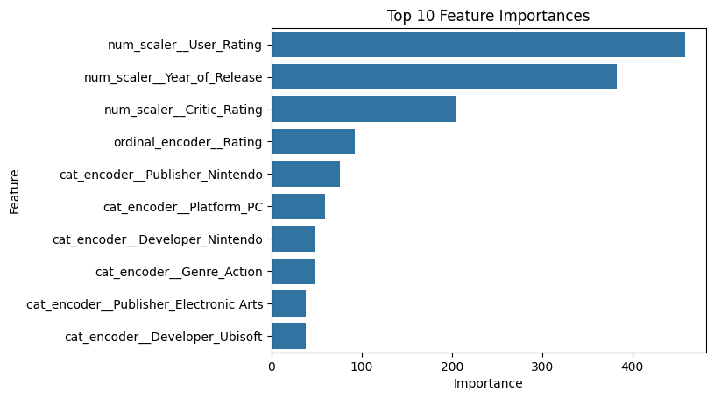
Visual Analysis 6

Slide 12
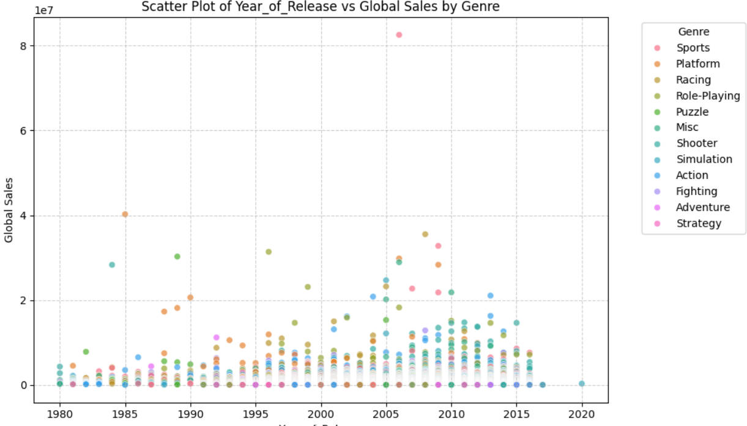
Visual Analysis 7

Slide 13
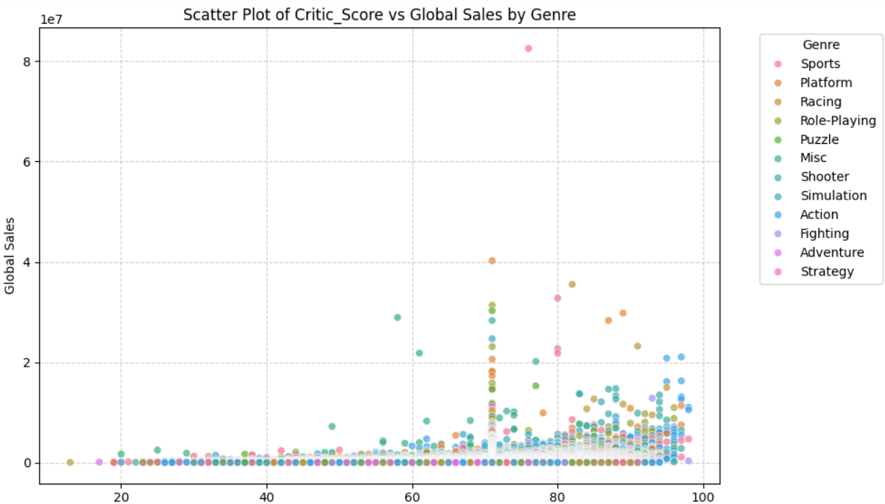
Visual Analysis 8

Slide 14
Model Performance Summary
Model | MAE | R² Score
------|-----|---------
Linear Regression | 0.78M | -0.09
Decision Tree | 0.48M | 0.09
Random Forest | 0.46M | 0.14
XGBoost | 0.40M | 0.25
LightGBM (Best) | 0.42M | 0.35

Slide 15
Feature Importance & Explainability
- Top Features:
• User Rating
• Year of Release
• Critic Rating
• ESRB Rating
• Publisher (e.g., Nintendo)
• Platform (e.g., PC)

Slide 16
Inference & Applications
- Predict future game sales
- Optimize inventory
- Budgeting & marketing planning
- Strategic portfolio management

Slide 17
References & Next Steps
- Kaggle Dataset: Video Game Sales
- Tools: Pandas, Scikit-learn, XGBoost, LightGBM
- Improvements:
• Add engagement metrics
• Deploy via API
• Regular model updates

