Slide 1
Machine Learning Model for Video Game Sales Prediction
PIYUSH GULATI

Slide 2
Problem Statement
Objective: Develop a machine learning model to accurately predict global video game sales.
Task: Address this as a regression problem, utilizing game attributes as key predictive features for global sales.
Impact: Enable better budgeting, optimize inventory management, and refine marketing strategies for the gaming industry.

Slide 3
Stakeholders & Business Use Case
Game Publishers: Utilize predictions for revenue forecasting, marketing, and setting realistic sales targets.
Retailers: Optimize inventory management based on anticipated sales figures.
Marketing Teams: Refine promotion strategies by understanding projected game performance.
Developers: Gain insights to guide production.

Slide 4
Approach
Data Cleaning (Fill missing values, Type conversion, etc)
Feature Engineering (Imputation, One-hot encoding, Standardization, Ordinal Encoder)
Exploratory data analysis (Univariate, Bivariate, Multivariate)
Modeling & Evaluation
Feature Importance Analysis

Slide 5
Data Preparation
~16,700 games with 12 features
Data Cleaning
Removed redundant sales columns
Handled missing data and engineered features
Data Type conversion
Feature Engineering
Imputation
One-hot encoding
Standardization
Ordinal Encoder

Slide 6
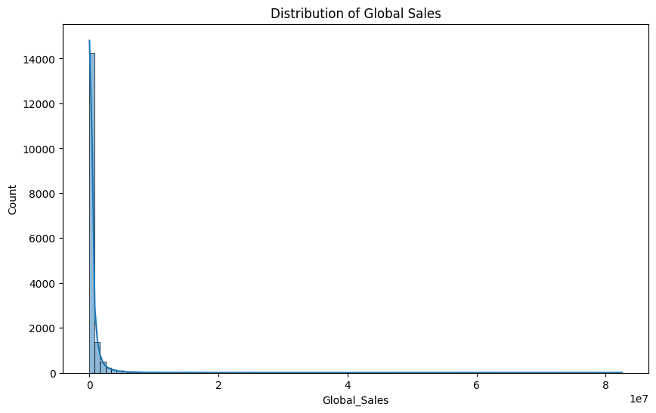
Visual 1(Univariate)

Slide 7
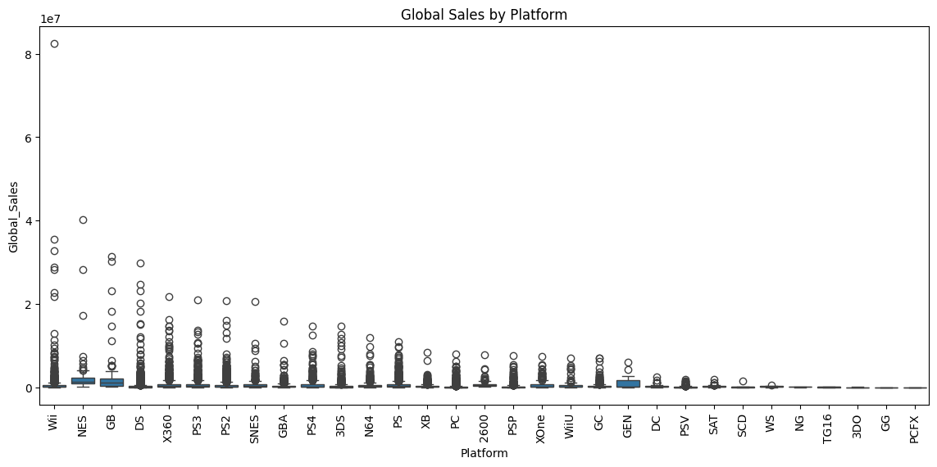
Visual 2(Bivariate)

Slide 8
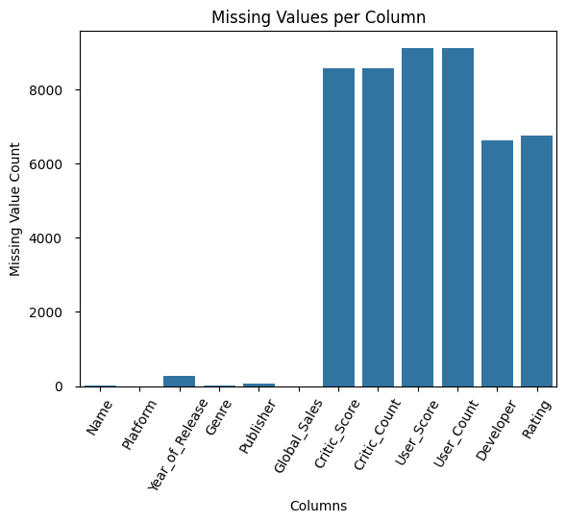
Visual 3(Multivariate)

Slide 9
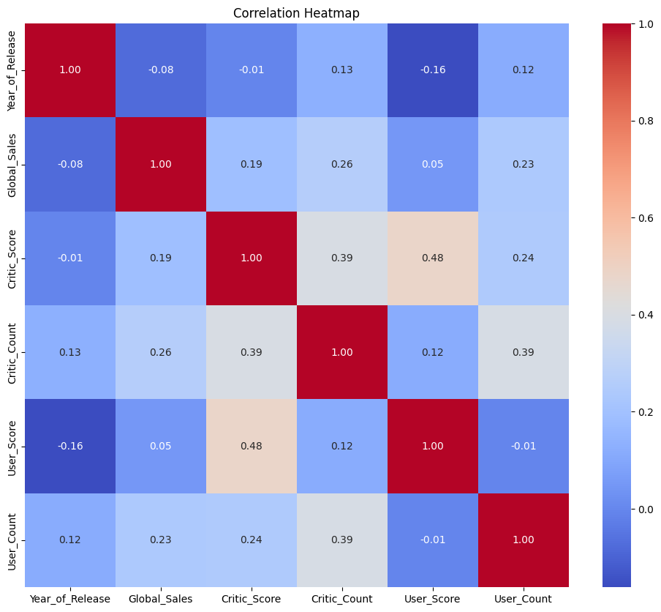
Visual 4(Multivariate)

Slide 10
Feature Importance & Explainability
Top Features:
Year of Release
User Count
Critic Score
Critic Count
User Score
ESRB Rating
Genre(Action)
Platform (PC)

Slide 11
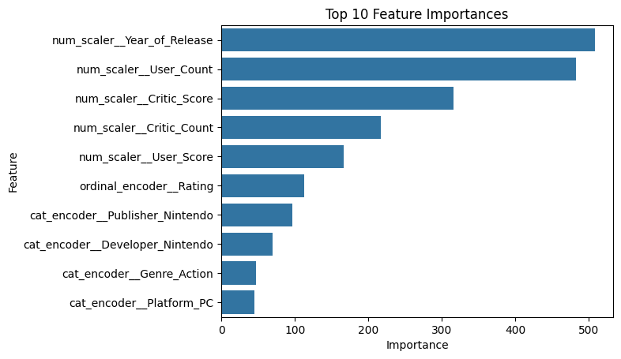
Feature Importance Analysis

Slide 12
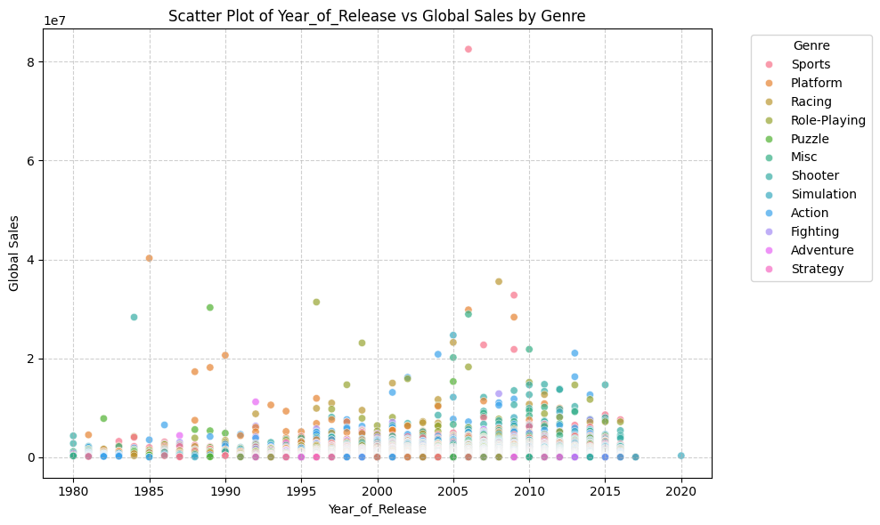
Visual Analysis 1 (Feature Importance)

Slide 13
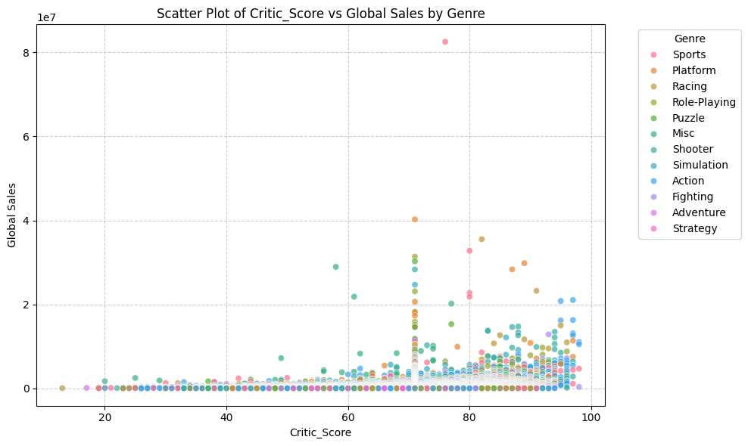
Visual Analysis 2 (Feature Importance)

Slide 14
Model Performance Summary
Model | MAE | R² Score
Linear Regression | 0.75M | -0.07
Decision Tree | 0.47M | 0.08
Random Forest | 0.45M | 0.14
XGBoost | 0.40M | 0.30
LightGBM (Best) | 0.42M | 0.35

Slide 15
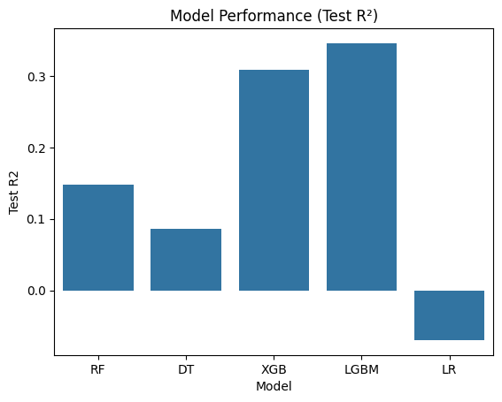
Evaluation

Slide 16
Inference & Applications
Sales Forecasting: Accurately predict future video game sales for better planning.
Inventory Optimization: Minimize overstocking and stockouts based on sales predictions.
Budgeting and Marketing: Develop targeted budgets and marketing campaigns using sales insights.
Strategic Portfolio Decisions: Guide game portfolio management and investment based on projected performance.

Slide 17
References & Improvements
Kaggle Dataset: Video Game Sales https://www.kaggle.com/datasets/gregorut/videogamesales/data
Tools: Pandas, Scikit-learn, XGBoost, LightGBM
GitHub Repo: https://github.com/Trader-Markets/Video_Games_Sales/tree/main
Improvements:
Using additional feature engineering techniques to further optimize the dataset for better results
Add engagement metrics
Deploy via API
Regular model updates

