Slide 1

DC Motors
Digital Experience
Customer website +
workshop management
26 October 2026
Product introduction for DC Motors Ltd
01
Notes:
Introduce the proposal as a connected customer website and workshop workspace. The deck shows the current prototype and the business workflow it is designed to support. This is a product prototype. Calendar and message workflows run locally in the browser. A production release needs a backend, authentication and configured service connections. No live WhatsApp messages or payments have been sent. Cover image: Unsplash, https://images.unsplash.com/photo-1503376780353-7e6692767b70. Concept automotive photography, not a DC Motors vehicle or completed project.

Slide 2
Website and workshop, working together
One customer enquiry can stay connected
through the whole visit
01
02
03
04
Discover
Request
Agree
Manage
Clear services and
a direct enquiry path
A calendar slot with
vehicle details attached
Staff approval or
a suggested time
Workshop work and
customer history
Product prototype
02
Notes:
Frame the product as a continuous business journey rather than two separate software demonstrations. Customers discover services and request visits. Staff review the request, agree a slot and carry the record through workshop work. Intended benefits are qualitative, not measured financial results. Source components: Prototype/app/website/CustomerWebsite.jsx, Prototype/app/page.jsx, Prototype/components/AdminFeatures.jsx, Prototype/lib/business.js and Prototype/lib/scheduling.js. This is a product prototype. Calendar and message workflows run locally in the browser. A production release needs a backend, authentication and configured service connections. No live WhatsApp messages or payments have been sent.

Slide 3
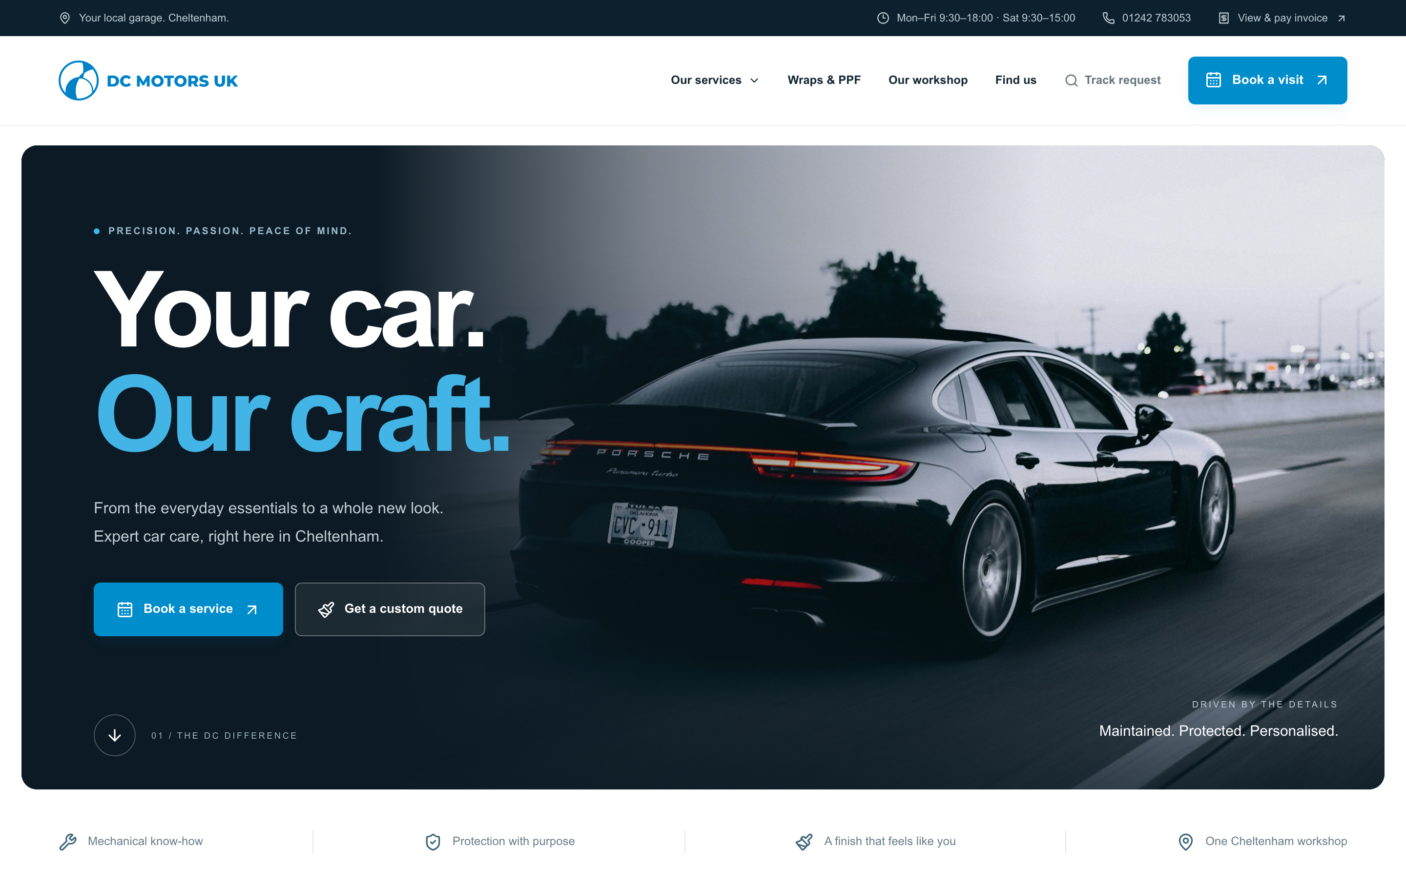
A stronger first impression
Clear service routes
Customers can find the work they need and choose a relevant next step.
Direct actions
Booking, quote enquiries and contact options stay visible.
Product prototype
03
Notes:
Screenshots: local DC Motors website and admin prototype, captured 26 October 2026. All customer records and prices are fictional demonstration data. Screens use prepared local demo states. The redesigned homepage presents the DC Motors brand, vehicle care and customisation offering. Point out the clear service and quote actions. Brand animation and responsive motion can be demonstrated live, while this slide contains a still screenshot. Existing website imagery is stock concept photography and does not depict the client workshop. Source components: Prototype/app/website/CustomerWebsite.jsx, Prototype/app/page.jsx, Prototype/components/AdminFeatures.jsx, Prototype/lib/business.js and Prototype/lib/scheduling.js.

Slide 4
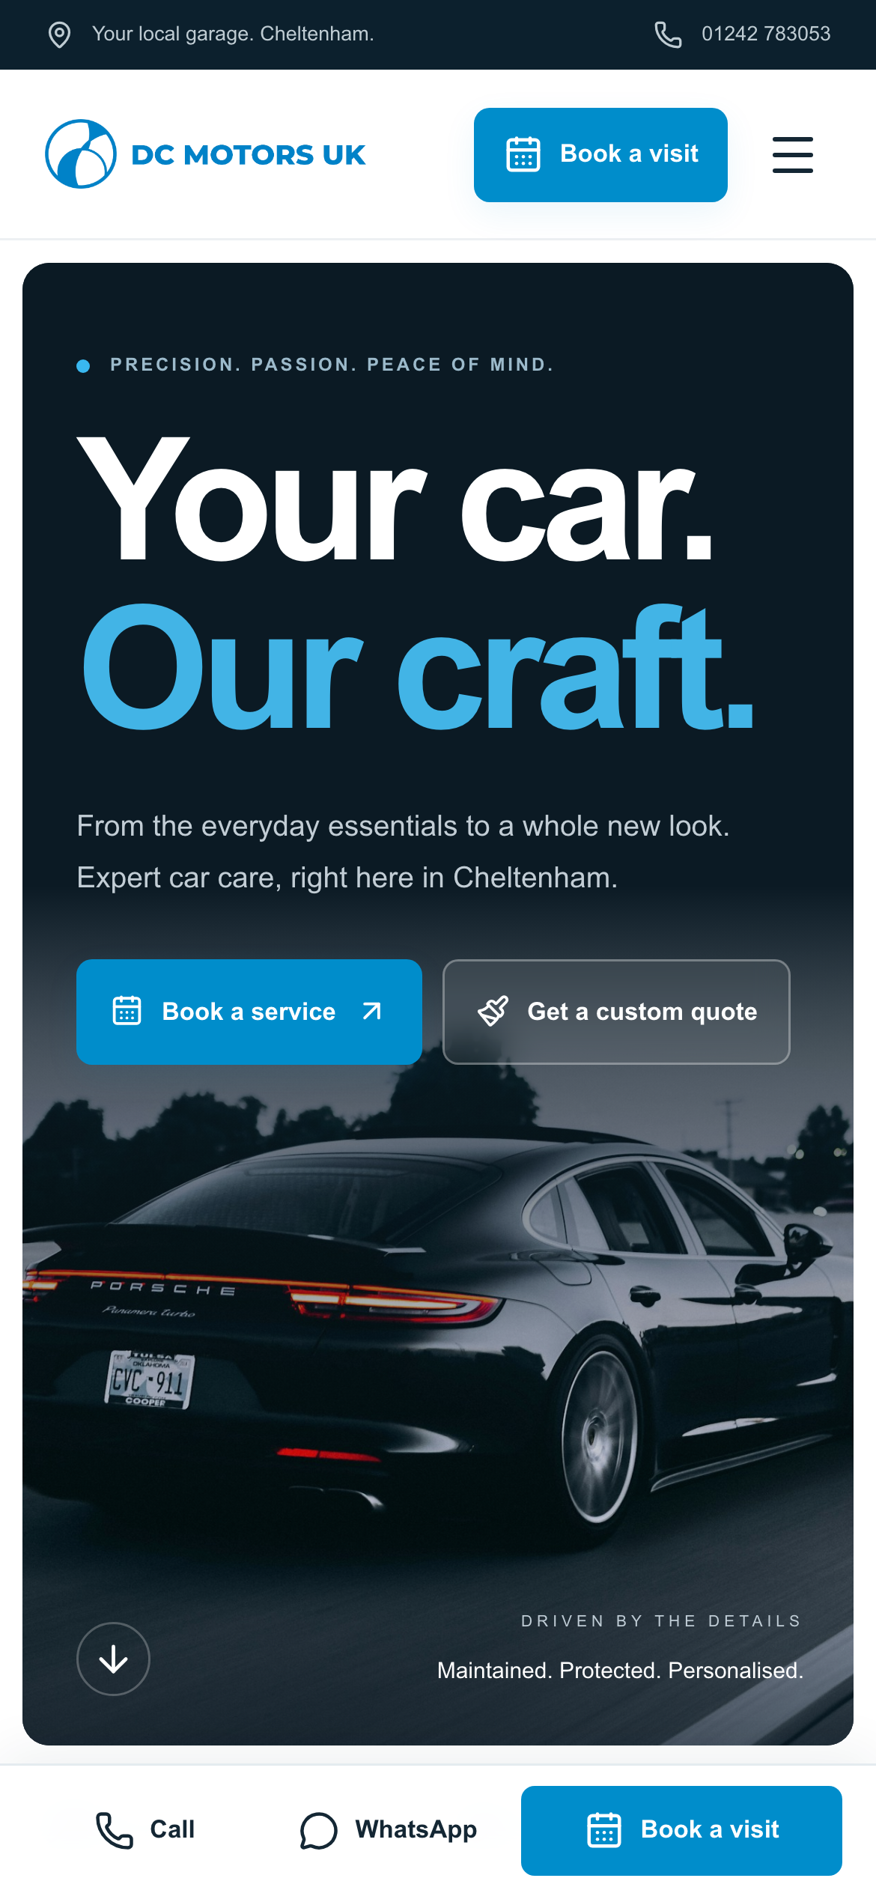
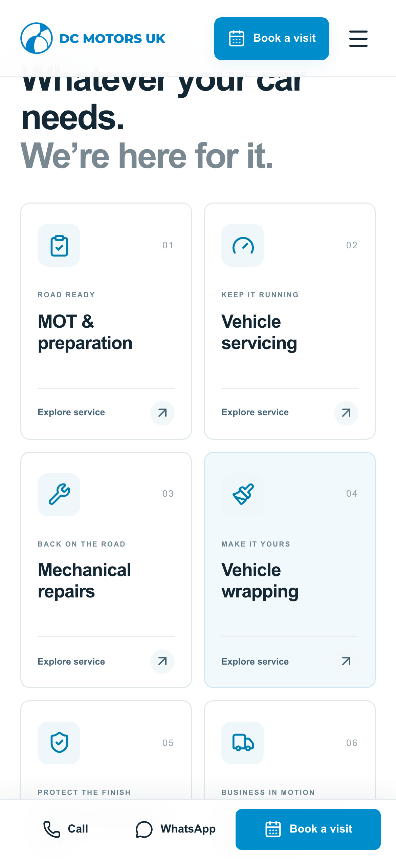
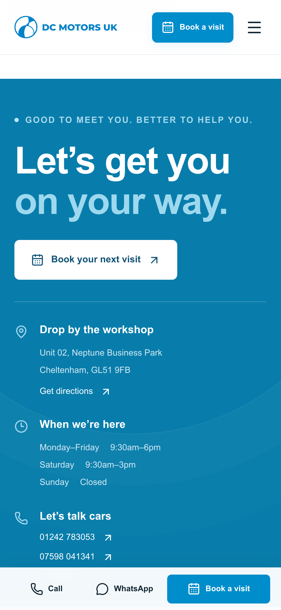
Designed for customers on their phone
The key actions remain
within easy reach
Explore the services.
Request a visit.
Contact the workshop.
Homepage
Services
Contact
Product prototype
04
Notes:
Screenshots: local DC Motors website and admin prototype, captured 26 October 2026. All customer records and prices are fictional demonstration data. Screens use prepared local demo states. These are real mobile viewport captures of the homepage, service categories and contact section. Explain the persistent call, WhatsApp and booking actions. The contact actions link to existing services. The deck makes no claim that every visitor uses mobile or that conversion has already increased. Source components: Prototype/app/website/CustomerWebsite.jsx, Prototype/app/page.jsx, Prototype/components/AdminFeatures.jsx, Prototype/lib/business.js and Prototype/lib/scheduling.js.

Slide 5
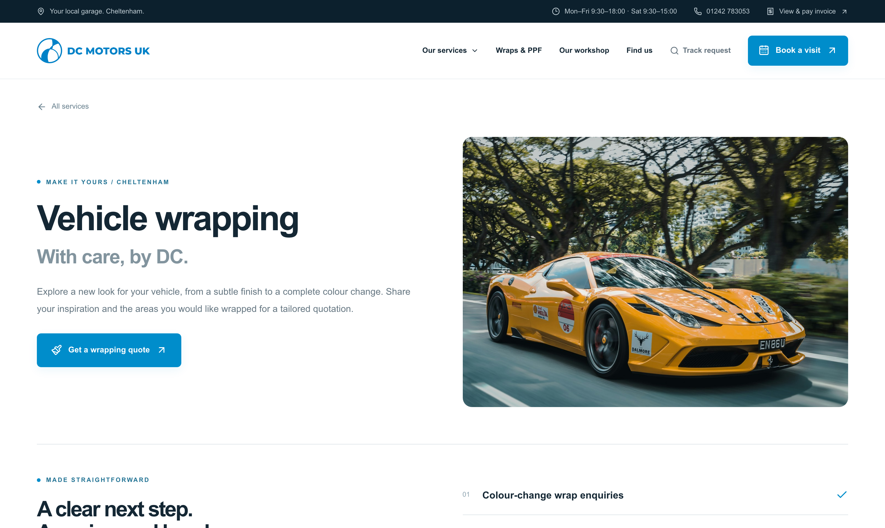
Services that are easy to explore
Every service has a place
Dedicated pages explain the next step for routine care and custom work.
Existing services stay connected
Used cars, invoice payment and contact links retain their roles.
Product prototype
05
Notes:
Screenshots: local DC Motors website and admin prototype, captured 26 October 2026. All customer records and prices are fictional demonstration data. Screens use prepared local demo states. The public experience covers MOT and preparation, servicing, mechanical repairs, wrapping, paint protection film and fleet branding. The selected screenshot shows the wrapping service page. Customers can request a consultation or submit a quote-only enquiry. Links to the existing used-car sales site, billing, maps, telephone and WhatsApp remain available. Source components: Prototype/app/website/CustomerWebsite.jsx, Prototype/app/page.jsx, Prototype/components/AdminFeatures.jsx, Prototype/lib/business.js and Prototype/lib/scheduling.js.

Slide 6
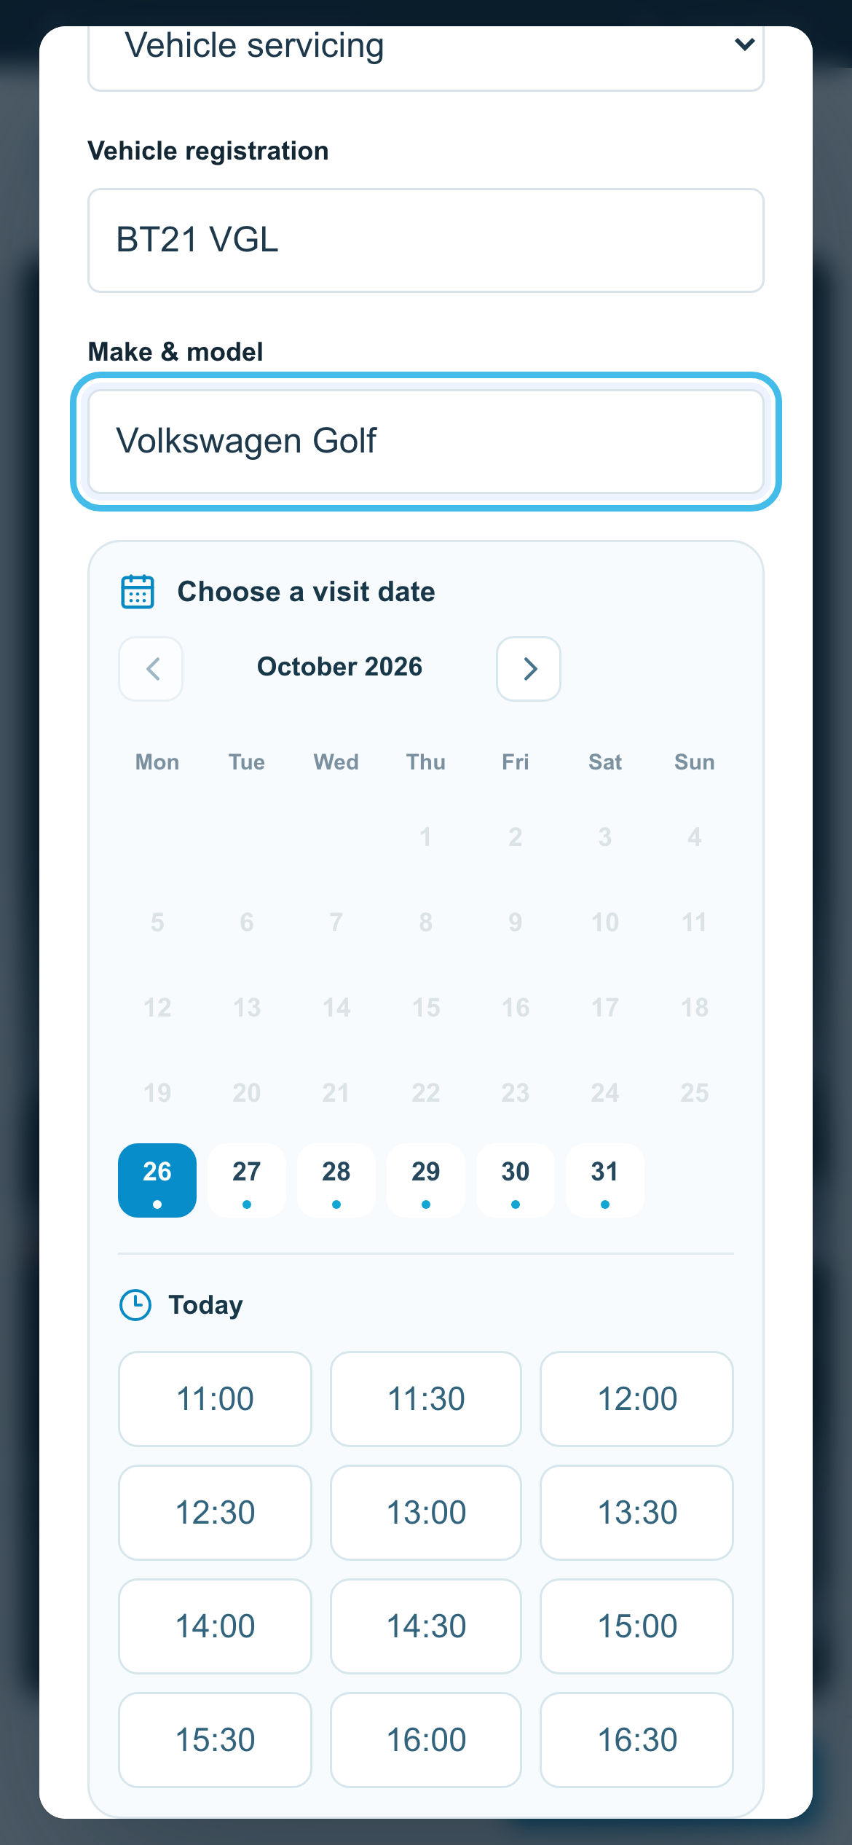
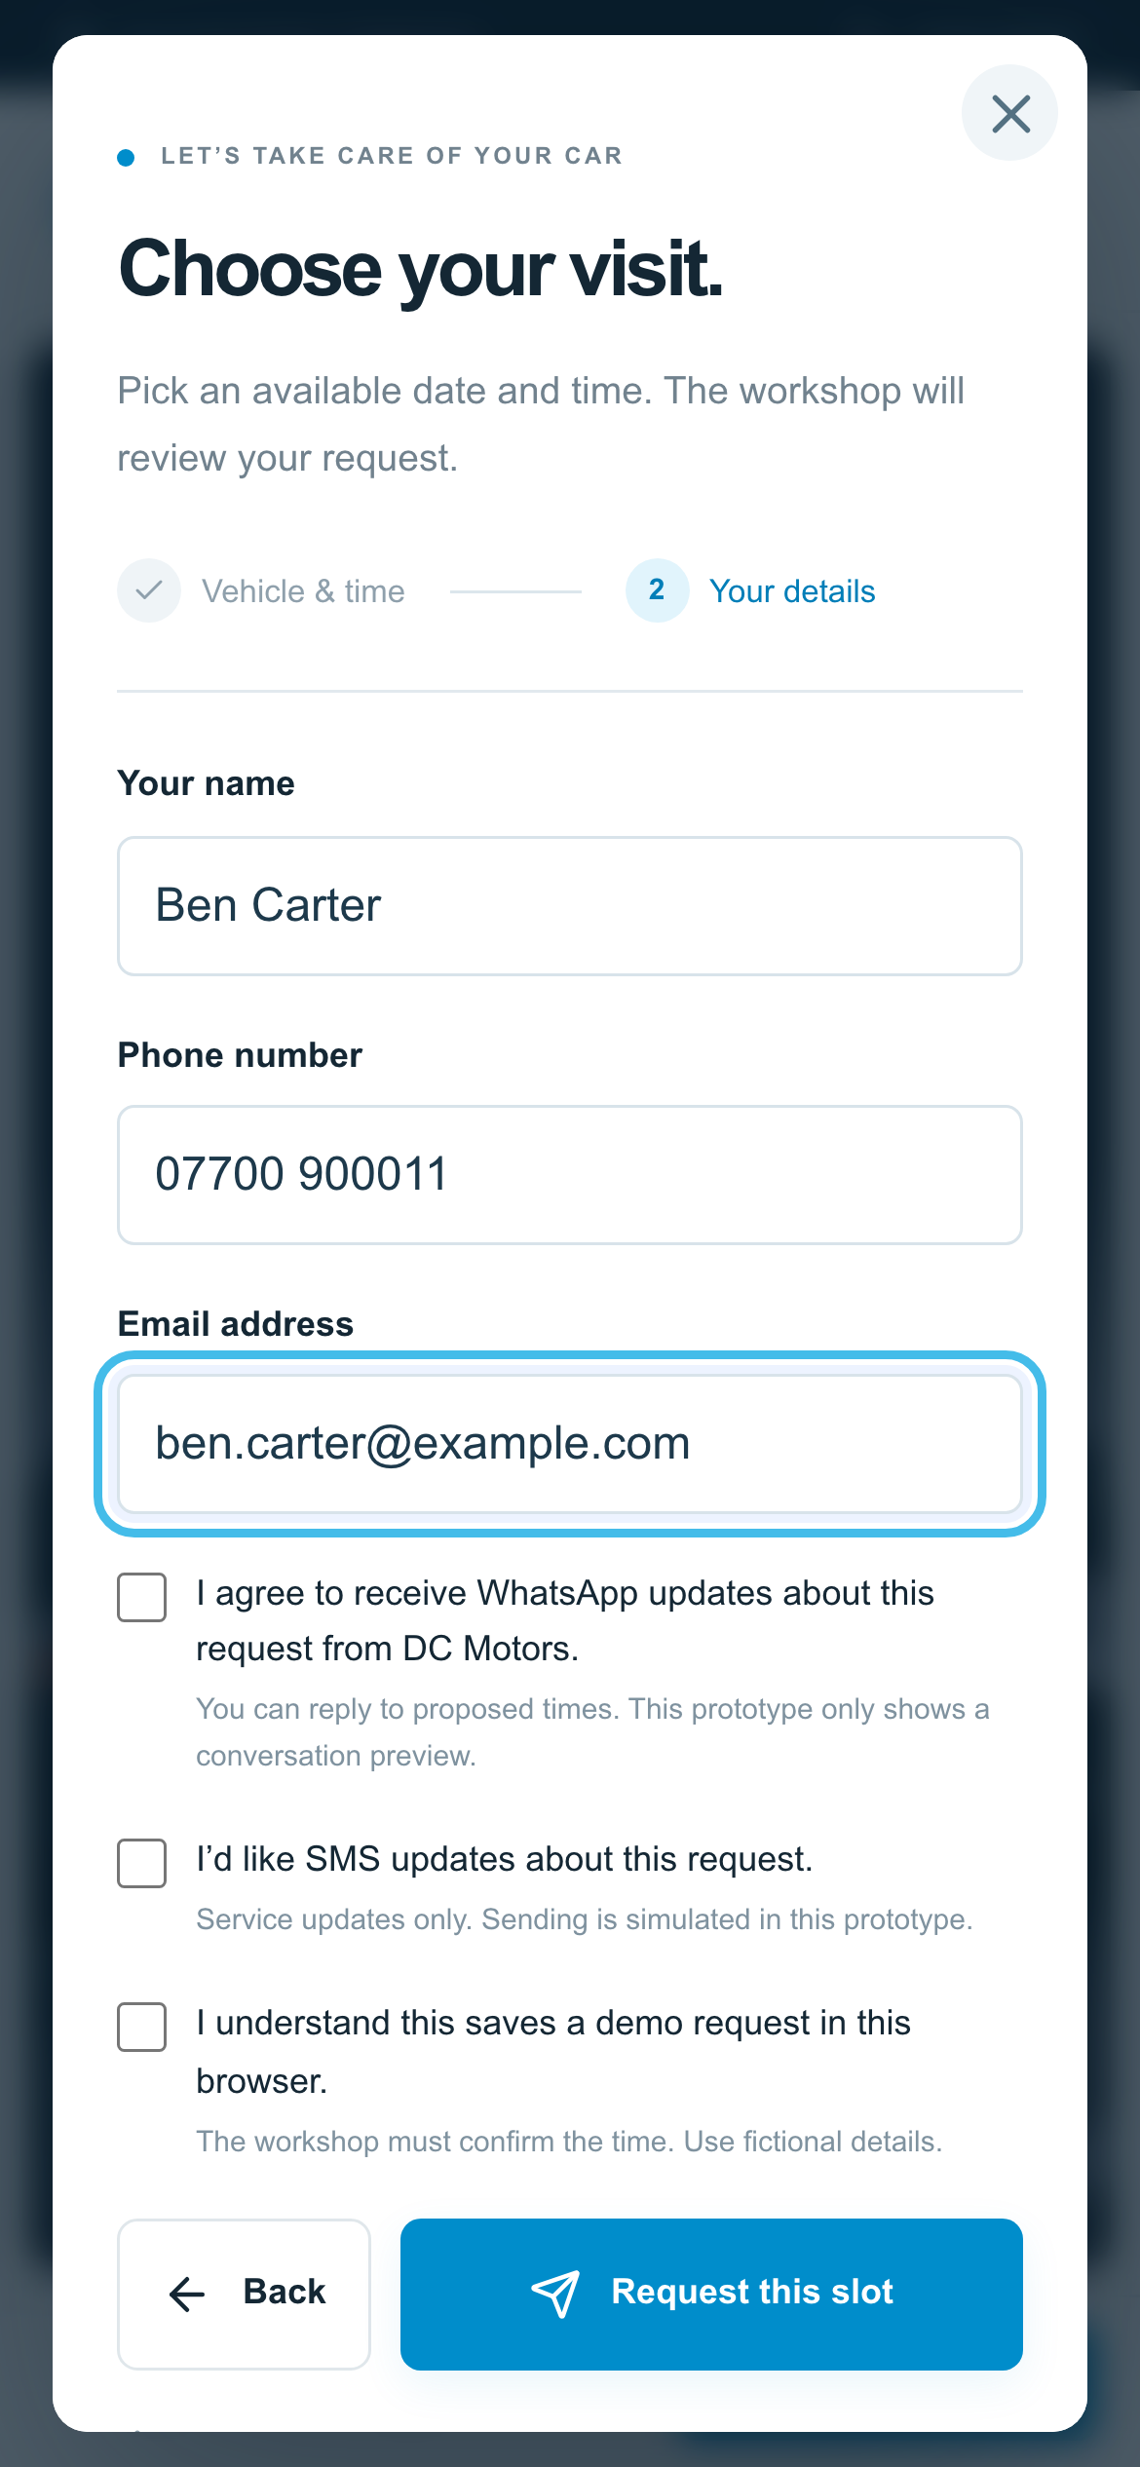
Calendar booking on mobile
Choose an available time
The calendar reflects the workshop’s scheduling rules.
Share the details once
The request carries the vehicle and contact information into admin.
Staff confirm the appointment
Date & time
Customer details
Product prototype
06
Notes:
Screenshots: local DC Motors website and admin prototype, captured 26 October 2026. All customer records and prices are fictional demonstration data. Screens use prepared local demo states. The website calendar shows available times after accounting for workshop hours, visit duration, bay and technician capacity, and provisional requests. The customer selects a time and shares vehicle and contact information. The slot is a request until workshop approval. Quote categories can request a consultation without committing to a project price, or submit an enquiry without a visit. Source components: Prototype/app/website/CustomerWebsite.jsx, Prototype/app/page.jsx, Prototype/components/AdminFeatures.jsx, Prototype/lib/business.js and Prototype/lib/scheduling.js.

Slide 7
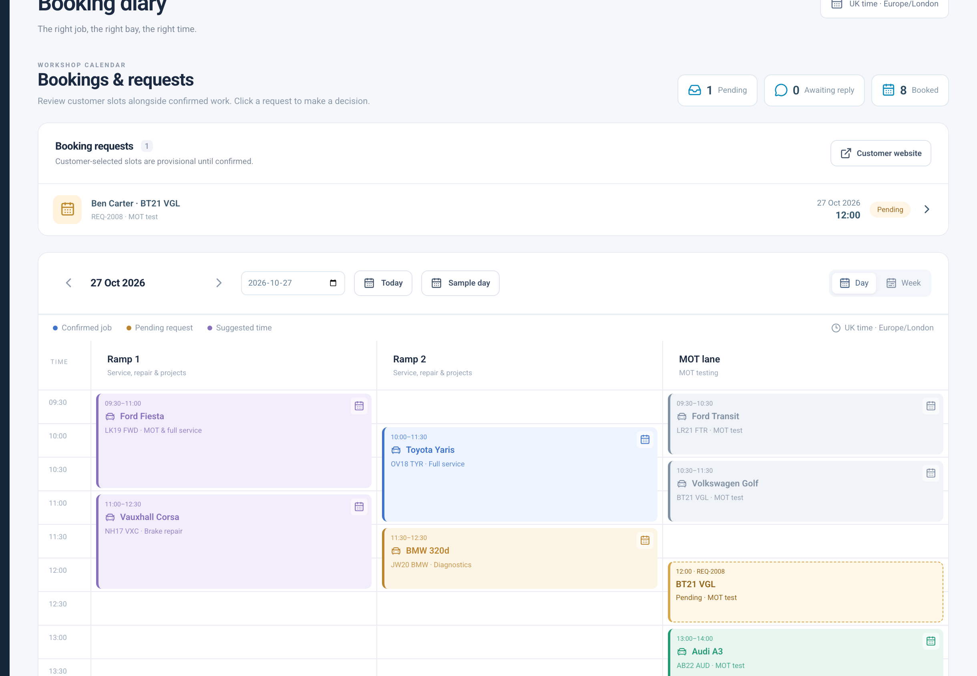
A calendar that keeps staff in control
One scheduling view
Customer requests appear beside work already booked.
Staff make the decision
Confirm, decline or agree another time before the visit.
Product prototype
07
Notes:
Screenshots: local DC Motors website and admin prototype, captured 26 October 2026. All customer records and prices are fictional demonstration data. Screens use prepared local demo states. The admin application opens to the diary. Pending requests, confirmed appointments and proposed times use distinct visual states. Staff can open a request to accept it, decline it or suggest another slot. Staff can also create and reschedule bookings. Opening hours and resources are prototype rules, not an integration with an external calendar. Source components: Prototype/app/website/CustomerWebsite.jsx, Prototype/app/page.jsx, Prototype/components/AdminFeatures.jsx, Prototype/lib/business.js and Prototype/lib/scheduling.js.

Slide 8
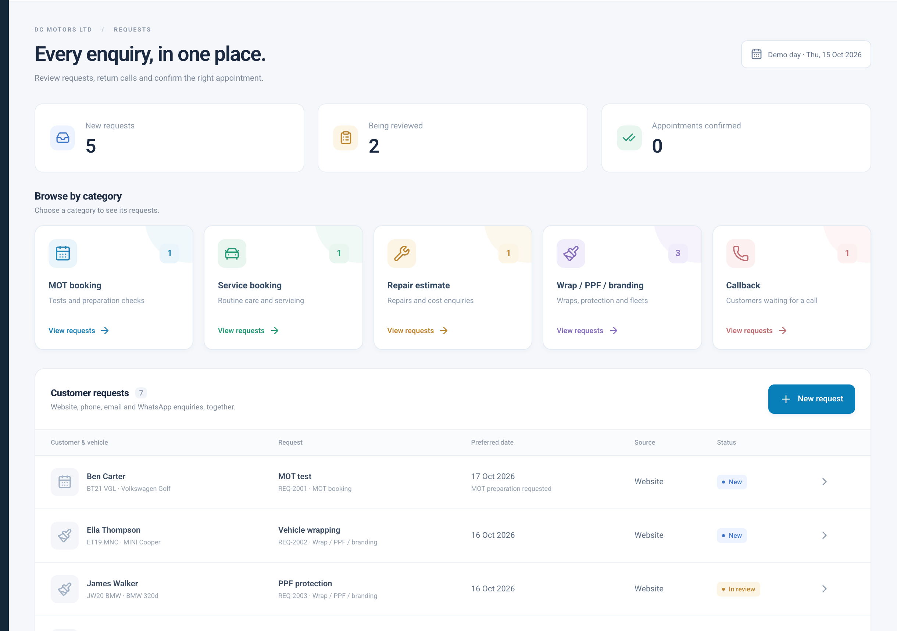
Every enquiry has a clear next step
Categories help staff
find the right enquiry
Each request retains the
customer, vehicle, source
and decision history.
Product prototype
08
Notes:
Screenshots: local DC Motors website and admin prototype, captured 26 October 2026. All customer records and prices are fictional demonstration data. Screens use prepared local demo states. The Requests inbox groups MOT, service, repair estimate, wrapping/PPF/branding and callback enquiries. Source and request status help staff understand what needs attention. Selecting a category filters the request list. The website feeds this local inbox; other channels can be recorded manually in the prototype. This is not a claim of live omnichannel ingestion. Source components: Prototype/app/website/CustomerWebsite.jsx, Prototype/app/page.jsx, Prototype/components/AdminFeatures.jsx, Prototype/lib/business.js and Prototype/lib/scheduling.js.

Slide 9
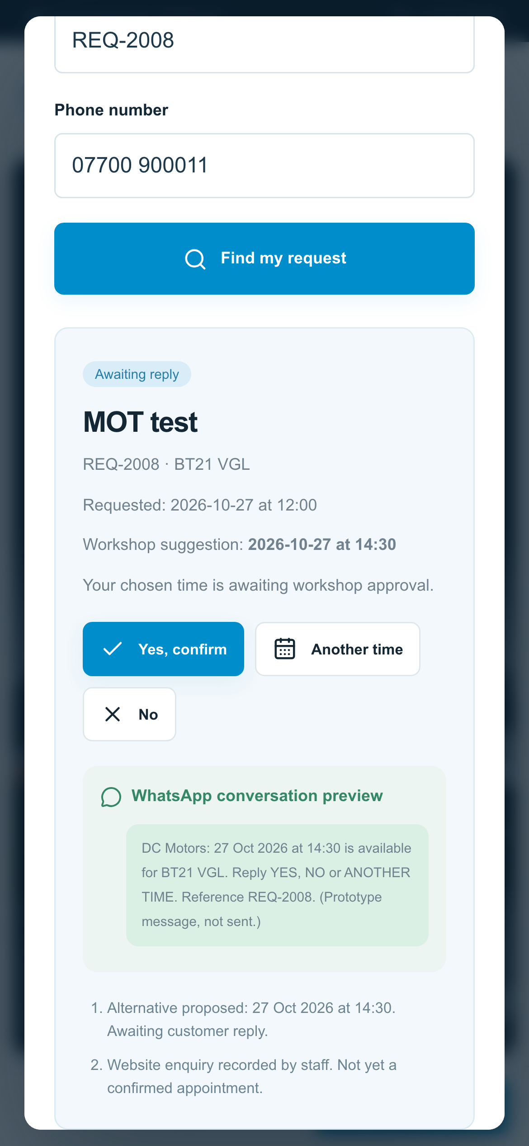
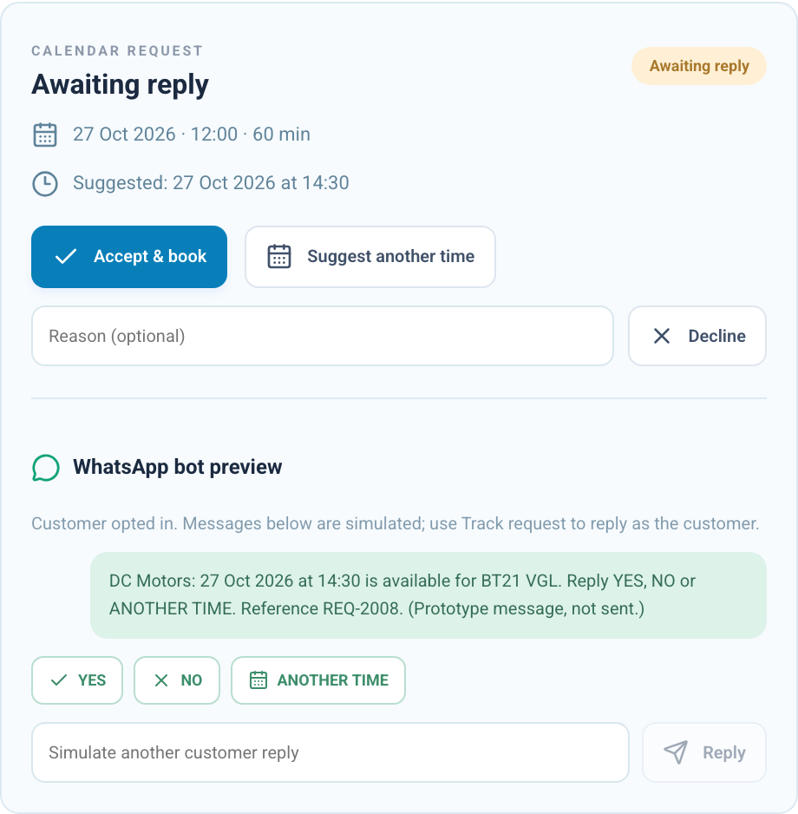
A better way to agree a new time
Staff suggests a slot.
The customer can reply.
Available alternatives stay connected
to the same request. Staff can step in
when a reply needs attention.
WhatsApp conversation shown in simulation. Live delivery requires the company’s API connection.
09
Notes:
Screenshots: local DC Motors website and admin prototype, captured 26 October 2026. All customer records and prices are fictional demonstration data. Screens use prepared local demo states. This slide shows the WhatsApp bot conversation simulator in the admin request detail and the corresponding customer tracking view. The flow supports YES, NO, ANOTHER TIME, numbered time options, common phrases and staff follow-up for unclear replies. The system rechecks availability before confirmation. Actual WhatsApp delivery needs the company Business Platform connection, approved templates where required and a server-side webhook. The customer reference/phone lookup is only a local demonstration. Source components: Prototype/app/website/CustomerWebsite.jsx, Prototype/app/page.jsx, Prototype/components/AdminFeatures.jsx, Prototype/lib/business.js and Prototype/lib/scheduling.js. This is a product prototype. Calendar and message workflows run locally in the browser. A production release needs a backend, authentication and configured service connections. No live WhatsApp messages or payments have been sent.

Slide 10
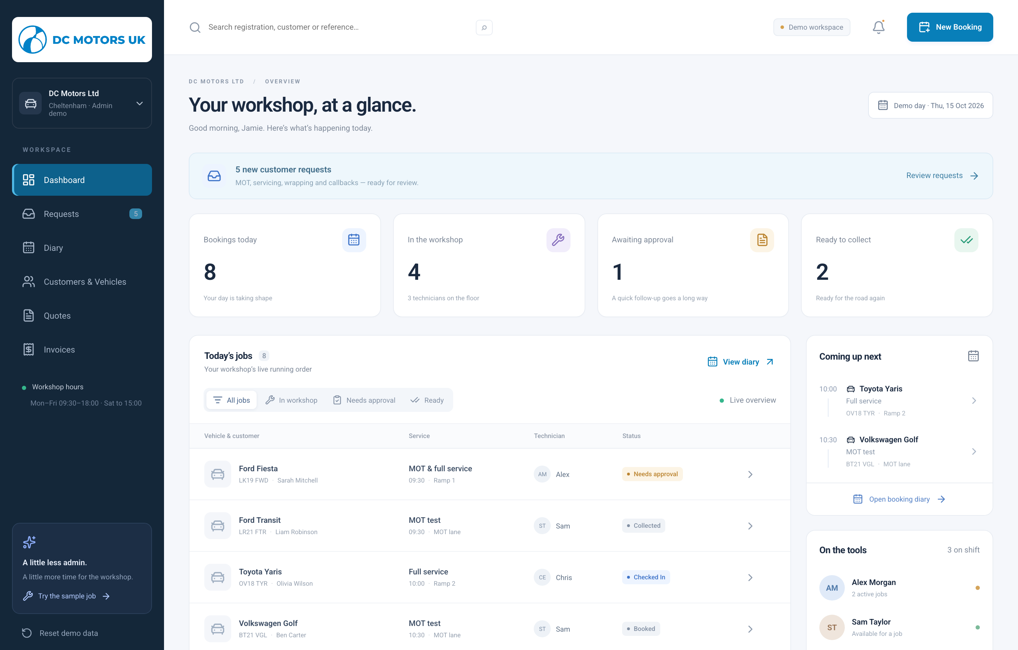
The workshop, at a glance
Attention where it matters
The team can see approvals, collection status and balances.
Quick access to the work
Open a job, review an enquiry or move into the diary.
Product prototype
10
Notes:
Screenshots: local DC Motors website and admin prototype, captured 26 October 2026. All customer records and prices are fictional demonstration data. Screens use prepared local demo states. The dashboard brings daily bookings, work in progress, pending repair approvals, ready vehicles and outstanding invoices into one overview. Discuss the decisions the team can make from this screen, without claiming automatic business results. The demo day and figures in the screenshot are sample data. Source components: Prototype/app/website/CustomerWebsite.jsx, Prototype/app/page.jsx, Prototype/components/AdminFeatures.jsx, Prototype/lib/business.js and Prototype/lib/scheduling.js.

Slide 11
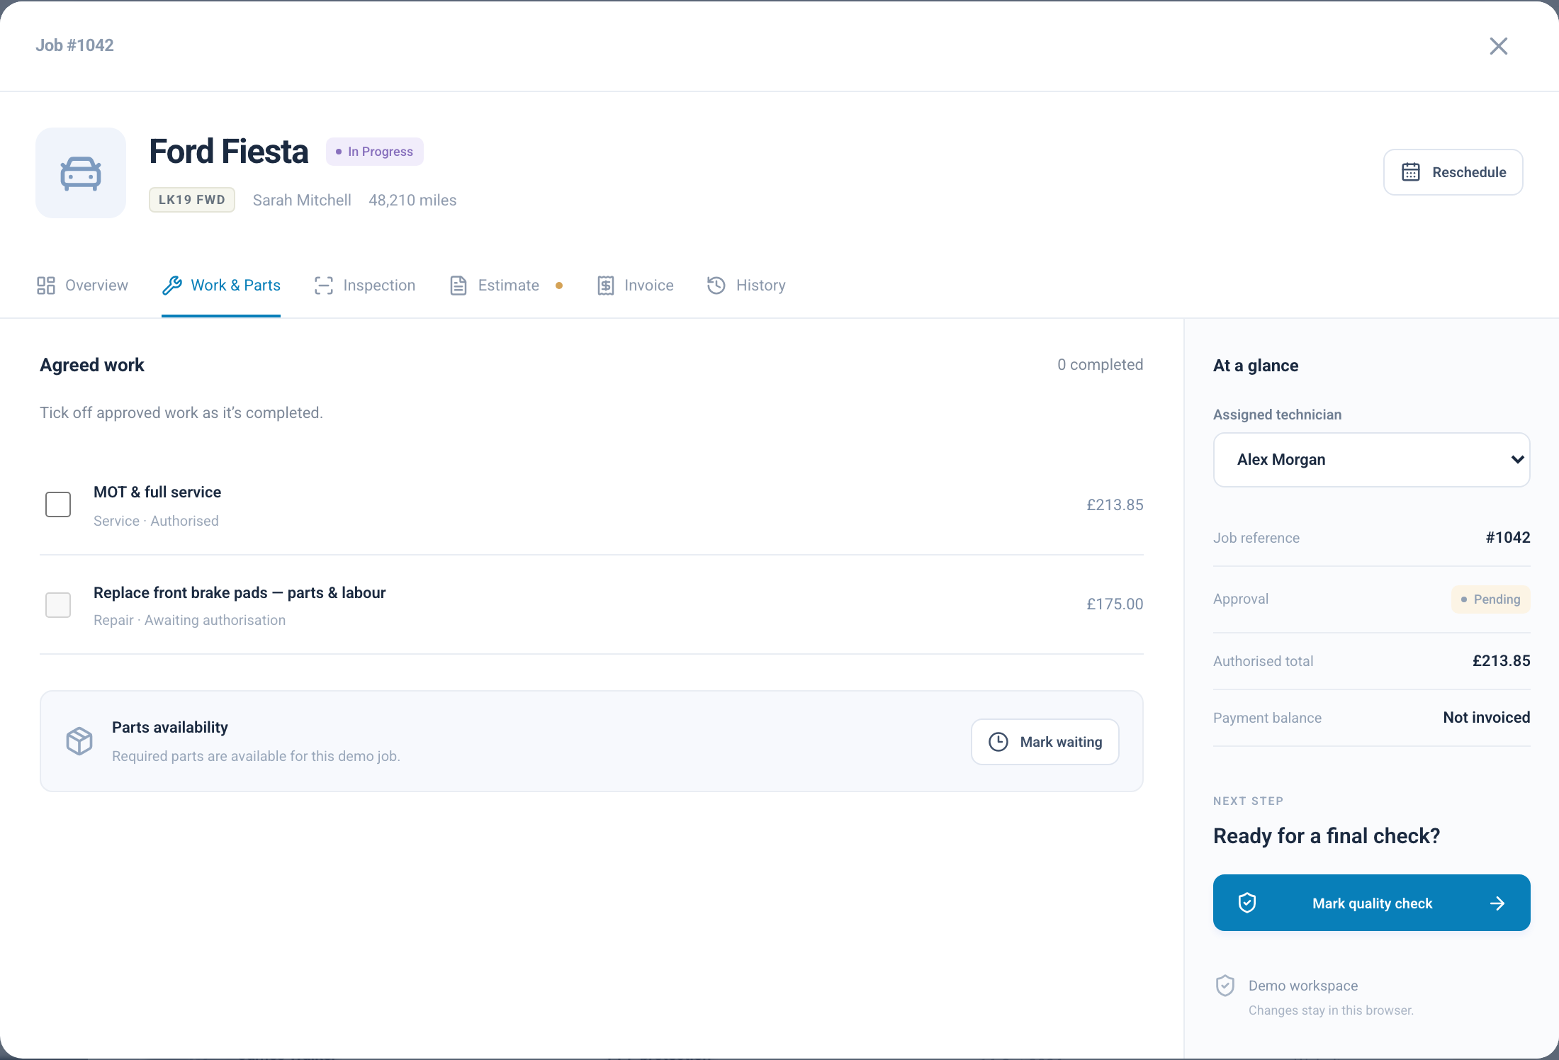
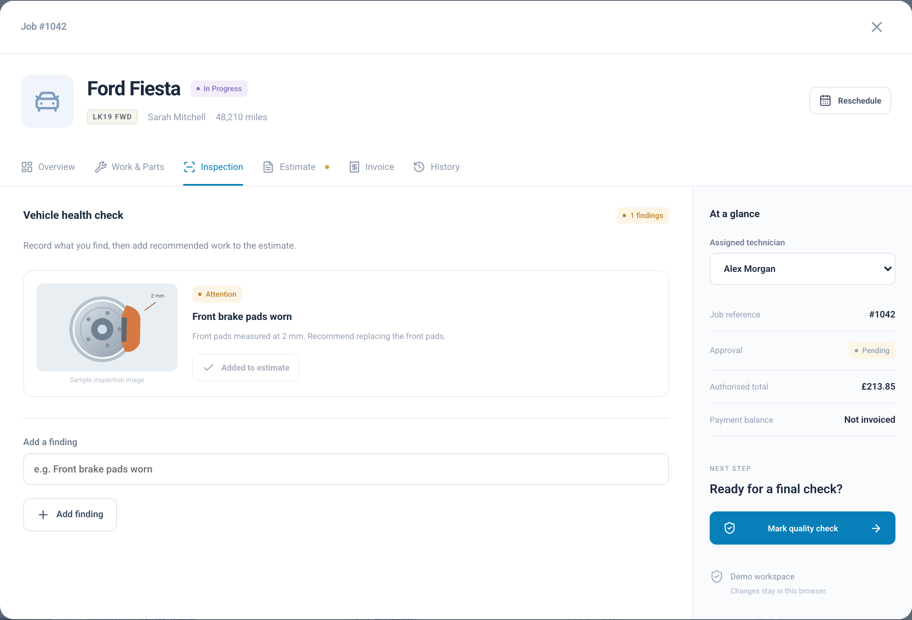
The job stays connected
Work & parts
Inspection findings
The team sees the tasks and parts linked to the visit
Findings remain attached to the same job record
Product prototype
11
Notes:
Screenshots: local DC Motors website and admin prototype, captured 26 October 2026. All customer records and prices are fictional demonstration data. Screens use prepared local demo states. The workshop job workspace includes work and parts, technician notes, inspection findings, estimates, invoices and history. The selected captures show the work/parts view and an inspection finding. Some progress steps require prerequisite tasks or approvals to be resolved. Inspection illustrations and records are simulated. Source components: Prototype/app/website/CustomerWebsite.jsx, Prototype/app/page.jsx, Prototype/components/AdminFeatures.jsx, Prototype/lib/business.js and Prototype/lib/scheduling.js.

Slide 12
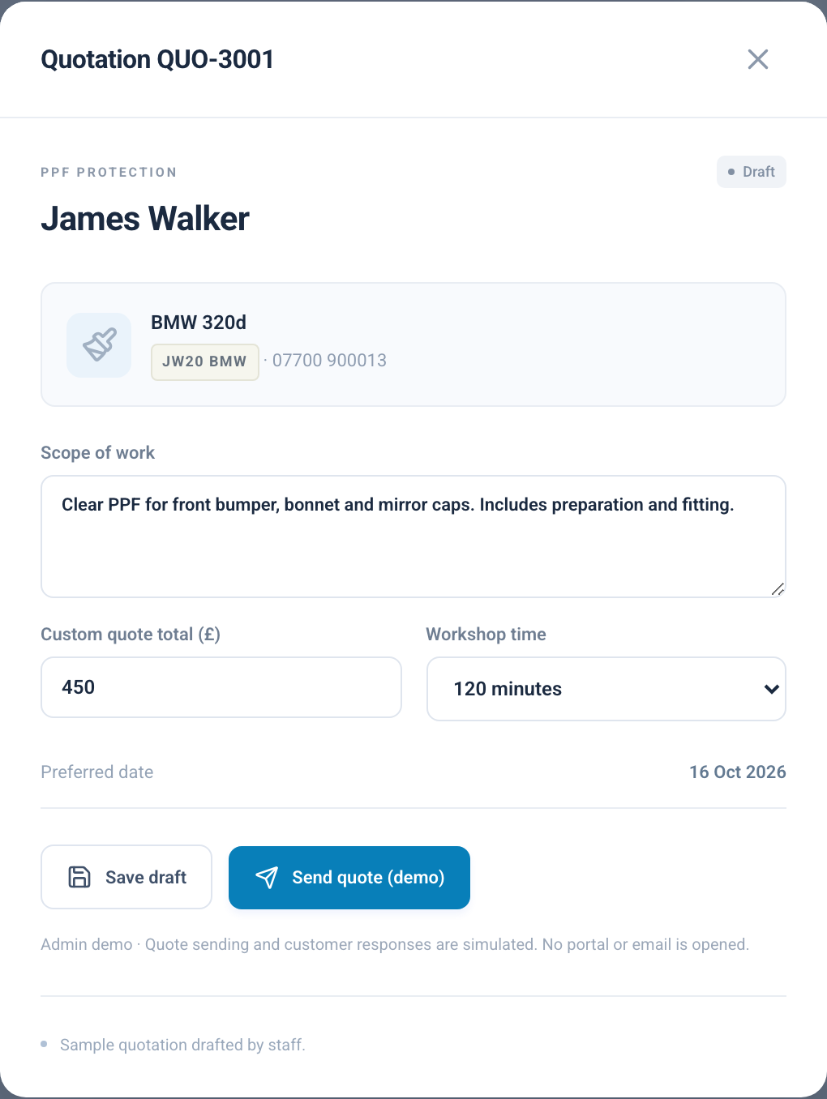
Clear quotations for custom work
The scope and price
stay together
A visible quotation status
Staff can follow a quote from draft to an accepted booking.
Useful for wrapping, PPF,
fleet branding and repair estimates
Product prototype
12
Notes:
Screenshots: local DC Motors website and admin prototype, captured 26 October 2026. All customer records and prices are fictional demonstration data. Screens use prepared local demo states. Quotations retain scope, total, preferred date, duration and status. Staff can prepare, send in simulation and record customer acceptance or decline, then book accepted work. Separate repair estimate approval workflows also exist in jobs. Project prices shown are examples, not the client’s production price list. No quote or approval is sent to a real customer. Source components: Prototype/app/website/CustomerWebsite.jsx, Prototype/app/page.jsx, Prototype/components/AdminFeatures.jsx, Prototype/lib/business.js and Prototype/lib/scheduling.js.

Slide 13
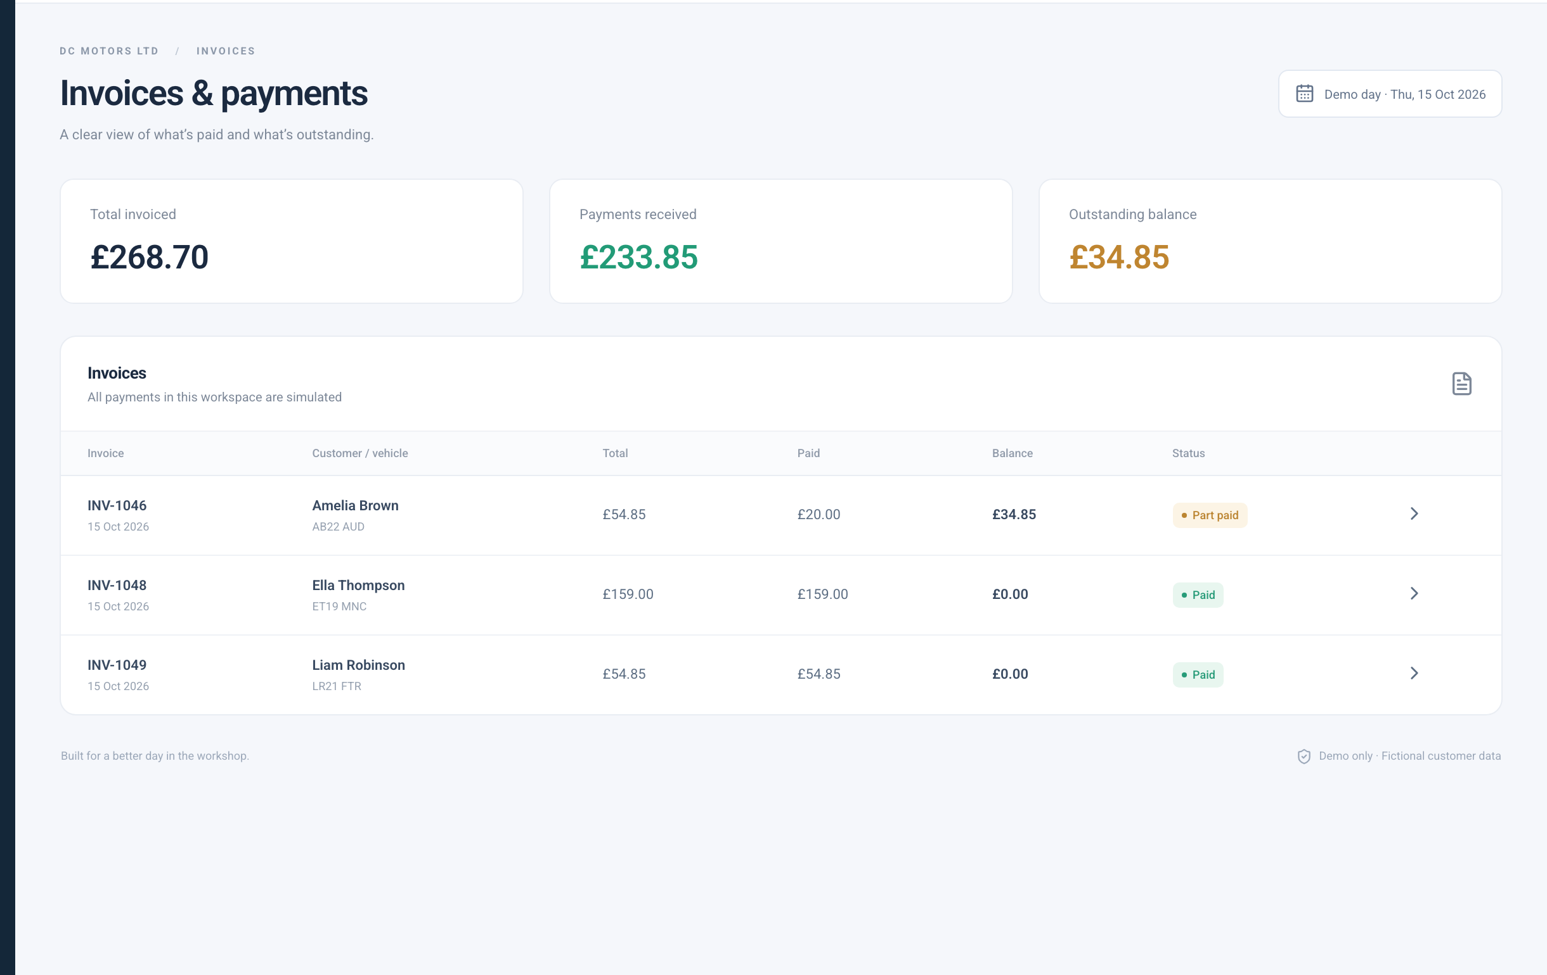
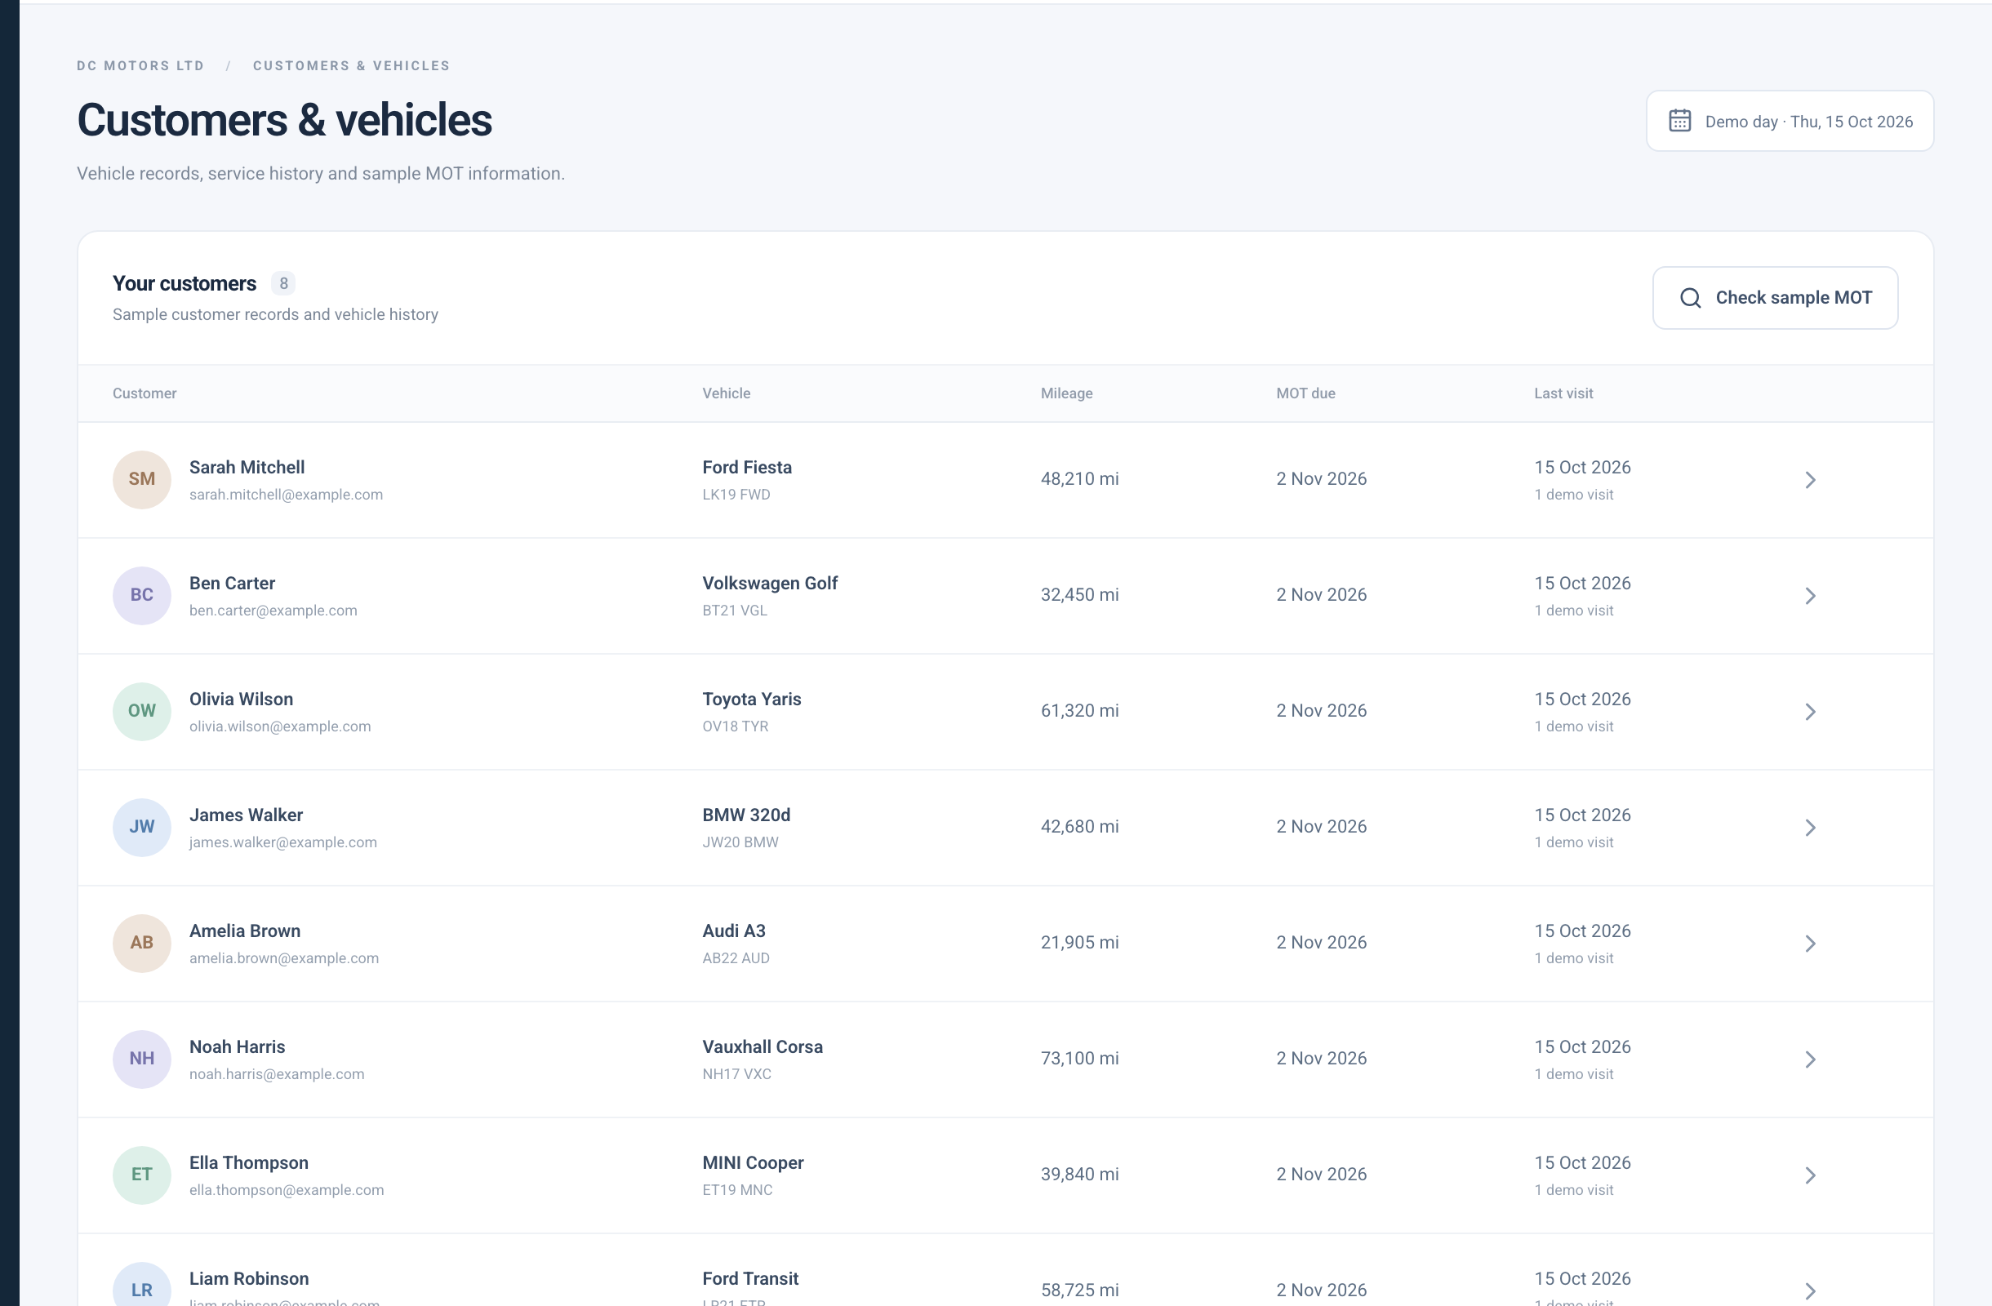
Invoices and customer history
Invoice visibility
Customer & vehicle records
A clear view of sample balances and payment status
Visit history helps staff keep the context of each vehicle
Product prototype
13
Notes:
Screenshots: local DC Motors website and admin prototype, captured 26 October 2026. All customer records and prices are fictional demonstration data. Screens use prepared local demo states. Invoice overview shows totals, paid amounts, balances and statuses for demo jobs. Customer and vehicle records retain visits and details. The public View & pay invoice action still links to the client’s existing billing site. The admin does not currently process real payments or provide production accounting. Source components: Prototype/app/website/CustomerWebsite.jsx, Prototype/app/page.jsx, Prototype/components/AdminFeatures.jsx, Prototype/lib/business.js and Prototype/lib/scheduling.js.

Slide 14
What this means for DC Motors
A clearer enquiry path
Less repeated information
Customers can move from the right service to a relevant request.
Customer and vehicle details stay with the enquiry and job.
Better scheduling visibility
More consistent follow-up
Staff can compare provisional requests with confirmed work.
Suggested times and decisions share one request history.
Product prototype
14
Notes:
These are intended qualitative benefits of the proposed workflow, not measured savings or revenue guarantees. Use them to invite the client to explain their present booking and workshop process. Suggested pilot measures: submitted requests, response time, confirmed appointments, reschedules and staff feedback. Do not invent targets without a baseline.

Slide 15
A controlled path to launch
The prototype makes the customer journey
and workshop workflow ready to review
01
Agree the operating rules
Confirm services, visit durations, resources and approval responsibilities.
02
Connect the live services
Add secure accounts, shared data and the company WhatsApp connection.
03
Pilot with the workshop team
Test real scheduling scenarios, customer replies and staff handoffs.
04
Launch and measure
Use approved content and review enquiry handling and booking outcomes.
Product prototype
15
Notes:
Close by agreeing the next scope decisions, not by implying the prototype is already live. The demonstrated local workflows can guide the production implementation. Production needs backend persistence, authenticated roles, secure customer tracking, WhatsApp integration and real delivery handling. Confirm whether invoice payment remains with the existing billing provider. Agree approved client photography, content and scheduling rules. A pilot should test real workshop processes before a public release. This is a product prototype. Calendar and message workflows run locally in the browser. A production release needs a backend, authentication and configured service connections. No live WhatsApp messages or payments have been sent.

