Slide 1
TradeZ
YOU WANT IT. I GOT IT.

Slide 2
WHAT IS tradez?
an application for employees to trade non-monetary benefits such as tickets, experiences, and products that they cannot sell due to employer restrictions
allows users to create accounts and be matched based on the product/experience which they are seeking and offering.
provide a messaging service on which the users can arrange a meet up to trade these benefits.

Slide 3
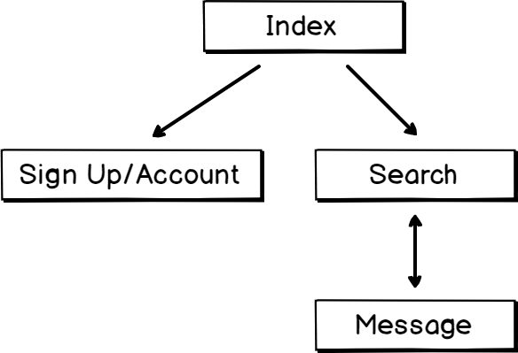
Site map
Notes:
Sign Up – Before Validation
Account – After Validation

Slide 4
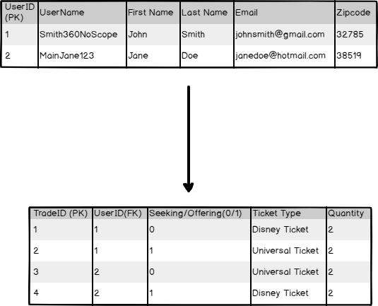
Data base relation

Slide 5
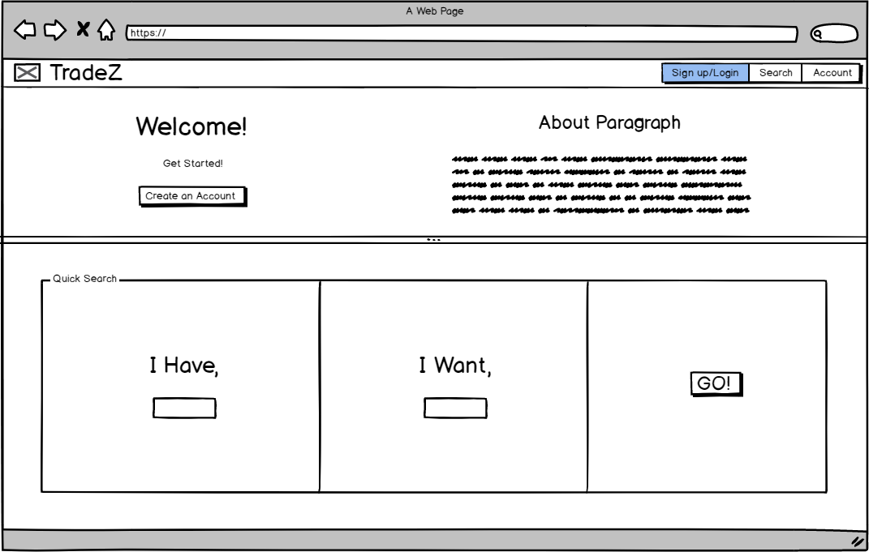
homepage

Slide 6
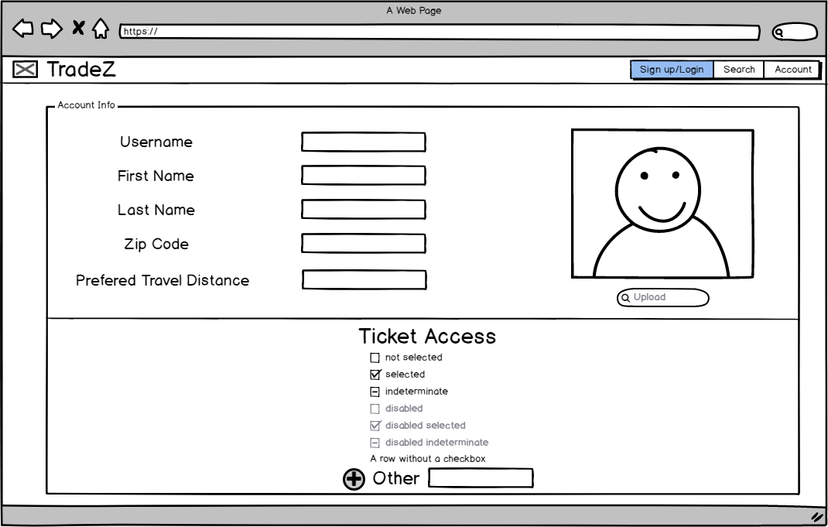
Sign up

Slide 7
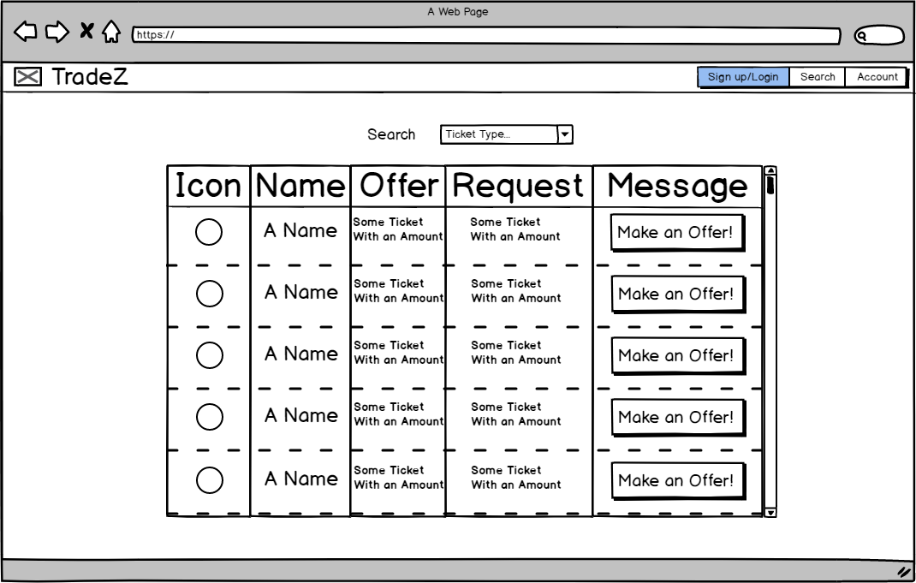
results

Slide 8
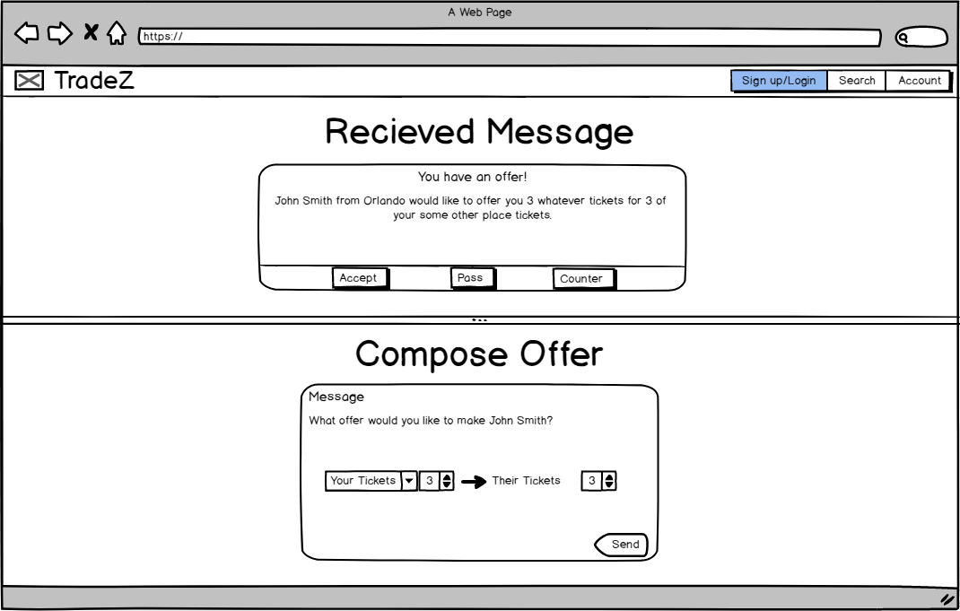
messaging

