Slide 1
34-SMA PREMARKET TREND
SMB PlayBook · davdunc · example trade RKLB · May 11, 2026
• Setup a limit order placed before the bell at the 34-SMA of the extended-hours 15-minute chart, in the direction of the premarket trend.
• Trend read 15-minute 9-EMA above the premarket VWAP → long; below → short. Read once, pre-open.
• Stock selection medium and large caps with premarket volume at least 2× their own 20-day median.
• Exit 1.0×ATR stop, no target; exit on the first 15-minute close back across the 9-EMA. Flat at 15:55.
• Evidence 733 simulated trades over three years on 14 names, +86R, +35R after 5¢ of stop slippage.
• Status 1R paper experiment. Every element of this rule was chosen after seeing the data; treat the numbers as in-sample.
Hypothetical backtest results on Massive.com minute data; simulated trades were not executed and do not reflect slippage, commissions or liquidity except where stated. Not investment advice. PlayBook format after SMB Training.
1

Slide 2
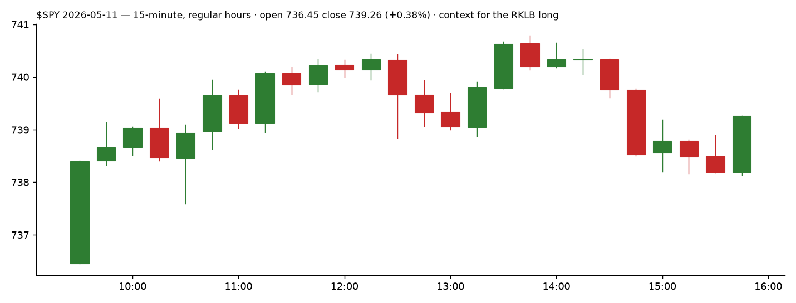
BIGGER PICTURE
$SPY on the example day · open 736.45, close 739.26 (+0.38%)
The setup is a single-stock premarket-volume play; the market only has to not fight it. SPY was quiet and slightly higher on the day, so the RKLB long was trading its own catalyst, not the tape.
Hypothetical backtest results on Massive.com minute data; simulated trades were not executed and do not reflect slippage, commissions or liquidity except where stated. Not investment advice. PlayBook format after SMB Training.
2

Slide 3
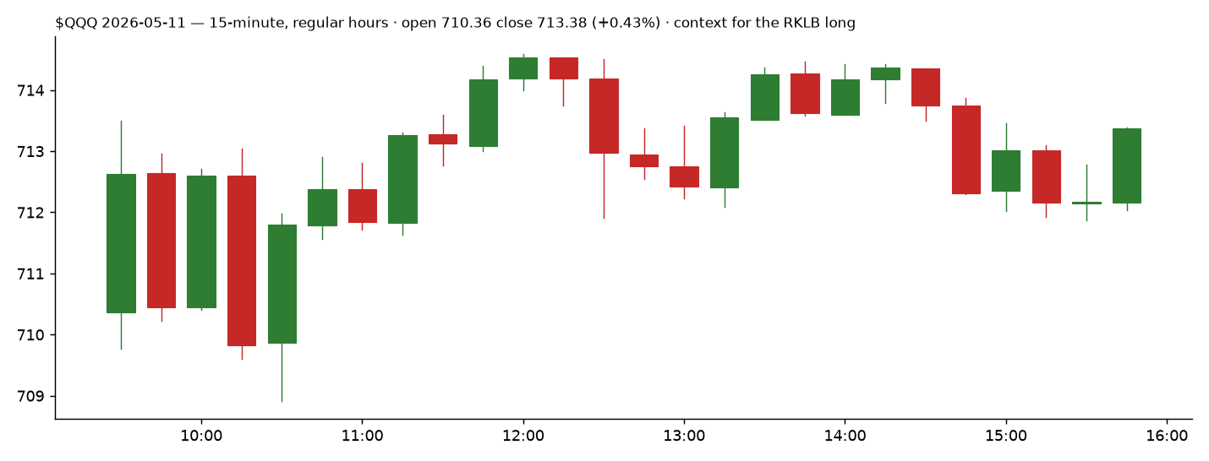
BIGGER PICTURE
$QQQ on the example day · open 710.36, close 713.38 (+0.43%)
Over three years the rule made money in both directions (shorts 332 trades / +33R, longs 292 / +26R in the intraday form), so the index direction is context, not a filter.
Hypothetical backtest results on Massive.com minute data; simulated trades were not executed and do not reflect slippage, commissions or liquidity except where stated. Not investment advice. PlayBook format after SMB Training.
3

Slide 4
INTRADAY FUNDAMENTALS
Why RKLB was on the list on 2026-05-11
• Premarket volume 3.61× its 20-day median premarket volume the only stock-selection filter. Two to three times is the sweet spot; above five it trades worse.
• Pre-open read at 09:15 9-EMA 105.09 above the premarket VWAP 105.04, so the trend was up and the order was a buy.
• Level the 34-SMA of the extended-hours 15-minute chart at 104.41, below the 09:29 price, so the limit rested away from the market.
• Universe AMD BB CRWD DELL DRI INTC IONQ META MSTR NVDA RKLB SMCI TSLA XOM. No ETFs, commodities or small caps: the tight stop needs single-stock range and the premarket-volume filter needs a name with a normal premarket.
Stat | Value | Stat | Value
Trades, 3 years | 733 | Win rate | 27.1%
Total | +86.5R | Per trade | +0.118R
Average winner | +2.63R | Average loser | -0.82R
Max drawdown | 35.4R | Daily Sharpe (all days) | 0.83
By year | 2023 +38R, 2024 -2R, 2025 +13R, 2026 +38R | Exits | stop 513 · 9-EMA close 201 · 15:55 19
Days with a fill | 1 in 3 across 14 names | One position a day | +32R on 230 trades
Hypothetical backtest results on Massive.com minute data; simulated trades were not executed and do not reflect slippage, commissions or liquidity except where stated. Not investment advice. PlayBook format after SMB Training.
4

Slide 5
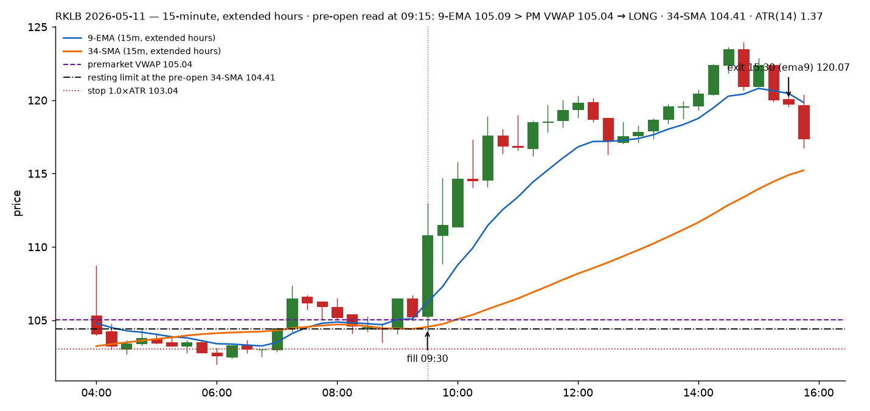
TECHNICAL ANALYSIS
RKLB 2026-05-11 · 15-minute, extended hours · the level, the read, the fill and the exit
Hypothetical backtest results on Massive.com minute data; simulated trades were not executed and do not reflect slippage, commissions or liquidity except where stated. Not investment advice. PlayBook format after SMB Training.
5

Slide 6
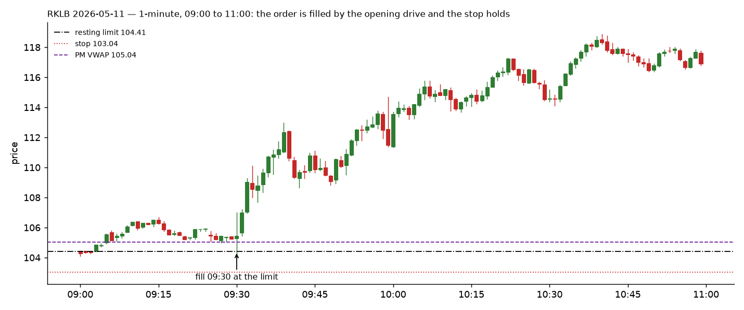
TECHNICAL ANALYSIS (EXTRA)
The first hour on 1-minute bars: the opening drive fills the resting order; the stop is 1.0×ATR so it survives the opening minute
Why 1.0×ATR and not 0.75: with the 0.75 stop, 344 of 521 first-fifteen-minute fills were stopped, median one minute after the fill. The opening minute's range is larger than 0.75 of a 15-minute ATR on these names.
Hypothetical backtest results on Massive.com minute data; simulated trades were not executed and do not reflect slippage, commissions or liquidity except where stated. Not investment advice. PlayBook format after SMB Training.
6

Slide 7
TRADE STRATEGY
The rule, as backtested (backtest/backtest_sma34_trend.py --preopen --gate 09:30 --exit-ema9-close --target-r 0 --stop-mult 1.0)
• Scan 09:15 premarket volume ≥ 2× the name's 20-day median premarket volume. Skip names above 5× (they trade worse) and anything sub-$10 or post reverse-split.
• Direction 9-EMA on the extended-hours 15-minute chart above the premarket VWAP → long; below → short.
• Order limit at the 34-SMA value of the last completed 15-minute bar before 09:30. Only if the 09:29 price is on the trade side of it (buy below the market, sell short above it).
• Stop 1.0 × ATR(14) of the 15-minute chart, entered with the order as a bracket.
• Target none. Exit on the first 15-minute bar that closes back across the 9-EMA, after at least one bar has closed with the trade.
• Time order live 09:30 to 15:00; anything still open is flat at 15:55. One entry per name per day; one position per day if that is the account rule.
• Size shares = 1R ÷ stop distance, 1R = $75 in SIM (TR4425), $28 live, per PREFERENCES.md R-CONFIG. Cap 300 shares.
• Do not re-price the order intraday, take a second fill, or hold a name that never closes a 15-minute bar with the trade past 12:00.
Hypothetical backtest results on Massive.com minute data; simulated trades were not executed and do not reflect slippage, commissions or liquidity except where stated. Not investment advice. PlayBook format after SMB Training.
7

Slide 8
TRADE MANAGEMENT
RKLB 2026-05-11 as it was simulated
Step | Time | Price | Detail
Pre-open read | 09:15 | 9-EMA 105.09 vs PM VWAP 105.04 | long; 34-SMA 104.41; ATR 1.37
Order placed | before 09:30 | buy limit 104.41 | stop 103.04 (1.0×ATR); 54 shares = $75 ÷ 1.37
Fill | 09:30 | 104.41 | opening drive trades down to the level, then reverses
Stop check | 09:30–09:45 | low held above 103.04 | the 0.75×ATR stop would have been 103.38: also held here, not in most cases
Armed | 09:45 | 09:30 bar closed above the 9-EMA | the 9-EMA exit is now live
Exit | 15:30 | 120.07 | 15:15 bar closed below the 9-EMA; sold at the 15:30 open
Result |  | +$846 | +11.4R on the planned risk
• Runner management is the whole P&L the ten largest wins are 144% of the net profit. Nothing in the rule takes partial profit; adding a partial at +1R tripled the win rate and removed most of the profit in the sister test.
• Stop fills are the risk 513 of 733 exits are stops. Five cents of adverse slippage per stop turns +86R into +35R; measure the first twenty live stops before sizing above 1R.
Hypothetical backtest results on Massive.com minute data; simulated trades were not executed and do not reflect slippage, commissions or liquidity except where stated. Not investment advice. PlayBook format after SMB Training.
8

Slide 9
READING THE TAPE
What to watch at the level between 09:30 and 10:00
• At the 34-SMA does the opening drive stall at the level or trade through it? A fill that comes with size lifting the offer (long) or hitting the bid (short) into the level is the good version; a fill inside a one-minute flush that keeps going is the stop.
• Premarket VWAP the second reference. For a long, price holding between the 34-SMA and the PM VWAP after the fill is confirmation; a print back below the PM VWAP with the 9-EMA turning is the early warning the 15-minute close will confirm.
• The 09:45 close the first completed bar. Above the 9-EMA arms the exit and says the drive is real; below it and the trade is living on the stop.
• Level to watch on the tape the fill price itself. The trade that never comes back to the fill after 09:45 is the runner; the one that keeps testing it is a scratch waiting to happen.
• Speed median one minute from fill to stop in the losing form. If the first minute after the fill runs against you, there is no decision to make; the stop makes it.
Hypothetical backtest results on Massive.com minute data; simulated trades were not executed and do not reflect slippage, commissions or liquidity except where stated. Not investment advice. PlayBook format after SMB Training.
9

Slide 10
TECHNOLOGY
Everything the trade needs is scripted; the human job is the 09:15 read and the order
• Scan fl_forward_test.py breadth and gameplan reader; premarket-ratio filter is the --pm-vol-mult logic in backtest_sma34_trend.py, to be lifted into the driver.
• Order DAS bracket via the CMD API (SCRIPT montage1 …): limit at the level, SLP stop at 1.0×ATR, sized by the R-CONFIG unit. Refuses without an ATR value.
• Exit 9-EMA close monitor on 15-minute bars, same pattern as the FL driver's ema9 exit; breakeven and flatten paths already exist (22-fl-flatten.das).
• Chart DAS 15-minute with extended hours ON, studies 9-EMA, 34-SMA, VWAP (premarket); the regular-hours chart gives a different level and a worse result for this form.
• Safety paper account TR4425 only until twenty live stop fills are measured; the driver halts new entries when the montage name is lost (the 09-25 failure).
• Reproduce docs/forward-tests/sma34-trend-3y.md, backtest/results/sma34-3y-preopen-ext-ema-s10.json.
Hypothetical backtest results on Massive.com minute data; simulated trades were not executed and do not reflect slippage, commissions or liquidity except where stated. Not investment advice. PlayBook format after SMB Training.
10

Slide 11
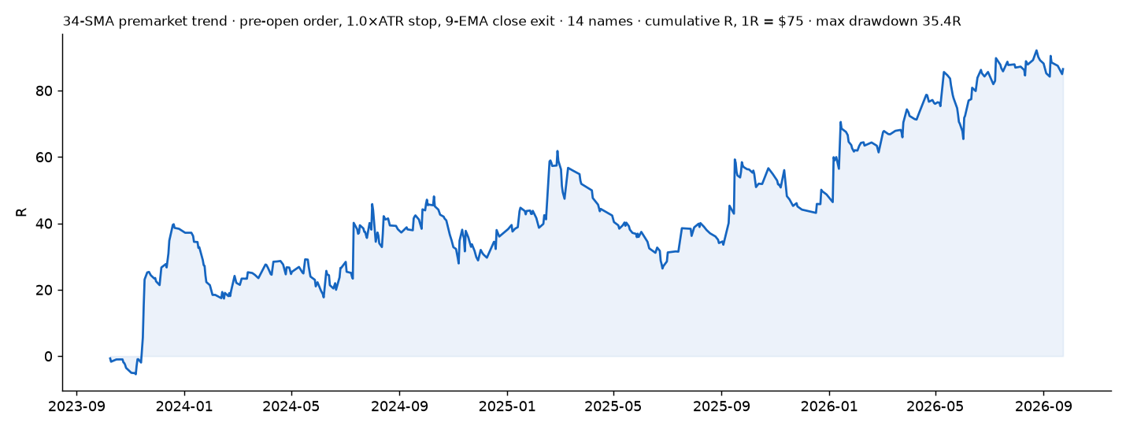
TRADE REVIEW
What the three years say to do better
• The original form does not work 0.75×ATR stop with a 1.8R target is −14R pre-open and −71R re-priced intraday; the opening minute takes the stop before the level can react.
• Two changes made it a trailing exit on the 9-EMA close instead of the target, and a stop outside the opening minute's range. Together they are the only positive pre-open form found.
• It is a runner strategy with a 27% win rate four trades in ten stop within minutes, one in four pays. Size for that, not for the win rate.
• In-sample chart type, stop width and exit were chosen after seeing the data. 2024 was flat; the three months of 2023 supplied 38 of the 86R. A walk-forward that picks the premarket band on 2024 alone is the next test.
• Fills touch-equals-fill at the limit and clean stop fills are assumed. Requiring a 1¢ trade-through cost 4R; five cents of stop slippage cost 51R.
• Next measure live stop slippage on TR4425; add --entry-window and the premarket scan to the driver; write the DAS bracket hotkey for the pre-open order.
Hypothetical backtest results on Massive.com minute data; simulated trades were not executed and do not reflect slippage, commissions or liquidity except where stated. Not investment advice. PlayBook format after SMB Training.
11

Slide 12
EV CALCULATOR
Expectancy from the simulated distribution (SMB's EV sheet inputs)
Input | Value | Note
Win rate | 27.1% | 199 winners / 733 trades
Average winner | +2.63R | 1R = the planned stop distance × shares = $75 in SIM
Average loser | −0.82R | smaller than 1R: gap-through and breakeven exits
Expectancy per trade | +0.118R | wr × avg win − (1 − wr) × avg loss
Three-year total | +86R | max drawdown 35.4R · daily Sharpe 0.83
With 5¢ adverse slippage on every stop | +35R | the number that decides whether it is tradeable
Read: a +0.12R expectancy on 733 trades is real but thin; it is carried by a 2.6R average winner against a 0.82R average loser. Any change that raises the win rate by capping winners destroys it. The friction row is the number to beat live.
Hypothetical backtest results on Massive.com minute data; simulated trades were not executed and do not reflect slippage, commissions or liquidity except where stated. Not investment advice. PlayBook format after SMB Training.
12

Slide 13
SCORE CARD
Self-graded 1–10 against the SMB rubric
Area | Grade | Reason
Big Picture | 6 | Market direction is context only; no index filter was found that helped.
Intraday Fundamentals | 7 | One clean, testable filter (premarket volume ratio); no news or catalyst layer yet.
Stock Selection | 7 | Single stocks with range; ETFs and small caps excluded for stated reasons.
Technical Analysis | 8 | Level, read and exit are all defined on one chart and were simulated without look-ahead.
Trade Strategy | 7 | Rule is explicit and reproducible; chosen in-sample, so provisional.
Risk Management | 6 | Stop is defined and sized; stop-fill slippage is unmeasured and decides the edge.
Reading the Tape | 5 | Tape rules are written from the simulation, not from watching fills yet.
Technology | 8 | Backtester, driver, CMD API harness and flatten paths exist; pre-open bracket hotkey still to write.
Review: what can you do better? | 7 | Walk-forward, live slippage, entry window; all listed and scheduled.
Hypothetical backtest results on Massive.com minute data; simulated trades were not executed and do not reflect slippage, commissions or liquidity except where stated. Not investment advice. PlayBook format after SMB Training.
13

