Slide 1
FASHIONABLY LATE
A Trading As Buddies PlayBook · 15-minute 9-EMA × 34-SMA cross · example trade MSTR · August 27, 2026
• Setup the 15-minute 9-EMA crosses the 34-SMA on a regular-hours chart with volume above 1.5× the 20-bar average. Enter at the next bar's open.
• When entries from 09:45 to 11:00 only. The first bar after the open carries most of the edge; entries after 11:00 lose.
• Stock selection single stocks from the morning in-play list; no ETFs or commodities. Prefer a name with an earnings release or 8-K in the prior 24 hours: those trades earn four times as much per unit of risk.
• Exit 0.75×ATR stop moved to breakeven at +0.5R, hold to the close. No target.
• Evidence 2282 simulated trades over three years, +201R, max drawdown 12.4R, +65R after 5¢ of stop slippage.
• How to start trade it at 1R in simulation; half the trades scratch at breakeven by design, and one in ten pays for everything.
Hypothetical backtest results on Massive.com minute data; simulated trades were not executed and do not reflect slippage, commissions or liquidity except where stated. Not investment advice. Trading As Buddies · github.com/TradingAsBuddies/DAS-hotkeys · PlayBook format after SMB Training (not affiliated).
1

Slide 2
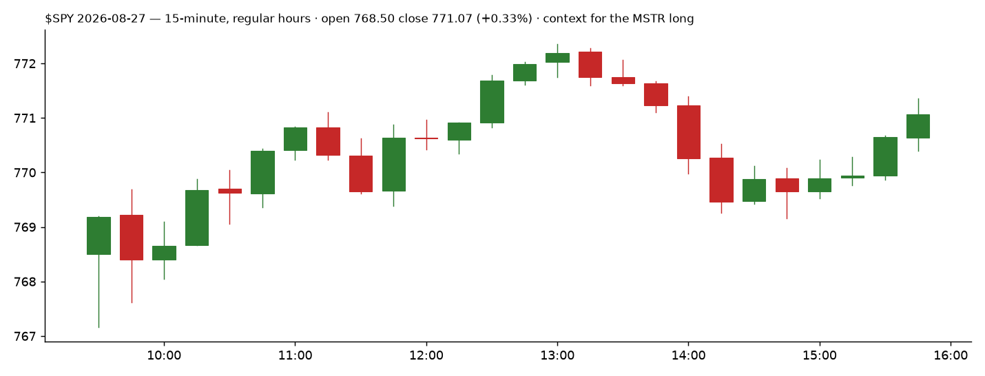
BIGGER PICTURE
$SPY on the example day · open 768.50, close 771.07 (+0.33%)
FL is a first-hour momentum trade in the stock; the market matters through breadth ($TICK, $ADD, $VOLD) at the time of the cross, which the driver reads, rather than through the index chart.
Hypothetical backtest results on Massive.com minute data; simulated trades were not executed and do not reflect slippage, commissions or liquidity except where stated. Not investment advice. Trading As Buddies · github.com/TradingAsBuddies/DAS-hotkeys · PlayBook format after SMB Training (not affiliated).
2

Slide 3
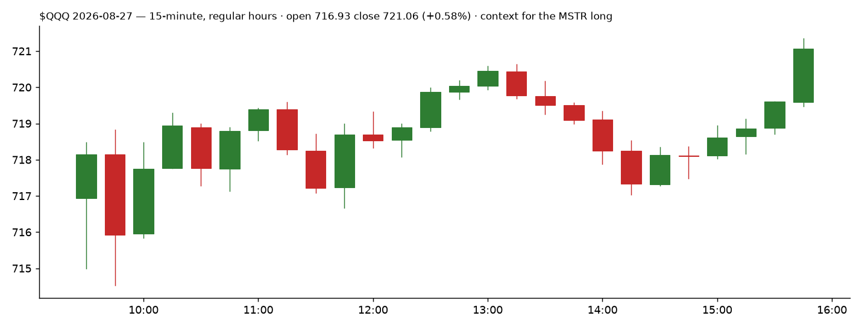
BIGGER PICTURE
$QQQ on the example day · open 716.93, close 721.06 (+0.58%)
Shorts carried about five times the longs over three years, but longs were not negative; both sides are taken.
Hypothetical backtest results on Massive.com minute data; simulated trades were not executed and do not reflect slippage, commissions or liquidity except where stated. Not investment advice. Trading As Buddies · github.com/TradingAsBuddies/DAS-hotkeys · PlayBook format after SMB Training (not affiliated).
3

Slide 4
INTRADAY FUNDAMENTALS
Why MSTR qualified on 2026-08-27
• In-play name MSTR was on the morning in-play list. Run FL only on that day's in-play single stocks; it is not a scan of the whole market.
• The cross on the 09:30–09:45 bar the 9-EMA closed above the 34-SMA on a regular-hours 15-minute chart, with the bar's volume above 1.5× the average of the prior 20 bars.
• First bar after the open this is where the rule earns. Over three years the 09:45 entries made +150R on 1,073 trades; 10:00 entries +36R on 614; 10:45 entries lost.
• Universe the single stocks from the morning lists (16 names in the test); the seven ETFs and commodities lost money under this rule and are excluded.
• Catalyst MSTR had no filing that morning, which is the common case (90% of trades). Earnings and 8-K mornings are 9% of the trades and 30% of the profit, +0.29R a trade against +0.07R; after 5¢ of stop slippage they are three quarters of what is left.
Stat | Value | Stat | Value
Trades, 3 years | 2282 | Win rate | 9.9% (1134 breakeven scratches)
Total | +201.1R | Per trade | +0.088R
Average winner | +2.58R | Average loser | -0.42R
Max drawdown | 12.4R | Daily Sharpe (all days) | 2.17
By year | 2023 -4R, 2024 +116R, 2025 +14R, 2026 +75R | Exits | stop 2053 (incl. breakeven) · close 229
First-bar entries only | 1,073 trades, +150R, +82R with 5¢ slip | With 5¢ stop slippage, all entries | +65R
Hypothetical backtest results on Massive.com minute data; simulated trades were not executed and do not reflect slippage, commissions or liquidity except where stated. Not investment advice. Trading As Buddies · github.com/TradingAsBuddies/DAS-hotkeys · PlayBook format after SMB Training (not affiliated).
4

Slide 5
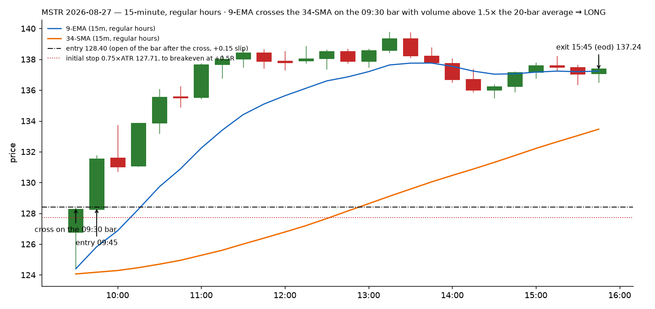
TECHNICAL ANALYSIS
MSTR 2026-08-27 · 15-minute, regular hours · cross, entry, stop, breakeven, close
Hypothetical backtest results on Massive.com minute data; simulated trades were not executed and do not reflect slippage, commissions or liquidity except where stated. Not investment advice. Trading As Buddies · github.com/TradingAsBuddies/DAS-hotkeys · PlayBook format after SMB Training (not affiliated).
5

Slide 6
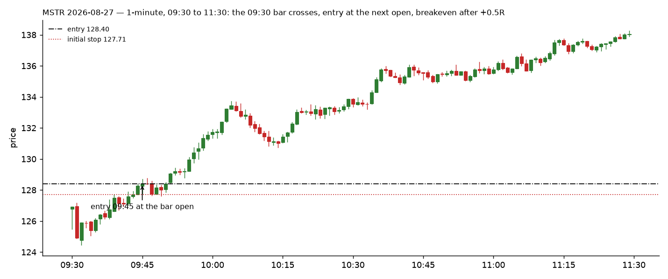
TECHNICAL ANALYSIS (EXTRA)
The first two hours on 1-minute bars: entry at the 09:45 open, stop 0.75×ATR, breakeven after the first bar shows +0.5R
Hypothetical backtest results on Massive.com minute data; simulated trades were not executed and do not reflect slippage, commissions or liquidity except where stated. Not investment advice. Trading As Buddies · github.com/TradingAsBuddies/DAS-hotkeys · PlayBook format after SMB Training (not affiliated).
6

Slide 7
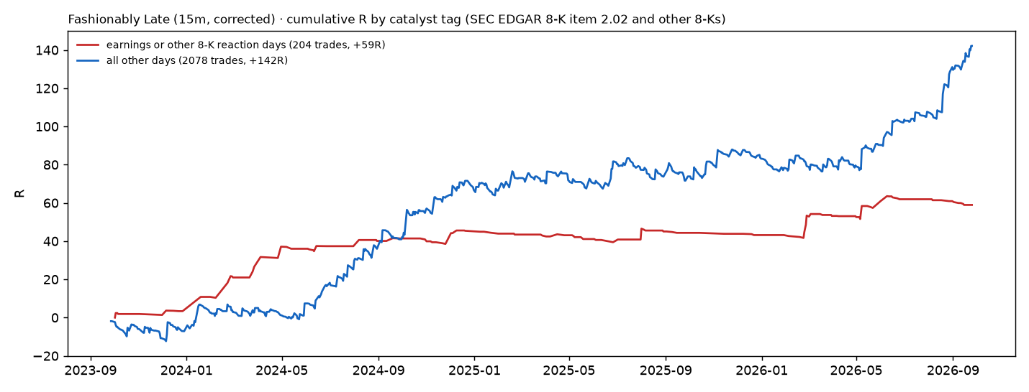
INTRADAY FUNDAMENTALS: CATALYSTS
SEC EDGAR 8-K filings joined to every trade day · catalyst mornings are the richer trade and the friction-proof one
Earnings and other-8-K reaction days: 204 trades, +59R, +0.29R each, +48R after 5¢ of stop slippage. Every other day: 2,078 trades, +142R, +0.07R each, +17R after slippage. The chance that a random 204-trade subset does this well is under 1%.
Hypothetical backtest results on Massive.com minute data; simulated trades were not executed and do not reflect slippage, commissions or liquidity except where stated. Not investment advice. Trading As Buddies · github.com/TradingAsBuddies/DAS-hotkeys · PlayBook format after SMB Training (not affiliated).
7

Slide 8
TRADE STRATEGY
The rule, as backtested (backtest_fl_week.py --bar-minutes 15 --rth-only --warmup-days 4 --stop-mult 0.75 --size-mult 1.5 --be-after 0.5 --last-entry 11:00)
• Chart 15-minute, regular hours only, 9-EMA and 34-SMA warm from four prior sessions.
• Signal a completed bar whose close moves the 9-EMA across the 34-SMA, with that bar's volume above 1.5× the average of the 20 bars before it. Crosses printed on a prior day's bar do not count.
• Catalyst when more signals fire than you can take, take the names with an earnings release or 8-K in the prior 24 hours first. Without a catalyst, take the trade only if your measured stop slippage is under two cents.
• Entry market at the open of the next bar, 09:45 to 11:00 only. Two entries per name per day at most.
• Stop 0.75 × ATR(14) of the 15-minute chart. Size = 1R ÷ (1.5 × ATR), so the position is half what the stop alone would allow; 1R is the amount you risk per trade.
• Breakeven once a completed bar has shown +0.5R in favour, move the stop to entry.
• Exit hold to the close (flat at 15:55). No target, no partials: partial profit at +1R cut the three-year result by 85%.
• Do not trade the 1-minute cross (−7,680R over three years), enter after 11:00, or use a 9-EMA trail on 1-minute bars (−1,395R).
• Breadth gate skip a signal whose side disagrees with the sign of $VOLD (NYSE up-volume minus down-volume) at the time of the cross.
Hypothetical backtest results on Massive.com minute data; simulated trades were not executed and do not reflect slippage, commissions or liquidity except where stated. Not investment advice. Trading As Buddies · github.com/TradingAsBuddies/DAS-hotkeys · PlayBook format after SMB Training (not affiliated).
8

Slide 9
TRADE MANAGEMENT
MSTR 2026-08-27 as it was simulated
Step | Time | Price | Detail
Cross | 09:30 bar close | 9-EMA crosses above the 34-SMA | bar volume above 1.5× the 20-bar average
Entry | 09:45 | 128.40 | open of the next bar + 0.15 slip; shares = 1R ÷ (1.5 × ATR)
Initial stop | 09:45 | 127.71 | 0.75 × ATR 0.92
Breakeven | 10:00 | 128.40 | the 09:45 bar showed more than +0.5R; stop to entry
Exit | 15:45 | 137.24 | flat at the close
Result |  | +$477 | +6.4R
• Half the trades scratch at breakeven 1,134 of 2,282 exits are at entry. That is the design; the stop is inside the noise and breakeven is the real stop.
• One in ten pays winners average 2.6R and the ten largest are a large share of the total. Never cap them.
Hypothetical backtest results on Massive.com minute data; simulated trades were not executed and do not reflect slippage, commissions or liquidity except where stated. Not investment advice. Trading As Buddies · github.com/TradingAsBuddies/DAS-hotkeys · PlayBook format after SMB Training (not affiliated).
9

Slide 10
READING THE TAPE
What to watch on the cross bar and the bar after it
• Volume persistence the cross bar's volume must be followed. The 50/2 rule: each of the next two bars prints at least half the cross bar's volume, or exit at that bar's close and do not re-enter on the same signal.
• The 09:45 open the entry is at the market; a wide spread or a print far from the 09:45 15-minute open is the slippage the backtest does not model.
• First bar after entry +0.5R moves the stop to breakeven. On the tape that is the bar that has to hold above the 9-EMA; if it closes back below, the scratch is coming.
• Level to watch the entry price. After breakeven the trade is free; the runner is the one that never revisits it.
• Breadth $VOLD sign must agree with the side at the cross; $TICK extremes against the trade at entry are a reason to wait one bar, not to skip.
Hypothetical backtest results on Massive.com minute data; simulated trades were not executed and do not reflect slippage, commissions or liquidity except where stated. Not investment advice. Trading As Buddies · github.com/TradingAsBuddies/DAS-hotkeys · PlayBook format after SMB Training (not affiliated).
10

Slide 11
TECHNOLOGY
Built and tested against DAS on the paper account
• Chart 15-minute, regular hours only, 9-EMA and 34-SMA, volume with a 20-bar average. The cross must be visible on this chart, not on a 1-minute chart.
• Entry market order at the 09:45 (or later) bar open, with a stop 0.75×ATR away entered at the same time. In DAS Trader Pro this is one hotkey; open-source scripts are in the repo (scripts/20-fl-long.das, 21-fl-short.das).
• Breakeven after the first completed bar shows +0.5R, move the stop to entry. A stop-order update or a chart alert both work.
• Breadth keep $VOLD, $TICK and $ADD on screen at the cross; the side must agree with $VOLD.
• Backtest backtest/backtest_fl_week.py in the repo reproduces every number here from Massive.com (Polygon) flat files; report in docs/forward-tests/fl-3y-2023-2026.md.
• Safety simulation first at 1R; the rule is only as good as your stop fills, and those are yours to measure.
Hypothetical backtest results on Massive.com minute data; simulated trades were not executed and do not reflect slippage, commissions or liquidity except where stated. Not investment advice. Trading As Buddies · github.com/TradingAsBuddies/DAS-hotkeys · PlayBook format after SMB Training (not affiliated).
11

Slide 12
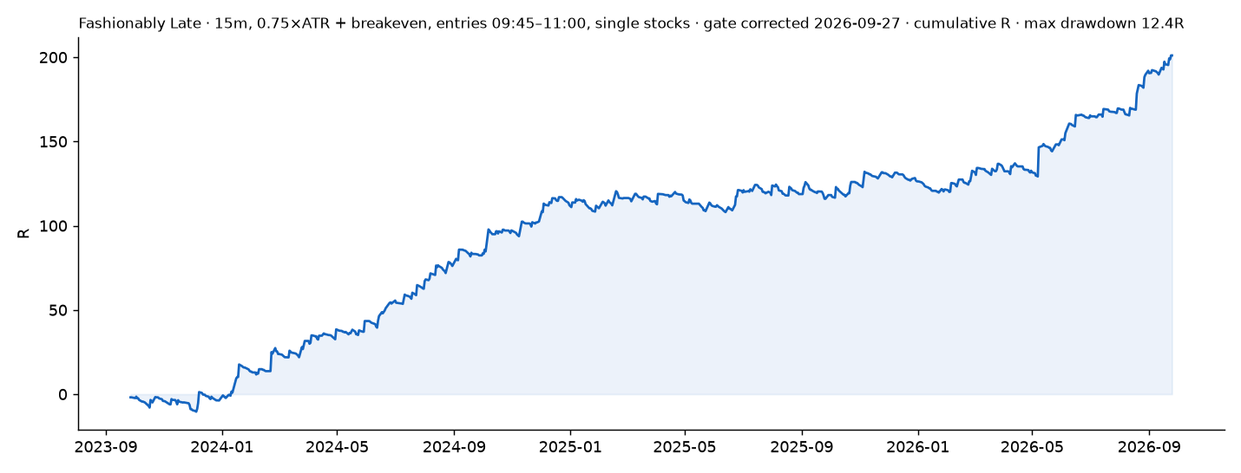
TRADE REVIEW
What the three years say to do better
• The 1-minute rule as traded on 09-24 has no edge 13 of 13 stops live, −7,680R over three years. The 15-minute chart is the setup.
• The edge is the first bar 09:45 entries carry three quarters of the profit. Everything after 11:00 is negative.
• Check your backtest against a chart an earlier run let a cross on the prior day's closing bar be bought at the open, which inflated the result by 90R. Those overnight trades are a different, untested idea.
• Win rate cannot be bought partials raise it and destroy the P&L; the return is the tail of runners into the close.
• Friction +65R after 5¢ stop slippage; first-bar entries alone +82R. Measure live stop fills before sizing.
• Next measure live stop fills in simulation, walk-forward the entry window, and test the overnight cross as its own setup.
Hypothetical backtest results on Massive.com minute data; simulated trades were not executed and do not reflect slippage, commissions or liquidity except where stated. Not investment advice. Trading As Buddies · github.com/TradingAsBuddies/DAS-hotkeys · PlayBook format after SMB Training (not affiliated).
12

Slide 13
EV CALCULATOR
Expectancy from the simulated distribution (SMB's EV sheet inputs)
Input | Value | Note
Win rate | 9.9% | 227 winners / 2282 trades (1134 breakeven scratches)
Average winner | +2.58R | 1R = your risk per trade = planned stop distance × shares
Average loser | −0.42R | smaller than 1R: gap-through and breakeven exits
Expectancy per trade | -0.119R | wr × avg win − (1 − wr) × avg loss
Three-year total | +201R | max drawdown 12.4R · daily Sharpe 2.17
With 5¢ adverse slippage on every stop | +65R | the number that decides whether it is tradeable
Read: +0.09R per trade with half the trades scratched. The average loser is 0.42R because the stop sits inside the noise and most losers are breakeven or gap-through fills; the average winner is 2.6R. Sharpe 2.2 and a 12R drawdown are the reasons to prefer this over the 34-SMA play for size.
Hypothetical backtest results on Massive.com minute data; simulated trades were not executed and do not reflect slippage, commissions or liquidity except where stated. Not investment advice. Trading As Buddies · github.com/TradingAsBuddies/DAS-hotkeys · PlayBook format after SMB Training (not affiliated).
13

Slide 14
SCORE CARD
Self-graded 1–10 against the SMB rubric
Area | Grade | Reason
Big Picture | 6 | Breadth gate exists in the driver; no index-regime filter has been tested.
Intraday Fundamentals | 8 | In-play names plus an EDGAR check; catalyst mornings carry the friction-adjusted edge.
Stock Selection | 7 | Single stocks only, ETFs excluded on evidence; universe is still today's names run backwards.
Technical Analysis | 8 | Cross, volume, stop, breakeven and exit are all on one chart and reproducible.
Trade Strategy | 7 | Explicit and backtested; the rule text was checked against plotted trades.
Risk Management | 7 | Breakeven at +0.5R keeps the drawdown to 12R; stop slippage still unmeasured live.
Reading the Tape | 6 | 50/2 volume persistence rule exists and is enforceable; not yet validated across a sample.
Technology | 7 | Open-source DAS scripts and backtester; entry and stop are one hotkey; breakeven update is manual or scripted.
Review: what can you do better? | 8 | Live trials reviewed to cause, backtest checked against the chart, corrections published.
Hypothetical backtest results on Massive.com minute data; simulated trades were not executed and do not reflect slippage, commissions or liquidity except where stated. Not investment advice. Trading As Buddies · github.com/TradingAsBuddies/DAS-hotkeys · PlayBook format after SMB Training (not affiliated).
14

