Slide 1

The Team3 Clinic
1, Foundation time and branches
The Clinic was founded in October 2023
no branch
2, Employee information
Total number of employees : 6
Including 3 nurses and 3 doctors
3, Opening hours:
Monday to Friday, 9 am to 4 pm

Slide 2
The purpose of creating this software system is :
1, To Record and management of the clinic's human resources.
2, Recording and management of patient information.
3, To register patients' appointments.
4, To record patient's treatment information.
5, To calculate treatment cost and print invoice.
For this purpose, we have built this software system using object facing programming.

Slide 3
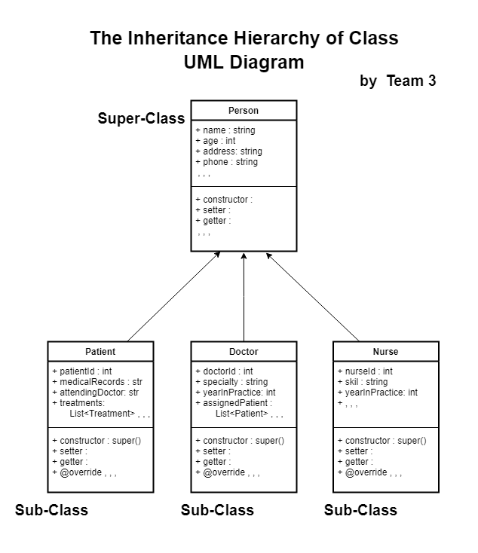

Slide 4
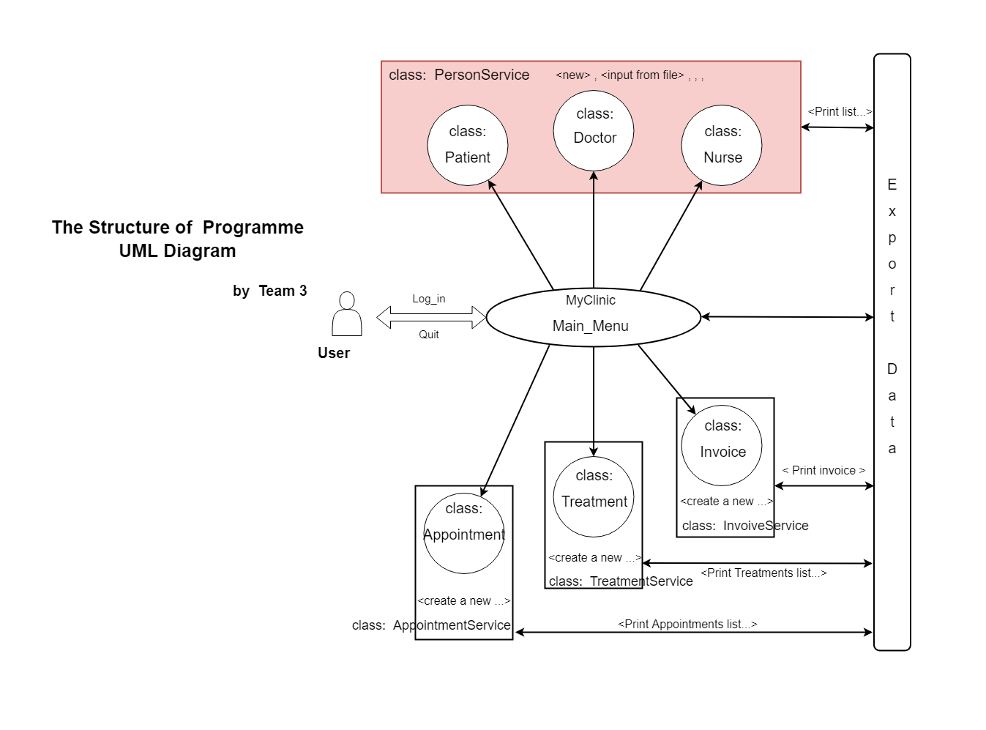

Slide 5
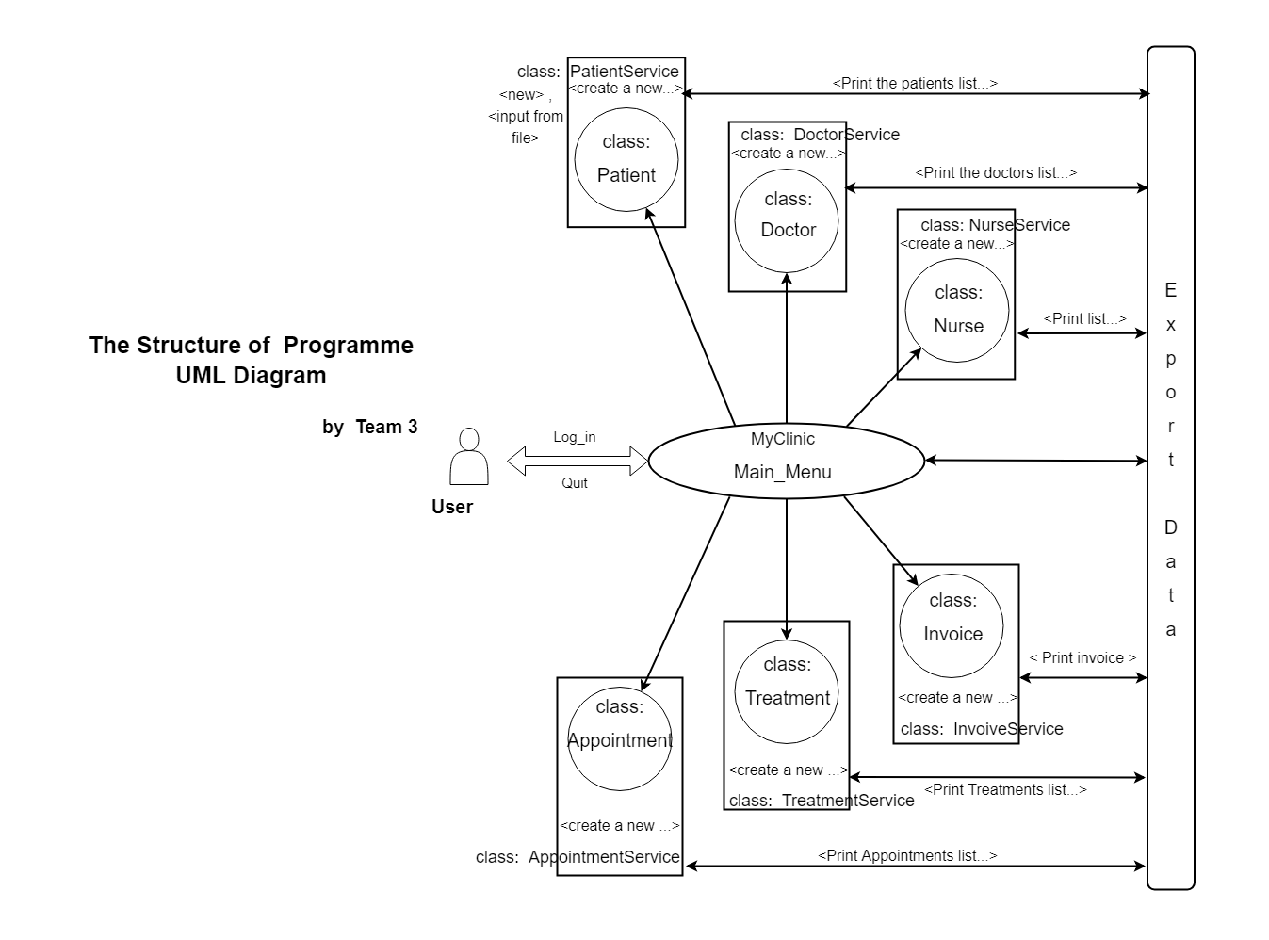

Slide 6
