Slide 1

Calgary’s Battle of Neighborhoods
Tadepalli Sarada KIranmayee

Slide 2
Introduction
Calgary is one of the largest city in the western Canadian province of Alberta. It is 299 km (186 mi) south of the Alberat’s capital- Edmonton
The city had a population of 1,285,711 in 2019. It is considered as one of the most-populous city in western Canada

Slide 3
Business Problem
Finding out common interest of the people of the city by analyzing the most
common places visited?
Understanding the top businesses in the current communities and setting up the
new business in the new extended community?

Slide 4
Targeted Audience
When new communities are created then both the government officials and the businesses will be looking for the welfare and the convenience for the people dwelling in these areas.
This analysis will help in urban planning for the government and business expansion plans for companies

Slide 5
Data
Data that will be used to solve the above business problems are collected from various publicly- available sources.
1. Calgary Communities (https://en.wikipedia.org/wiki/List_of_neighbourhoods_in_Calgary )
2. Each Community coordinates (https://data.calgary.ca/resource/j9ps-fyst.json )
3. Top venues in each Community (Four Square API)

Slide 6
Methodology
Data Acquisition
Data Wrangling
Data Analysis and Normalization
K-Mean Clustering
Results

Slide 7
Data Acquisition
The dataset is taken from large different sources and the details are already discussed.

Slide 8
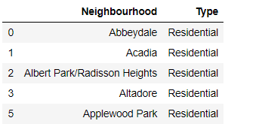
Data Wrangling

Slide 9
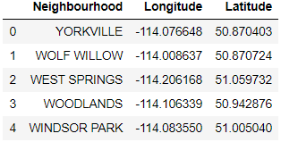
Latitude and longitude for Neighbourhood

Slide 10
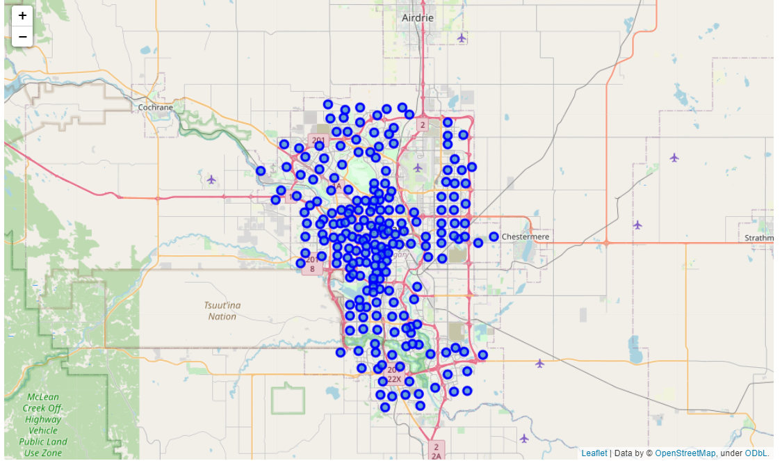
Neighbourhood Details

Slide 11
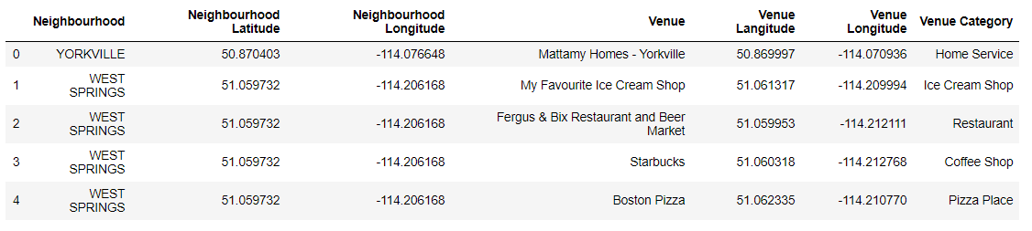
Top 100 Venue details

Slide 12
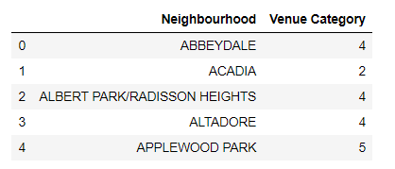
Data Analysis

Slide 13
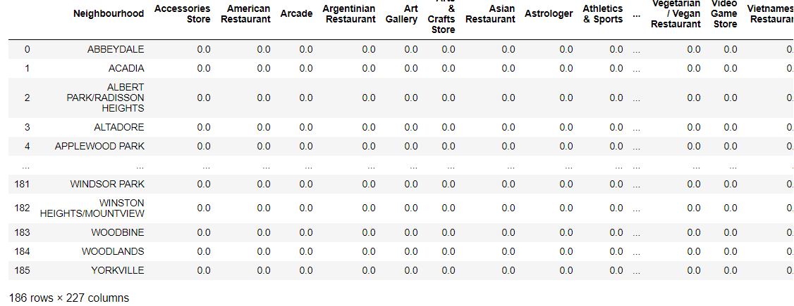
One-Hot Encoding

Slide 14
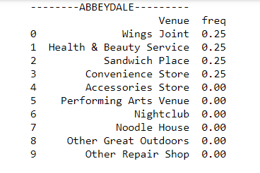
Top 10 Venues of each community

Slide 15
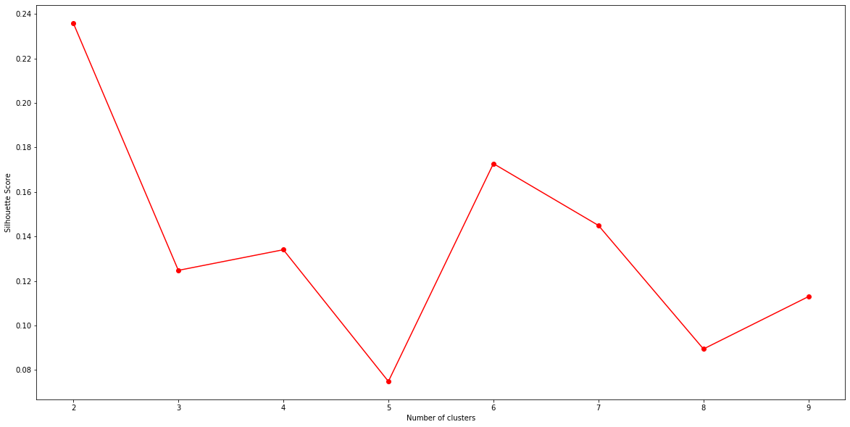
Silhouette Score

Slide 16
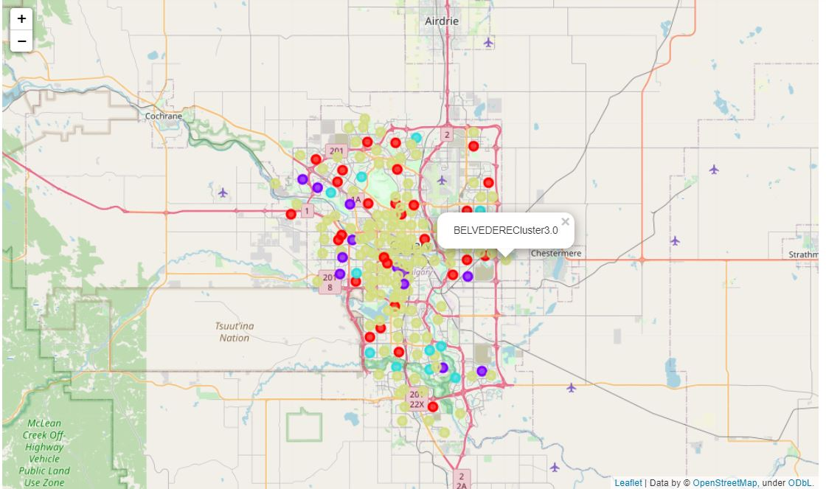
K-Mean Clustering

Slide 17
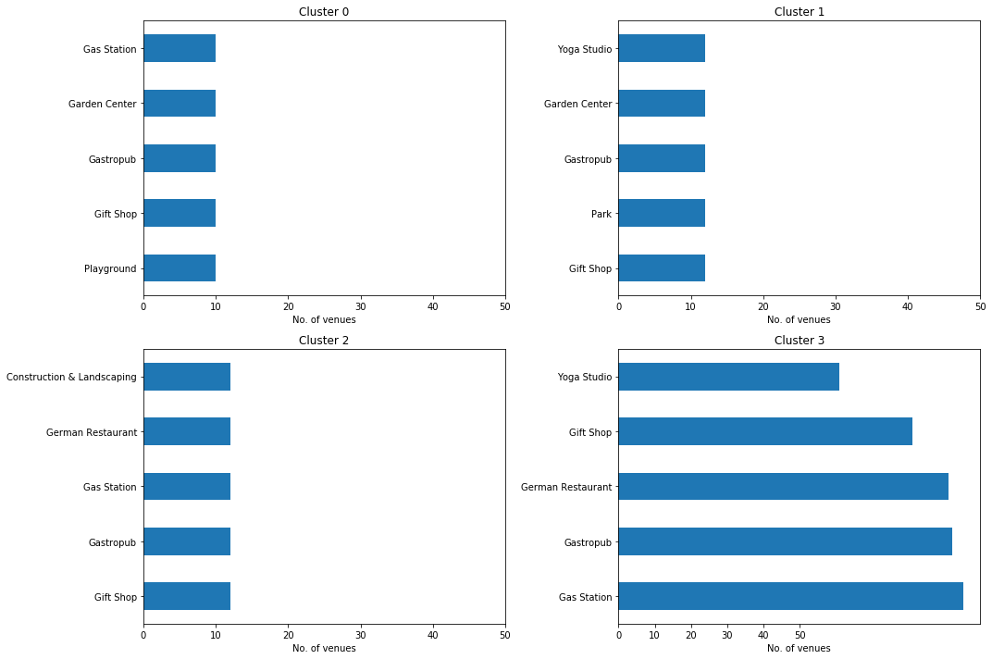
Results

Slide 18
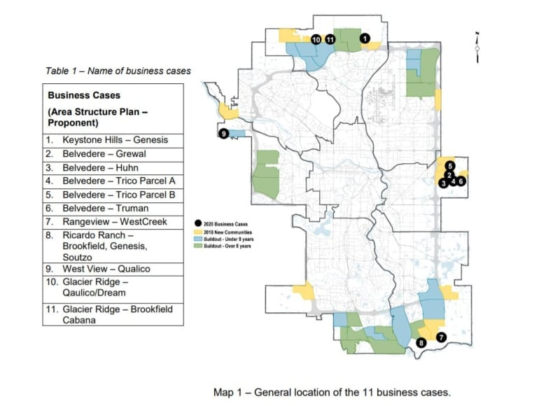
Discussion
New Proposed Communities in Calgary.

Slide 19
Conclusion
After the analyzing the clusters, the best place to open the juice and health bar is determined, i.e., cluster 3 near the new communities adjacent to “Belvedere”.

