Slide 1
Control Flow

Slide 2
Conditional statements
If condition
Alternative conditions(if-else)
Syntax :
If(condition):
Statements
Example:
If(5==5):
print(“Yes”)
Syntax:
If(condition):
statement1
Else:
statement2
Example:
If(x%2==0):
print(“Even”)
Else:
print(“Odd”)

Slide 3

Chained and Nested Conditions
Chained Condition
Nested Condition
Syntax:
If(condition1):
statement1
elif(conditon2):
statement2
else:
statement3
Example:
If (a>b):
use_a()
Elif(a<b):
use_b()
Else:
use_default()
Syntax:
If(condition1):
statement1
else:
if(condition2):
statment2
Example:
if(a!=b):
print(“not equal”)
else:
if(a<=b):
print(“a is less and equal to b”)

Slide 4
Practice…Practice
The Greatest Number Among the Given Three Number
The Number Is Positive or Negative
Character Is Vowel or Consonant
A Character Is an Alphabet or Not
Uppercase, Lowercase, Special Character, or Digit
The Number Is Positive or Negative
The Number Is Even or Odd
Greatest of Two Numbers
Greatest Among Three Numbers
Leap Year
The Date Is Correct or Not
Voting Eligibility Checker
Check whether a character is an uppercase or lowercase alphabet.
Input week number and print weekday.
Input month number and print number of days in that month.
Find the maximum between two numbers.
Find the maximum between the three numbers.
Check whether a number is negative, positive or zero.
Check whether a number is divisible by 5 and 11 or not.
Find whether a number is even or odd.
Check whether a year is a leap year or not.
Check whether a character is an alphabet or not.
Input any alphabet and check whether it is vowel or consonant.
Input any character and check whether it is the alphabet, digit or special
character.
Count the total number of notes in a given amount.
Input angles of a triangle and check whether the triangle is valid or not.
Input all sides of a triangle and check whether the triangle is valid or not.
Check whether the triangle is an equilateral, isosceles or scalene triangle.
Find all roots of a quadratic equation.
Calculate profit or loss.

Slide 5
Practice….Practice…
Write a Program to Check Whether a Number is Prime or not.
2. Write a program to find the largest and smallest among three entered numbers and
also display whether the identified largest/smallest number is even or odd.
3. Write a program to compute grade of students using if else adder. The grades are assigned as followed:
a. Marks Grade
b. marks<50 F
c. 50≤marks< 60 C
d. 60≤marks<70 B
e. 70≤marks<80 B+
f. 80≤marks<90 A
g. 90≤mars≤ 100 A+
4. Write a program to check whether the entered year is leap year or not (a year is leap if it is divisible by 4 and divisible by 100 or 400.)
5. Write a program to find the factorial of a number.
6. Write a program to check number is Armstrong or not. (Hint: A number is Armstrong if the sum of cubes of individual digits of a number is equal to the number itself).
Write a program to calculate simple and compound interest.
2. Write a program to swap values of two variables with and without using third variable.
3. Write a program to display the size of every data type using “sizeof” operator.
4. Write a program to illustrate the use of unary prefix and postfix increment and decrement operators.
5. Write a program to input two numbers and display the maximum number.
6. Write a program to find the largest of three numbers using ternary operators.
7. Write a program to find the roots of quadratic equation.
8. Write a program to input name, marks of 5 subjects of a student and display the name of the student, the total marks scored, percentage scored and the class of result.

Slide 6
Iterative statements
While loop
For loop
Syntax:
While(condition):
statement if the condition is true
Example:
i=1
while(i<=10):
Print(“i=“,i)
Syntax:
for each item in the sequence:
statement if the condition is true
Example:
For i in range(1,11): #range() will consider 1-10 only
print(“i=“,i)

Slide 7
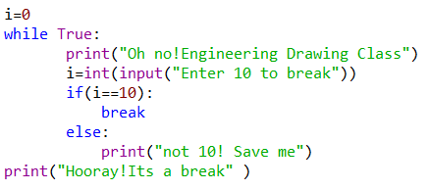
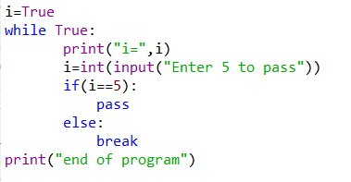
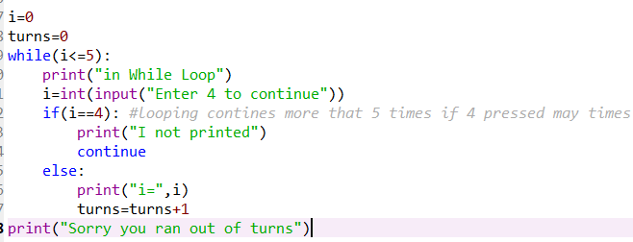
Break, pass and continue
Break(Exit Loop)
Pass(null statement)
Continue(keep Going, Don’t break)
Syntax:
while condition1:
statement1
if(condition2):
break
Example:
Syntax:
while condition1:
statement1
if(condition2):
pass
Example:
Syntax:
While condition1:
statement1
if(condition2):
continue
Example:

Slide 8
Practice….Practice
While Loop
Reverse A given Number
Find Number Is Armstrong Or Not
Calculate Sum of Natural Numbers
Display Fibonacci Series
Find LCM of two Numbers
Reverse a Number
Check Whether a Number is A Palindrome or Not
Count Number of Digits of an Integer
Find A Generic Root Of Number
Print A Calendar Taking Input From User Using Loop
Number Is Divisible By 11 Using (VEDIC MATH)
Denomination of an Amount
For Loop Questions
Generate IP (Internet Protocol) Addresses Using
Print Multiplication Table Using
Sort A Float Array In Ascending And Descending
Order Using
Find GCD of two Numbers Using
Write a program to count number of digits in a given integer.
2. Write a program to reverse a given integer.
3. Write a program to print number in reverse order with a difference of 2.
4. Write a program to print the sum of digits of a number using for loop.
5. Write a program to check whether a number is Palindrome or not.
6. Write a program to generate Fibonacci series.
7. If a four-digit number is input through the keyboard, write a program to obtain the sum of the first and last digit of this number.
8. Write a program to find GCD (greatest common divisor or HCF) and LCM (least common multiple) of two numbers.

Slide 9
9. Write programs to display each of the following patterns.
(i)
* * * * *
* * * *
* * *
* *
*
(ii)
1
2 2
3 3 3
4 4 4 4
5 5 5 5 5
(v)
A
A B
A B C
A B C D
A B C D E
(vi)
*
* * *
* * * * *
* * * * * * *
* * * * * * * * *
(iii)
1
1 2
1 2 3
1 2 3 4
1 2 3 4 5
(iv)
* * * * * * * * *
* * * * * * *
* * * * *
* * *
*
(v)
*
* *
* * *
* * * *
* * * * *

Slide 10
(vii)
1
1 2 1
1 2 3 2 1
1 2 3 4 3 2 1
1 2 3 4 5 4 3 2 1
(viii)
A B C D E F
A B C D E
A B C D
A B C
A B
A
(ix)
1
1 2 3
1 2 3 4 5
1 2 3
1
(xi)
* * * * * * *
* * * * * *
* * * *
* *
(xii)
* * * * * *
*
*
*
*
* * * * * *
(x)
* * * * *
* *
* *
* *
* * * * *

