Slide 1
Functions

Slide 2
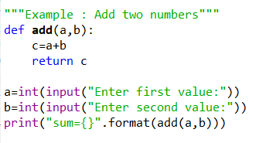
Functions
Functions are blocks of reusable code.
Syntax:
def func_name(arguments):
statements
return some_value
Example:
Def:
a , b = arguments
add() = function name
c = local variable created to store & return
result

Slide 3
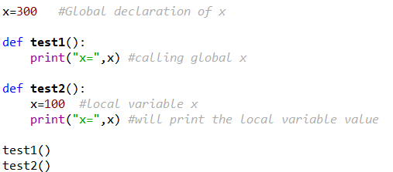
Variable Scope
Variable scope: it determines the visibility of the variable
2 types:
Local Variable: Visible only in the function where it’s declared
Global Variable: Declared once in program and visible to all the functions
Example:

Slide 4
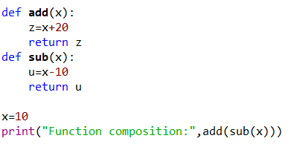
Function Composition
f(g(x))
Syntax:
def f(x):
statement1
return something
def g(x):
statement2
return something
call f(g(x)) #main function
Example:

Slide 5
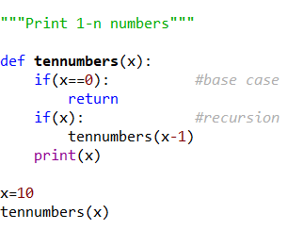
Recursion
Function calling itself until it reaches a base condition is recursion.
Syntax:
def func1():
base case statements
return func1()
print(func()) #main function
Example:

Slide 6
Write a C program to find cube of any number using function.
Write a C program to find diameter, circumference and area of circle using functions.
Write a C program to find maximum and minimum between two numbers using functions.
Write a C program to check whether a number is even or odd using functions.
Write a C program to check whether a number is prime, Armstrong or perfect number using functions.
Write a C program to find all prime numbers between given interval using functions.
Write a C program to print all strong numbers between given interval using functions.
Write a C program to print all Armstrong numbers between given interval using functions.
Write a C program to print all perfect numbers between given interval using functions.
Write a C program to find sum of digits of a given number using recursion.
Write a C program to find factorial of any number using recursion.
Write a C program to generate nth Fibonacci term using recursion.
Write a C program to find GCD (HCF) of two numbers using recursion.
Write a C program to find LCM of two numbers using recursion.
Write a C program to display all array elements using recursion.
Write a C program to find sum of elements of array using recursion.
Write a C program to find maximum and minimum elements in array using recursion.
Write a C program to find sum of all natural numbers between 1 to n using recursion.
Write a C program to find sum of all even or odd numbers in given range using recursion.
Write a C program to find reverse of any number using recursion.
Write a C program to check whether a number is palindrome or not using recursion

Slide 7
1. Write a program to add, subtract, multiply and divide two integers using user-defined type function with return type.
2. Write a program to calculate sum of first 20 natural numbers using recursive function.
3. Write a program to generate Fibonacci series using recursive function.
4. Write a program to swap two integers using call by value and call by reference methods of passing arguments to a function.
5. Write a program to find sum of digits of the number using Recursive Function.
6. Write a program to read an integer number and print the reverse of that number using recursion.
7. Write a C program to find maximum and minimum between two numbers using functions.
8. Write a C program to check whether a number is even or odd using functions.
9. Write a C program to check whether a number is prime, Armstrong or perfect number using functions.
10. Write a C program to find power of any number using recursion.
Write a C program to find power of any number using recursion.
Write a C program to print all natural numbers between 1 to n using recursion.
Write a C program to print all even or odd numbers in given range using recursion.
.Recursion
Adding Two Numbers
Factorial
Fibonacci Series
Sum of First N Numbers
Sum of Digits
Palindrome
Power of N
Largest Array Element
Prime or Composite
LCM of Two Numbers
GCD of Two Numbers
Reverse a String

