Slide 1
Strings

Slide 2
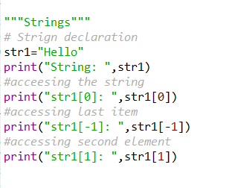

Strings
A string is a collection of characters
Result:

Slide 3
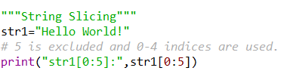
String Slicing
Result:

Slide 4
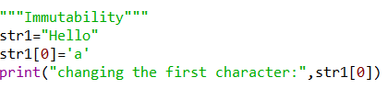
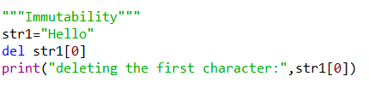


Immutability
Change
Deletion
Result: It’s gives Error(Immutability)
Result: It’s gives Error(Immutability)

Slide 5
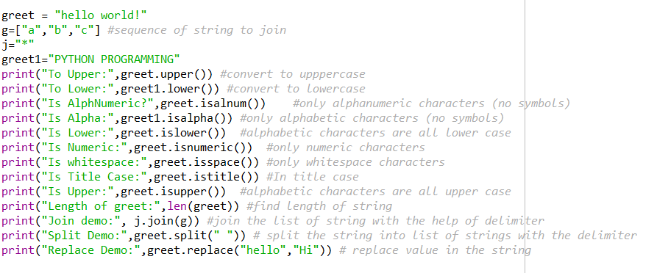
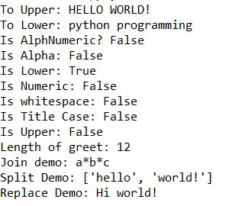
String Function
Functions
Result

Slide 6
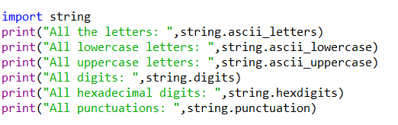
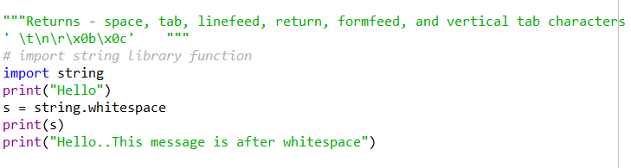
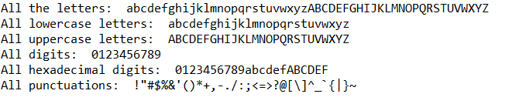

String Module
It’s a built-in module.
Result:
Result:

Slide 7
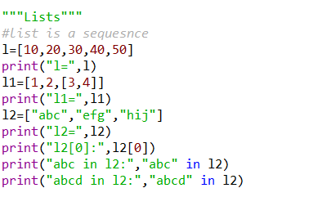


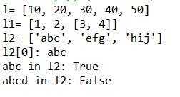
Lists as Array
Membership using ‘in’:
Traversing a list
Result:
Result:

Slide 8
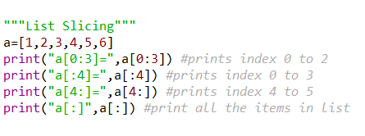
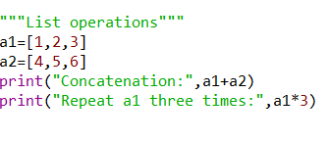



List Operations
Result:

Slide 9
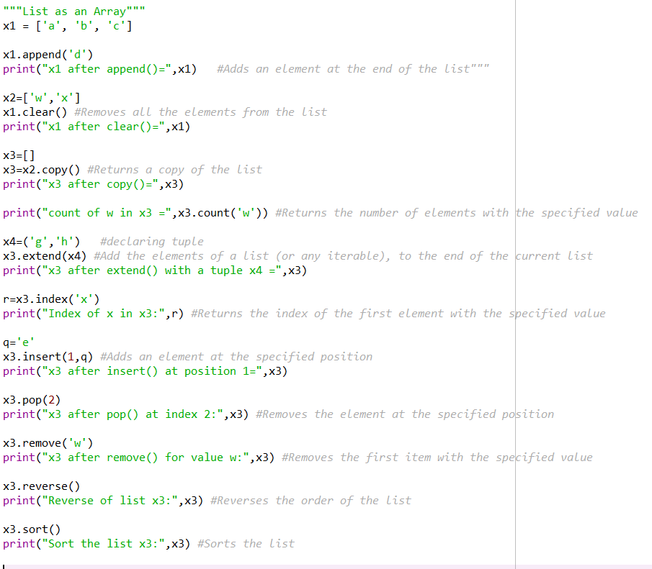
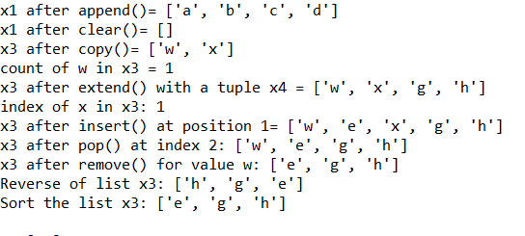
List Methods

Slide 10
Arrays Programs
Insert An Element Desired or Specific Position In An Array
● Remove Duplicates Items In An Array
● Delete Element From Array At Desired Or Specific Position
● Print “I AM IDIOT” Instead Of Your Name Using Array
● Check String Is Palindrome Or Not Using For Loop
● Convert All Input String Simultaneously Into Asterisk ( * )
● Read and print elements of the array. – using recursion.
● Print all negative elements in an array.
● Sum of all array elements. – using recursion.
● Find a maximum and minimum element in an array. – using recursion.
● Get the second largest element in an array.
● Count the total number of even and odd elements in an array.
● Count the total number of negative elements in an array.
● Copy all elements from an array to another array.
● Insert an element in an array.
● Delete an element from an array at the specified position.
● Count frequency of each element in an array.
● Print all unique elements in the array.
● Count the total number of duplicate elements in an array.
● Delete all duplicate elements from an array.
● Merge two arrays to the third array.
● Find the reverse of an array.
● Put even and odd elements of an array in two separate arrays.
● Search an element in an array.
● Sort array elements in ascending or descending order.
● Sort even and odd elements of the array separately.
● Left rotate an array.
● Right rotate an array.

Slide 11
String Programs
String Char-Case Change
● A String is Palindrome or Not
● A String Is an Anagram or Not
● Find the length of a string.
● Copy one string to another string.
● Concatenate two strings.
● Compare two strings.
● Convert lowercase string to uppercase.
● Convert uppercase string to lowercase.
● Toggle case of each character of a string.
● Find a total number of alphabets, digits or special character in a string.
● Count the total number of vowels and consonants in a string.
● Count the total number of words in a string.
● Find the reverse of a string.
● Check whether a string is a palindrome or not.
● Reverse order of words in a given string.
8. String Questions: Level Up
● Find the first occurrence of a character in a given string.

Slide 12
● Find the last occurrence of a character in a given string.
● Search all occurrences of a character in a given string.
● Count occurrences of a character in a given string.
● Find the highest frequency character in a string.
● Find the lowest frequency character in a string.
● Count the frequency of each character in a string.
● Remove the first occurrence of a character from a string.
● Remove the last occurrence of a character from a string.
● Delete all occurrences of a character from a string.
● Remove all repeated characters from a given string.
● Replace the first occurrence of a character with another in a string.
● Replace the last occurrence of a character with another in a string.
● Put all occurrences of a character with another in a string.
● Find the first occurrence of a word in a given string.
● Find the last occurrence of a word in a given string.
● Search all occurrences of a word in a given string.
● Count occurrences of a word in a given string.
● Remove the first occurrence of a word from the string.
● Remove the last occurrence of a word in a given string.
● Delete all occurrence of a word in a given string.
● A Trim leading white space characters from a given string.
● Trim trailing white space characters from a given string.
● Trim both leading and trailing white space characters from a given string.
● Remove all extra blank spaces from the given string.

