Slide 1
Sets, Tuples & Dictionary

Slide 2
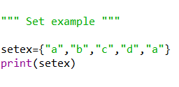

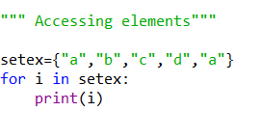


Sets
Immutable
No Duplication
Unordered
Result:

Slide 3
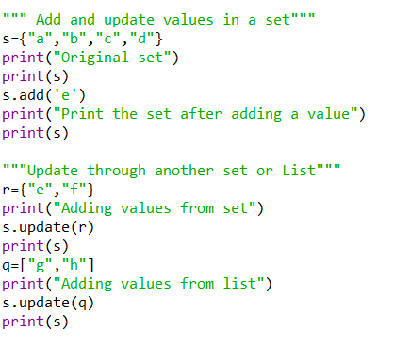
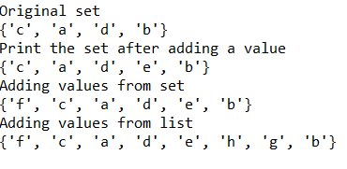
Sets- Add and Update
Result:

Slide 4
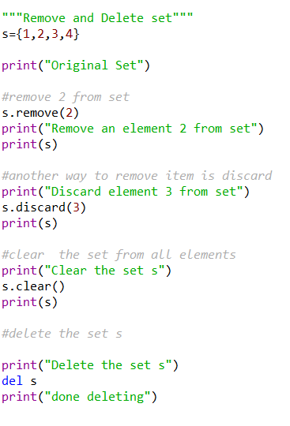
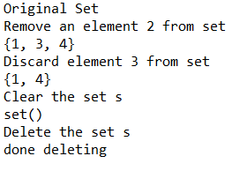
Sets - Remove
Result:

Slide 5
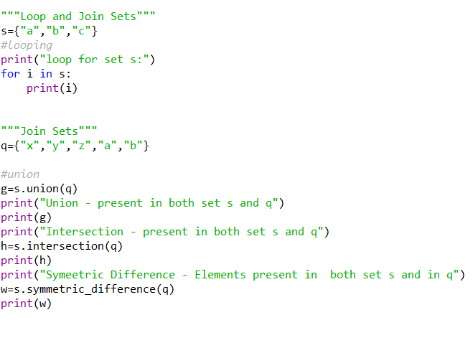
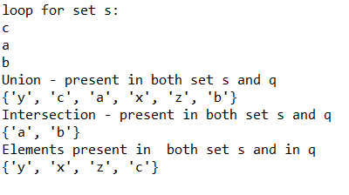
Sets - Loop & Join
Result:

Slide 6
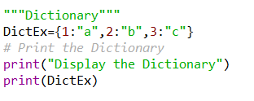

Dictionaries
Key/value pair
Ordered
Changeable
No Duplication
Result:

Slide 7
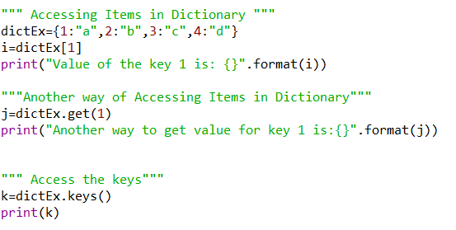

Dictionary – Accessing Items
Result:

Slide 8
Dictionary – Change Values

