Slide 1
Strings

Slide 2
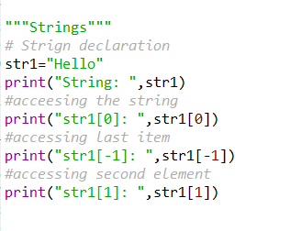

Strings
A string is a collection of characters
Result:

Slide 3
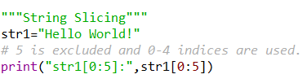
String Slicing
Result:

Slide 4
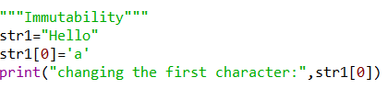
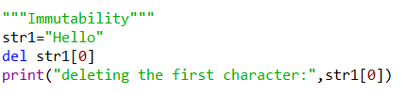


Immutability
Change
Deletion
Result: It’s gives Error(Immutability)
Result: It’s gives Error(Immutability)

Slide 5
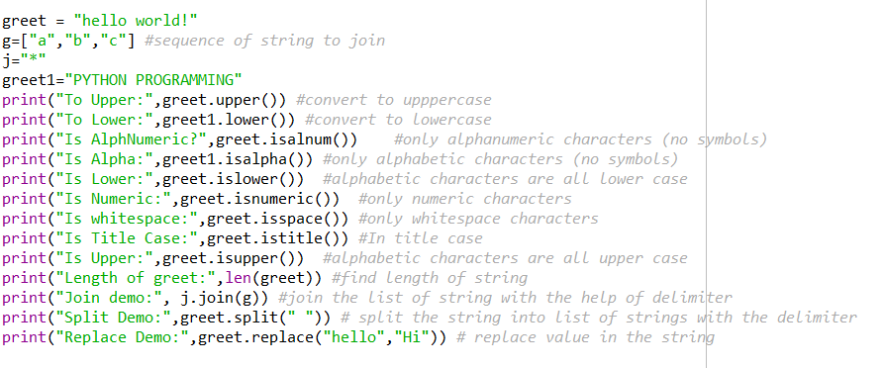
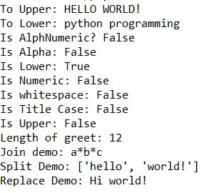
String Function
Functions
Result

Slide 6
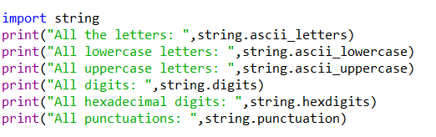
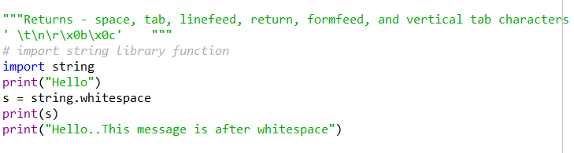
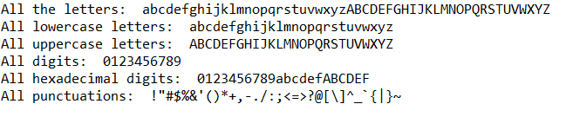

String Module
It’s a built-in module.
Result:
Result:

Slide 7
String Programs
String Char-Case Change
● A String is Palindrome or Not
● A String Is an Anagram or Not
● Find the length of a string.
● Copy one string to another string.
● Concatenate two strings.
● Compare two strings.
● Convert lowercase string to uppercase.
● Convert uppercase string to lowercase.
● Toggle case of each character of a string.
● Find a total number of alphabets, digits or special character in a string.
● Count the total number of vowels and consonants in a string.
● Count the total number of words in a string.
● Find the reverse of a string.
● Check whether a string is a palindrome or not.
● Reverse order of words in a given string.
8. String Questions: Level Up
● Find the first occurrence of a character in a given string.

Slide 8
Find the last occurrence of a character in a given string.
Search all occurrences of a character in a given string.
Count occurrences of a character in a given string.
Find the highest frequency character in a string.
Find the lowest frequency character in a string.
Count the frequency of each character in a string.
Remove the first occurrence of a character from a string.
Remove the last occurrence of a character from a string.
Delete all occurrences of a character from a string.
Remove all repeated characters from a given string.
Replace the first occurrence of a character with another in a string.
Replace the last occurrence of a character with another in a string.
Put all occurrences of a character with another in a string.
Find the first occurrence of a word in a given string.
Find the last occurrence of a word in a given string.
Search all occurrences of a word in a given string.
Count occurrences of a word in a given string.
Remove the first occurrence of a word from the string.
Remove the last occurrence of a word in a given string.
Delete all occurrence of a word in a given string.
A Trim leading white space characters from a given string.
Trim trailing white space characters from a given string.
Trim both leading and trailing white space characters from a given string.
Remove all extra blank spaces from the given string.

Slide 9
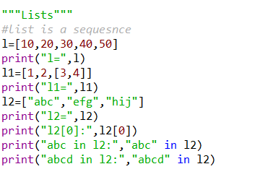


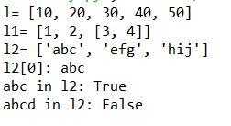
Lists as Array
Membership using ‘in’:
Traversing a list
Result:
Result:

Slide 10
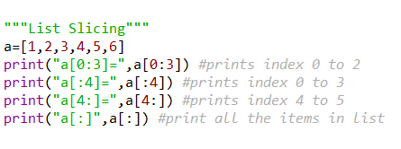
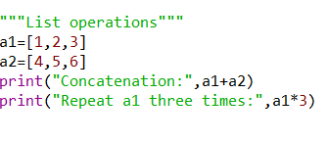



List Operations & Slicing
Result:

Slide 11
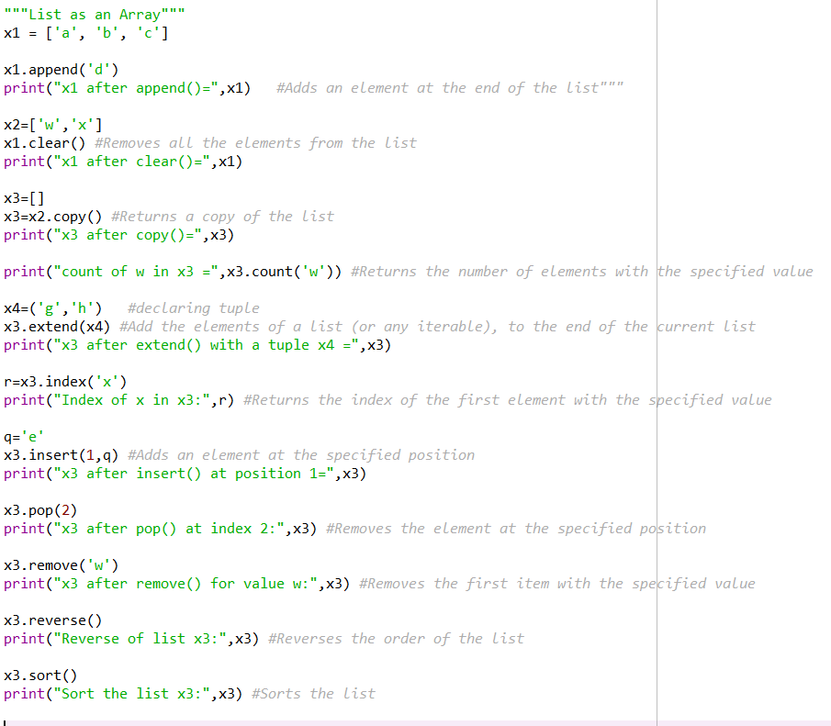
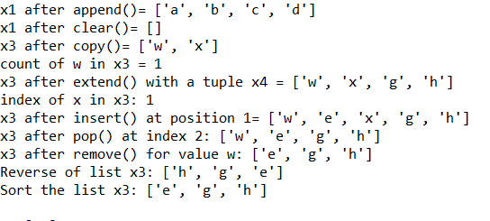
List Methods

Slide 12
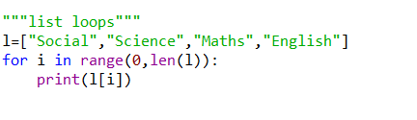
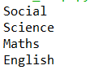
List Loop
Result:
Code:

Slide 13
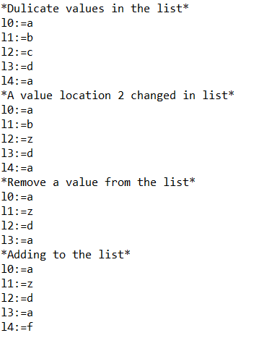
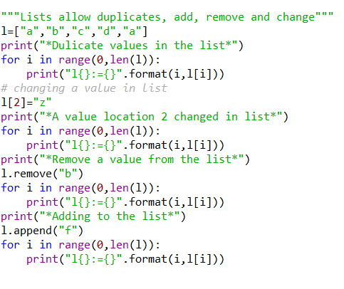
Lists are mutable
Mutability means add or remove or change
List allow duplicated
Result:

Slide 14
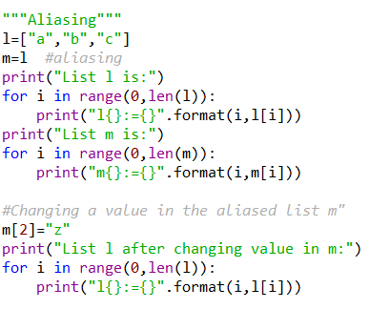
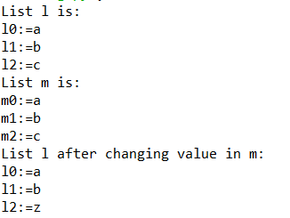
Aliasing
Result:

Slide 15
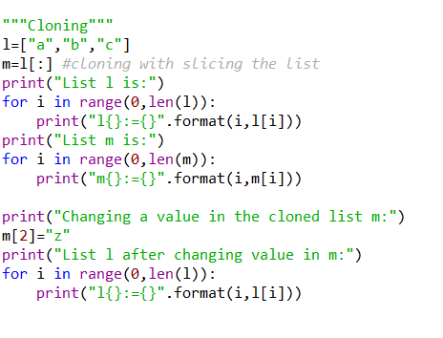
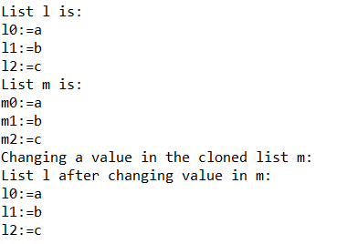
Cloning
Result:

Slide 16
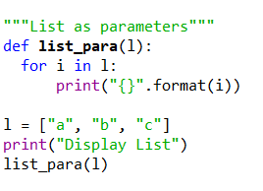

List parameters
Result:

Slide 17
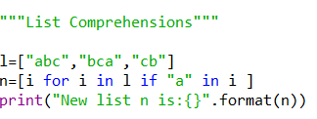

List Comprehension
Syntax:
n_list = [any_expr for i in
iterable(can be list or tuple or set)
if condition]
Example:
Result:

Slide 18
List comprehension programs
List with values greater than 5
List with squares of values
Built-in functions(lower(),upper()) as
expressions
Maximum value in each row of matrix
List of values ends with “a” and length > n
Matrix to a list

Slide 19
List or Arrays Programs
Insert An Element Desired or Specific Position In An Array
Remove Duplicates Items In An Array
Delete Element From Array At Desired Or Specific Position
Print “I AM GENIUS” Instead Of Your Name Using Array
Check String Is Palindrome Or Not Using For Loop
Convert All Input String Simultaneously Into Asterisk ( * )
Read and print elements of the array. – using recursion.
Print all negative elements in an array.
Sum of all array elements. – using recursion.
Find a maximum and minimum element in an array. – using recursion.
Get the second largest element in an array.
Count the total number of even and odd elements in an array.
Count the total number of negative elements in an array.
Copy all elements from an array to another array.
Insert an element in an array.
Delete an element from an array at the specified position.
Count frequency of each element in an array.
Print all unique elements in the array.
Count the total number of duplicate elements in an array.
Delete all duplicate elements from an array.
Merge two arrays to the third array.
Find the reverse of an array.
Put even and odd elements of an array in two separate arrays.
Search an element in an array.
Sort array elements in ascending or descending order.
Sort even and odd elements of the array separately.
Left rotate an array.
Right rotate an array.

