Slide 1
Java + Geoserver + QGIS
A Quick How To

Slide 2
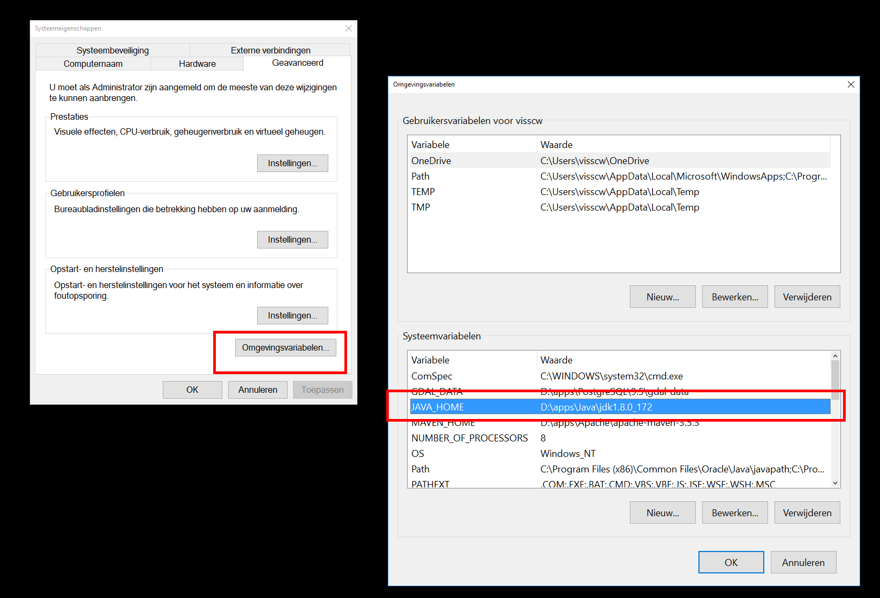
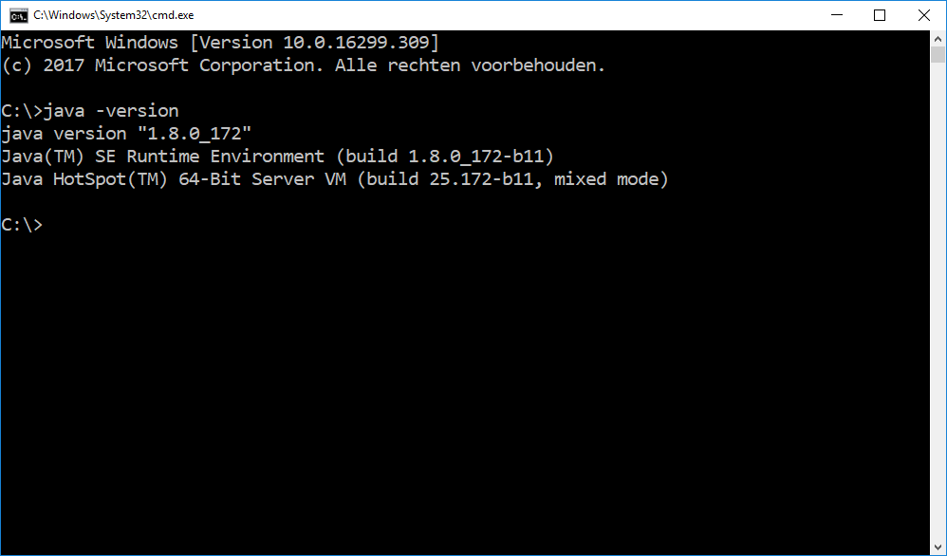
Java
Installing -> run the executable 32bit or 64bit
validate: path variables
checking is java works
“java –version”

Slide 3
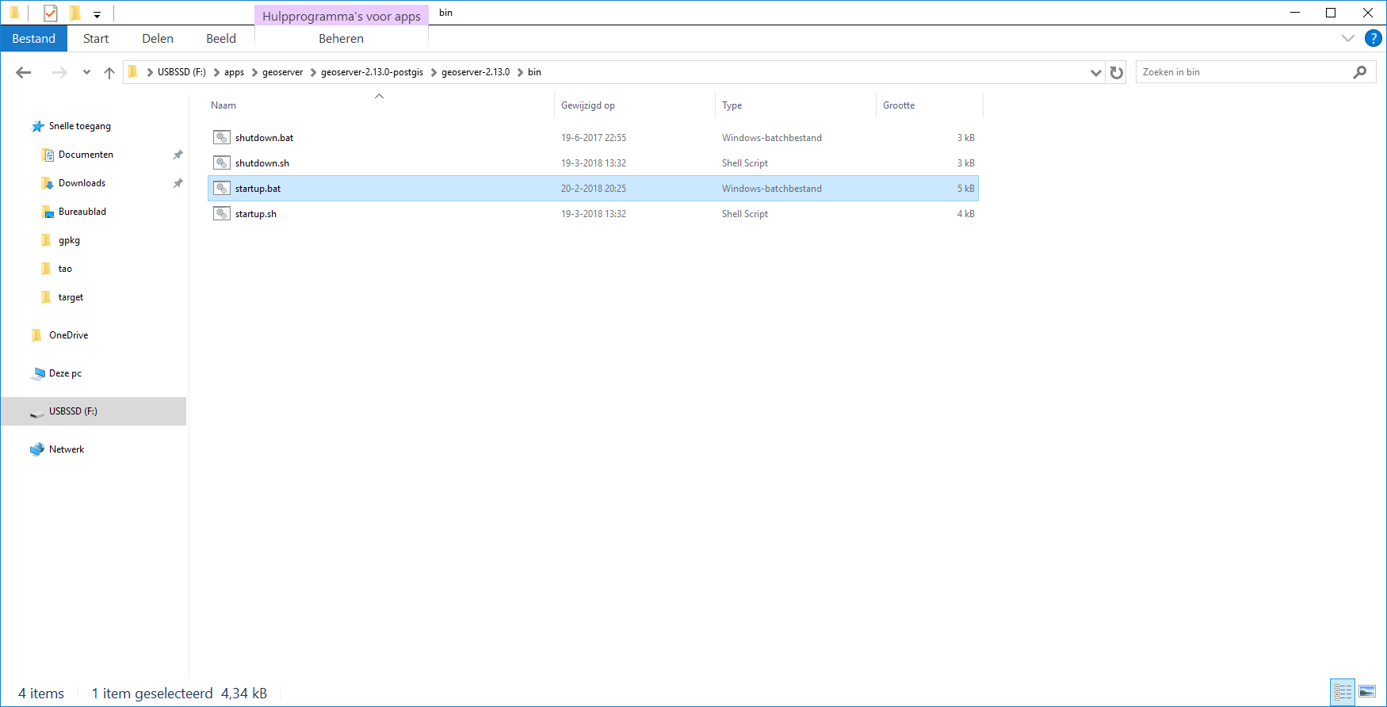
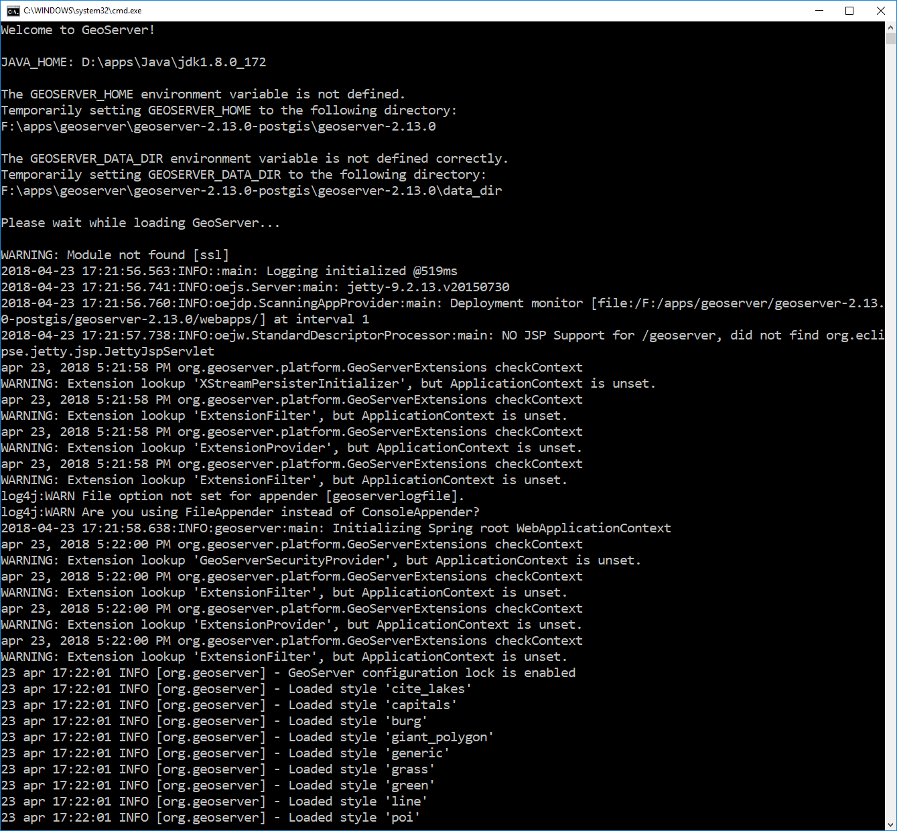
Geoserver
Unzip: geoserver-2.13.0-postgis.zip
Navigate: to .. \geoserver-2.13.0-postgis\geoserver-2.13.0\bin
Run: startup.bat

Slide 4
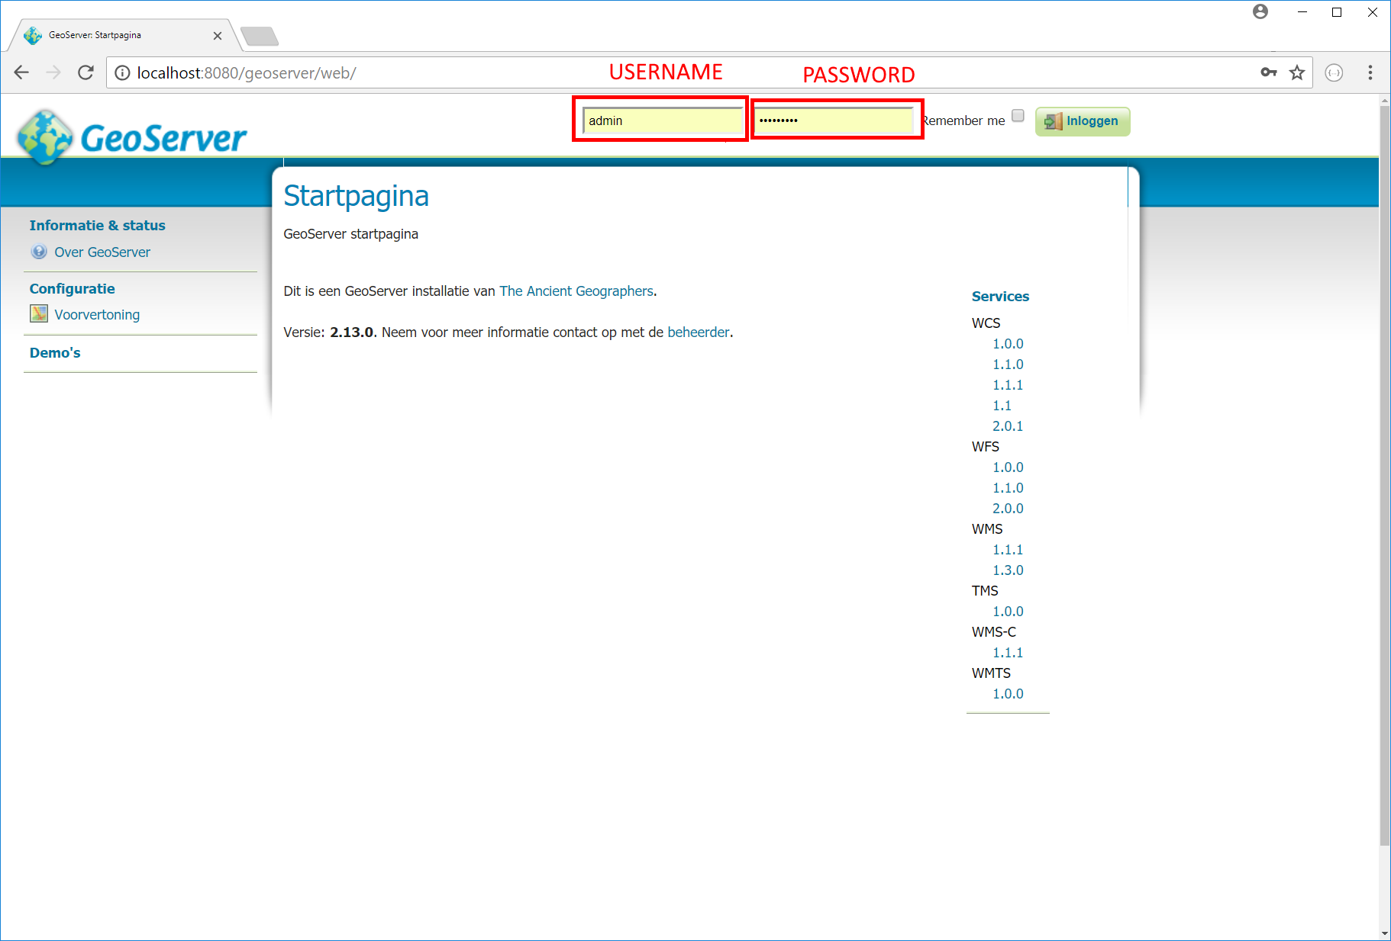
Geoserver
Goto: http://localhost:8080/geoserver/web/
Username: admin
Password: geoserver

Slide 5
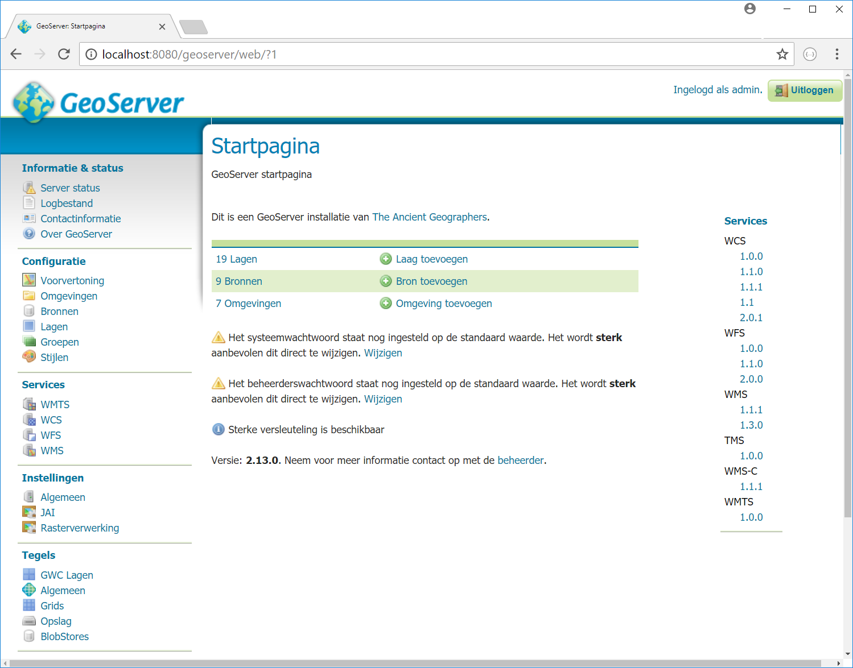
Geoserver
What should you see?

Slide 6
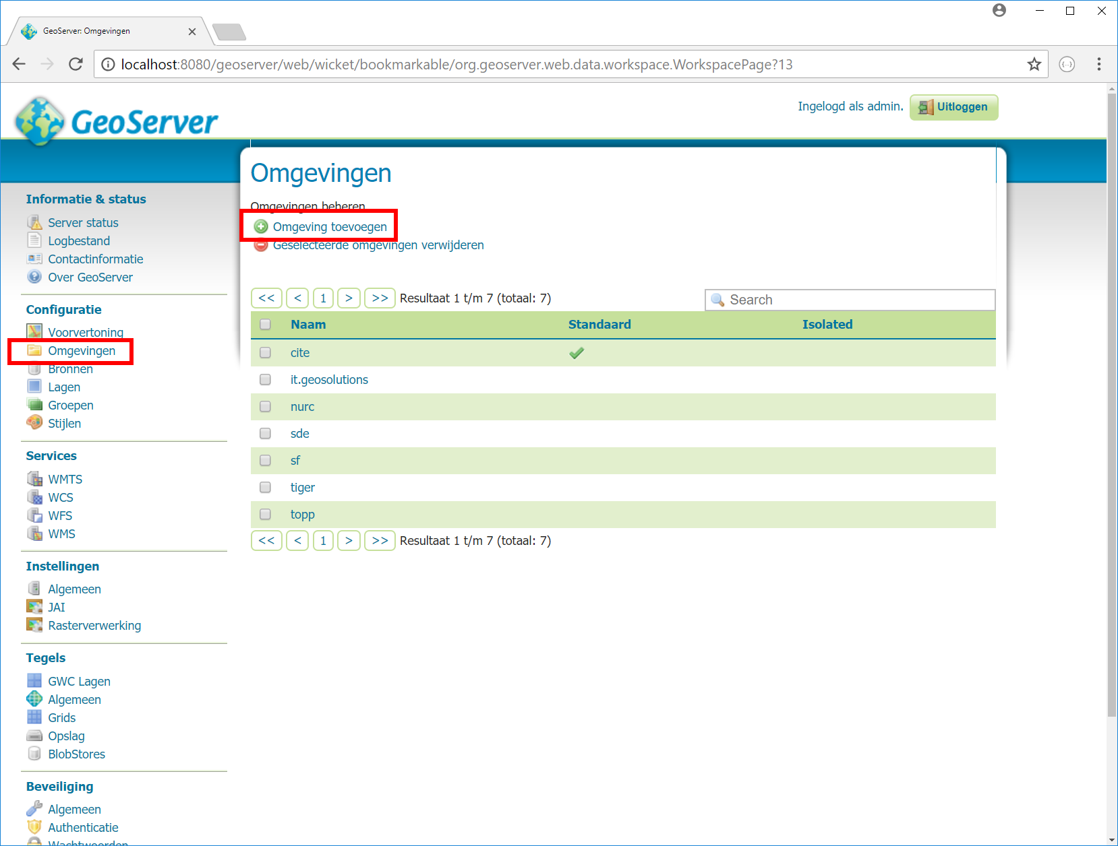
Geoserver - Workspace
Add Workspace

Slide 7
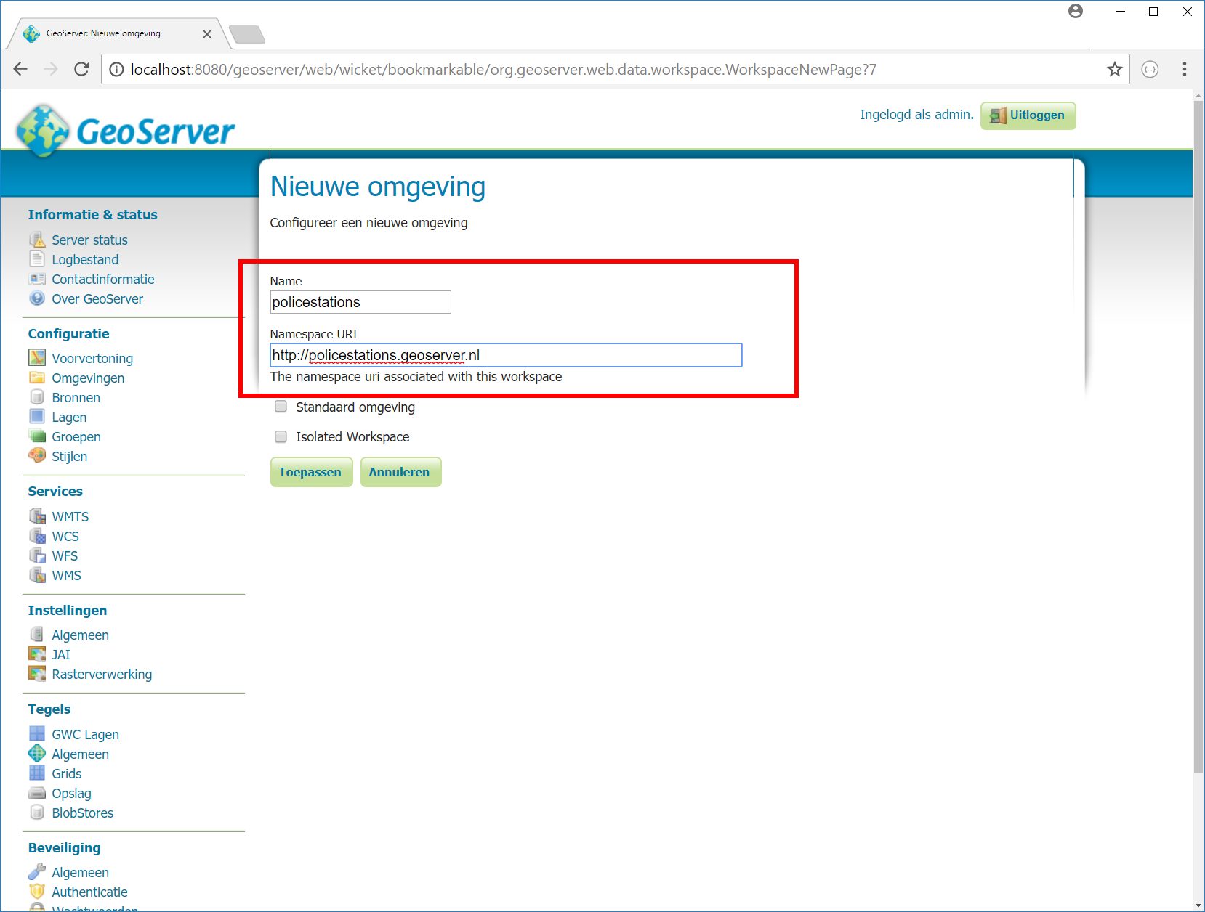
Geoserver - Workspace
Create a workspace
Name
Namespace URI

Slide 8
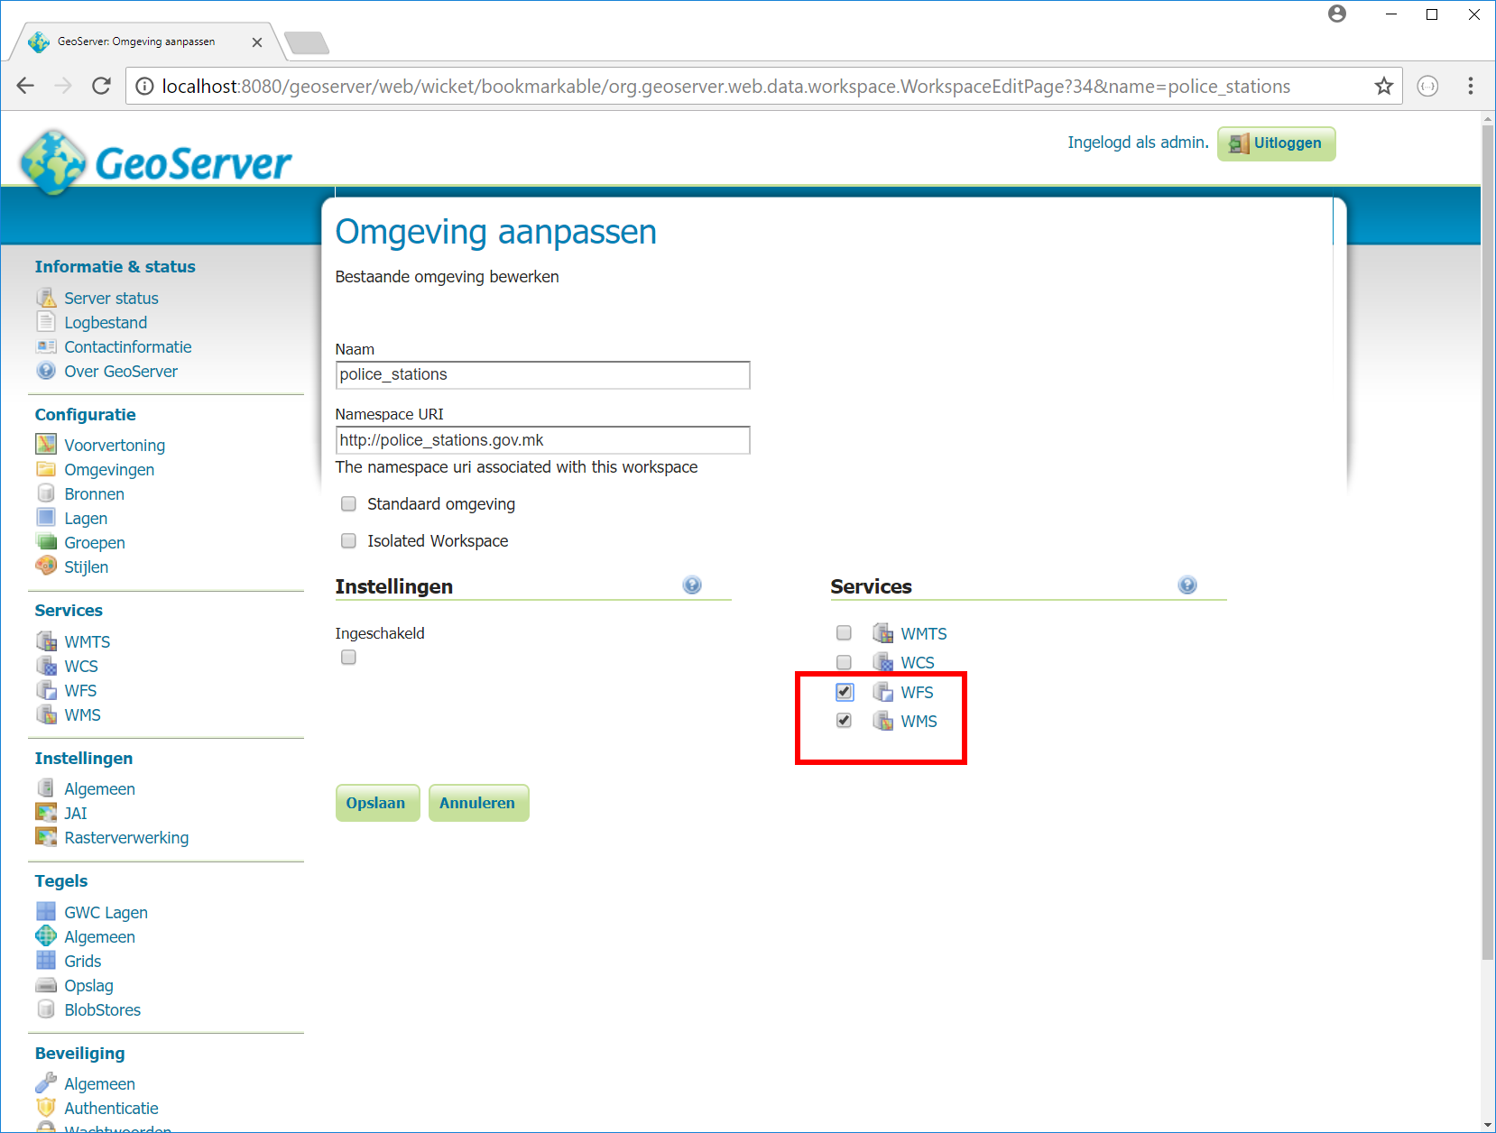
Geoserver - Workspace
Enable WMS/WFS

Slide 9
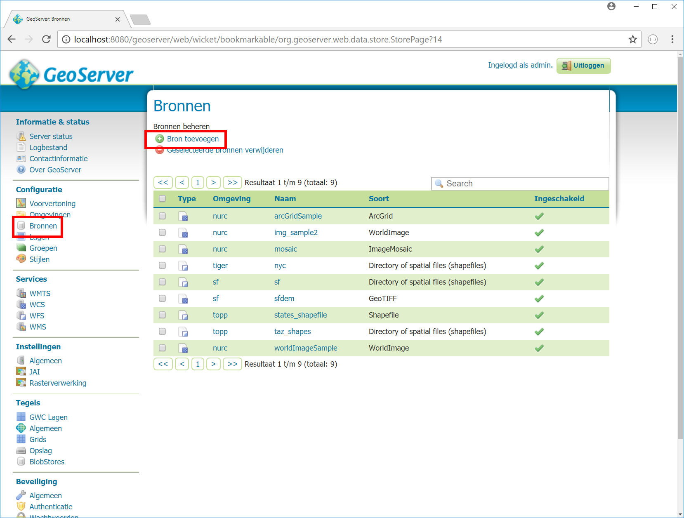
Geoserver - Datasource
Add Datasource

Slide 10
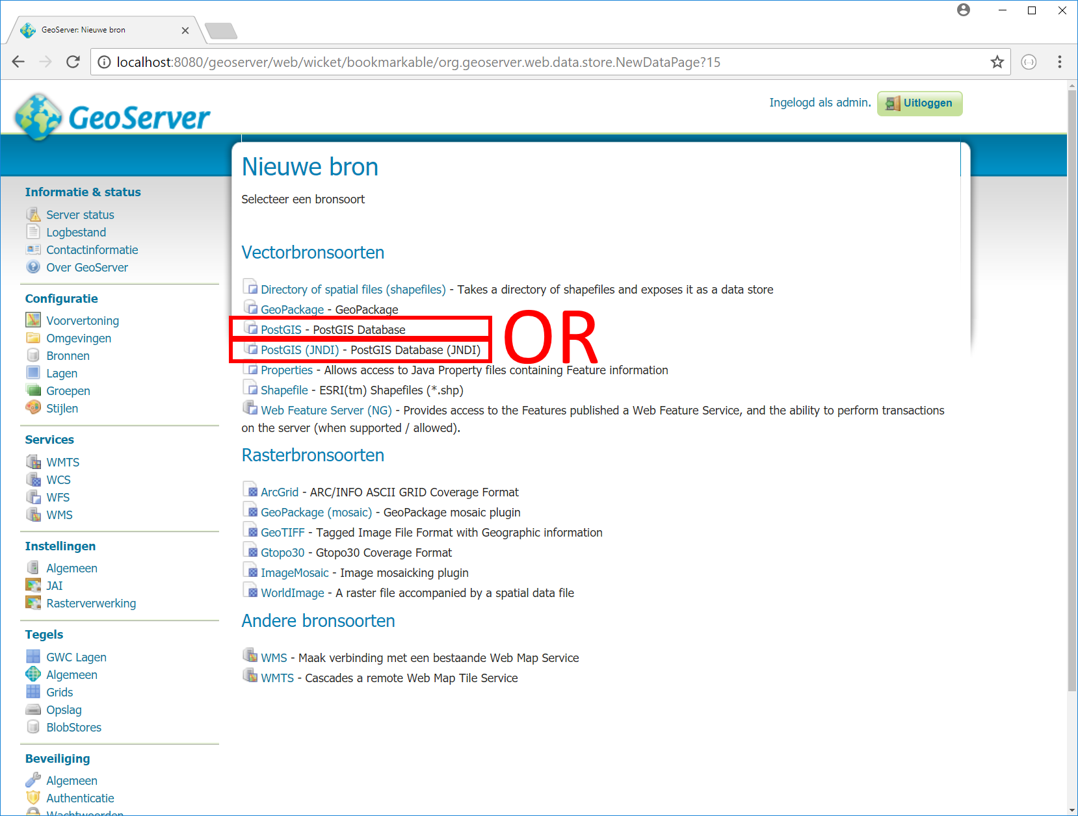
Geoserver - Datasource
PostGIS
PostGIS (JNDI)

Slide 11
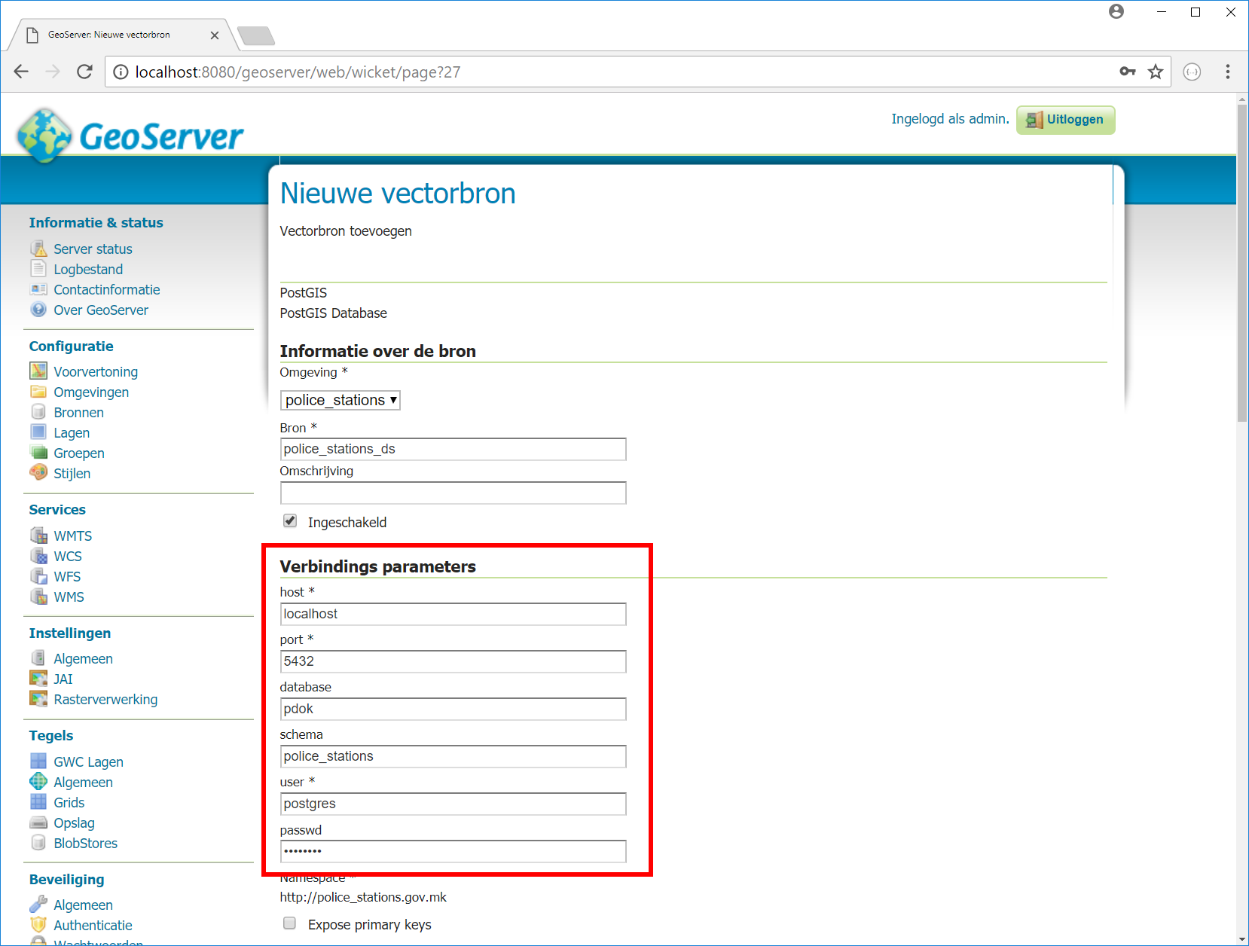
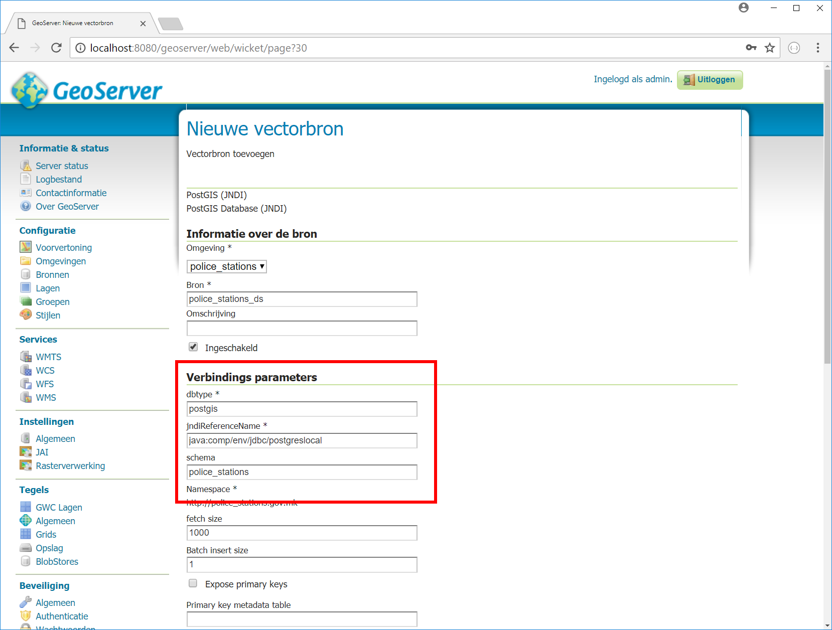
Geoserver - Datasource
PostGIS
PostGIS (JNDI)

Slide 12
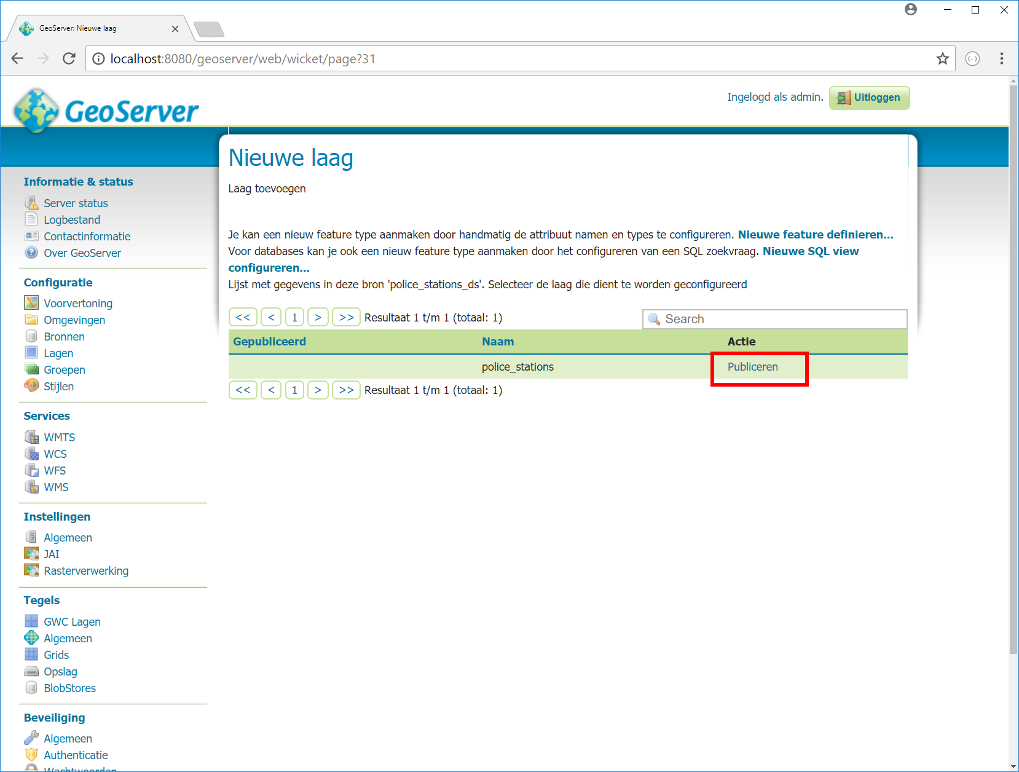
Geoserver - Layer
Add a Layer

Slide 13
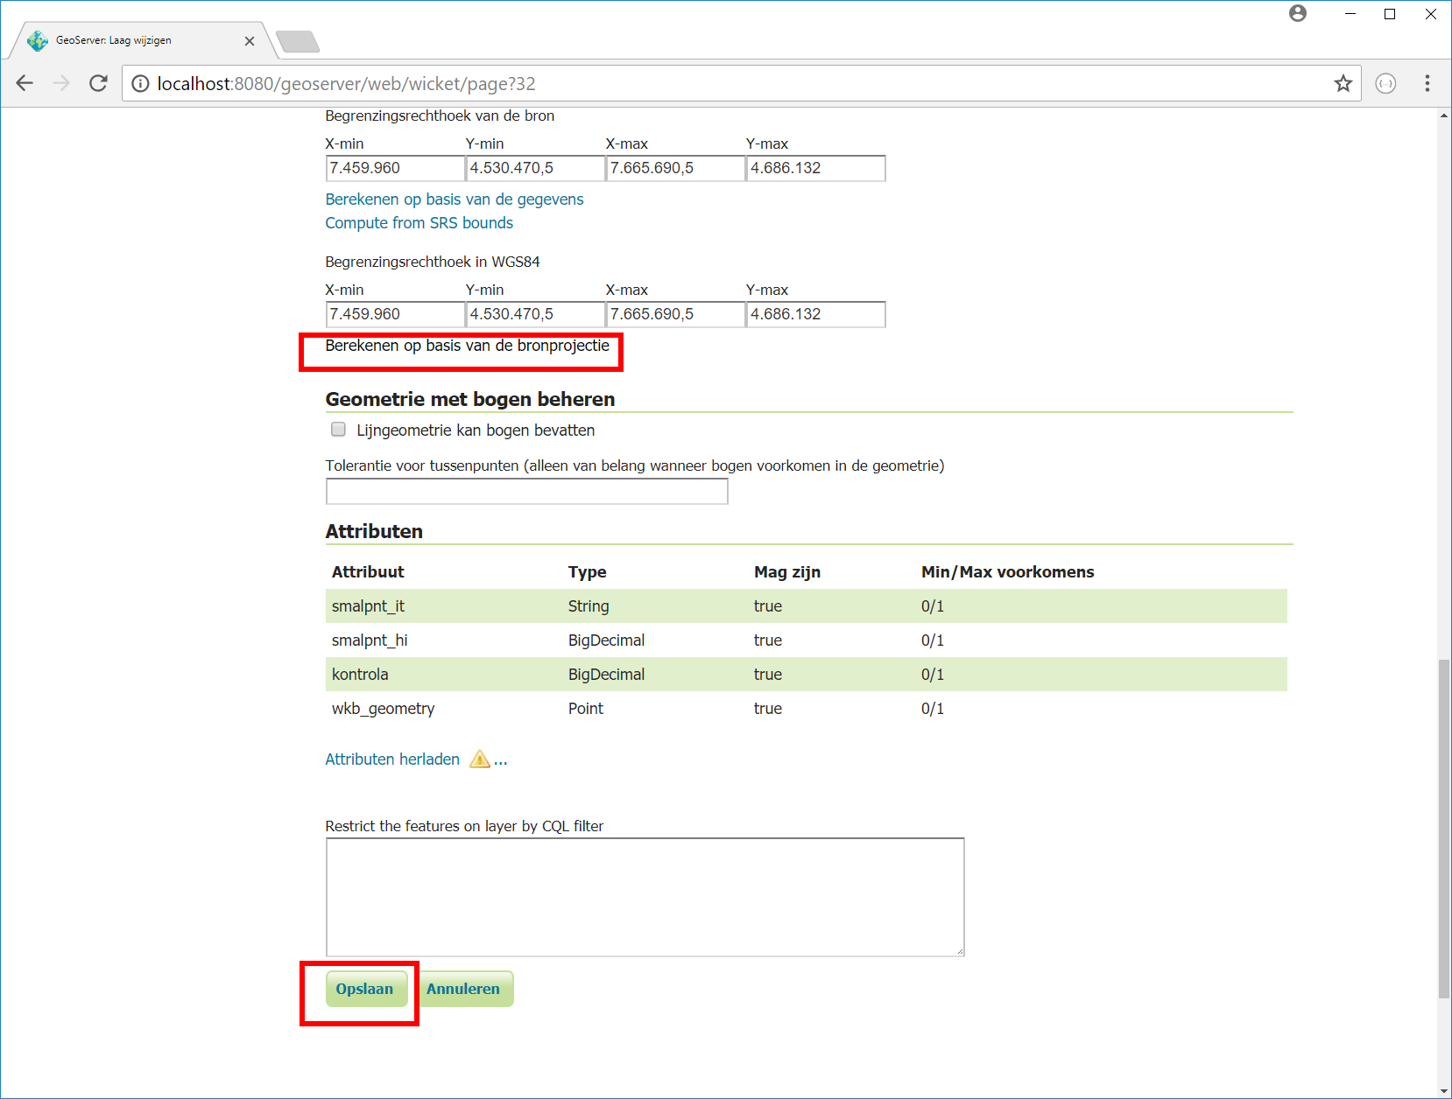
Geoserver - Layer
Calculate BBOX
Save

Slide 14
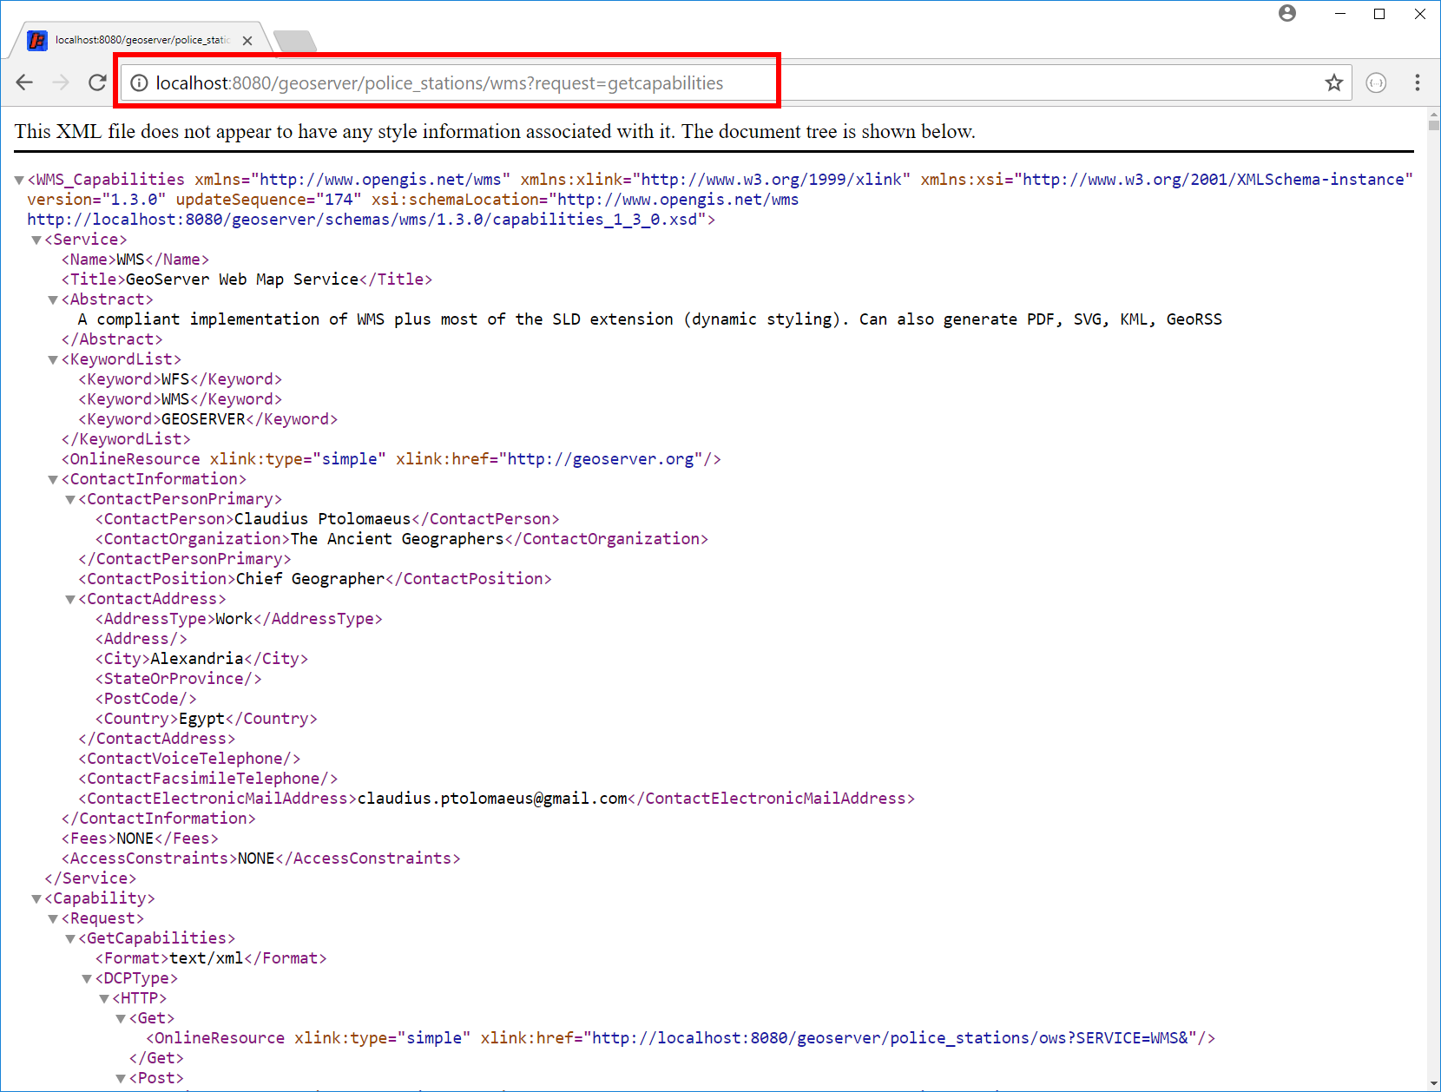
Geoserver
http://localhost:8080/geoserver/police_stations/wms?request=getcapabilities
Check if it works!

Slide 15
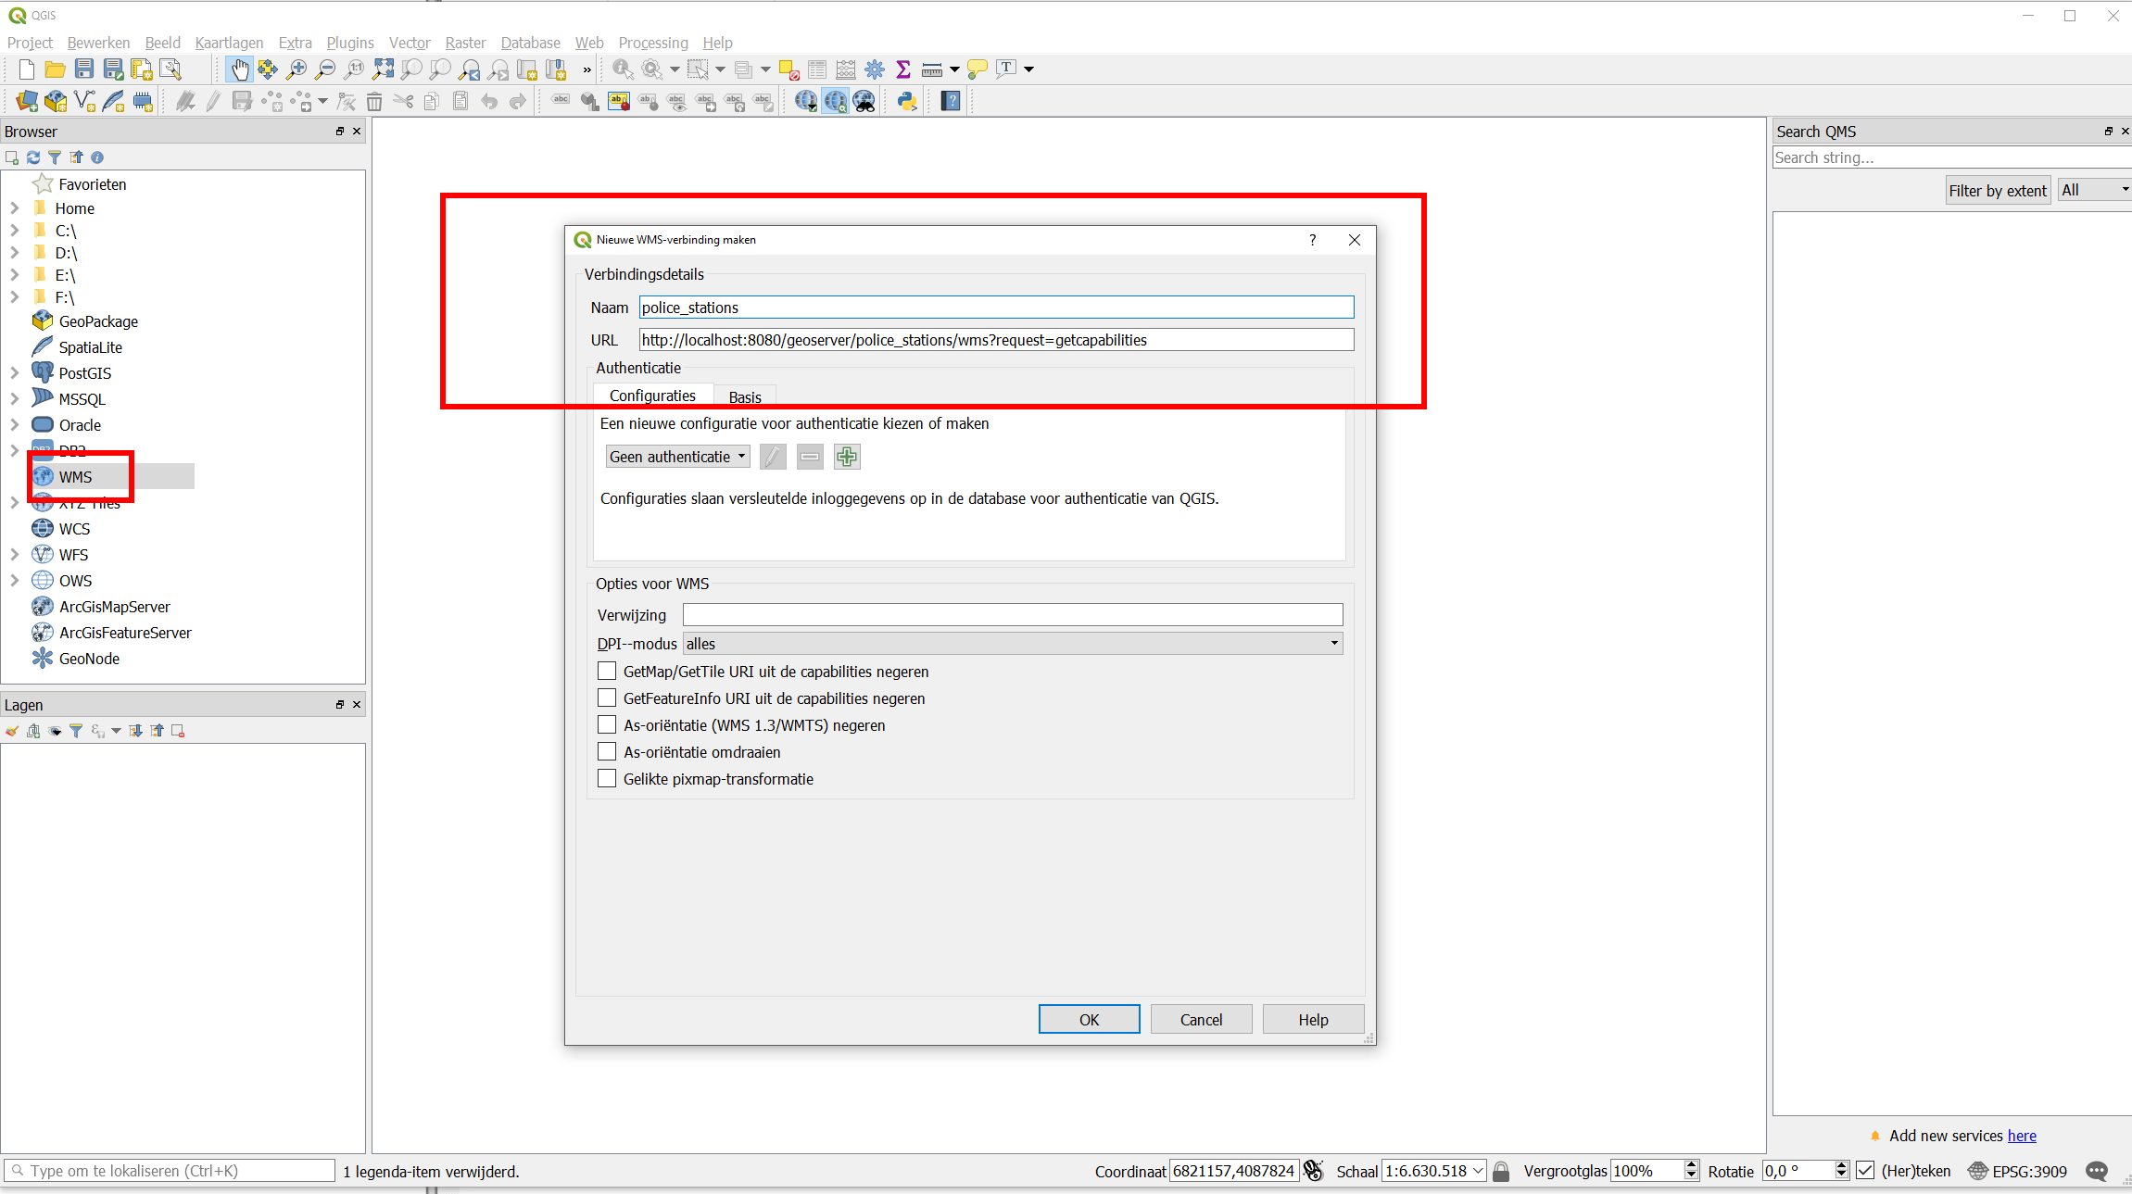
QGIS
Load Layer in QGIS

Slide 16
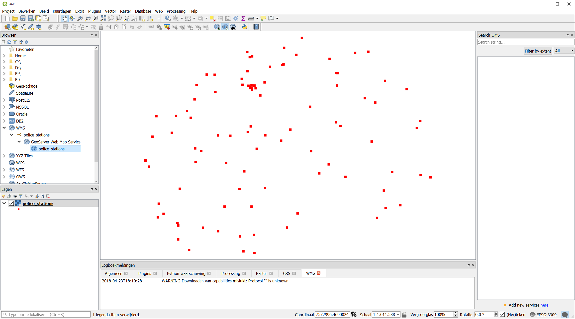
QGIS
Succes!?

Slide 17
Do it yourselves
Change the styling (SLD)
Configure a different datasource (SHP, GPKG, PostGIS)
Change (rename/alter/..) the columns
Geoserver documentation:
http://docs.geoserver.org/stable/en/user/index.html
SLD cookbook:
http://docs.geoserver.org/stable/en/user/styling/sld/cookbook/

