Slide 1
Setup Training Env

Slide 2
Components
Requirements
Java
Geoserver
Postgresql
PostGIS
QGIS

Slide 3
Requirements
OS: 64-bit Windows 10 or higher
CPU: Quad core or better
RAM for Desktop: 4 GB or higher
Screen resolution: 1440x900 or higher at standard dpi
Screen color depth: 32-bit
Video RAM for Desktop: 512 MB or higher
Graphics card: DirectX 11 (OpenGL 3.2) or better
Disk space for Desktop (and data): 3 (40) GB or higher

Slide 4
Java
Java JDK 1.8 64bit latest version
Example: jdk-8u171-windows-x64.exe

Slide 5
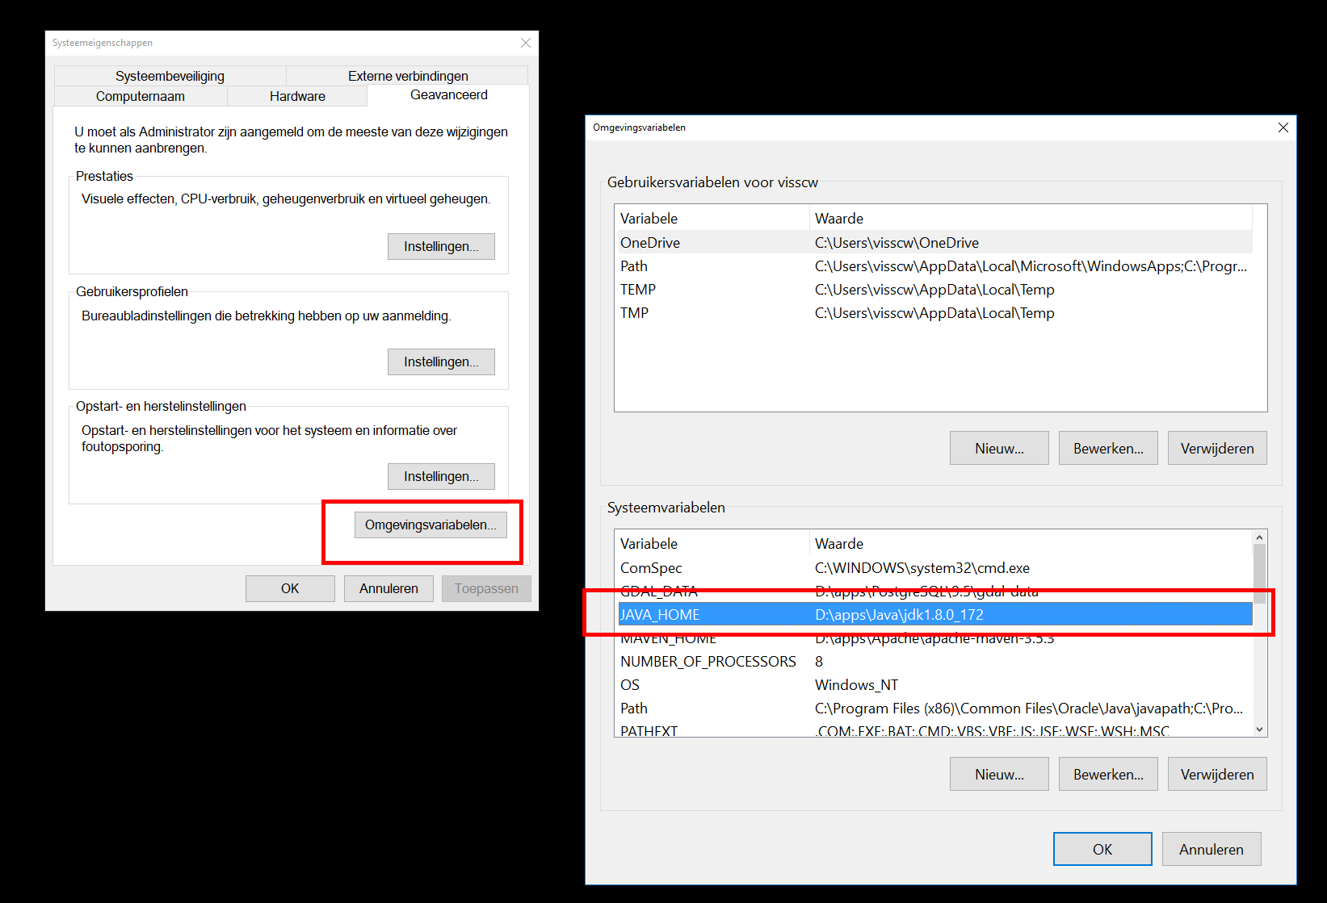
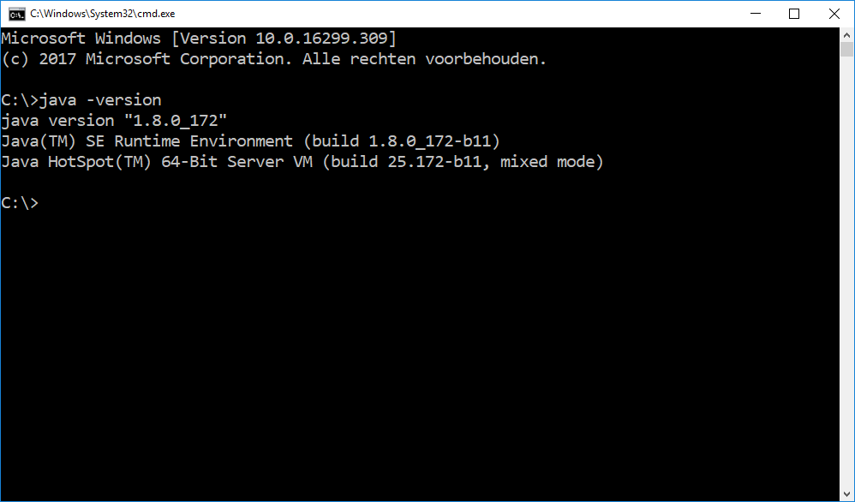
Java - validation
validate: path variables
checking is java works
“java –version”

Slide 6
Geoserver
Geoserver latest stable
Example 2.13.x
http://geoserver.org/release/stable/

Slide 7
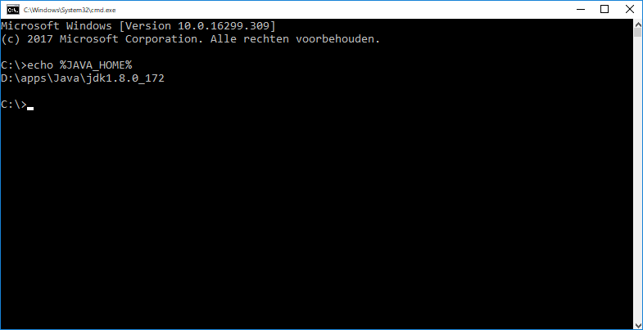
Geoserver - validation
Made sure the JAVA_HOME is set
JAVA_HOME is included in the PATH variable
echo %JAVA_HOME%

Slide 8
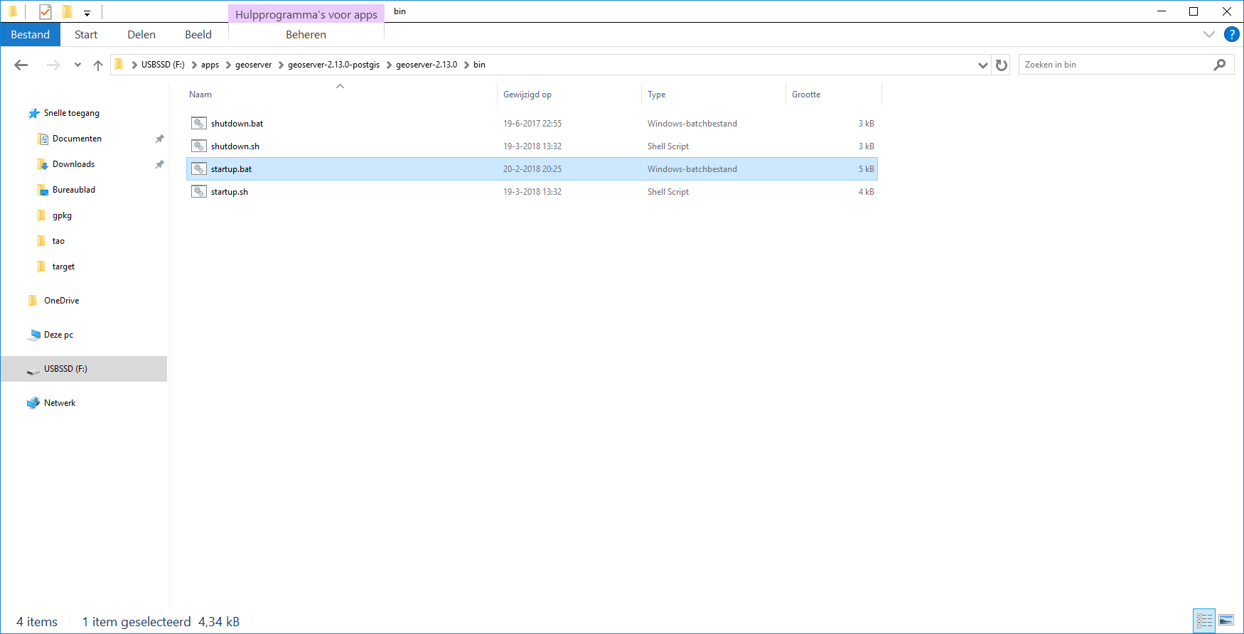
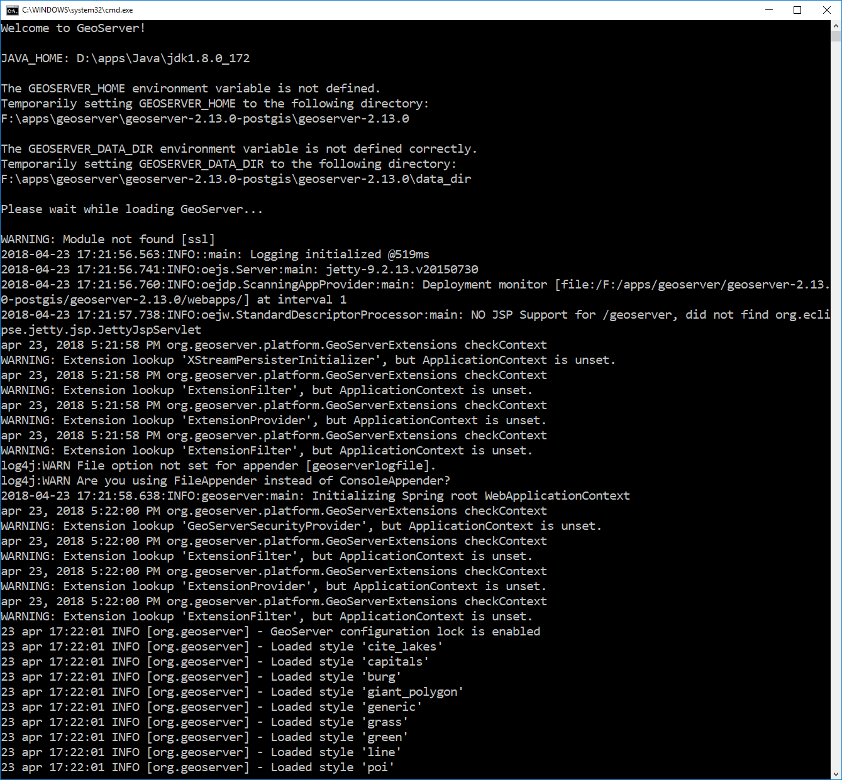
Geoserver - Startup
Navigate: to .. \geoserver-2.13.0-postgis\geoserver-2.13.0\bin
Run: startup.bat

Slide 9
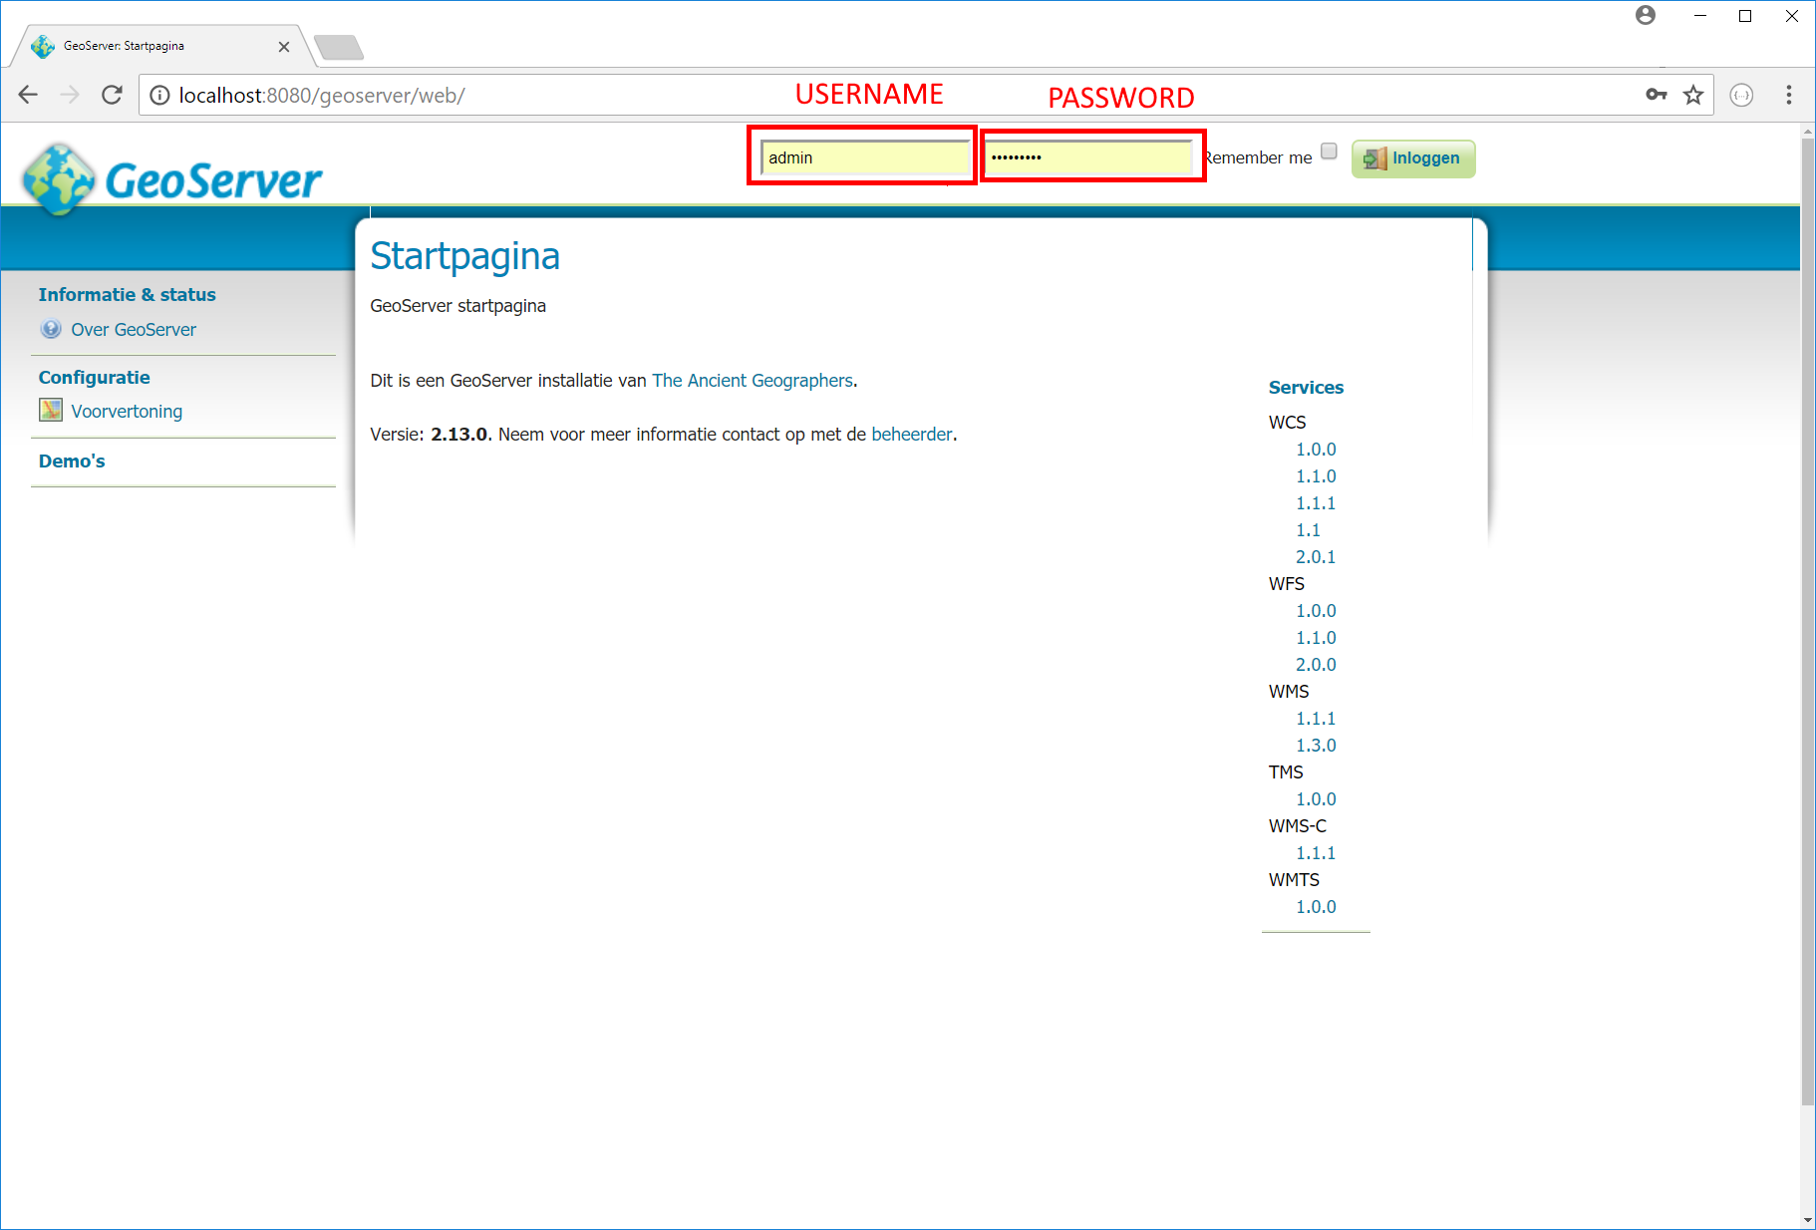
Geoserver - check
Goto: http://localhost:8080/geoserver/web/
Username: admin
Password: geoserver

Slide 10
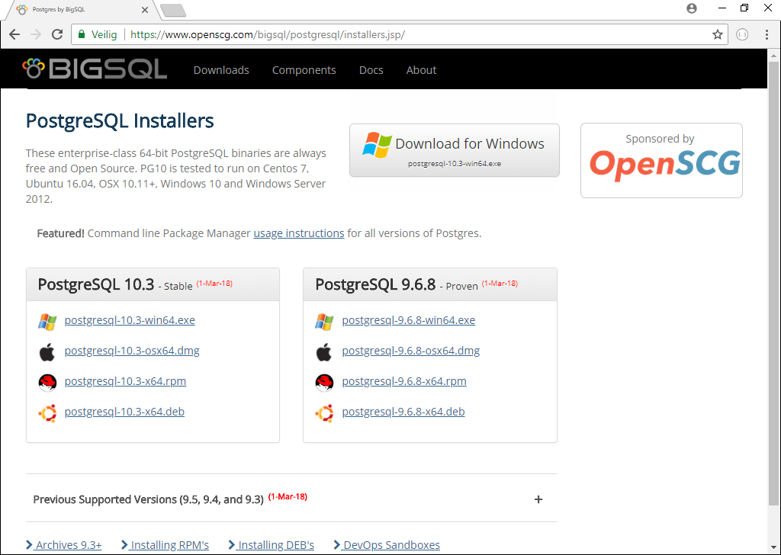
Postgresql
Download the latest 9.x or 10.x
Both should work
Download the installer
Run the installer
https://www.postgresql.org/download/windows/

Slide 11
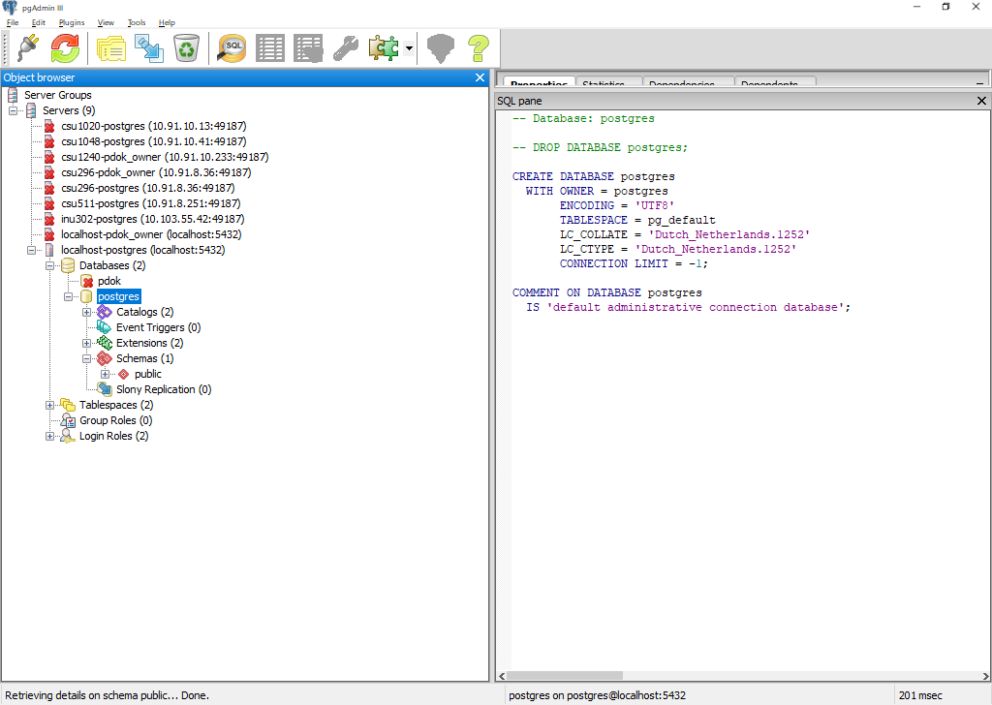
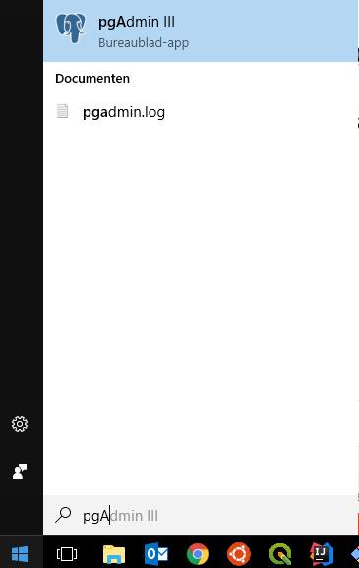
Postgresql - validate
With the installation PgAdmin is installed
Open PgAdmin
Click on the available connection

Slide 12
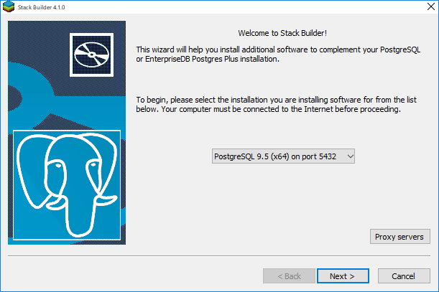
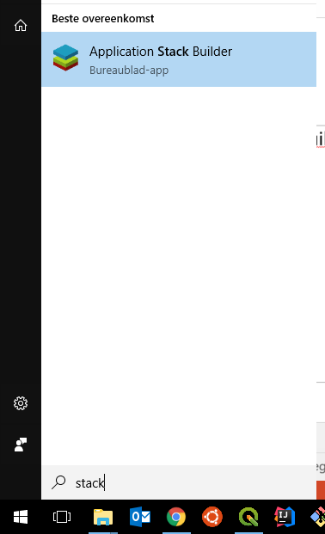
PostGIS
Run stackbuilder, that is included with the postgresql installation
Select the latest
PostGIS version 2.x
Run the installer

Slide 13
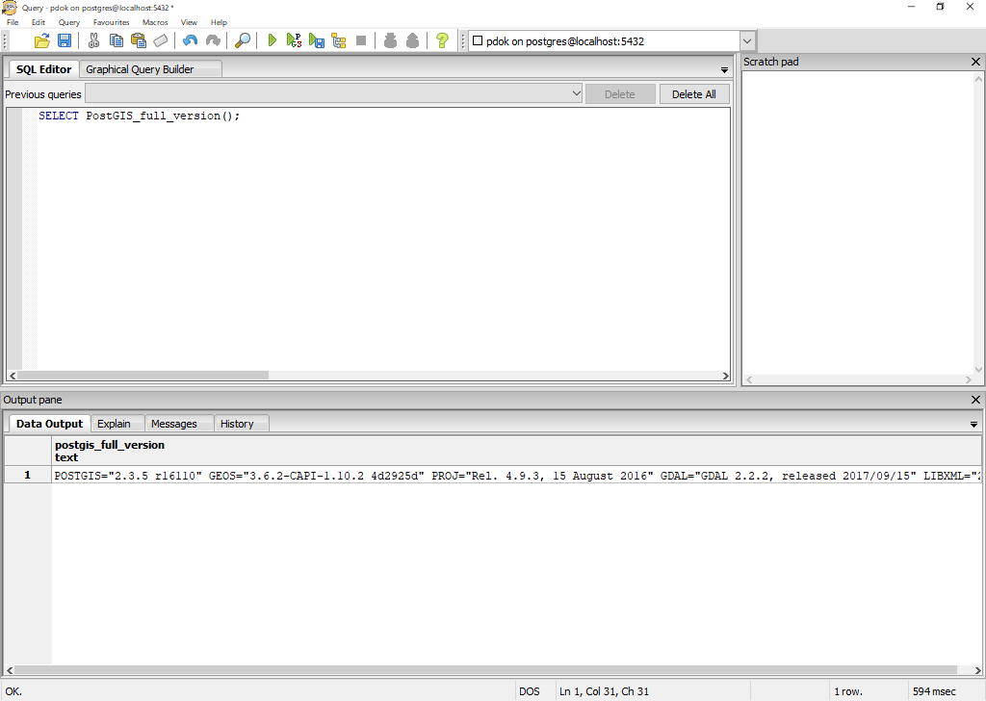
PostGIS - validation
Run in a Query window the command:
SELECT PostGIS_full_version();

