Slide 1
Banking Transaction , Risk & Exposure Analytics
An Integrated Business Intelligence Approach
PRESENTED BY: Group 03
TOOLS: Power BI | Tableau | Qlik Sense

Slide 2
BUSINESS PROBLEM & PROJECT OBJECTIVES
Fragmented banking datasets make it difficult to obtain a consolidated view of transaction activity, risk patterns and branch-level exposure.
Our Approach: Integrate and analyse banking data through interactive BI dashboards.
  Analyse banking transactions across branches and customers.
  Identify high-risk transactions and risk patterns.
  Evaluate regional and branch-level risk.
  Analyse financial exposure.
  Develop interactive dashboards across three BI platforms.
  Ensure consistency in KPIs and business logic.

Slide 3
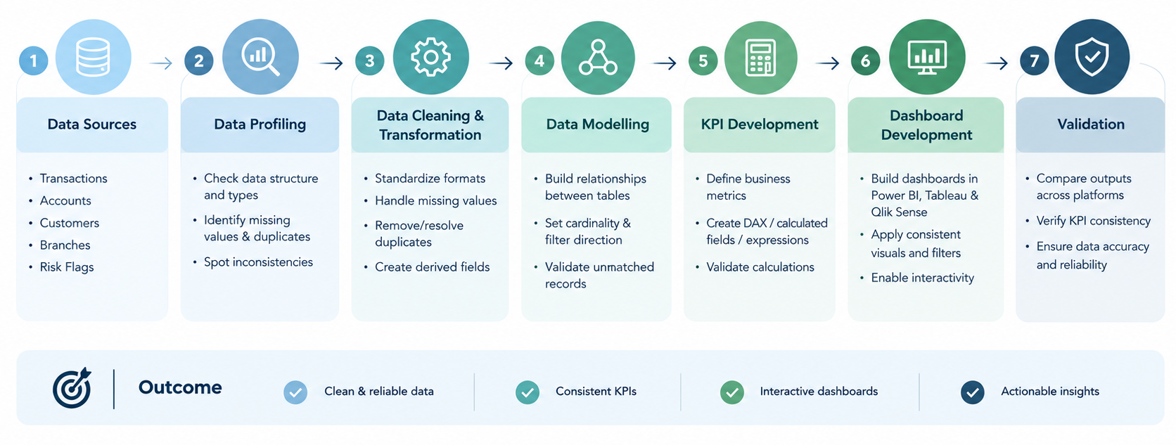
WORKFLOW

Slide 4
EXECUTIVE RISK OVERVIEW DASHBOARD

Slide 5
ACCOUNT EXPOSURE ANALYSIS DASHBOARD
Purpose:

Slide 6
BRANCH RISK DISTRIBUTION DASHBOARD
Purpose: Evaluate branch-level risk concentration and financial exposure.

Slide 7
TRANSACTION TREND ANALYSIS DASHBOARD

Slide 8
Thank you

