Slide 1




Optimizing Angular
MAY 21 / TLV, Israel

Slide 2

Performance
Myths vs. Reality

Slide 3

Modern software tent to get more complex
Limited time & resources before release
software systems do not perform well

Slide 4

Elad Hirsch
Consultant @
MAY 21 / TLV, Israel

Slide 5


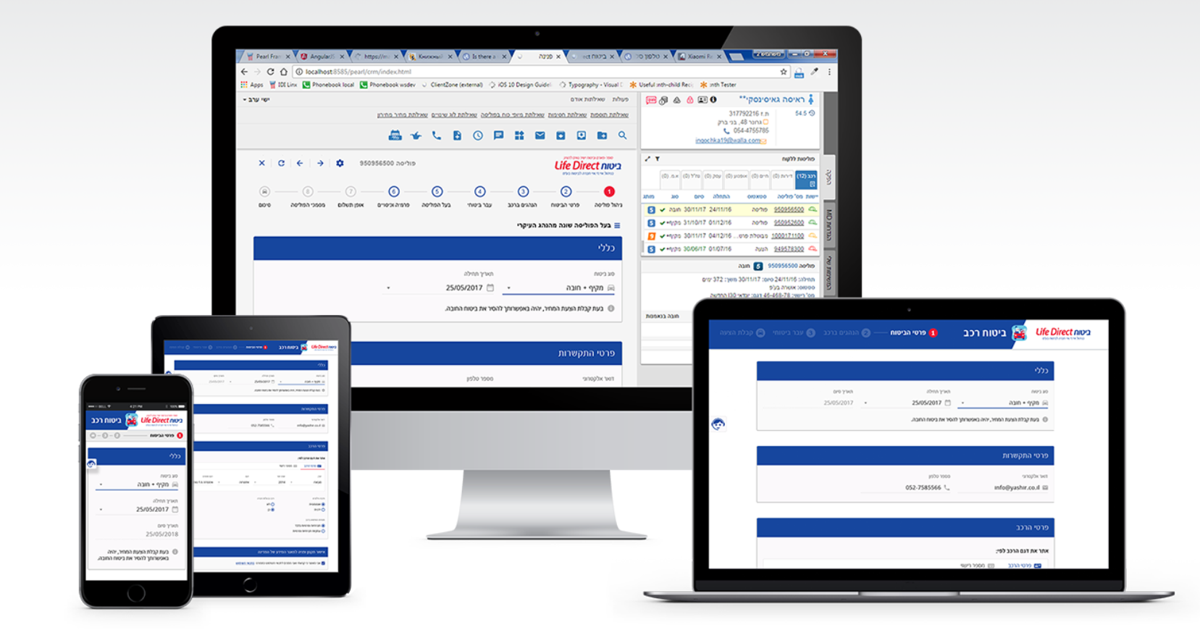

Slide 6


CD – Occurrences , Duration
Components , Bindings
DOM Size , Network , Timers
CSS Recalculation

Slide 7

Angular Debugging Probe

Slide 8

Explore ApplicationRef to get Many undocumented interesting fields
Angular expose Debugging probe and we can use it to collect Angular statistics

Slide 9

Can we reduce the number of angular change detection ?

Slide 10
this._zone.onMicrotaskEmpty.subscribe({ next: function () { this._zone.run(function () { this.tick(); }); } });
When all Micro Async Operations finished
Run Angular change detection method

Slide 11
this.ngZone.runOutsideAngular(()=> { let map=L.map('mapid').setView(); }
);

Slide 12


Can we disable angular zone ?

Slide 13

Disable ngZone:
No more automatic change detection
You must invoke change detection manually when application’s state changes
Use ApplicationRef.tick()

Slide 14

Can we take control on angular change detection ?

Slide 15

Reducing Change Detection:
Use ChangeDetectionStrategy.OnPush
Breakdown your component tree
Detach Top-level components:
Update @Input values
CDR.detectChanges()

Slide 16
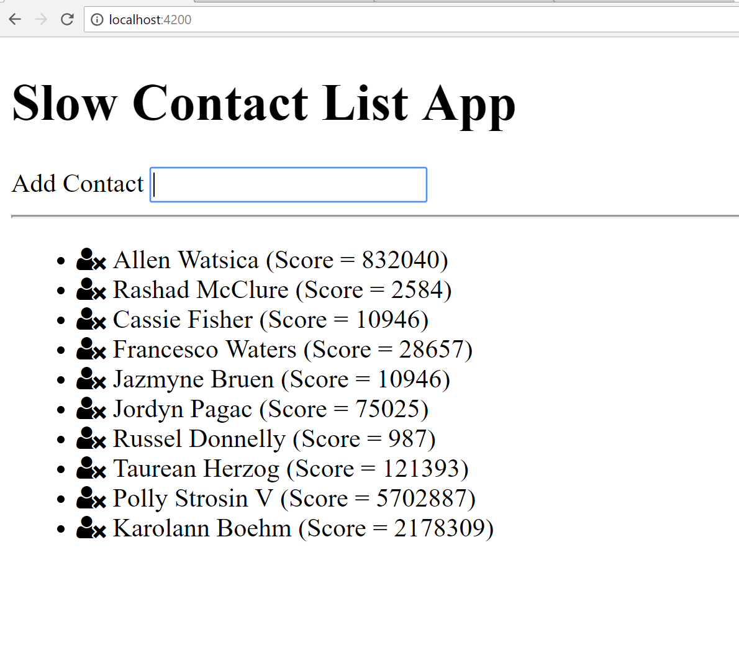


Slide 17

What about Forms ?

Slide 18

Angular Web Worker

Slide 19
… And what about Development Performance ?

Slide 20

Hot Module Reload

Slide 21

Optimize bundle

Slide 22
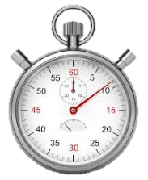
Reduce build time

Slide 23

It’s 2018,
Wake up people …

Slide 24
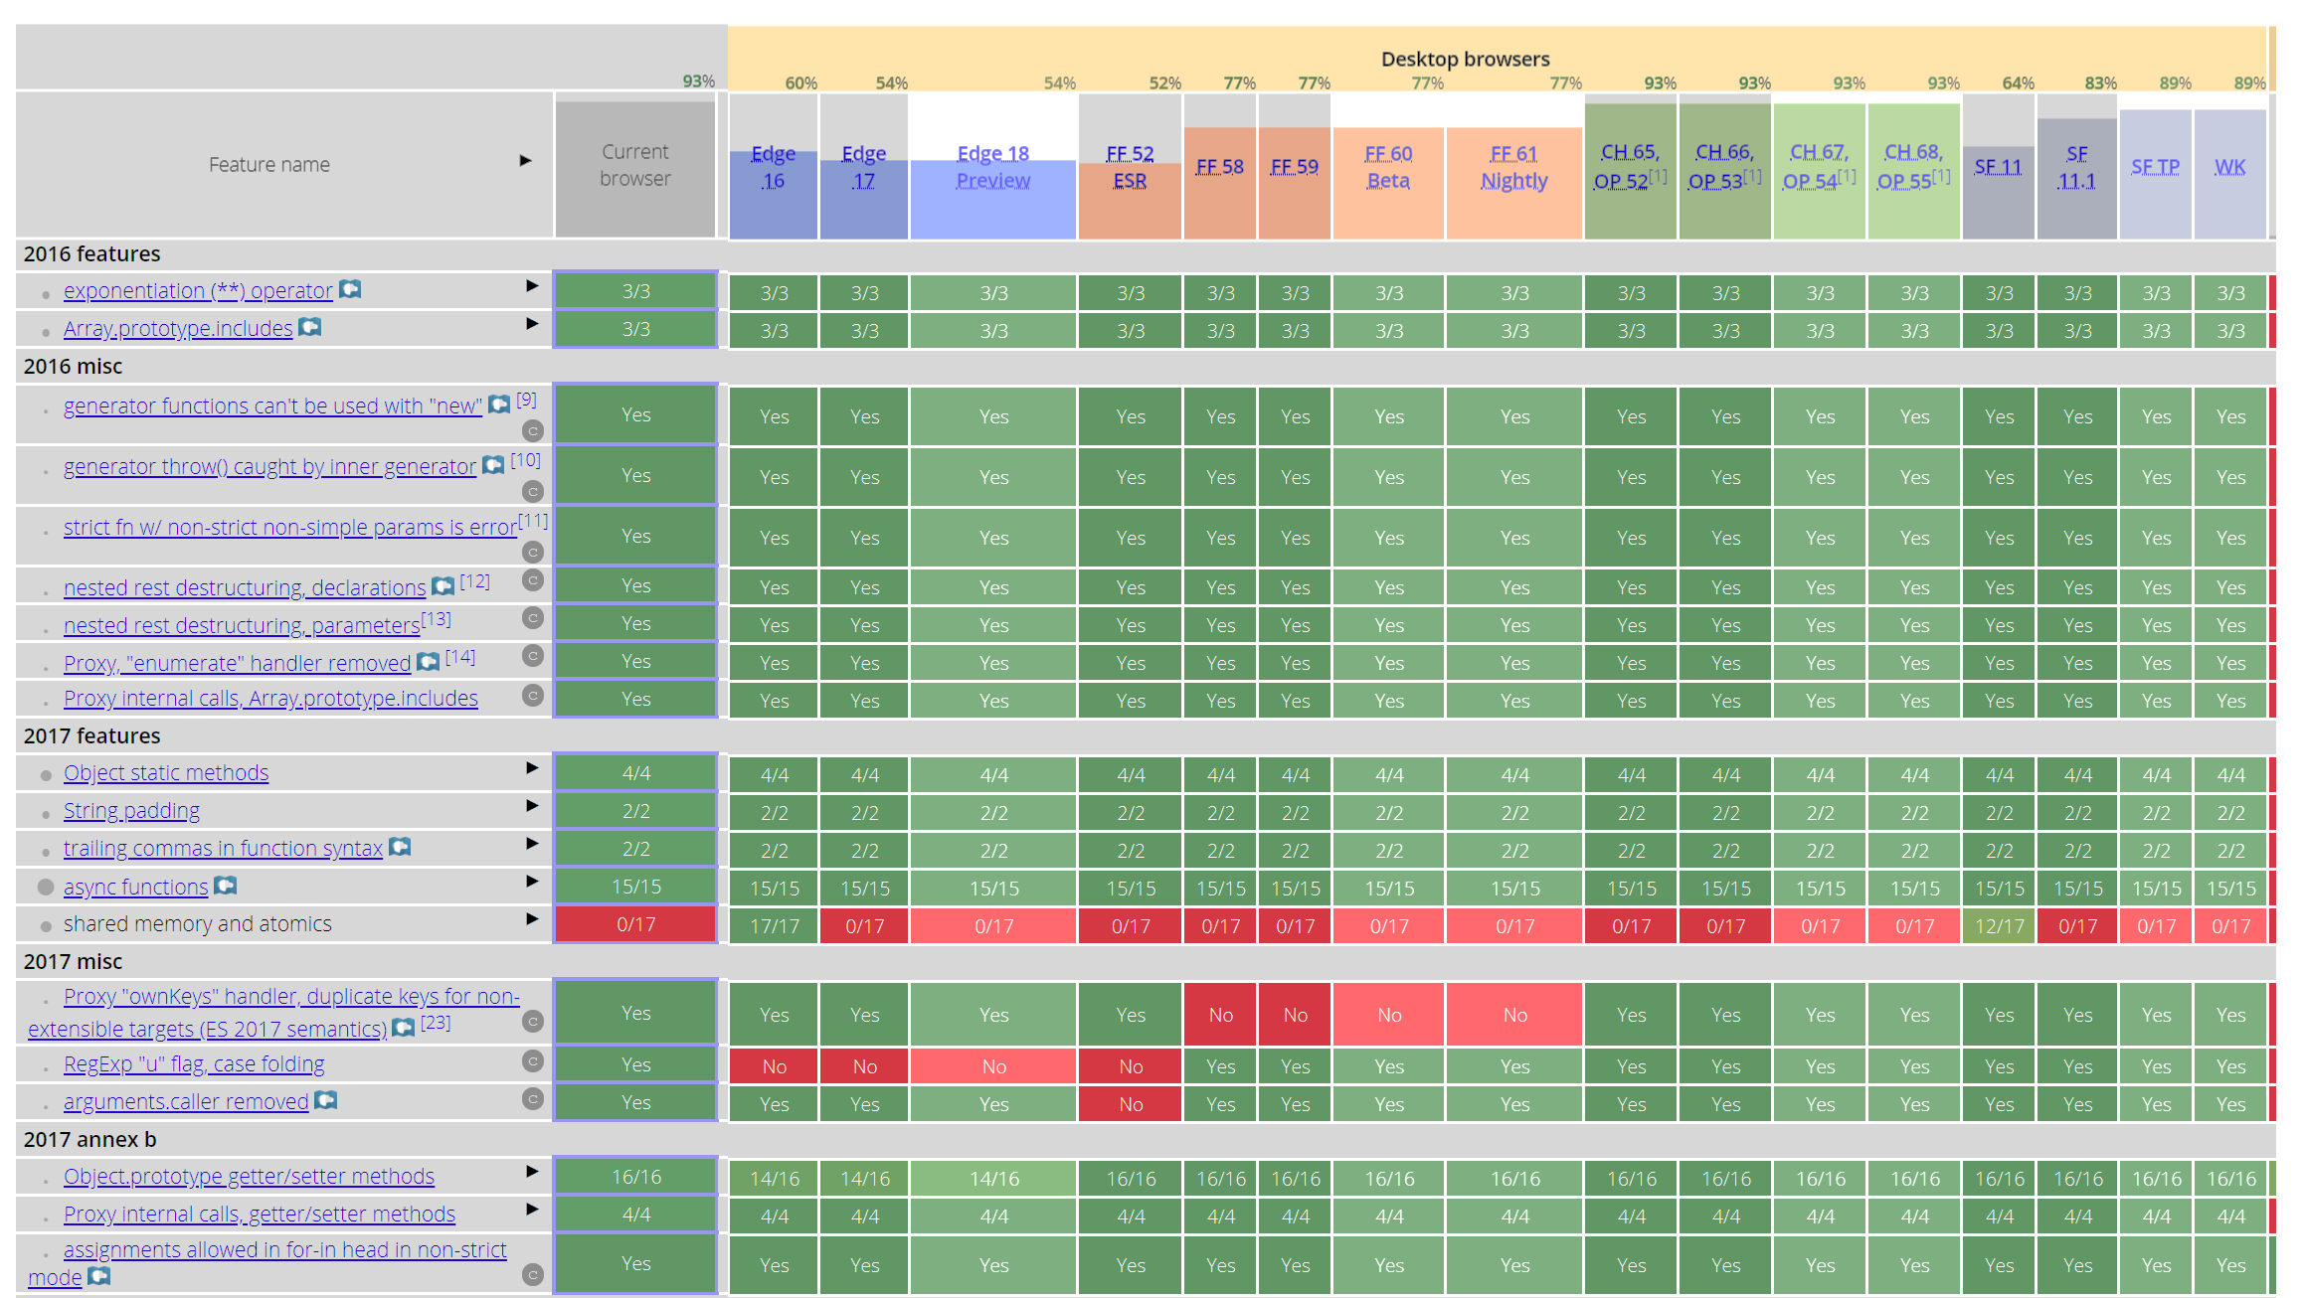
Notes:
Lets show some es7 code and use typescript to compile to ES2017 then just run in the browser
Let show example

Slide 25

Server side rendering

Slide 26


Slide 27

Angular Service Worker

Slide 28
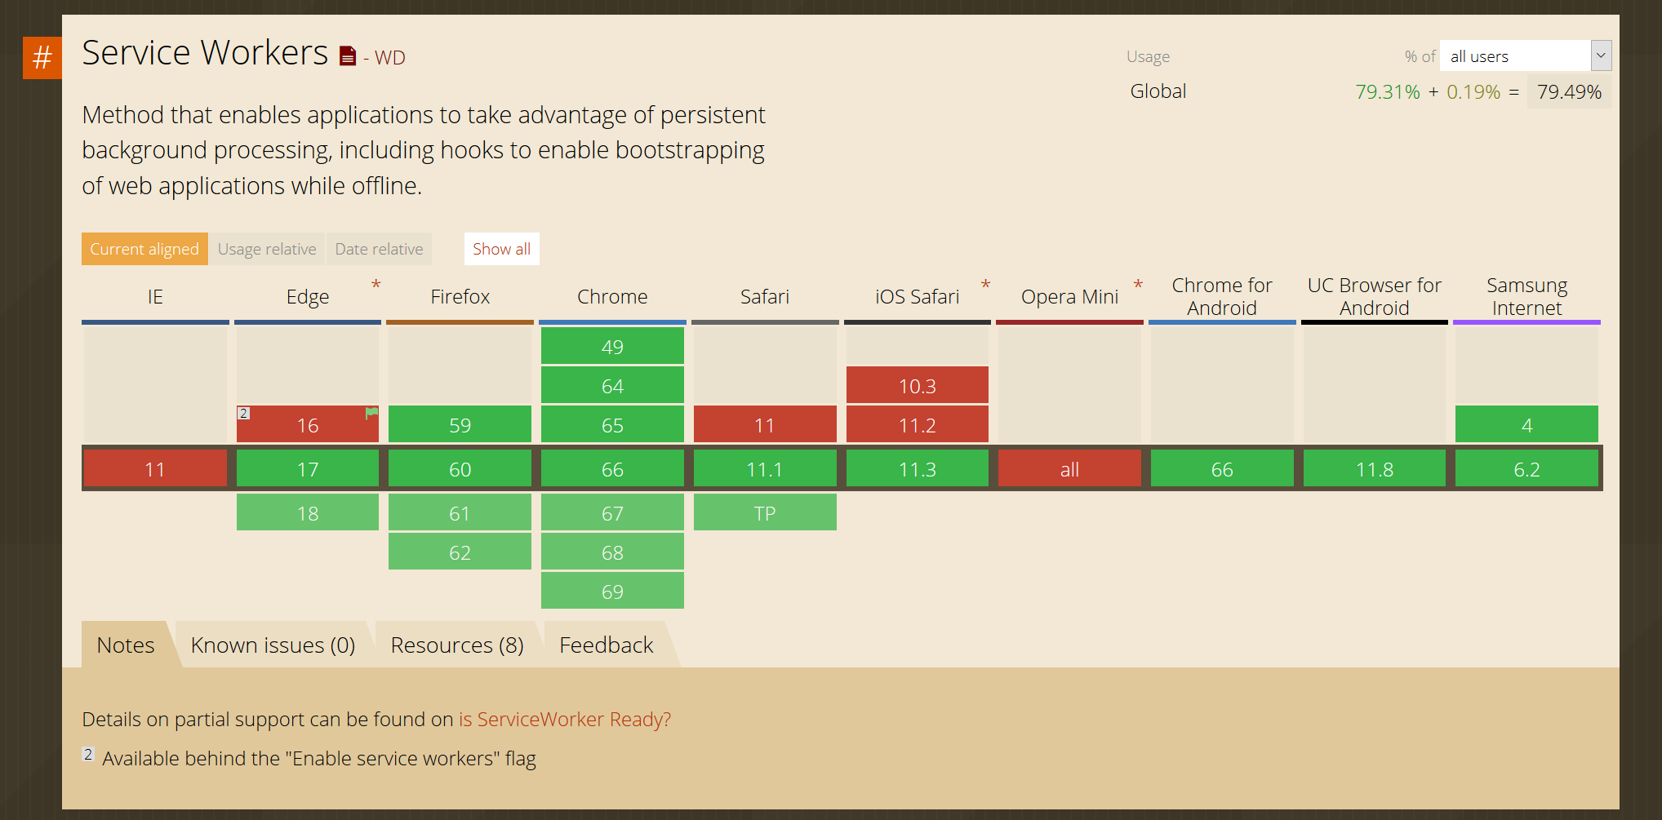

Slide 29
_{Questions ?}
MAY 21 / TLV, Israel

Slide 30
_{Thanks}
MAY 21 / TLV, Israel

