Slide 1

Tekstuele reviews
BERTopic
Clusterverdeling (van BERTopic)
Gebruikersprofiel of restaurantprofiel
Evaluatie van de clusters
Evaluatie van de profielen

Slide 2

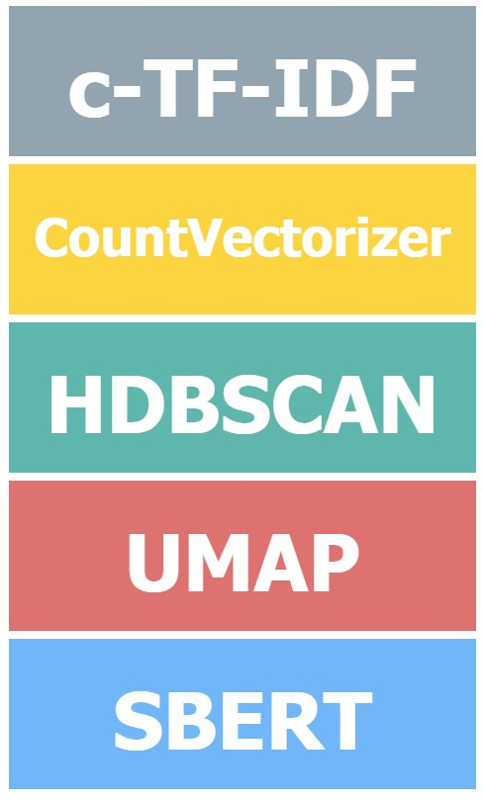

BERTopic
Online BERTopic
Online CountVectorizer
MiniBatch
K-Means
Incremental
PCA

Slide 3
Small dataset 1
Large pre-trained Language Model
Head: task 1
Predictions 1
Small dataset 2
Head: task 2
Predictions 2
…
…
…
Small dataset n
Head: task n
Predictions 3

