Slide 1

Tweets2GPT Automated Maintenance Insights for Company

Slide 2
Table of contents
01
02
Data Understanding
Data Preparation

Slide 3
CRISP-DM Model
Train/Test split
Perform ETL and adopt preprocessing steps include text cleaning, tokenization, stemming, lemmatization, stopword removal, etc.
1
2
Business Understanding
Data Understanding
3
Use Twitter API/web scraping tool to collect related tweets.
Evaluate data quality and perform exploratory data analysis (EDA) to gain initial insights.
Data Preparation
Problem Statement
and
Product Vision
User Stories
and
Stakeholders
4
Approach to Business Process Intergation
KPIs and
Potential Risks
Modeling
6
5
Select appropriate model types to perform topic categorization and sentiment analysis.
Deployment
Evaluation
Connects the prompts generated by NLP model to OpenAI for automated recommendations.
Visualize the insights for operation and management team.
Assess the performance of each model based on confusion matrix, F1/F2 scores and plot ROC/AUC curve.

Slide 4
01
Data Understanding
What is the quality of our data set?

Slide 5
Overview of the Dataset
Adjusting the Dataset:
Converting and flattening the Json file to Pandas data frame.
Removing duplicated columns.
17 columns
16,949 rows
3 sentiment variables
23 topic variables
Columns | Total | Unique values | Duplicated values | N/A values
source_created_at | 16,949 | 15,682 | 1,267 | 0
author_id | 16,949 | 7,139 | 9,810 | 0
text | 16,949 | 15,749 | 1,200 | 0
source | 16,949 | 2 | 16,947 | 0
language | 16,949 | 2 | 16,947 | 0
longitude | 16,949 | 160 | 16,789 | 15,524
latitude | 16,949 | 161 | 16,788 | 15,524
id | 16,949 | 15,749 | 1,200 | 0
source_id | 16,949 | 14,465 | 2,484 | 1,401
tweet_id_1 | 16,949 | 15,749 | 1,200 | 0
..... | ..... | ..... | ..... | .....

Slide 6
Frequency of Sentiment
Imbalanced target variable
The majority of tweets have negative sentiment
→ likely complaints
→ may trigger maintainence action
Understand neutral and positive tweets through wordcloud

Slide 7
Frequency of Topic
Highly imbalanced target variable, predominantly delays
Multiclass classification (23 values)
Topics may be irrelavant to maintainance (none, covid, announcement, noise, etc.)
Rare occurance of some topics, less than 100 tweets

Slide 8
Columns Review
Identify which columns contribute to the model and omits the rest:
Irrelevant
Missing values
Constant value
Irrelevant columns lack significant contributions to data analysis.
Columns with more than 90% missing values
Columns contains only one variable

Slide 9
Rows Review
Based on the ‘text’ column, identify which tweets contribute to the model and removes those duplicated tweets:
Official account of ThamesLink
Duplicated tweets
Official ThamesLink tweets for client responses or announcements
Duplicate tweets in the dataset

Slide 10
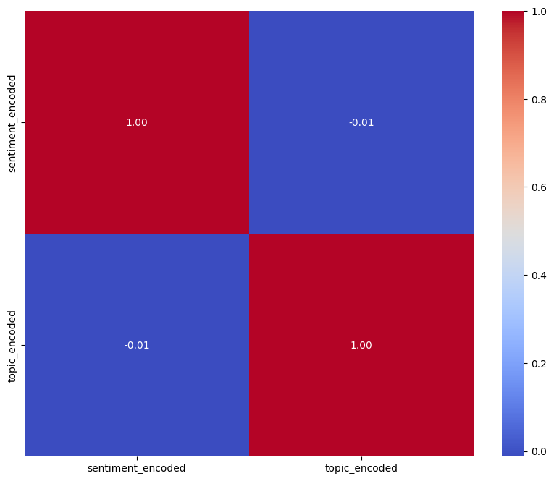
Correlation Heatmap
Very weak negative relationship
Minimal association between “sentiment” and “topic” in the analyzed data
When building models, “sentiment” and “topic” will be treated as separate target variables

Slide 11
02
Data Preparation
02
How do we treat our data set?

Slide 12
Spliting the Dataset
For either 'sentiment' or 'topic' as the target variable, employ stratified sampling to generate training (80%) and test (20%) datasets, ensuring that the ratios of the 'sentiment' column or the 'topic' column align with those in the original dataset.
‘SENTIMENT’ AS THE TARGET VARIABLE
ORIGINAL DATASET
TRAINING DATASET
TEST DATASET
17
columns
16,949
rows
17
columns
13,559
rows
17
columns
3,390
rows
62.7%
negative
36.3%
non-negative
62.7%
negative
36.3%
non-negative
62.7%
negative
36.3%
non-negative
62.7%negative
35.9%neutral
1.4%
positive
62.7%negative
35.9%neutral
1.4%
positive
62.7%negative
35.9%neutral
1.4%
positive

Slide 13
Dimensionality Reduction
longitude, latitude: 12,440 missing values
17 columns
Many missing values
Constant value
Irrelevant
3 columns
source_created_at, author_id, source, id, source_id, tweet_id, id_topic, id_sentiment
relevant, ground_truth, language
text
sentiment
topic
Training dataset

Slide 14
Remove Duplicated Rows
768 duplicated rows
13,559
rows
996
rows
11,795
rows
Official account of ThamesLink
Duplicated rows
768
rows
Tweets starting with #TLUpdates or (Thameslink Update) 996 rows
Training dataset

Slide 15
Format the Tweets
For each model type, whether supervised or unsupervised, the approach to handling the 'Tweet' data will vary.
SUPERVISED
UNSUPERVISED
1
Lowercase
5
Remove Punctuation
1
Tokenization
3
Max length of the text
2
Remove Stopwords
6
Remove Numbers
2
Add [CLS], [SEP]
4
Add [PAD] token
3
Remove URLs
7
Remove Emojis
5
Add attention mask
4
Remove Username
8
Tokenization
9
Stemming and Lemmatization
Training dataset

Slide 16
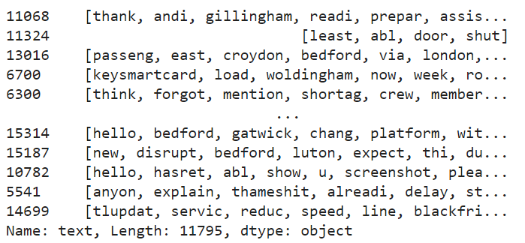
The final vision of the Tweets
**Supervised
Training dataset

Slide 17
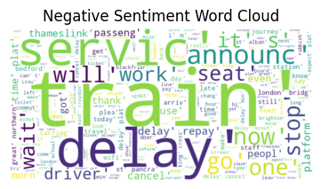
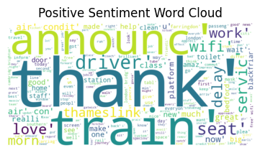
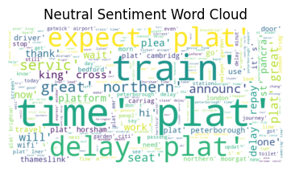

Wordclouds
Training dataset

Slide 18
Encoding and Balancing
ENCODING
BALANCING
Sentiment
Topic
Original
Afer balancing
62.7%
33.33%
33.33%
33.33%
0
0
Negative
Delays
1
None
35.9%
1
Neutral
2
Services
2
Positive
.....
1.4%
22
Handrails
Negative
Neutral
Positive
Negative
Neutral
Positive
Training dataset

Slide 19

Re-cap
Dimensionality reduction
Original dataset
Remove duplicated rows
Training
Format text
Encoding
Spliting
Model building
Balancing
Dimensionality reduction
Next-steps
Test
Remove duplicated rows
Format text
Encoding

Slide 20
Thank you for listening!

