Slide 1

McKenna Galle, Michael Zeng, Nico Rode, Vina Le
2018 Spring – Software Engineering

Slide 2

The mission
Cancer Can’t
President Becky Van Kreulen started a non-profit organization to provide help for cancer patients around the Spokane area.
Cancer Can’t focuses strictly on providing aid for adult oncology patients in the hospital room.
The Next program
A support program that pairs people up based on their role with cancer.
Provides aid for patients, family members, caregiver, etc.
Hopes the build lasting relationships for those who traveled the same journey.
Does not require only a currently-battling patient can join.

Slide 3
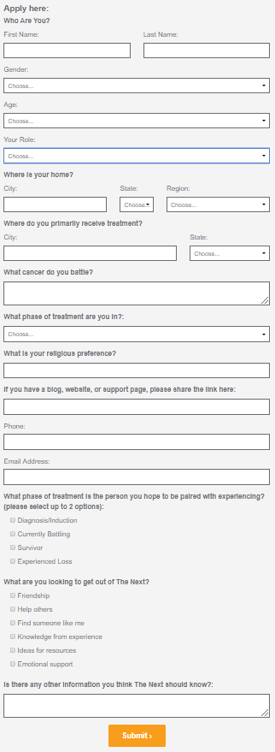

Project overview
We were asked to create an automated matching algorithm for The Next program.
An applicant will fill out the application.
The application fields will be inputted into a database.
Database will use the information and assign a scale system to the fields.
Database displays the best three matches.
Notify applicant and Cancer Can’t.

Slide 4
Our task
We were asked to re-create The Next application and create a matching algorithm to pair the applicants.
There already applicants in the system that applied to the program, which needs to be imported into our new database.
Have the applicants be matched based on the cancer type they are currently battling, the age group, and gender.
Have the program run and provide the applicant with three best matches.
Our inspiration: Cancer Can’t was putting too much time in matching applicants. Now that The Next is expanding, the administrators should be putting more dedication towards other tasks.

Slide 5
Platform
Originally started with Java coding language by using Spring
Pros and Cons
Was a large-scale application for extensive database
Was too large for a small organization.
Currently operating using PHP coding language
Our algorithm was converted from Java into PHP although the functions are the same.
Our database is ran by Amazon Web Services (AWS)
Allows for remote or online modification and quick access.
The website was modified for a more compatible testing optimized for the algorithm.

Slide 6

Our timeline
We have created backlogs of what we have been doing to help us perform tasks in a timely manner.
On schedule except for getting the information to set up the database.
Input by hand the existing applicants the database.
Transferring all the algorithm coding files from Java into PHP.
Connect the database with the algorithm.
Copy the User Interface to test the matching algorithm.
Implement email to send to the newly matched applicant.
Interesting Facts:
Working with an third-party web developer.
Running Spring was much more difficult than we thought.

Slide 7
design
Modified the original application to include a drop-down menu for the cancer categories and religion for better matching.
Set the getters and setters in the program to have two types of applicants in the system: new applicant and existing applicant
The matching will be done based on a point system of 300 points for a perfectly matched pair.
This is the original point system (175 points):
110 pts: Cancer Type
Age
30 pts: 5 years difference
20 pts: 10 years difference
10 pts: 15 years difference
20 pts: Gender
15 pts: Religion

Slide 8
The algorithm
The modified (220 pts):
The final (300 pts):
110 pts: Cancer Type
Age
30 pts: 5 years difference
20 pts: 10 years difference
10 pts: 15 years difference
20 pts: Gender
15 pts: Religion
15 pts: Treatment Location
10 pts (x2): Phase Treatment
10 pts: Role
110 pts: Cancer Types
50 pts: Age
30 pts: Gender
25 pts: Religion
20 pts: Treatment Phase
15 pts: Treatment City
10 pts: Treatment State
15 pts: Role to Cancer
15 pts: City
10 pts: State

Slide 9
Project Demo

Slide 10
The structure
Applicant fills out form.
Applicant information is inputted into the database.
Database connects with the PHP algorithm.
Algorithm will assign points to appropriate fields.
Algorithm picks the top three best matches.
The matches are sent out in an email to applicant.
Applicant chooses one match they found applicable.
An separate email is sent to applicant with detailed information.

Slide 11
conclusion
We enjoyed working on this project because it taught us teamwork and took us out of our comfort zone.
We had to learn PHP as we continued working on the project.
We feel accomplished when each part of the project that did what we wanted to.
Difficulties encountered:
We were working with a website that we had no direct access to.
Learning to work around the clock, dedicating whatever free time we have to the project.
Properly check that the algorithm runs correctly across all fields.
Making sure that the User Interface is bug-free.
Implementing email to send to the applicant after the match is completed.

Slide 12
improvements
Create the new website for Cancer Can’t and The Next program.
Create a user profile and provide a login.
Add feature where users can put themselves on matching hiatus.
Create a way for the applicant to be matched absolutely.
Once the email is sent out to the applicant and they choose a match they want to be paired up with, we have no control over the decision the other person is going to make.
This limits our project because this is a user-decision. We can only keep sending them emails to remind them to be matched.
Create a Database Manager program for Cancer Can’t.

Slide 13
Questions?

