Slide 1

Building storage and processing pipelines for European football teams
Hanoi University of Science and Technology
TRAN TIEN BANG (20241173M)
BUI DUC (20242464M)
LE HUY PHONG (20242462M)
Hanoi, 12th April 2025

Slide 2
Table of Contents
Introduction
Data Pipeline
Data Collection
Data Processing
Demo

Slide 3

Introduction
Soccer Data:
Timely information, large volume
Objectives:
Dashboard for statistics
Ranking Team base on point & W/L/D

Slide 4




Data Pipeline
Data Collection
Data Processing
Data Storage
Data Analysis
Collect match and tournament data from various sources
Tool: soccerdata
Standardize, clean, and transform data for ease of use.
Tool: pyspark, Power Query Editor
Where processed data is stored, for analysis purposes
The data will be used for:
Statistics: team performance
Visualization

Slide 5
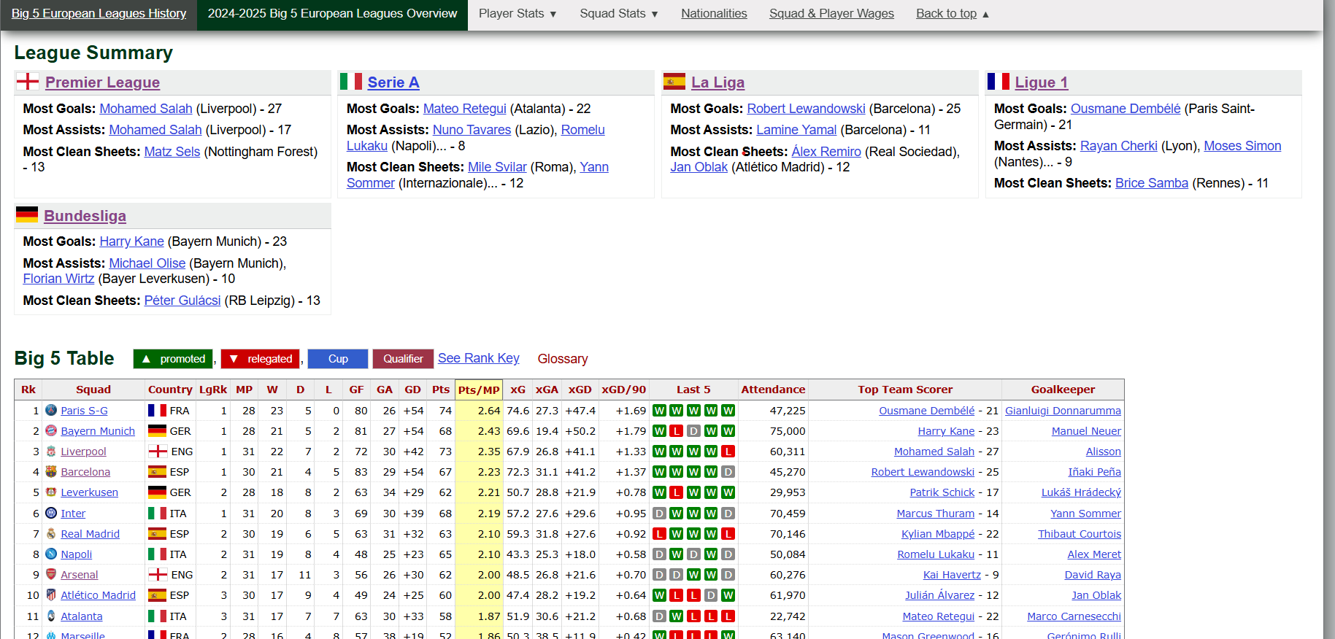
Data Collection:
FBref provides detailed and advanced football statistics (like xG, xA) from StatsBomb, suitable for tactical and data analysis.

Slide 6
Data Collection:
Data from fbref
Includes 46231 matches from 5 big European leagues from 2000 to 2025 with 217 football club
Includes 170 columns of status for each team in each match about keeper, shooting, passing, passing types, goal shot creation, defense, possession, fouls, cards

Slide 7


Data overview:
ENG-Premier league
The Premier League is England’s top-tier football league, featuring 20 clubs competing each season.
It’s known for its high intensity, global viewership, and iconic teams like Manchester United and Liverpool.
ESP-La Liga
La Liga is Spain’s premier professional football league, also made up of 20 competitive teams.
It’s famous for technical style and legendary rivalries, especially between Real Madrid and Barcelona.

Slide 8



Data overview:
FRA-Ligue 1
Ligue 1 is France’s top football league with 18 clubs. It’s known for young talents and PSG’s dominance.
GER-Bundesliga
The Bundesliga is Germany’s top-tier league with 18 teams. Famous for attacking football and passionate fans.
ITA-Serie A
Serie A is Italy’s highest football league with 20 clubs.Renowned for tactical play and historic teams.

Slide 9
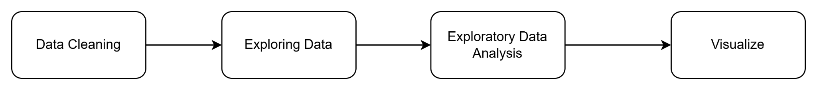
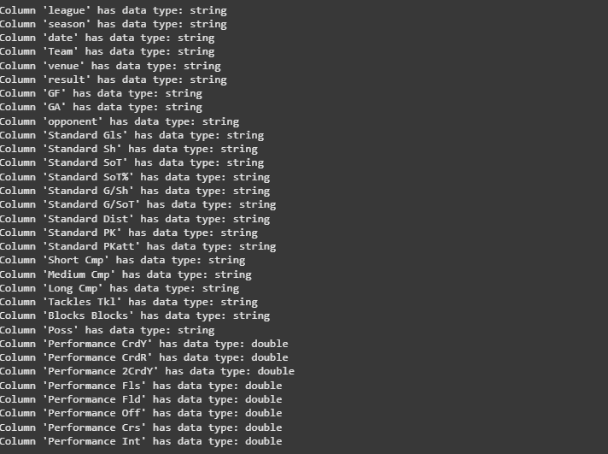
Data Processing
After having merged all 5 leagues into 1, we create a dataframe that consist of only columns that we used for the model.

Slide 10
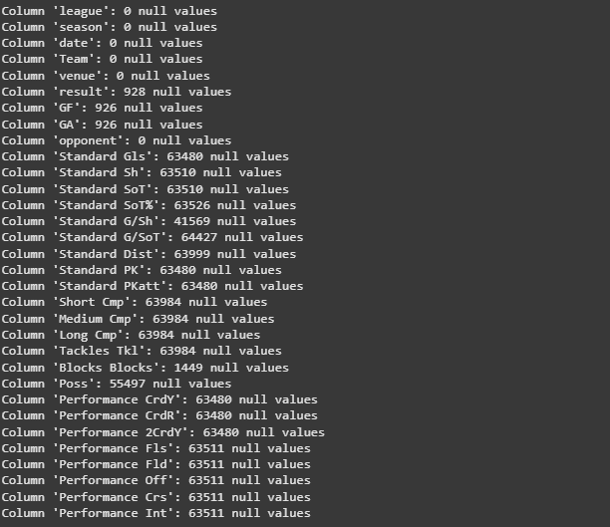
Data Processing
After that, we check for the null values in each column
Notice that in the “result” column, there exist more than 900 null values, the reason for that is because those game havent happened yet or hadn’t happened at all.
For those values, we choose to drop them as they can’t contribute anything to the model
As for the null values for other column we choose to ignore them completely.

Slide 11
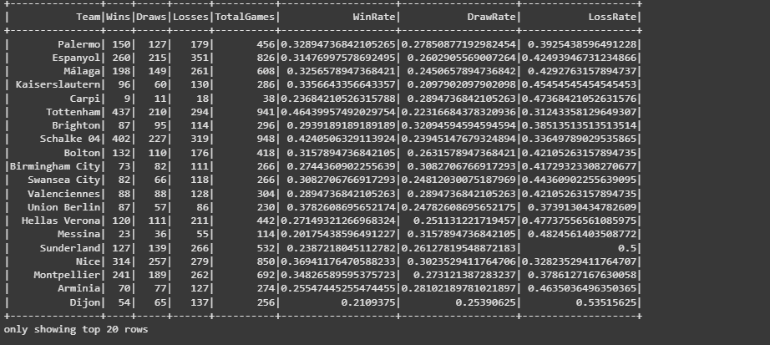
Data Explore & Analysis
Some features Total games. W,L,D rate of each team of all season:

Slide 12
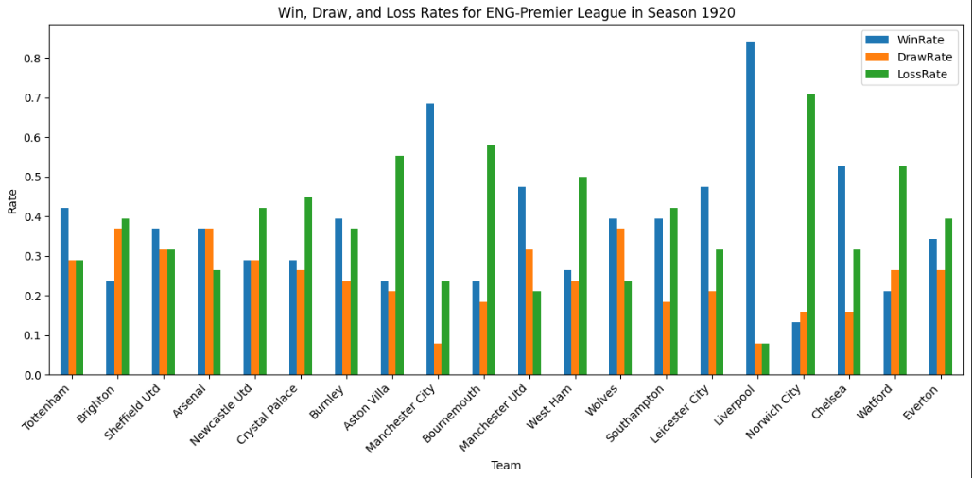
Data Explore & Analysis
Some features: W,L,D of individual team in a specific season

Slide 13
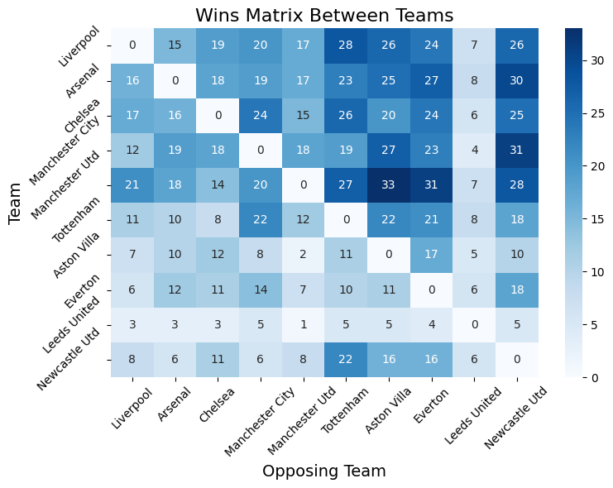
Data Explore & Analysis

Slide 14
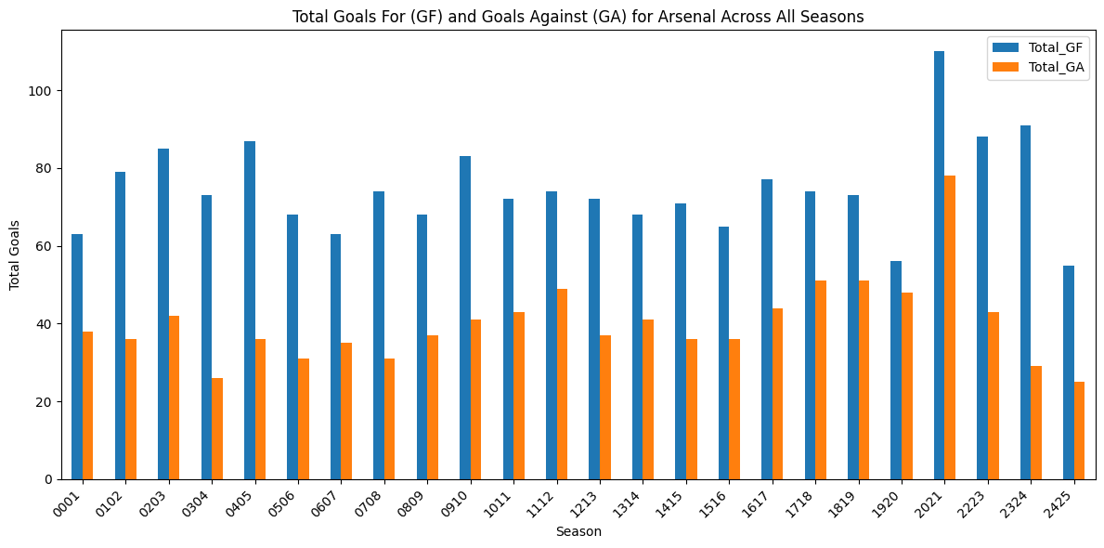
Data Explore & Analysis

Slide 15
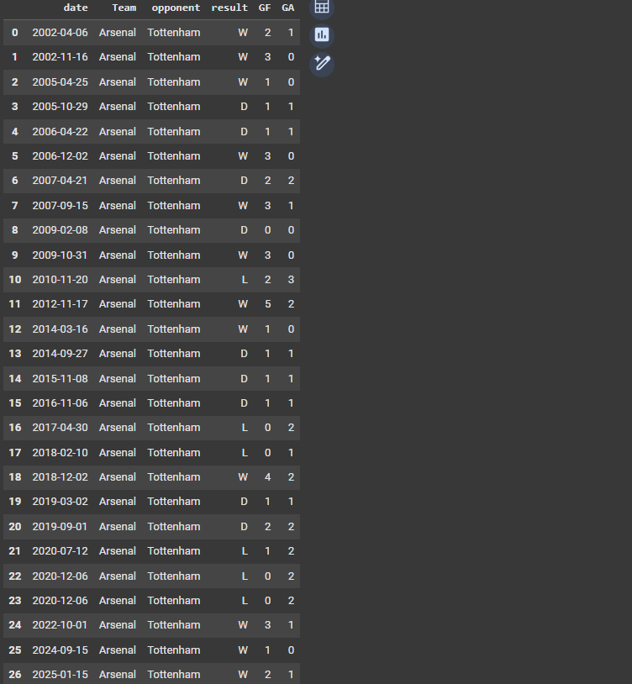
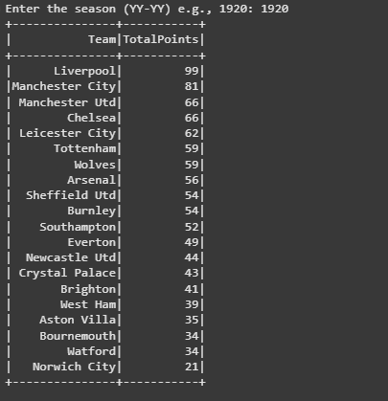
Data Explore & Analysis
A total game of result of goals between 2 specific team
Team Ranking Based on Calculated Points

Slide 16
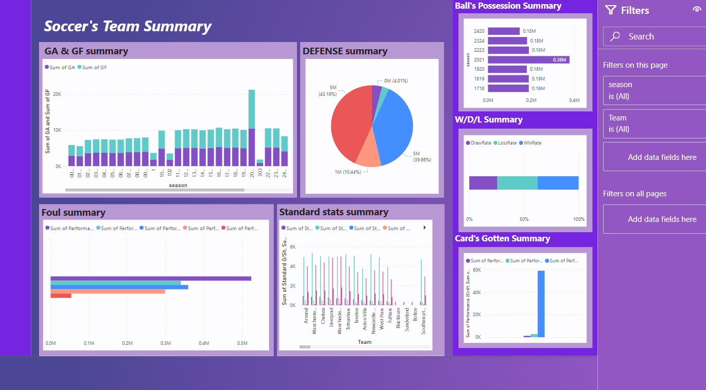
Data Visualize
A summary of the team

Slide 17
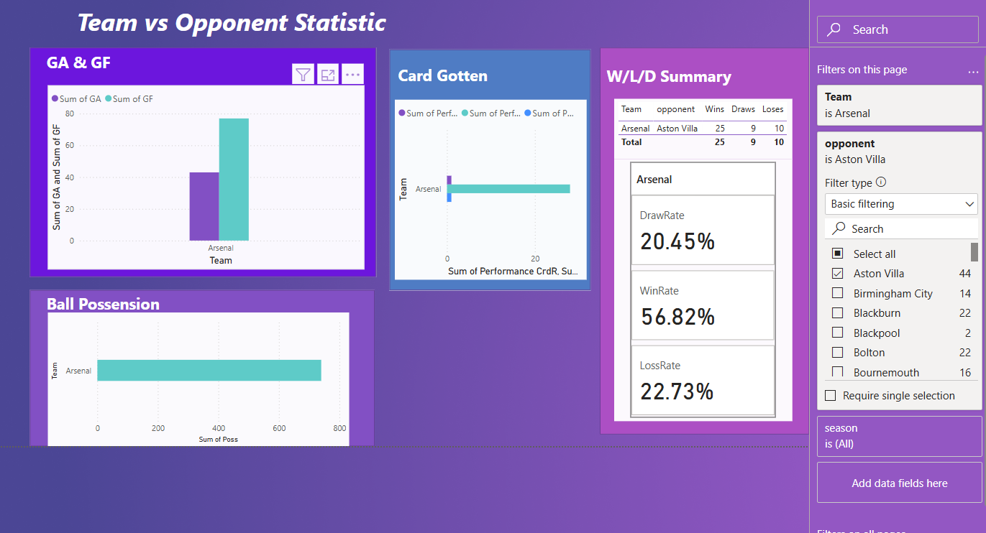
Data Visualize
A statistic of the team vs team

Slide 18
Data Analysis
Team | Matches | Win | Draw | Lose | GF | GA | +/- | Avg Poss% | Avg xG
Arsenal | 38 | 28 | 5 | 5 | 33 | 10 | 23 | 58.20% | 2.01
Man City | 38 | 28 | 7 | 3 | 35 | 10 | 25 | 65.20% | 2.12
Liverpool | 38 | 24 | 10 | 4 | 34 | 14 | 20 | 61.30% | 2.31
Tottenham | 38 | 20 | 6 | 12 | 26 | 18 | 8 | 61.60% | 1.79
Aston Villa | 38 | 20 | 8 | 10 | 28 | 18 | 10 | 53.10% | 1.67
Chelsea | 38 | 18 | 9 | 11 | 27 | 20 | 7 | 58.60% | 1.96
Man United | 38 | 18 | 6 | 14 | 24 | 20 | 4 | 50.60% | 1.49
Newcastle Utd | 38 | 18 | 6 | 14 | 24 | 20 | 4 | 52.20% | 2
West Ham | 38 | 14 | 10 | 14 | 24 | 24 | 0 | 41.10% | 1.38
Wolves | 38 | 13 | 7 | 18 | 20 | 25 | -5 | 48.90% | 1.24

Slide 19
Result
Model | L | D | W | All
KNN | 0.49 | 0.40 | 0.56 | 0.49
Decision Tree | 0.52 | 0.44 | 0.59 | 0.53
Random Forest | 0.62 | 0.43 | 0.71 | 0.63
Gradient Boosting | 0.61 | 0.43 | 0.70 | 0.62
Naive Bayes | 0.50 | 0.30 | 0.58 | 0.48

Slide 20
Thank you!

