Slide 1

OOP PROJECT
Name : Trần Đình Khôi Nguyên – ITITIU19166.
Hồ Thị Thu Hòa – ITITIU19120.

Slide 2
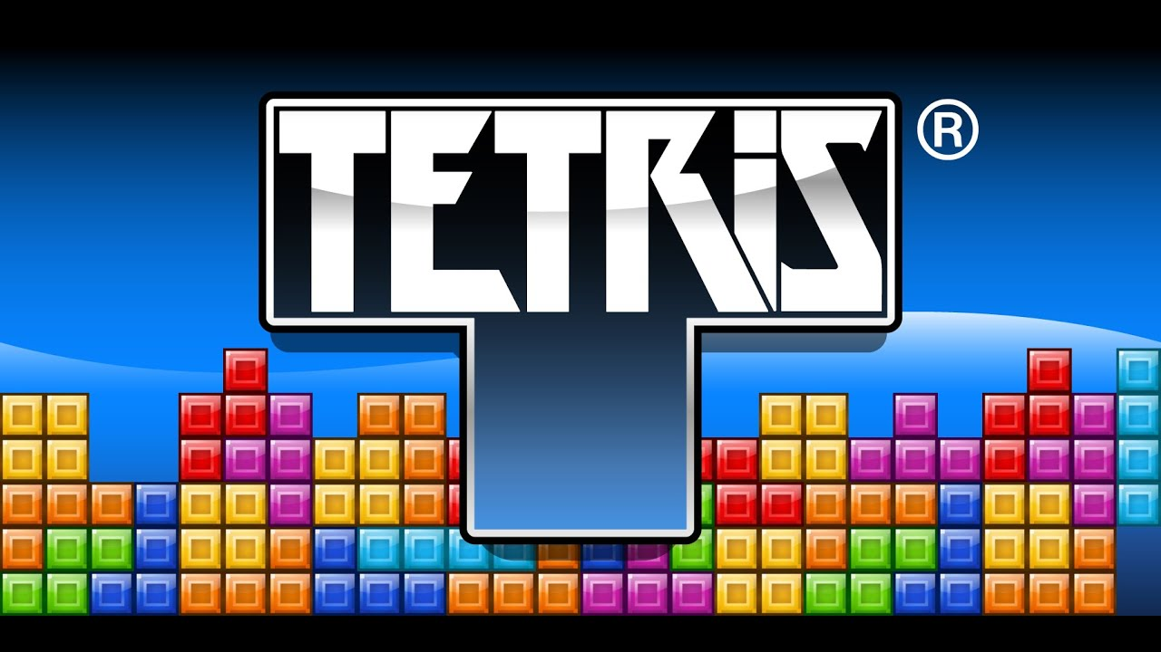

Slide 3
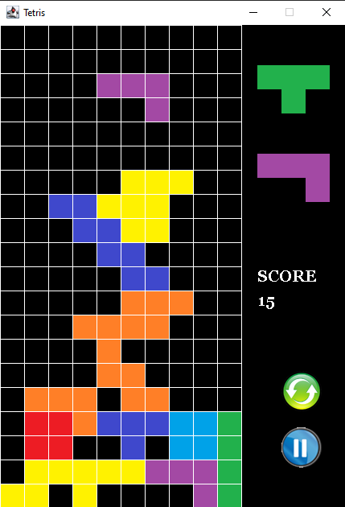
RULE OF GAME
Move the pieces and it will fall faster when you press down button.
Fill all the blank space in a line to remove it.
Get the score.
Game over when your pieces reach the top of screen.

Slide 4
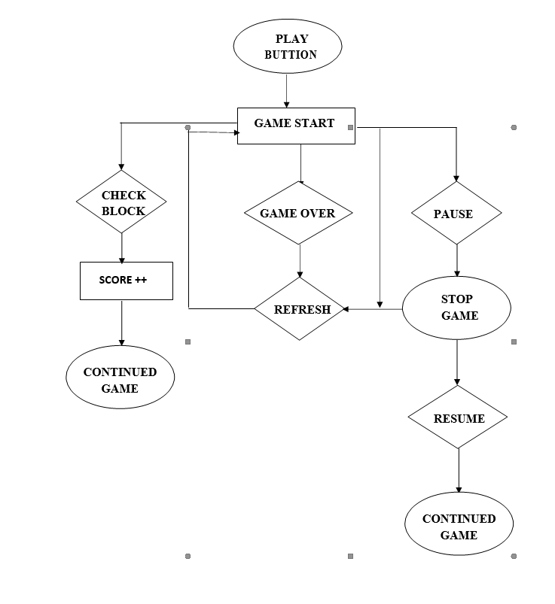
ALGORITHM

Slide 5
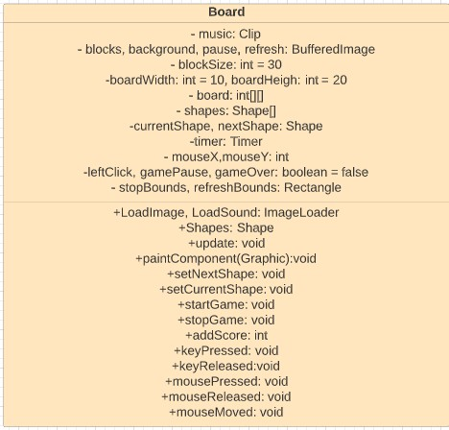
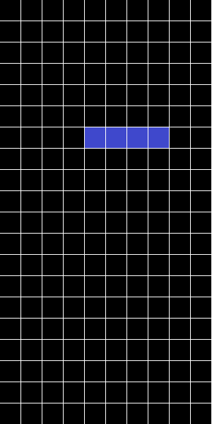
BOARD

Slide 6
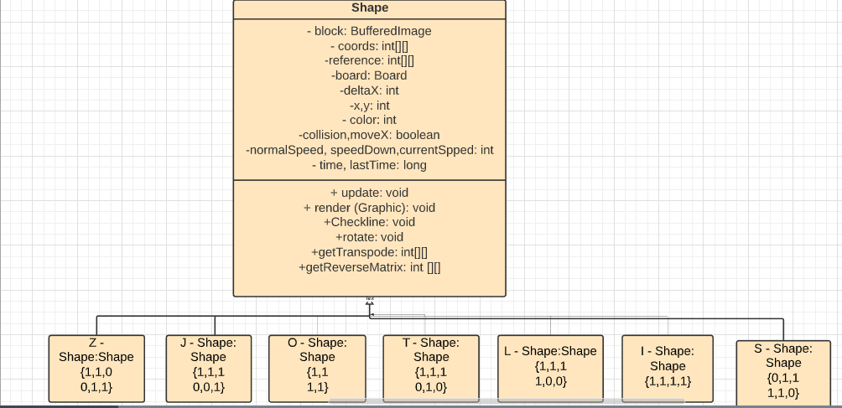
SHAPE

Slide 7
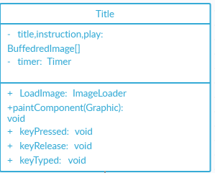
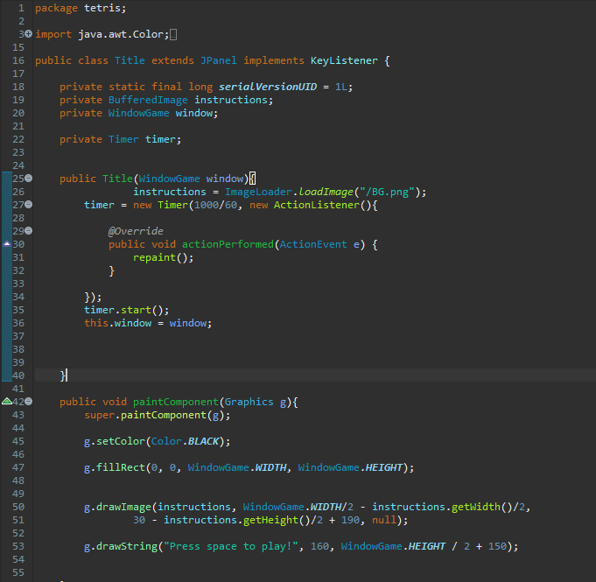
TITLE

Slide 8
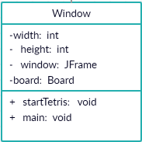
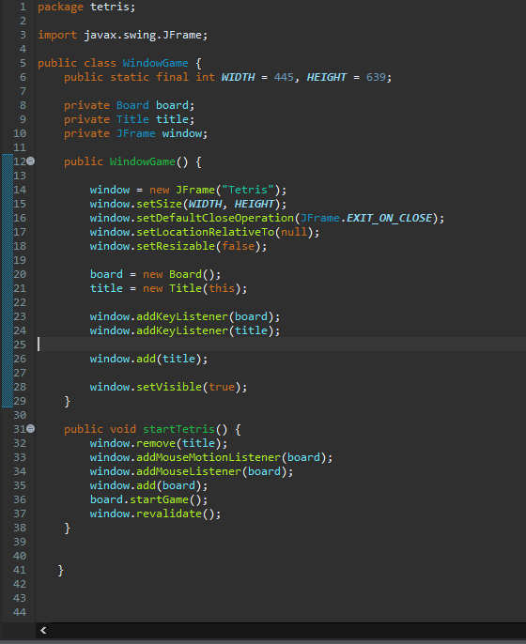
WINDOW

Slide 9
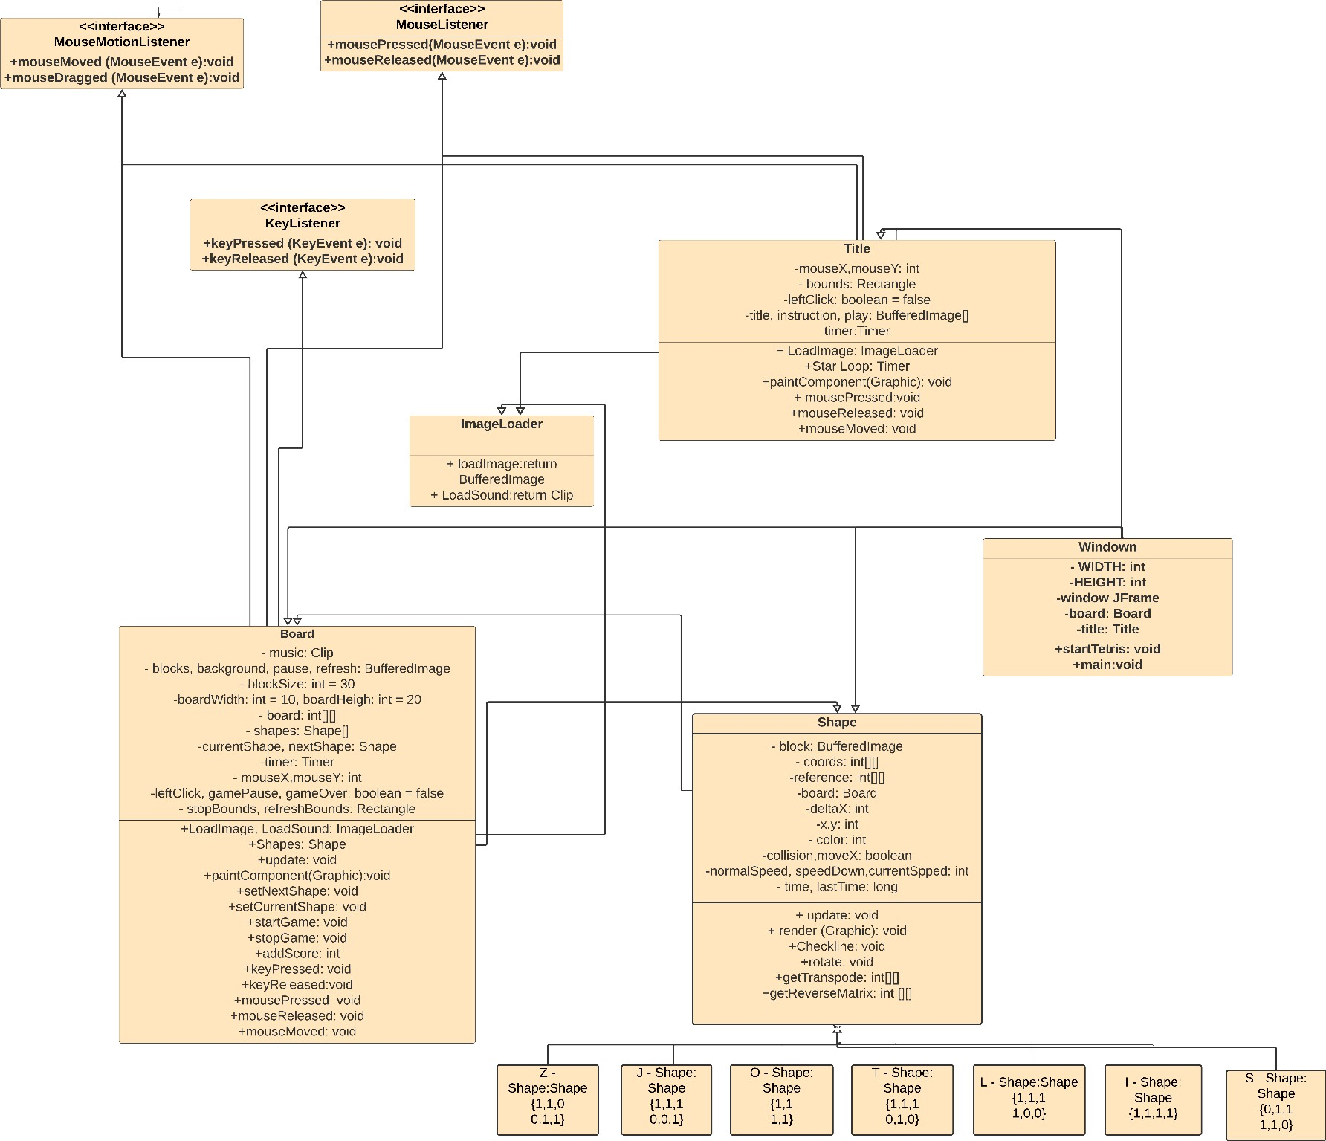
DIAGRAM

Slide 10
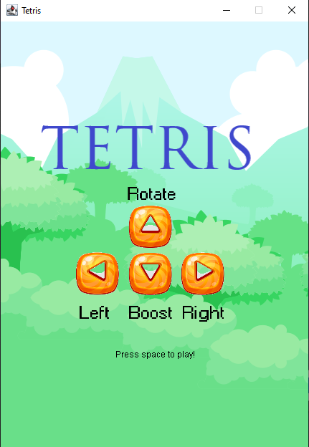
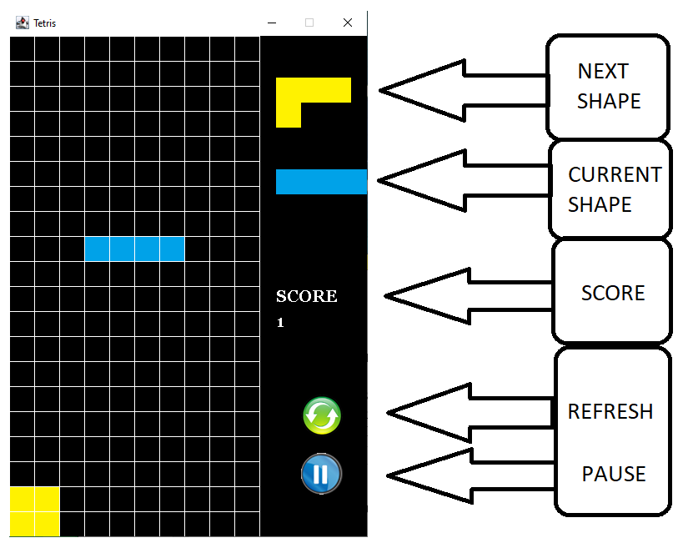
INTERFACE

Slide 11
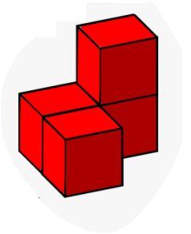
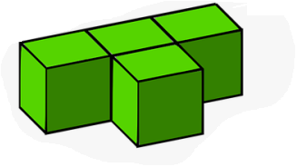
REFERANCE
https://www.youtube.com/watch?v=_U0Io6Utf98
https://github.com/phamngocthachlt6c/Tutorial_Tetris_Java

Slide 12
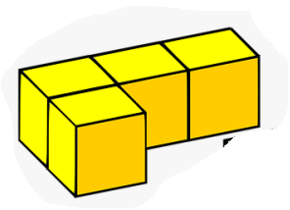
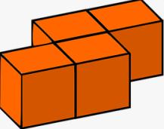
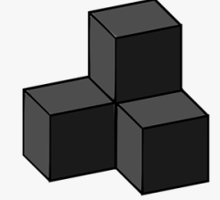
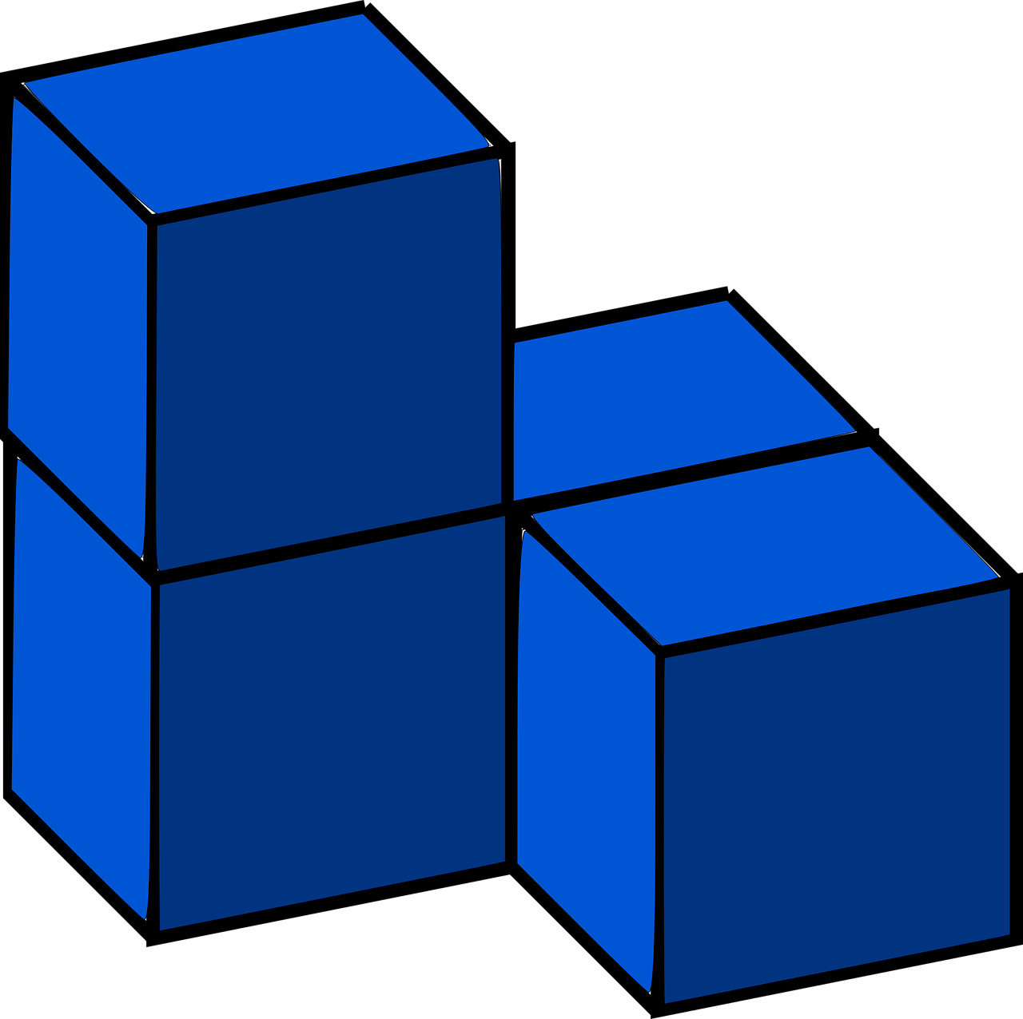
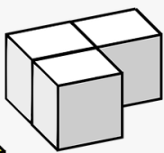
THANK YOU FOR YOUR ATTENTION

