Slide 1
RZ CIP TEAM
April, 2022 My Tran

Slide 2
Linux device driver (communicate with harware)
Description: This document describe how to create a GPIO device driver which is connected to real hardware
In this document we use Raspberry Pi 3B+
My Tran
Software Engineering
RZ Team

Slide 3
1. IDEA
There are many ways to interact with hardware. But in this document, we will read and write directly to hardware registers to deeply understand how the driver works.
To read or write to the register. First we need to determine the physical address of the peripheral we need to interact with.
Because the operating system uses virtual memory, we will convert the physical address to a virtual address.

Slide 4
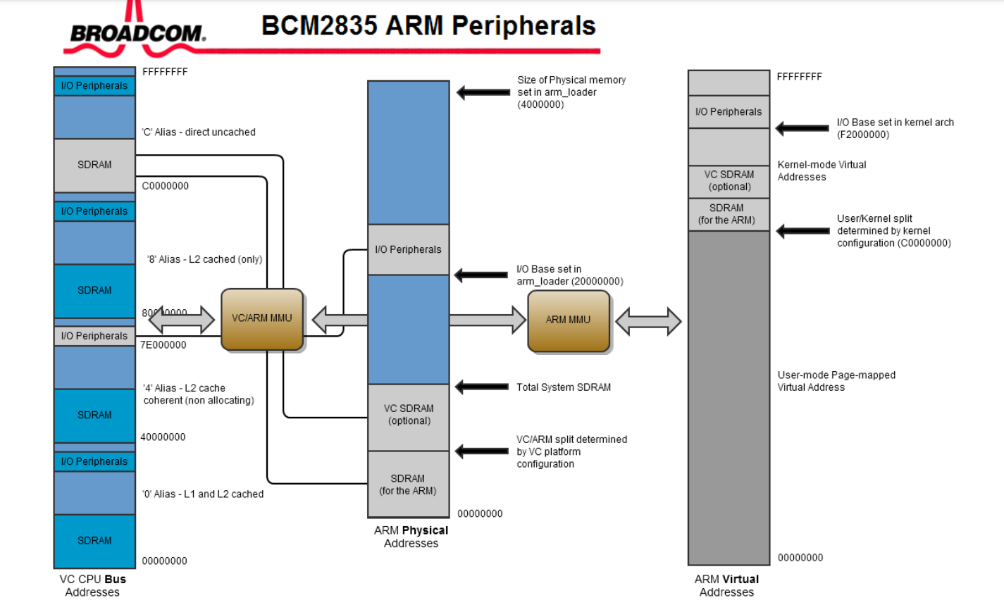
1. ADDRESS MAP

Slide 5
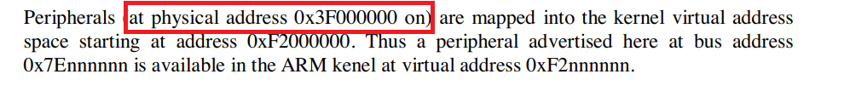
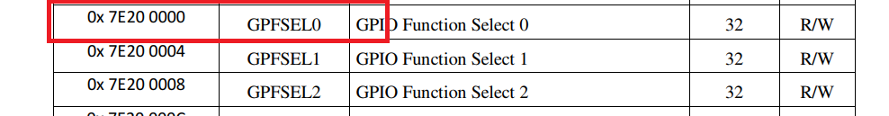
2. ADDRESS MAP
Specifies physical base address of peripherals
Specifies the physical base address area of GPIO

Slide 6
2. ADDRESS MAP
However, the address used in the datasheet is the "bus address“.
To convert to the physical address, we remove the first 2 bytes of the bus address.
The rest will be the offset of the peripheral area.
Then we add the base address and offset to get the address of the GPIO
GPIO bus address = 0x7E200000
➔ GPIO offset = 0x200000
Physical GPIO base address = peripheral base address + GPIO offset
⬄ Physical GPIO base address = 0x3F000000 + 0x200000
➔Physical GPIO base address = 0x3F200000

Slide 7
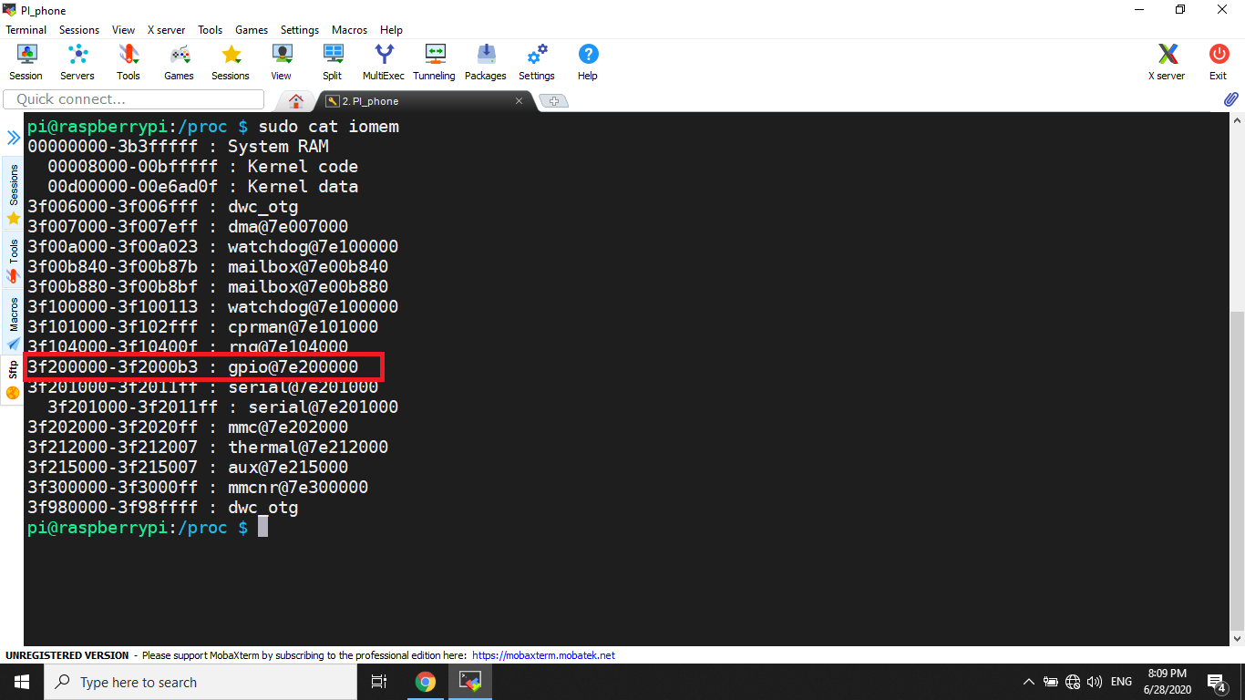
2. MEMORY MAP I/O FUNCTIONS:
In Linux operating system, you also can check physical memory in /proc/iomem.

Slide 8
2. MEMORY MAP I/O FUNCTIONS:
ioremap
Prototype: void *ioremap(unsigned long phys_addr, unsigned long size);
Funtionality: mapping physical address to virtual address
Phys_addr: physical base address
Size: size of memory region
iounmap
Prototype: void iounmap(void * addr);
Funtionality: free memory
adddr : the address need to be freed

Slide 9
3. IOCTL:
If you want to control device from user application. You can use ioctl function which will call unlocked_ioctl file operation at kernel space.
Prototype: int ioctl(int fd, int cmd, ...);
Here, fd is the file descriptor returned from open() and cmd is the same as what is implemented in the kernel module’s ioctl().

Slide 10
4. GPIO hardware:
There are 54 general-purpose I/O (GPIO) lines split into two banks. All GPIO pins have at least two alternative functions within BCM. The alternate functions are usually peripheral IO and a single peripheral may appear in each bank to allow flexibility on the choice of IO voltage

Slide 11
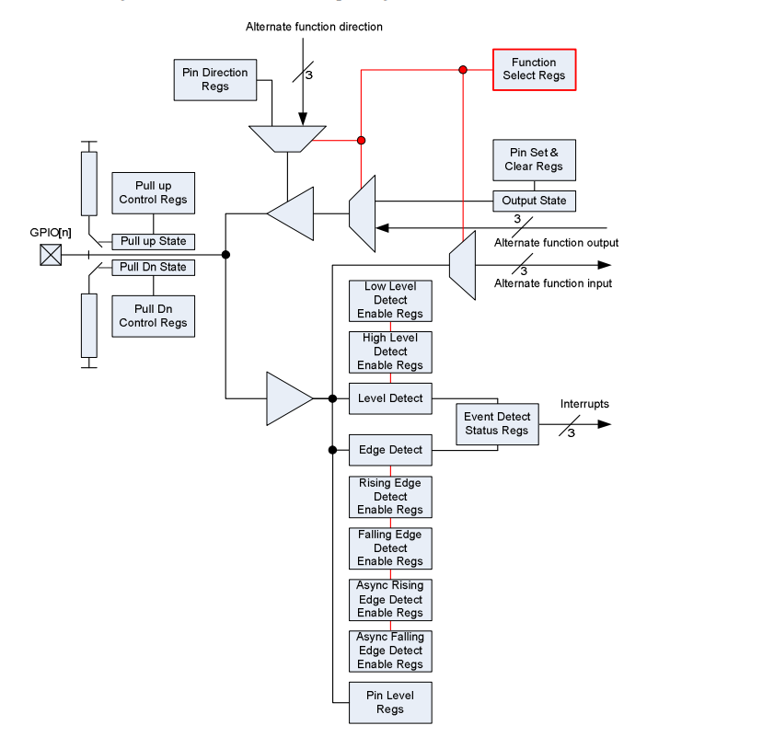
4. GPIO hardware:

Slide 12
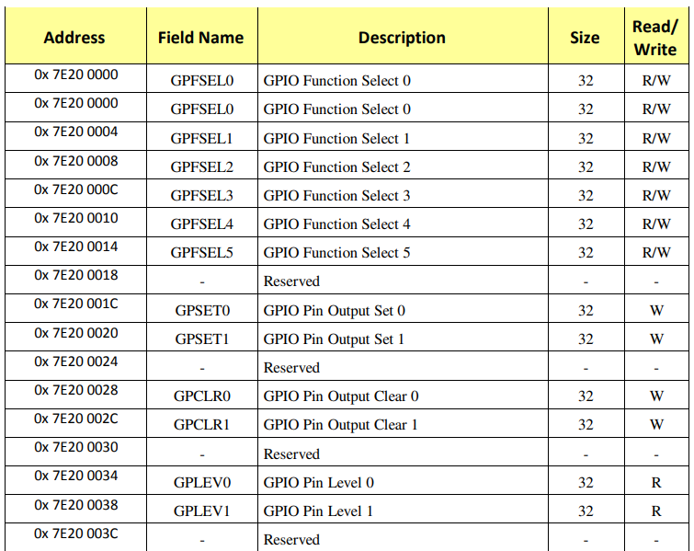
4. GPIO hardware:
The GPIO has 41 registers. All accesses are assumed to be 32-bit.

Slide 13
5. DRIVER CODE DEMO:
Please refer driver codes and related document at the link below
http://gitlab.banvien.com/my.tran-duy/rz_training.git

Slide 14
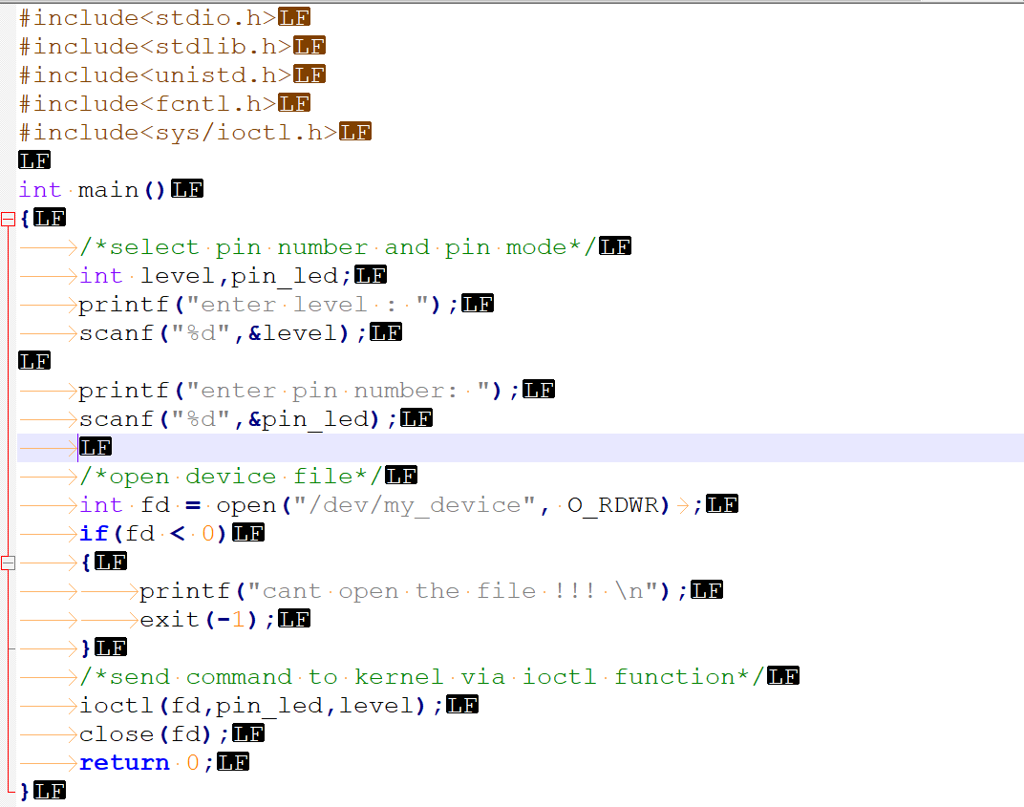
5. USER APPLICATION CODE DEMO:

Slide 15
Thank You For Your Attendance

