Slide 1
Linux embedded overview
RZ CIP TEAM
Jan, 2022 My Tran

Slide 2
Linux embedded overview
Summary:
Introduction about Linux
Elements of Embedded Linux
Toolchain.
Bootloaders.
Kernel.
Root Filesystem.
Reference
My Tran
Software Engineering
RZ Team

Slide 3
Introduction about Linux
1.Birth of Free Software:
1983, Richard Stallman, GNU project and the free software concept. Beginning of the development of gcc, gdb, glibc and other important tools
1991, Linus Torvalds, Linux kernel project, a UNIX-like operating system kernel. Together with GNU software and many other open-source components: a completely free operating system, GNU/Linux
A program is considered free when its license offers to all its users the following four freedoms
Freedom to run the software for any purpose
Freedom to study the software and to change it
Freedom to redistribute copies
Freedom to distribute copies of modified versions
These freedoms are granted for both commercial and non-commercial use
The source code, software can be modified and distributed to customers

Slide 4
Introduction about Linux
2. Advantage of Linux and Open Source for Embedded systems:
The key advantage of Linux and open-source in embedded systems is the ability to re-use components
Free software can be duplicated on as many devices as you want, free of charge
Allows unlimited modifications, changes, tuning, debugging, optimization, for an unlimited period of time
Many open-source components are widely used, on millions of systems

Slide 5
Elements of Embedded Linux
Every project begins by obtaining, customizing, and deploying these four elements: the toolchain, the bootloader, the kernel, and the root filesystem
Toolchain: The compiler and other tools needed to create code for your target device.
Bootloader: The program that initializes the board and loads the Linux kernel.
Kernel: This is the heart of the system. The kernel contains the process and memory management, network stack, device drivers and provides services to user space applications
Root filesystem: Contains the libraries and programs that are run once the kernel has completed its initialization

Slide 6
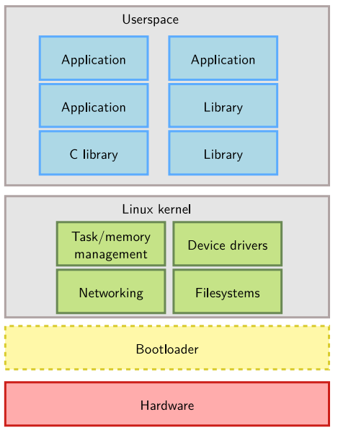
Elements of Embedded Linux
Linux embedded system

Slide 7
Toolchain
1.Overview:
A toolchain is a set of tools that compiles source code into executables that can run on your target device and includes a compiler, a linker, and runtime libraries.

Slide 8
Toolchain
2. Elements of toolchain:
A standard GNU toolchain consists of four main components:
Binutils: A set of binary utilities including the assembler and the linker (as, ld, objdump, objcopy...).
GNU Compiler Collection (GCC): These are the compilers for C and other languages, which, depending on the version of GCC, include C++, Objective-C, Objective-C++, Java, Fortran, Ada, and Go.
C library: A standardized application program interface (API) based on the POSIX specification, which is the main interface to the operating system kernel for applications.
Debugger: The debugger is used to debug application. In the embedded Linux world, the typical debugger is GDB.

Slide 9
Toolchain
3. Types of toolchain:
For our purposes, there are two types of toolchain:
• Native: This toolchain can be found in normal Linux distributions, has usually been compiled on x86, runs on x86 and generates code for x86.
• Cross: This toolchain has been built on x86, but runs on your target architecture and generates code for your target architecture (ARM, MIPS, PowerPC…)

Slide 10
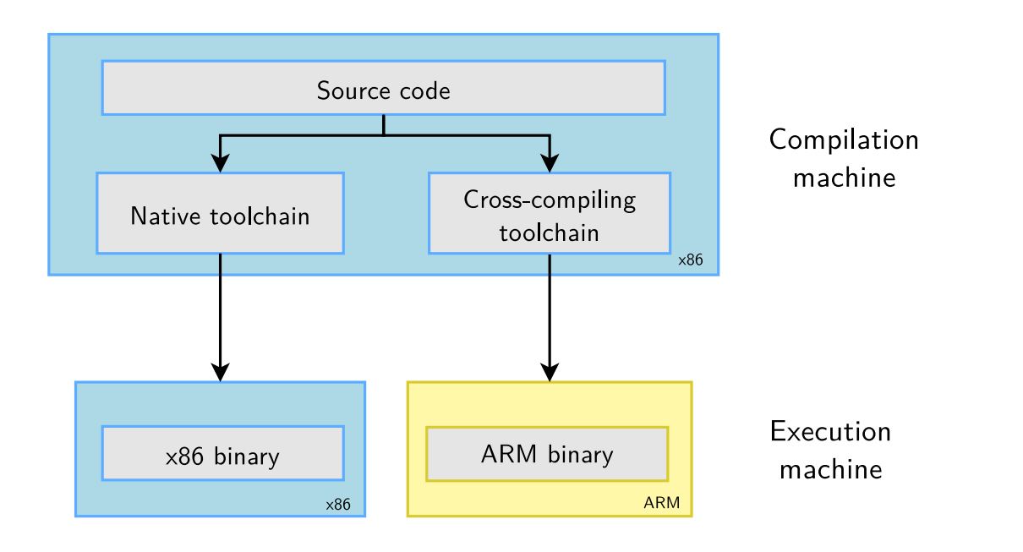
Toolchain
3.Types of toolchain(1):
Native and cross toolchain

Slide 11
Toolchain
4. Embedded Toolchain:
For embedded system development, it is usually impossible or not interesting to use a native toolchain:
The target is too restricted in terms of storage and/or memory
The target is very slow compared to your workstation
You may not want to install all development tools on your target
➔Therefore, cross-compiling toolchains are generally used. They run on your workstation but generate code for your target.

Slide 12
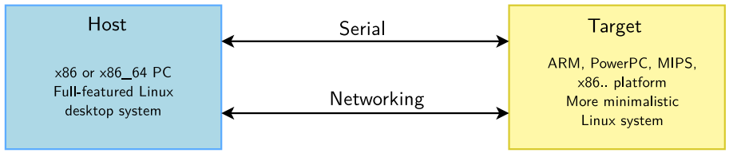
Toolchain
3. Embedded Toolchain(1):
Cross compile

Slide 13
Bootloader
1.Overview:
In an embedded Linux system, the bootloader has two main jobs: to initialize the system to a basic level and to load the kernel.
When the first lines of the bootloader code are executed, following a power-on or a reset, the system is in a very minimal state.
The DRAM controller is not set up, so the main memory is not accessible.
Likewise, other interfaces are not configured, so storage that's accessed via NAND flash controllers, MMC controllers, the other is unavailable. ➔ The only resources that are operational at the beginning are CPU core, some on-chip static memory, and the boot ROM.

Slide 14
Bootloader
2. Boot sequence:
Boot sequence consist of 3 main phases:
Phase 1 – ROM code:
It is loaded into the chip when it is manufactured, and hence the ROM code is proprietary and cannot be replaced by an open source equivalent.
Usually, it does not include code to initialize the memory controller, since DRAM configurations are highly device-specific, and so it can only use Static Random Access Memory (SRAM), which does not require a memory controller
In SoCs, where the SRAM is not large enough to load a full bootloader such as U-Boot, there has to be an intermediate loader called the Secondary Program Loader (SPL)

Slide 15
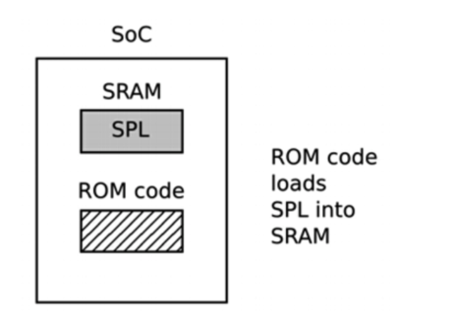
Bootloader
2. Boot sequence(1):
Phase 1 – ROM code

Slide 16
Bootloader
2. Boot sequence(2):
Phase 2 – secondary program loader:
The SPL must set up the memory controller and other essential parts of the system in preparation for loading the Tertiary Program Loader (TPL) into DRAM.
The functionality of the SPL is limited by the size of the SRAM.
At the end of the second phase, the TPL is present in DRAM

Slide 17
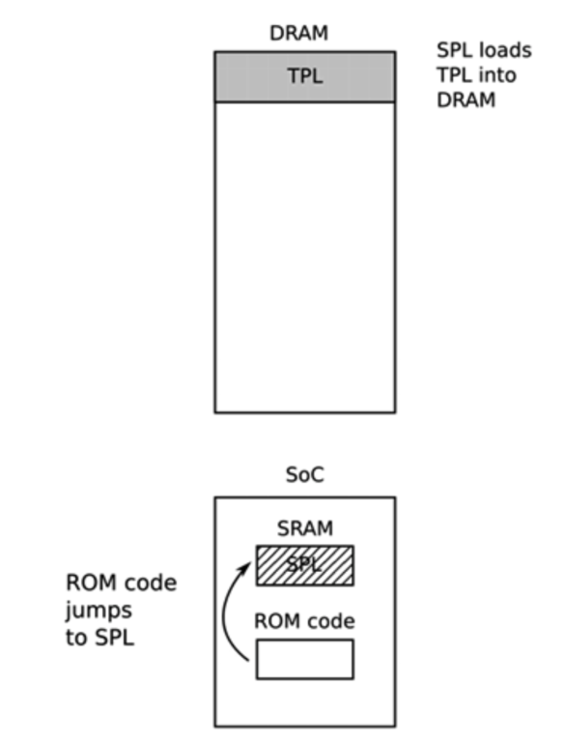
Bootloader
2. Boot sequence(3):
Phase 2 – SPL

Slide 18
Bootloader
2. Boot sequence(4):
Phase 3 – TPL :
At this point, we are running a full bootloader, such as U-Boot
Usually, there is a simple command-line user interface that lets you perform maintenance tasks, such as loading new boot and kernel images into flash storage, and loading and booting a kernel, and there is a way to load the kernel automatically without user intervention

Slide 19
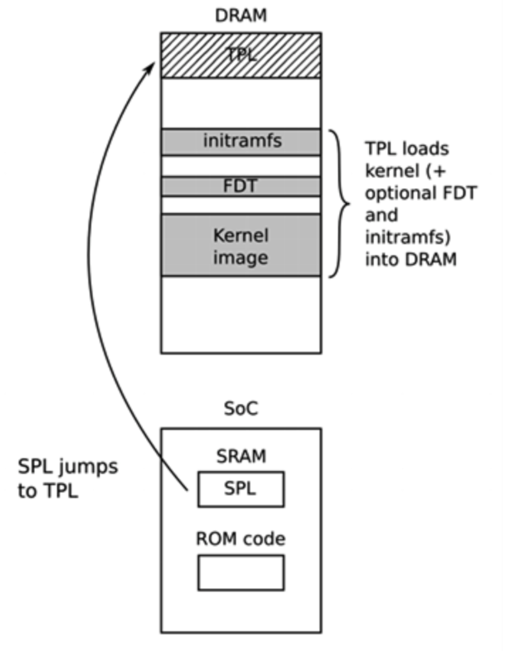
Bootloader
2. Boot sequence(5):
Phase 3 – TPL

Slide 20
Bootloader
3. Uboot:
U-Boot, the universal bootloader by Denx. The most used on ARM, also used on PPC, MIPS, x86, m68k, RISC-V, etc.
U-Boot is a typical free software project.
Documentation available at https://u-boot.readthedocs.io/en/latest/

Slide 21
Bootloader
3. Uboot(1):
Important command on Uboot
help and help command
fatload, loads a file from a FAT filesystem to RAM
Example: fatload usb 0:1 0x21000000 zImage
And also fatinfo, fatls, fatsize, fatwrite...
Note that filesystem independent commands such as load, ls, and size exist. Examples:
load usb 0:1 0x21000000 zImage
ls mmc 0:2 boot/
size mmc 0:1 dtb (result stored in filesize environment variable)
loadb, loads, loady, load a file from the serial line to RAM
tftp, loads a file from the network to RAM (example given later

Slide 22
Bootloader
3. Uboot(1):
Important command on Uboot
Help, print online help
tftp, loads a file from the network to RAM
ping, to test the network
bootd (can be abbreviated as boot), runs the default boot command, stored in the bootcmd environment variable
bootz <address>, starts a compressed kernel image loaded at the given address in RAM
usb, to initialize and control the USB subsystem, mainly used for USB storage devices such as USB keys
mmc, to initialize and control the MMC subsystem, used for SD and microSD cards

Slide 23
Bootloader
3. Uboot(2):
Important command on Uboot
Commands to manipulate environment variables:
printenv : Shows all variables
printenv <variable-name> :Shows the value of a variable
setenv <variable-name> <variable-value> :Changes the value of a variable or defines a new one, only in RAM
editenv <variable-name> :Edits the value of a variable in-place, only in RAM
saveenv :Saves the current state of the environment to storage for persistence

Slide 24
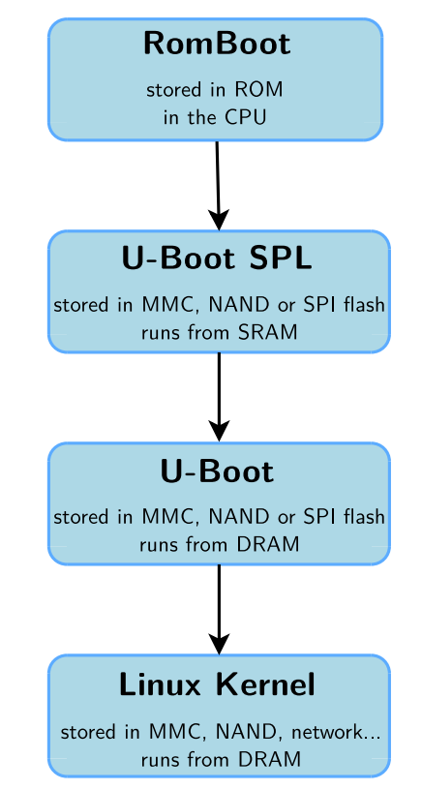
Bootloader
3. Summary:
RomBoot: tries to find a valid SPL from various storage sources, and load it into SRAM.
U-Boot SPL: runs from SRAM. Initializes the DRAM, the NAND or SPI controller, and loads the secondary bootloader into DRAM and starts it. No user interaction possible.
U-Boot: runs from DRAM. Initializes some other hardware devices (network, USB, etc.). Loads the kernel image from storage or network to DRAM and starts it. Shell with commands provided.
Linux Kernel: runs from DRAM. Takes over the system completely (the bootloader no longer exists).

Slide 25
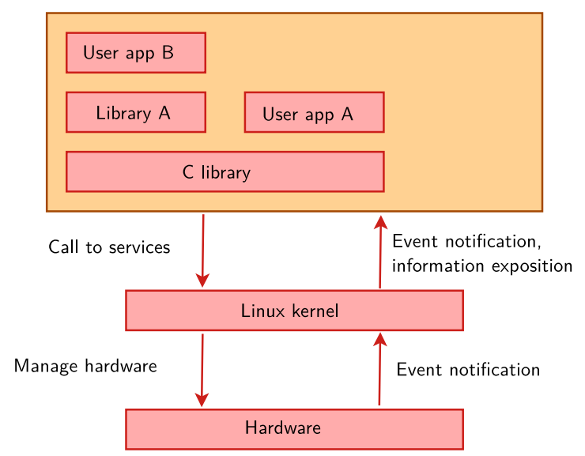
Kernel
1.Overview:
The kernel has three main jobs: to manage resources, to interface with hardware, and to provide an API that offers a useful level of abstraction to user space programs, as summarized in the following diagram:
Linux system overview

Slide 26
Kernel
2.Linux kernel main roles:
Manage all the hardware resources: CPU, memory, I/O.
Provide a set of portable, architecture and hardware independent APIs to allow user space applications and libraries to use the hardware resources.
Handle concurrent accesses and usage of hardware resources from different applications.

Slide 27
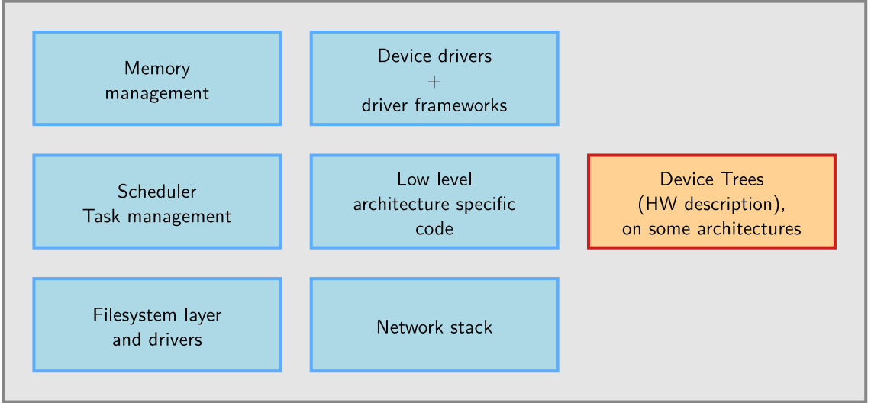
Kernel
2.Linux kernel main roles(1):
Inside linux kernel

Slide 28
Kernel
2.System calls:
The main interface between the kernel and user space is the set of system calls
About 400 system calls that provide the main kernel services
File and device operations, networking operations, inter-process communication, process management, memory mapping, timers, threads, synchronization primitives, etc.
This interface is stable over time: only new system calls can be added by the kernel developers
This system call interface is wrapped by the C library, and user space applications usually never make a system call directly but rather use the corresponding C library function.

Slide 29
Linux Root Filesystem
1. Overview:
A root filesystem consists of a directory and file hierarchy.
Filesystems are mounted in a specific location in this hierarchy of directories
When a filesystem is mounted in a directory (called mount point), the contents of this directory reflects the contents of the storage device
When the filesystem is unmounted, the mount point is empty again.
This allows applications to access files and directories easily, regardless of their exact storage location

Slide 30
Linux Root Filesystem
2. Location of the root filesystem:
It can be mounted from different locations:
From the partition of a hard disk
From the partition of a USB key
From the partition of an SD card
From the partition of a NAND flash chip or similar type of storage device
From the network, using the NFS protocol
etc.

Slide 31
Linux Root Filesystem
3. Important directories:
/bin Basic programs
/boot Kernel images, configurations and initramfs (only when the kernel is loaded from a filesystem, not common on non-x86 architectures)
/dev Device files (covered later)
/etc System-wide configuration
/home Directory for the users home directories
/lib Basic libraries
/media Mount points for removable media
/mnt Mount points for static media
/proc Mount point for the proc virtual filesystem

Slide 32
Linux Root Filesystem
3. Important directories(1):
/root Home directory of the root user
/sbin Basic system programs
/sys Mount point of the sysfs virtual filesystem
/tmp Temporary files
/usr
/usr/bin Non-basic programs
/usr/lib Non-basic libraries
/usr/sbin Non-basic system programs
/var Variable data files, for system services. This includes spool directories and files, administrative and logging data, and transient and temporary files

Slide 33
Reference:
[1] Mastering Embedded Linux Programming (Third Edition) by Chris Simmonds and Frank Vasquez
[2] Introduction to Embedded Linux by Thomas Petazzoni
[3] Embedded Linux system development by Bootlin

Slide 34
Thank You For Your Attendance

