Slide 1
RZ CIP TEAM
April, 2022 My Tran

Slide 2
Cross compile services
Description: This document describe how to cross compile a new service for target device (RZ board)
My Tran
Software Engineering
RZ Team

Slide 3
Clone logrotate from github by command:
git clone https://github.com/logrotate/logrotate
Checkout to master branch:

Slide 4
INSTALL SDK 2.4.3
Run command:
./poky-glibc-x86_64-core-image-weston-sdk-aarch64-toolchain-2.4.3.sh

Slide 5
EXPORT LIBRARY AND CROSS TOOLCHAIN
Run all command below:
source /opt/poky/2.4.3/environment-setup-aarch64-poky-linux
export LDFLAGS=""
export LIBSHARED=/opt/poky/2.4.3/sysroots/aarch64-poky-linux/usr/lib
export BUILDDIR=/opt/poky/2.4.3/sysroots/aarch64-poky-linux/usr/include
export KERNELSRC=/opt/poky/2.4.3/sysroots/aarch64-poky-linux/usr/src/kernel

Slide 6
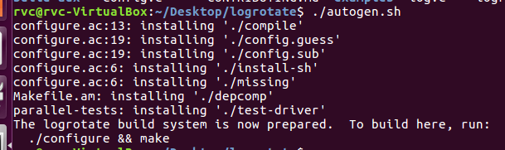
GENERATE CONFIGURE FILE
Run command below:
./autogen.sh

Slide 7
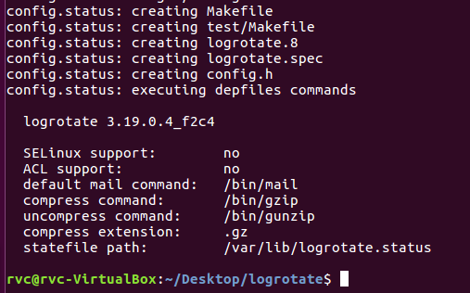
CONFIGURING THE COMPILATION ENVIRONMENT FOR TARGET DEVICE
Run command below: ./configure --host=aarch64

Slide 8
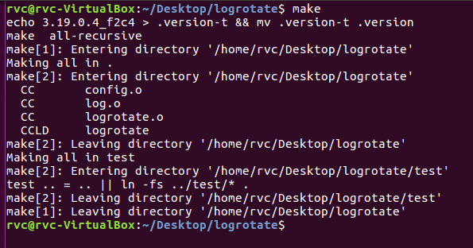
CROSS COMPILE FOR TARGET DEVICE
Run command below: make

Slide 9
CROSS COMPILE FOR TARGET DEVICE
Run command below: make

Slide 10

TRANSFER OUTPUT FILE TO TARGET DEVICE
You can transfer data via ftp, nfs or anything method do you want.
Copy logrotate file to /bin folder:
cp logrotate /bin
Type logrotate at any location to test service:

Slide 11
Thank You For Your Attendance

