Slide 1

IT TEAM — SMBC VPFC COMPANY
SDLC Agents For Enterprise
A system to store, organize, and retrieve source code knowledge — with AI, graph visualization, and centralized access control.
Internal Solution · Presented to Leadership · 2026

Slide 2
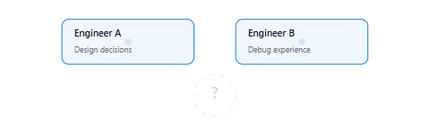
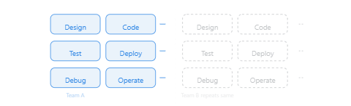
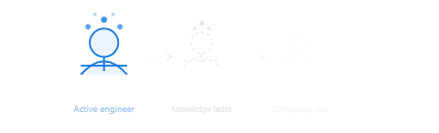
The Challenge
Source code knowledge across the organization is scattered, undocumented, and lost when people leave. The software delivery process remains slow and manual.
Knowledge Has No Central Hub
Duplicate Effort
Risk of Losing Talent
Architecture decisions, error patterns, and lessons learned exist only in people's minds — no central repository to consult.
The same solution gets designed multiple times — teams don't know someone already solved it.
When engineers leave, all system knowledge leaves with them — no proper knowledge transfer.
No structured knowledge repository
No cross-cutting search mechanism
No audit trail for technical decisions
Speed Benchmark
Feature Delivery Speed
Traditional SDLC
3–6 months
Manual only
+ AI Copilot
4–8 weeks
Assisted
AI Agent System
1–2 weeks
Automated
No AI assistance
Basic code completion
9 AI agents + KB graph
SDLC Agents For Enterprise
THE CHALLENGE

Slide 3





9 AI Agents
6 IDE Targets
5 KB Panels
VS Code Extension
Solution
SDLC Agents 4 Enterprise — internal solution by the IT Team, SMBC VPFC Company. A VS Code extension that injects 9 AI agents into any IDE and connects them to a centralized Knowledge Graph backend via MCP protocol.
9 AI Agents SM · BA · TA · SA · QA
DEV · DevOps · UI · Security
6 IDE swap
Backend Server
Hono + MCP SDK :48721
ModuleRegistry
6 modules plugin
Knowledge Graph
5 webview panels
→
IDE Extension
→
→
→
Injector + MCP
9 SDLC Agents
Multi-IDE Platform Swap
Knowledge Graph Backend
Steering & Guardrails
Full software team in your IDE — agentic SDLC pipeline from Jira ticket to deployment.
Inject 9 agents into your IDE of choice with one command — no manual migration.
Centralized KB with 6 plugin-style modules — Memory, CodeIntel, Analytics, Graph, Orchestration, Utility.
35 steering files, 17 hooks — enforce quality gates and autonomy levels across every agent action.
SM Scrum Master
BA Business Analyst
TA Technical Analyst
Kiro — .kiro/agents/, .kiro/steering/
35 steering files — rules, templates, boundaries
VS Code / Copilot — .github/agents/
Dashboard — health score, trends, recommendations
17 hooks — code indexing, drawio, KB lookup, sync
Claude Code — .claude/agents/, CLAUDE.md
Graph — 3D force-directed knowledge graph
Circuit breaker — 3 failures → open → 30′ cooldown
SA Solution Architect
QA Quality Assurance
DEV Developer
Codex / OpenAI — AGENTS.md
Tags + Quality + Analytics — taxonomy, scores, gaps
Autonomy L1–L3 — supervised → semi-auto → full auto
OpenCode + AntiGravity
Chat Panel — 135+ LLM providers (cloud, local, gateway)
DevOps Deployment
UI UI Designer
Security Review
SDLC Agents For Enterprise
SOLUTION OVERVIEW

Slide 4




9 Languages
6 Graph Services
4 Intent Strategies
Code Intelligence Engine
Tree-sitter AST parsing engine supporting 9 languages with cross-file call graph, impact analysis, symbol resolution, and AI-aware context assembly for developer agents.
Tree-sitter AST Parsing
Call Graph & Impact Analysis
GrammarRegistry loads WASM grammars lazily. IndexingEngine orchestrates: scan workspace → register files (batch 200) → index symbols (batch 50) → resolve cross-file references → sync graph nodes.
BFS traversal engine with configurable depth, file/kind filters, and blast radius prediction across 5 severity levels.
CallGraphService
— BFS depth 1-5 (default 1), limit 20, file/kind filters
9 Languages: TypeScript, JavaScript, Python, Kotlin, Java, Go, Rust, Apex, Salesforce Metadata
ImpactAnalysisService
— call graph + dependency graph + test detection
Max file size: 1MB (1,048,576 bytes)
5 severity levels:
low, medium, high, critical, blocker
Methods: tree-sitter (primary) / regex-fallback (secondary)
SymbolResolver
— 3 strategies: exact, qualified name, file:symbol
File watcher: chokidar-based incremental index
DependencyGraphService
— incoming/outgoing file-level deps
TreeSitterIndexer
IndexingEngine
GrammarRegistry
FileWatcher
web-tree-sitter
TestDetector
— auto-finds related test files
AI Context Assembly
Pipeline Architecture
AIContextService assembles developer intent-aware context with TokenBudgetManager (default 4,000 tokens, min 500). 4 intents with 7 context sections each.
Multi-layered pipeline from parsing to AI-ready context, wired through CodeIntelModule with code_* MCP tools.
explain
Understand existing code
modify
Edit with safety context
1
2
3
4
5
AST Parse
Index
Resolve
Graph
Context
debug
Root cause analysis
test
Test generation context
CodeIntelModule
GraphSyncService
Tenant isolation
code_* MCP tools
7 context sections
Source + callers + callees + tests + siblings + imports
Tenant isolation via CodeIntelIsolation
SDLC Agents For Enterprise
CODE INTELLIGENCE ENGINE

Slide 5









LangGraph Pipeline
6 Subgraphs
30+ State Channels
9 AI Agents
Multi-agent architecture orchestrating the full SDLC lifecycle — from requirements to deployment. Each agent specializes in a distinct domain, collaborating through LangGraph state machine with 6 subgraphs and 30+ shared state channels.
SM
Scrum Master
BA
Business Analyst
TA
Technical Analyst
Sprint Orchestrator
Requirements Handler
System Analysis
Manages sprint lifecycle — backlog grooming, sprint planning, daily standups, retrospectives. Tracks ticket progress across 8 SDLC phases, triggers retry logic up to 2 attempts per phase.
Analyzes business requirements, transforms them into structured user stories and acceptance criteria. Outputs requirements documentation consumed by TA and SA in subsequent phases.
Performs technical feasibility analysis, identifies system dependencies, data flow impacts, and API contracts. Produces technical specification documents for the SA and DEV agents.
SA
Solution Architect
DEV
Developer
QA
Quality Assurance
Architecture Design
Implementation
Quality Gatekeeper
Designs system architecture, component diagrams, tech stack decisions, and data models. Outputs architecture documentation and guides DEV implementation with design constraints.
Writes production code following SA architecture and TA specifications. Implements features, unit tests, and integrates with existing codebase. Outputs code diff and test results to QA gate.
Runs automated test suites, validates acceptance criteria, performs quality scoring. Enforces Quality Gate: max 2 retries per phase, automatic strategy switch on failure, human intervention escalation.
DO
DevOps
SEC
Security
UI
UI/UX Designer
Deployment
Security Audit
Interface Design
Manages CI/CD pipeline, build configuration, containerization, environment provisioning. Handles deployment artifacts generation, rollback procedures, and release note creation.
Performs security vulnerability scanning, dependency auditing, threat modeling, and compliance checks. Generates security audit reports and recommends remediation steps.
Designs user interfaces, wireframes, and user experience flows. Produces UI specifications, component mockups, and accessibility guidelines consumed by DEV during implementation.
SDLC Agents For Enterprise
9 AI AGENTS

Slide 6



35 Steering Rules
8 Pattern Guides
3 Autonomy Levels
Steering Rules & Guardrails
Hierarchical steering system governing agent behavior: 35 rules with front-matter metadata, circuit breaker for failure handling, token budget enforcement, and 3-tier autonomy levels (L1–L3).
35
3
L1–L3
STEERING RULES
CIRCUIT BREAKER STATES
AUTONOMY LEVELS
Rule System
Circuit Breaker
Autonomy Model
Front-matter metadata: targets, inclusion, priority
Auto-injected (~4000 chars / ~1000 tokens budget)
7 phase-specific rules (requirements through deployment)
8 shared rules: Jira, quality gates, diagrams, etc.
8 architectural pattern guides (microservice, monolith, etc.)
Rules sorted by priority descending
closed — Normal execution flow
open — Hard stop after 3 failures/phase, report user, no retry
half-open — Allow 1 retry after 30 min cooldown
User override: "retry {phase}" or "reset circuit breaker"
Token Budget: dailyCap 500K, 3 modes (normal/report-only/stopped)
Per-action estimates: BRD 50K, FSD 60K, Implementation 100K
L1 Report — No agent invocations, no Jira transitions. Observes and reports only.
L2 Assisted (default) — Invoke agents + ask user before each phase transition
L3 Unattended — Full pipeline auto; stops at UAT, Deploy, or circuit breaker open
17-phase SDLC pipeline including security reviews
Human gates: uat, deployment, feedback_loop_start
Failure Mode Catalog for structured error classification
SteeringLoader
injectSteering()
sm-core.md
TokenBudgetManager
dailyCap: 500,000
exhaustion <50 tokens
LangGraph state
Quality Gate
max 2 retries/phase
phase-1-requirements.md through phase-7-deployment.md
shared-jira.md / shared-quality-gates.md / shared-diagrams.md
code-standards.md / loop-constraints.md
SDLC Agents For Enterprise
STEERING RULES & GUARDRAILS

Slide 7





VS Code + Kiro
20+ Commands
9 AI Agents
IDE Extension
Thin client connects to backend via MCP StreamableHTTP. McpServerManager on local port 9181. 6 webview panels, LangGraph pipeline engine, 9 SDLC agents.
Extension Architecture
Commands & Features
McpServerManager — spawn/kill/restart wrapper server on :9181, auto-starts with IDE
20+ commands, activity bar icon, sidebar tree view:
RemoteBackendClient — HTTP + MCP StreamableHTTP, health check every 30s
Inject Agents
— injectAll / injectSelective (9 agent prompts + hooks)
AuthManager — SSO/PKCE flow, token refresh, auto-reconnect
KB Operations
— Open KB Graph, Dashboard, Tags, Quality, Analytics
ConfigWatcher — watches kiroSdlc.* changes, auto-restarts server
Code Intel
— Symbol Search, Impact Analysis, AI Context, Edit Context
KbEventBus — SSE bridge receives KB change notifications from backend
Connection
— Login/Logout/Reconnect/Disconnect backend
Platform Swap — auto-switches agent config between IDEs (Claude, Roo, GitHub Copilot, OpenCode, Codex)
Indexing
— Index Documents, Index Source Code, Sync Workspace
Settings
— backend.url, mcpServerPort, llmProvider, ssoEnabled, 20+ config keys
Webview Panels
LangGraph Pipeline Engine
6 real-time panels, communicating with backend via SSE + JWT token:
Multi-graph architecture with checkpointing filesystem:
Dashboard
Graph 3D
Router Graph
— classify_intent → 1 of 6 subgraphs
System health overview
Three.js knowledge graph
SDLC Subgraph
— 8 phases: requirements → specification → design → test_planning → implementation → user_guide → testing → deployment
Hotfix / Code Review / Docs / Security / Chat
— specialized subgraphs, lazy-loaded
KB Tags
KB Quality
30+ state channels
: ticketKey, currentPhase, documents, agentOutputs, verifyPassed, feedbackIterations, toolCalls
Quality Gate
: verify node → max 2 retries → strategy switch → human intervention
Tag CRUD + merge + rename
Score distribution + tier filter
Analytics
Chat Panel
9 AI Agents
Charts + usage metrics
Webview chat UI with agent
SM
Scrum Master
BA
Business Analyst
TA
Technical Analyst
SA
Solution Architect
DEV
Developer
QA
Quality Assurance
DevOps
Deployment
Security
Security Expert
UI
UI/UX Designer
SDLC Agents For Enterprise
IDE EXTENSION

Slide 8



6 IDE Targets
4 Swap Platforms
3 Inject Modes
Multi-IDE Platform Swap
Inject SDLC Agents into any major IDE. Platform Swap switches agent configs between IDEs seamlessly. Injector installs all 9 agents with hooks, steering rules, and MCP config in one command.
Platform Swap
6 IDE Targets
Template Method pattern orchestrates swap between 4 IDE platforms. PlatformDetector uses Strategy pattern (appName, extensions, env vars) to identify the active IDE.
Injector copies all 9 agent prompts + hooks + steering rules + MCP config. Conversion directories for each platform maintained in conversions/.
Swap Sequence:
validate → backup → delete (3 retry, 500ms delay) → copy → update state → rollback on failure
Kiro
.kiro/agents/ (default)
VS Code
.github/agents/
Protected paths:
documents/, .code-intel/, backend/, node_modules/, .git/ — never touched
State managed
via .agent-config.json: activePlatform, autoSwap, platformOverride, backups[]
Claude Code
.claude/agents/
Codex/OpenAI
AGENTS.md + agents/
1
2
3
4
OpenCode
.opencode/agents/
AntiGravity
.agents/ + skills/
Validate
Backup
Deploy
Verify
SwapExecutor
PlatformDetector
StateManager
BackupManager
StatusBar indicator
Injector Commands
Two entry points for agent installation, plus diff-based safe updates.
injectAll
— copies all core components + MCP config, shows IDE picker
injectSelective
— component-level selection with QuickPick checkboxes
safeUpdate
— diff-based: overwrite / skip modified / backup-then-update (3 modes)
9 Agent prompts
35 Steering rules
17 Hook files
MCP config
SDLC Agents For Enterprise
MULTI-IDE PLATFORM SWAP

Slide 9
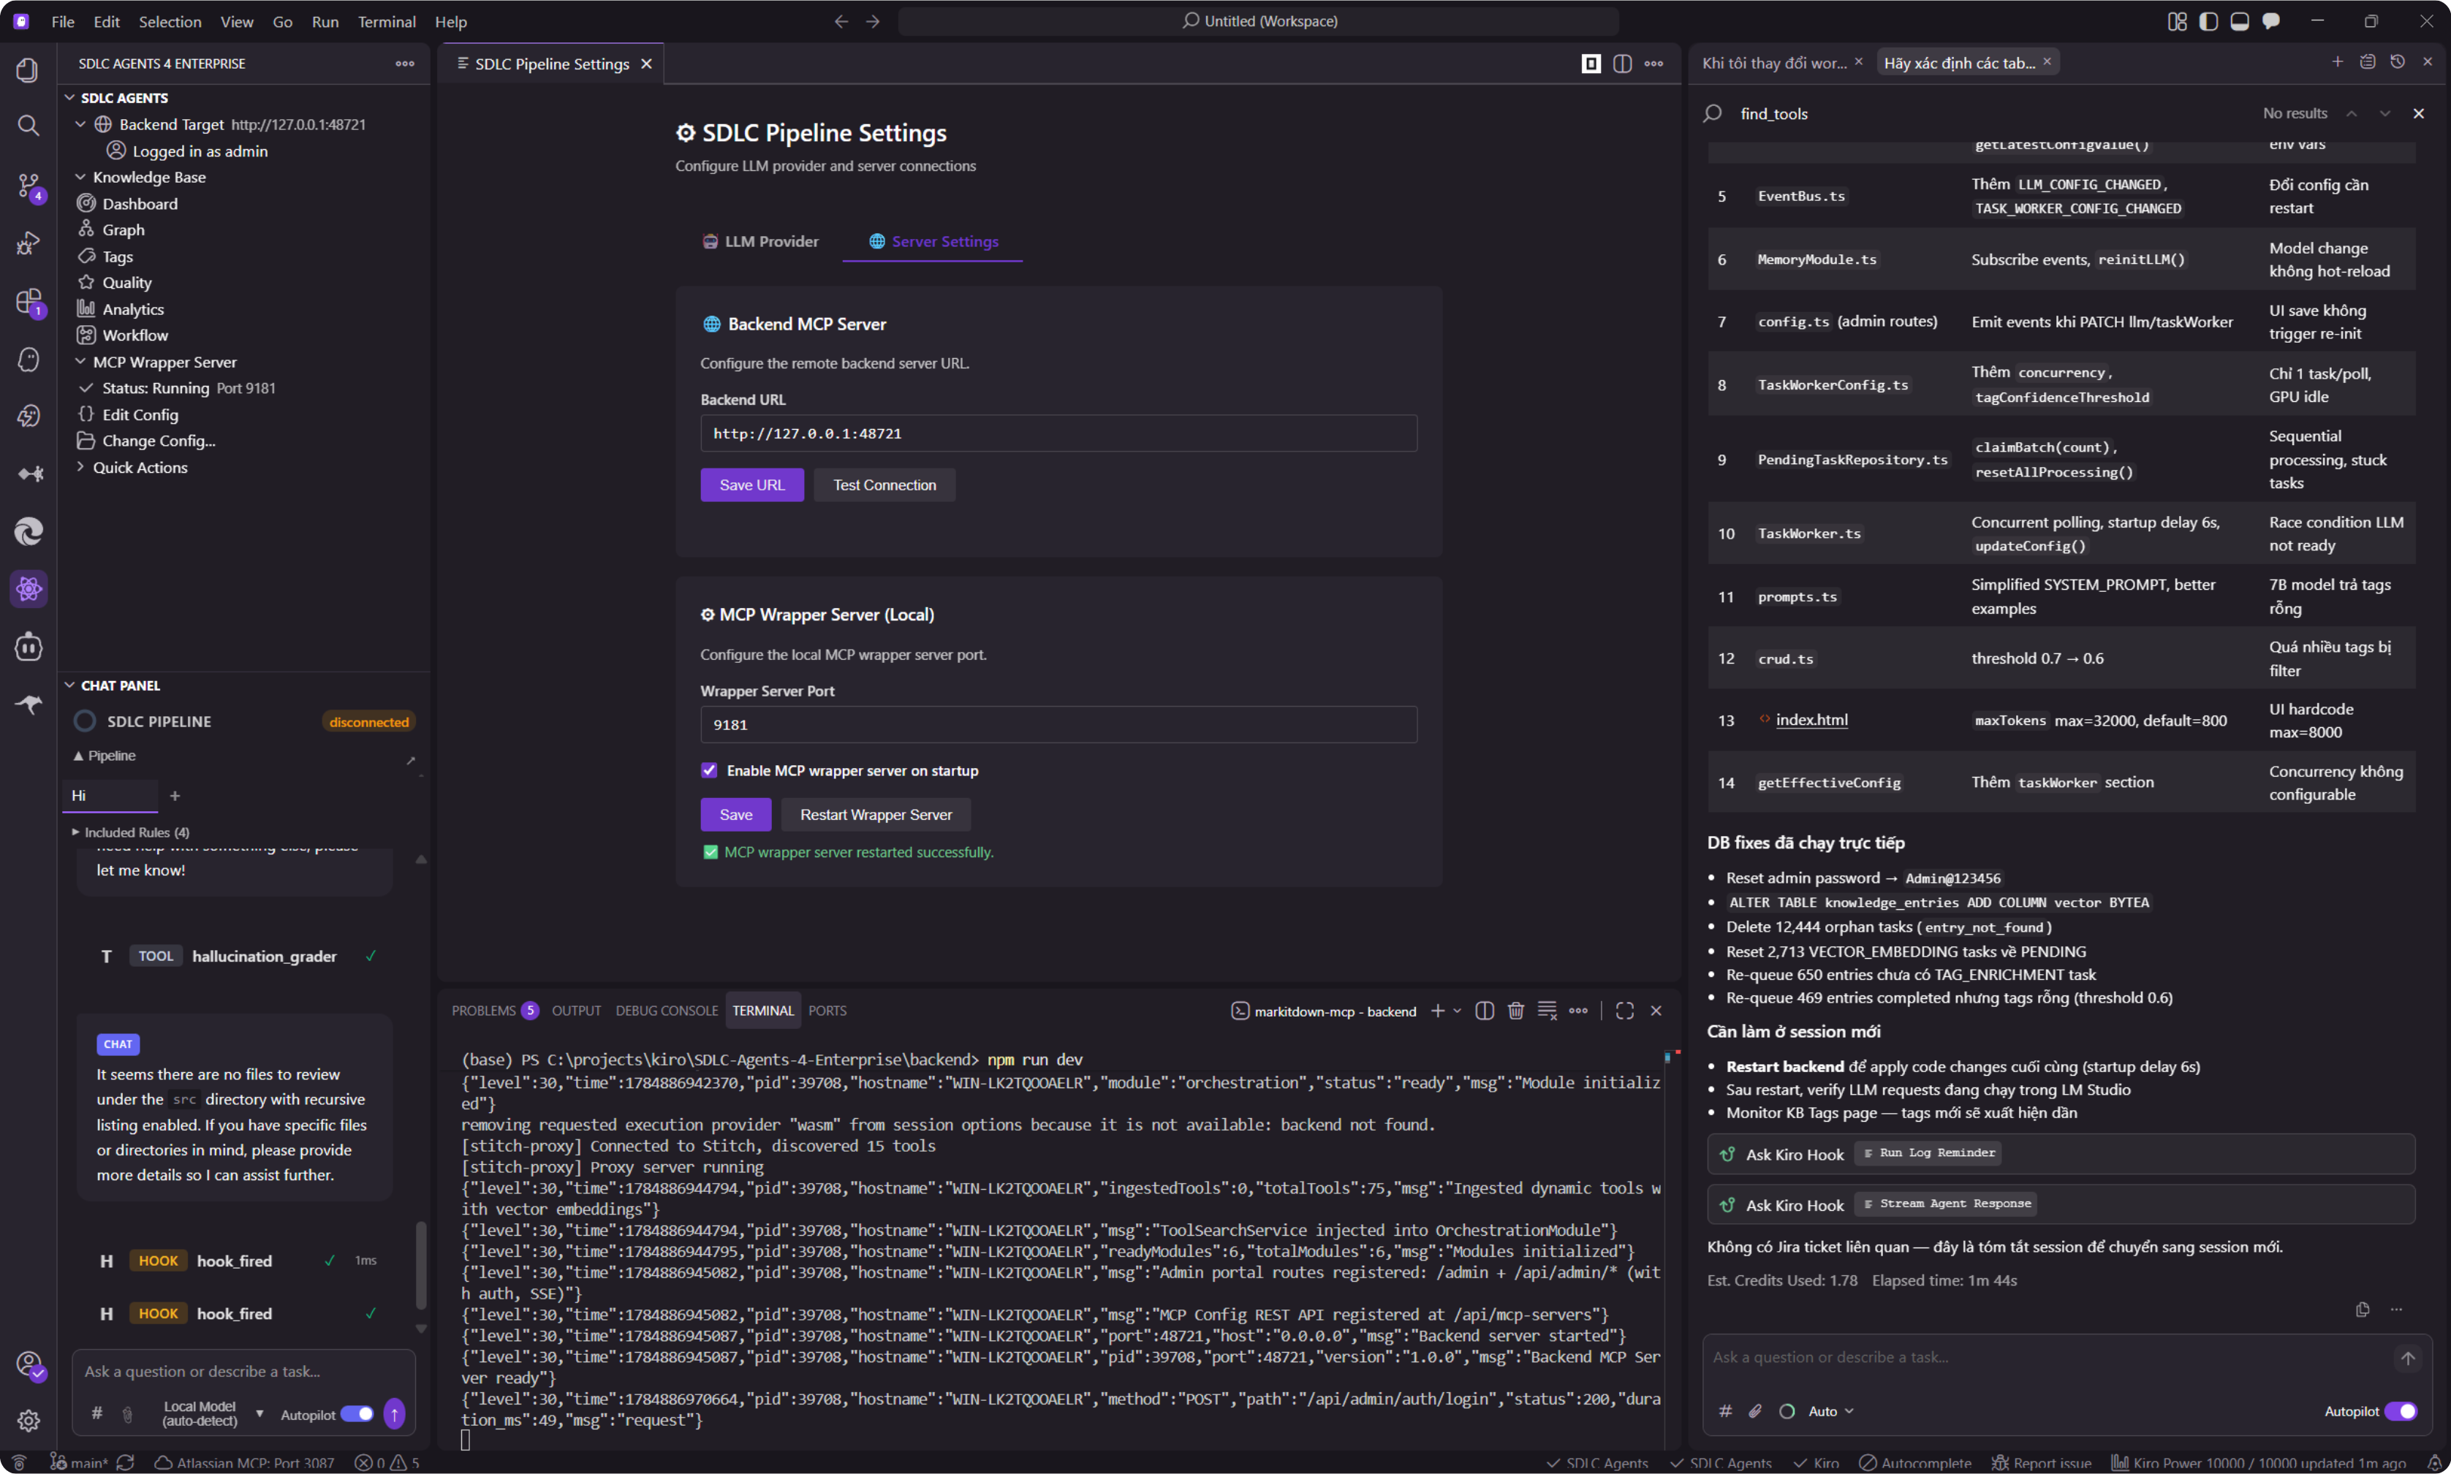
Extension on VS Code
SDLC Agents For Enterprise on VS Code — activity bar, sidebar tree view, KB Dashboard webview.
SDLC Agents For Enterprise
EXTENSION SCREENSHOT

Slide 10


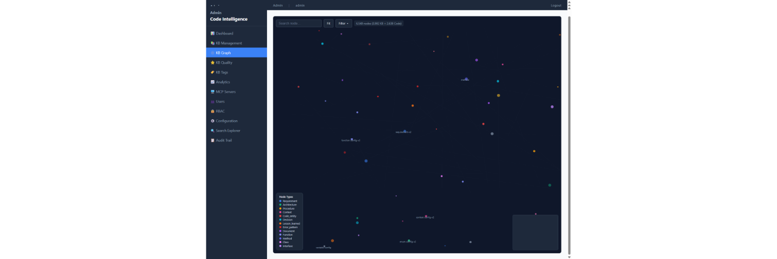
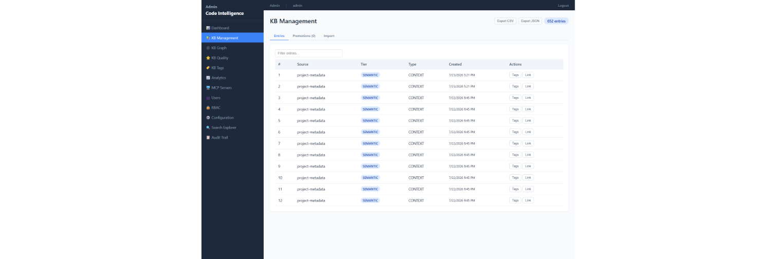
6.903 KB Entries
6.540 Graph Nodes
9.894 Code Symbols
Knowledge Base & 3D Graph
KB stores structured 3-tier entries with quality scoring. The 3D graph uses Fibonacci sphere + Z-offset layers to distribute nodes naturally on a sphere surface.
Knowledge Base
Knowledge Graph 3D Engine
Entries classified into 3 tiers: USER (personal), PROJECT (project-level), SHARED (organization-wide). Each entry: markdown content, tags, cross-links (entry link + KB link), auto quality score.
Three.js + Fibonacci sphere distribution: nodes positioned on a sphere of radius 1200, local spread 180, Z-offset by type layer. 20 node types, auto-edge seeding TYPE_MATCH (0.6) + TIER_MATCH (0.4).
mem_ingest / mem_search
mem_promote
Z-offset layers: REQUIREMENT 0, CONTEXT 50, DOCUMENT 100, ARCHITECTURE 150, DECISION 200, PROCEDURE 300, CLASS 500, FUNCTION 600, CONSTANT 400, ERROR_PATTERN -150, LESSON_LEARNED -100
Hybrid search: BM25 + vector + graph
USER → PROJECT → SHARED
mem_pin / mem_tag
mem_ingest_file
LOD Clustering
Spatial queries
Auto TYPE/TIER edges
Minimap + Legend
Node detail panel
Pin auto-recall + tag system
Zero-context file ingestion
SDLC Agents For Enterprise
KB & GRAPH

Slide 11



5 Scoring Strategies
24h Decay Cycle
LLM Smart Ingest
KB Evolution & Smart Ingest
Knowledge Base evolution engine with composite scoring, temporal decay, stagnation detection, and LLM-powered smart ingest — ensuring KB entries stay relevant and high-quality over time.
CompositeScorer
Scheduler & Decay Service
5 strategies multiplied together for a composite quality score. Each strategy contributes a factor between 0 and 1.
Background jobs keep the knowledge base fresh. Entries untouched beyond 60 days receive additional decay.
score = fts_rank × temporal_weight × confidence × outcome_factor × predictive_boost × supersede_factor
Decay cycle: every 24 hours, batch size 100
Stagnation detection: every 6 hours, threshold 3 failures in 7-day window
Access threshold: 60 days untouched triggers additional decay
TemporalStrategy
ConfidenceStrategy
EpochService: epoch-triggered evolution cycles
Half-life 30 days configurable. Decay rate 0.05 (5%) per cycle.
Entry confidence score with configurable floor of 0.1.
Consolidation log: tracks all scope changes (USER → PROJECT → SHARED)
SupersededStrategy
OutcomeStrategy
Smart Ingest
Penalty factor 0.3 if superseded_by is set. Zero when includeSuperseded=false.
Outcome-derived factor using DatabaseAdapter for historical tracking.
LLM-powered message classification decides whether content is worth storing in the KB. Falls back to unfiltered ingest when LLM is unavailable.
mem_smart_ingest
— LLM classifies message as ingest / skip
PredictiveStrategy
Duplicate detection
— content hash on first 500 chars
Predictive boost factor. Enabled/disabled via predictiveEnabled flag.
Max message:
10,000 chars, max summary: 200 chars
Cleanup tool:
batch re-evaluates unfiltered entries (max batch 100, default 50)
Scopes:
USER → PROJECT → SHARED with IsolationLayer enforcement
CompositeScorer
DecayService
StagnationDetector
ScopePromotionService
MemoryModule
EpochService
OutcomeService
SDLC Agents For Enterprise
KB EVOLUTION & SMART INGEST

Slide 12

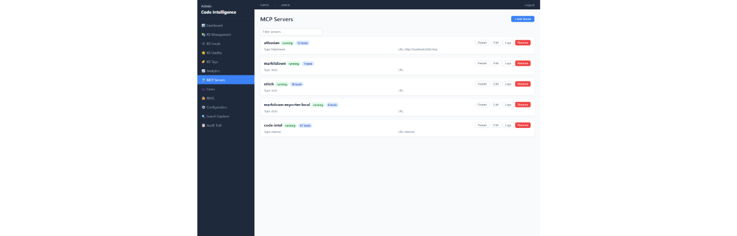

Analytics & AI Integration
Multi-dimensional analytics (summary cards, bar/line/scatter charts) + MCP server manages child servers through OrchestrationModule with 3 transport protocols.
Analytics Dashboard
MCP Server Integration
Total entries
Avg Quality
OrchestrationModule manages child MCP servers. Reads config from orchestration.json, supports 3 transports: httpStream, SSE, stdio.
6.903
62%
5 LLM Providers:
Query time
Cache hit rate
Ollama
Local, no key
<100ms
~85%
Anthropic Claude
API key
OpenAI GPT
API key
3 chart types (SVG):
OpenRouter
Multi-model
Quality Score Distribution (bar)
Usage 14-day (line)
Embedding 2D Scatter
LM Studio / ONNX
Local CPU
Form/JSON editor
Tool toggle
Live logs
McpClientManager
Knowledge Quality
247
265
140
Good (≥70%)
Fair (40-70%)
Poor (<40%)
SDLC Agents For Enterprise
ANALYTICS & AI

Slide 13

19 Permissions
5 RBAC Groups
6 Users
Granular Access Control
19 granular permissions with role CRUD per permission. Group system (System Owner cannot be deleted), cascade constraint (GROUP_HAS_USERS), and auto cache invalidation.
DASHBOARD_VIEW
exportAllowed (bool)
KB_READ
allowedTiers (USER/PROJECT/SHARED)
KB_WRITE
allowedTiers, maxEntries, allowedOperations
KB_PROMOTE
targetTiers (enum list)
KB_IMPORT_EXPORT
allowedFormats, allowImport, allowExport
MCP_ACCESS
toolAccess (per-server tool table)
MCP_MANAGE
allowAdd, serverPermissions
USER_MANAGE
canDelete, canForceLogout, canDisable
RBAC_MANAGE
canDeleteSystemGroups, canEditSystemPerms
CONFIG_EDIT
allowedSections (enum list), readOnly
CONFIG_VIEW
allowedSections
GRAPH_VIEW
exportAllowed
ANALYTICS_VIEW
(none)
SEARCH_EXPLORE
allowDebug
AUDIT_VIEW
exportAllowed, dateRange (days)
PROJECT_MANAGE
canCreate, canDelete, maxProjects
API_KEYS
canGenerate, canRevoke, maxKeys
IMPERSONATE
allowedUsers (whitelist)
SYSTEM_INFO
canViewLogs, canViewProcesses, canViewMetrics
Role CRUD
System Owner protected
Cascade GROUP_HAS_USERS
Cache invalidate
SDLC Agents For Enterprise
RBAC

Slide 14






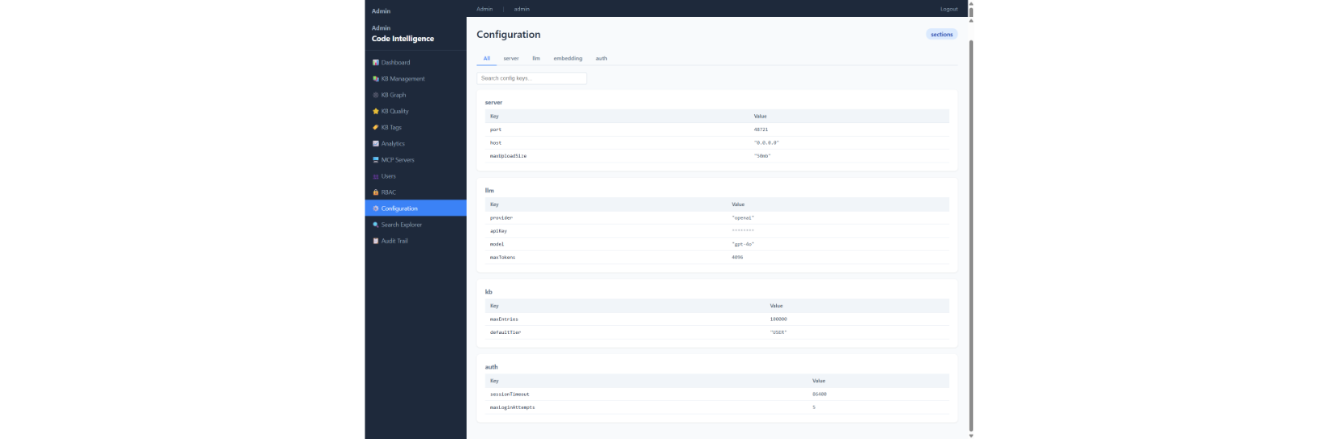
Configuration & Architecture
3-layer backend architecture (config → engine → admin). Supports 3 database engines (SQLite/PostgreSQL/MySQL), cross-engine migration, and project ID multi-tenant.
Database Engine
Configuration Sections
Default better-sqlite3 (WAL + FTS5). Can switch to PostgreSQL or MySQL via DatabaseAdapterFactory. MigrationService: TypeMapper generates DDL dynamically → batch copy 500 rows → verify phase → safe rollback (no table drops).
server
embedding
llm
mcp-servers
kb
auth
database
DatabaseAdapter interface
5 Repositories (Facade)
Migration SSE progress
Inline editing per key. Config validated by Zod schema, env override. Supports LLM connection test + model list refresh.
Engine Layer
MCP Notification System
Tree-sitter AST (TypeScript grammar) + chokidar file watching incremental index. ONNX Runtime (all-MiniLM-L6-v2) for embeddings. Draw.io integration (export PNG, layout, parse with OCP pattern router).
OCP (Open-Closed Principle) pattern: declarative notification map. Tool pattern → method: ingest/create → kb_entry_added, update/modify → kb_entry_updated, delete/remove → kb_entry_deleted, tag → tag_created. Broadcast connection to every transport.
web-tree-sitter
chokidar
ONNX + Transformers.js
Draw.io engine
Project ID Multi-tenant
Extension (VS Code + Kiro)
Project ID is derived in 3 steps: project.json → git remote hash → user+folder hash (SHA256, 12 hex chars). Ensures data isolation between users/projects.
20+ commands: injectAll, injectSelective, KB Graph/Dashboard/Tags/Quality, Symbol Search, Impact Analysis, AI Context. LangGraph pipeline engine with 6 subgraphs (SDLC, hotfix, code_review, docs, security_audit, chat). 9 agents: SM, BA, TA, SA, QA, DEV, DevOps, Security, UI.
LangGraph state machine
9 AI agents
SSO/PKCE auth
Platform Swap
SDLC Agents For Enterprise
CONFIGURATION & ARCHITECTURE

Slide 15
Knowledge is the
Most Valuable Asset
SDLC Agents For Enterprise — an internal solution by the IT Team, SMBC VPFC Company. Helping organizations collect, protect, and leverage source code knowledge — turning individual experience into collective advantage.
IT DEPARTMENT · SMBC VPFC
6.903
9.894
6.540
5
KB Entries
Code Symbols
Graph Nodes
MCP Servers
Try the Admin Portal →
localhost:48721/admin · admin / Admin@123456

