Slide 1
Data Objects and Attribute Types
Group 4
Nguyễn Thế Hào
Trần Huy Hiệp
Nguyễn Việt Anh
Nguyễn Đức Lộc
Phạm Công Định
Group 5
Nguyễn Thị Phương Anh
Nguyễn Bình An
Đỗ Thành Đạt
Bùi Tố Uyên
Đào Huy Hoàng
1

Slide 2
First overview:
Data sets are made up of data objects
A data object represents an entity
Data objects are typically described by attributes. If the data objects are stored in a database, they are data tuples.
2

Slide 3
CONTENT
01
02
03
What is an Attribute?
Nominal Attributes.
Binary Attributes.
04
Ordinal Attributes.
05
Numeric Attributes.
06
Discrete versus Continuous Attributes.
3

Slide 4

01
What is an Attribute?
4

Slide 5
1. What is an Attribute?
- An attribute is a data field, representing a characteristic or feature of a data object.
- The nouns attribute, dimension, feature, and variable are often used interchangeably in the literature.
- A set of attributes used to describe a given object is called an attribute vector (or feature vector).
5

Slide 6
02
Nominal Attributes.
6

Slide 7
2. Nominal attributes.
- Nominal means “relating to names”. The values of a nominal attribute are symbols or names of things.
- Each value represents some kind of category, code, or state, and so nominal attributes are also referred to as categorical.
- In computer science, the values are also known as enumerations.
7

Slide 8

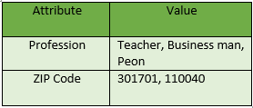
Example:
8

Slide 9
Besides:
- It is possible to represent such symbols or “names” with numbers.
- E.g.: we can assign a code of 0 for black, 1 for brown, and so on.
- Even though a nominal attribute may have integers as values, it is not considered a numeric attribute because the integers are not meant to be used quantitatively.
9

Slide 10
03
Binary Attributes.
10

Slide 11
3. Binary Attributes.
- A binary attribute is a nominal attribute with only two categories or states: (0 or 1).
- Binary attributes are referred to as Boolean if the two states correspond to true and false
- E.g.: Given the attribute smoker describing a patient object, 1 indicates that the patient smokes, while 0 indicates that the patient does not.
- A binary attribute is symmetric if both of its states are equally valuable and carry the same weight.
- E.g.: The attribute gender having the states male and female
11

Slide 12
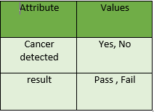
- A binary attribute is asymmetric if the outcomes of the states are not equally important.
- E.g.: About a medical test for HIV. By convention, we code the most important outcome, which is usually the rarest one, by 1 and the other by 0.
12

Slide 13
04
Ordinal Attributes.
13

Slide 14
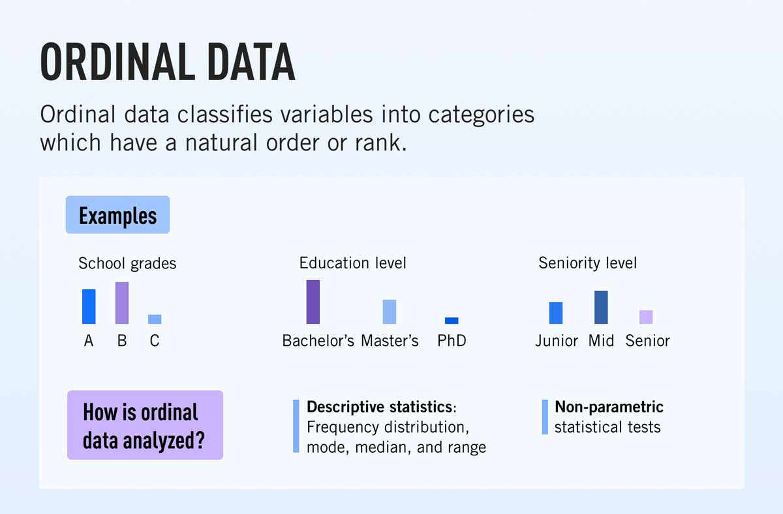
4. Ordinal Attributes.
- An ordinal attribute is an attribute with possible values that have a meaningful order or ranking among them, but the magnitude between successive values is not known.
14

Slide 15
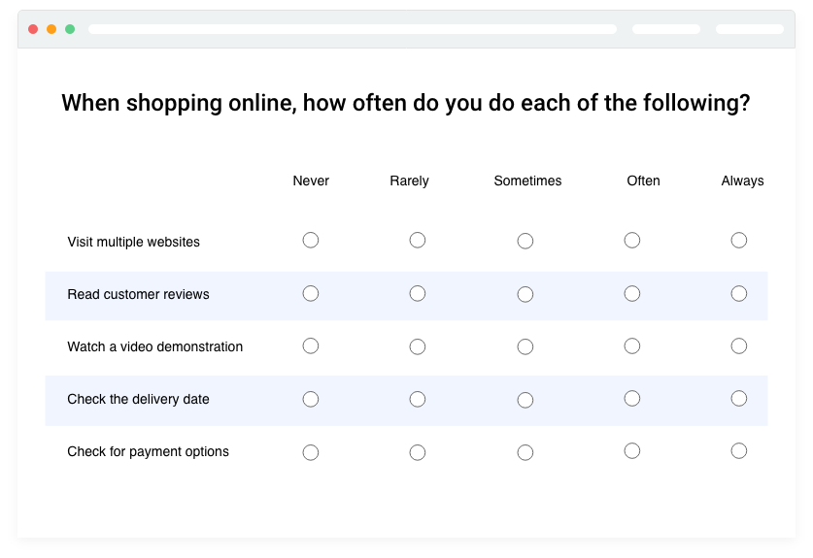
- Ordinal attributes are useful for registering subjective assessments of qualities that cannot be measured objectively; thus ordinal attributes are often used in surveys for ratings.
15

Slide 16
05
Numeric Attributes.
16

Slide 17
5. Numeric Attributes.
- A numeric attribute is quantitative; that is, it is a measurable quantity, represented in integer or real values.
- Numeric attributes can be divided into two types:
+ Interval-scaled.
+ Ratio-scaled.
17

Slide 18
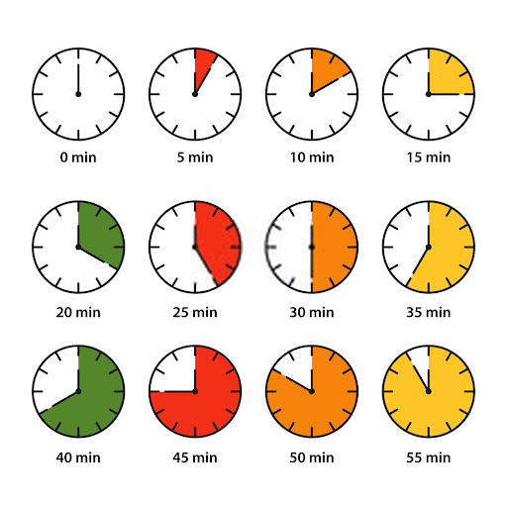
* Interval-Scaled Attributes:
Are measured on a scale of equal-size units. The values of interval-scaled attributes have order and can be positive, 0, or negative. Thus, attributes allow us to compare and qualify the difference between values.
18

Slide 19
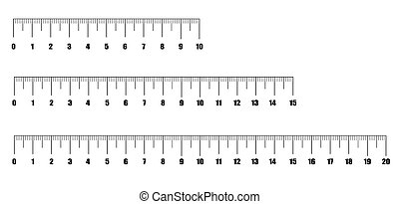
* Ratio-Scaled Attributes:
Is a numeric attribute with an inherent zero-point. That is, if a measurement is ratio-scaled, we can speak of a value as being a multiple (or ratio) of another value.
19

Slide 20
06
Discrete versus Continuous Attributes.
20

Slide 21
6. Discrete versus Continuous Attributes
- We have organized attributes into nominal, binary, ordinal, and numeric types. There are many ways to organize attribute types, but they are not mutually exclusive.
- To differentiate, it will be divided into 2 types:
+ Discrete attribute.
+ Continuous attribute.
21

Slide 22
* Discrete Attributes:
Has a finite or countably infinite set of values, which may or may not be represented as integers.
* Continuous Attributes:
If an attribute is not discrete, it is continuous. The terms numeric and continuous attribute are often used interchangeably in the literature. Continuous attributes are typically represented as floating-point variables.
22

Slide 23
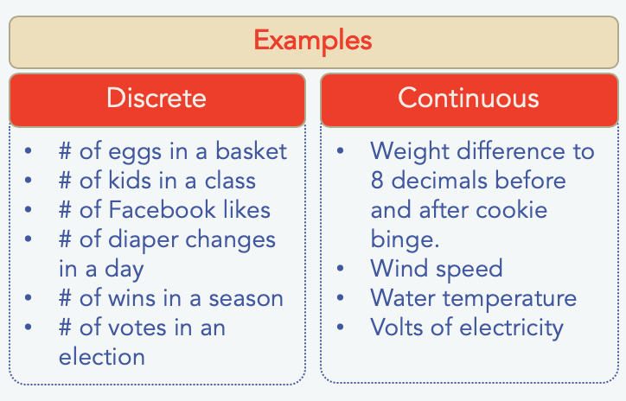
23

Slide 24
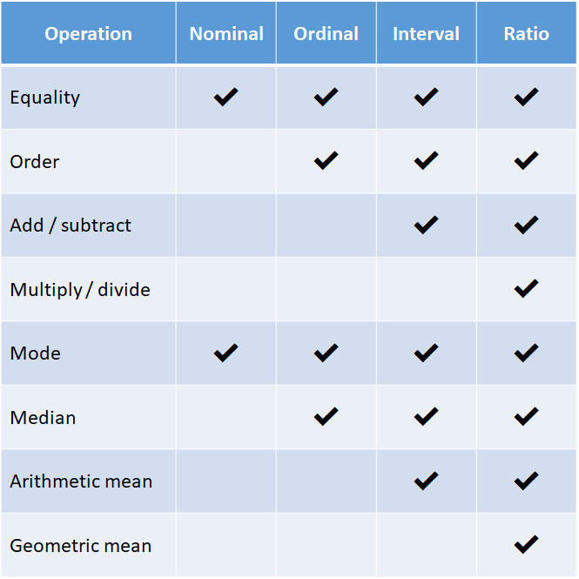
7. Summary:
24

Slide 25

THANK FOR LISTENING
25

