Slide 1


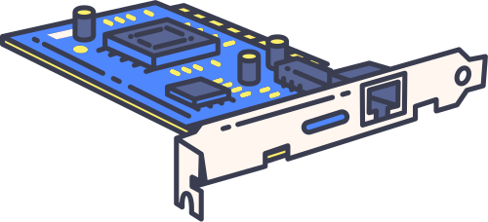

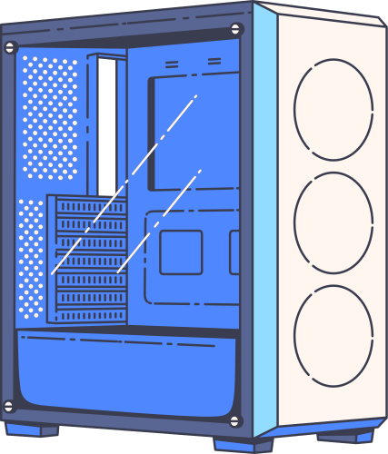

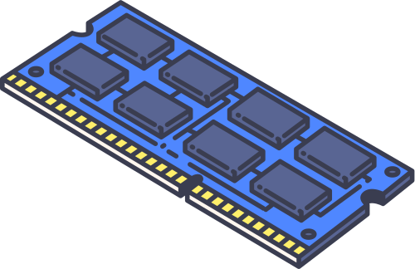
Computer Components
Project Presentation

Slide 2
Our Team
Joseph Adeyemi
Sana Mahmood

Slide 3
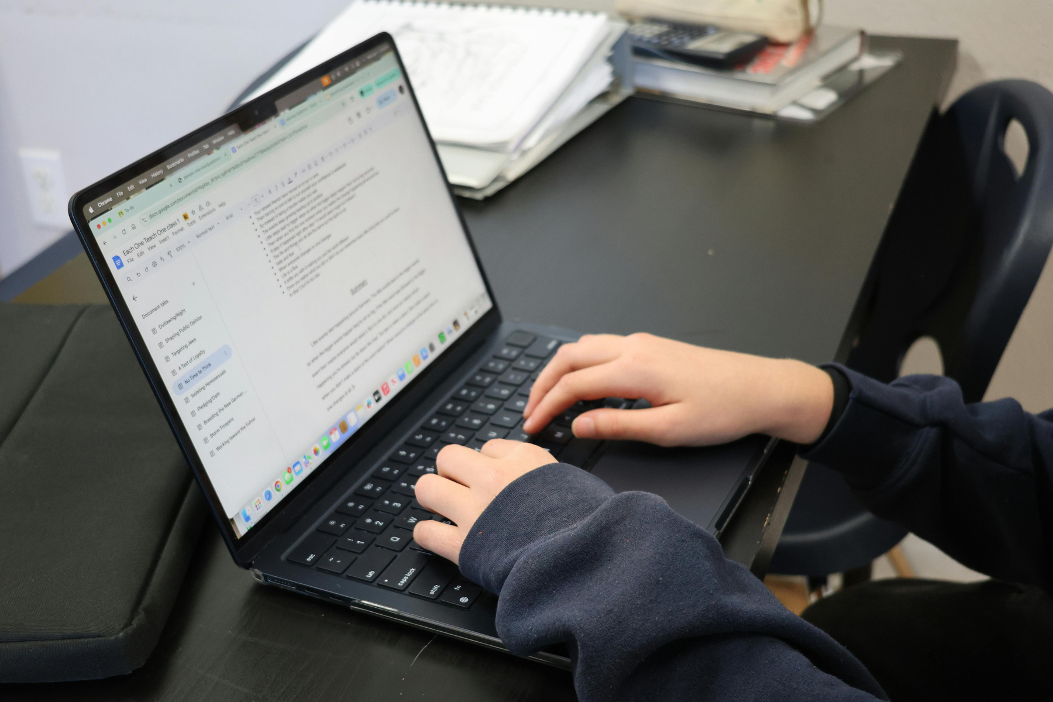
{{TITLE}}
{{CONTENT}}

Slide 4
{{TITLE}}
{{CONTENT}}

Slide 5

{{CONTENT}}
{{TITLE}}

Slide 6

{{TITLE}}
{{CONTENT}}

Slide 7
{{CONTENT}}
{{TITLE}}

Slide 8
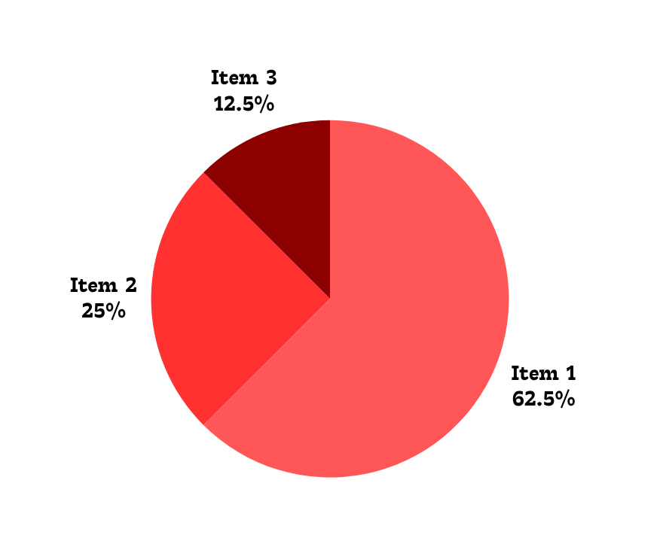
{{TITLE}}
{{CONTENT}}

Slide 9
{{CONTENT}}
{{TITLE}}

Slide 10
{{CONTENT}}
{{TITLE}}

Slide 11
{{CONTENT}}

Slide 12
{{CONTENT}}

