Slide 1
Final Project – Cloud Computing
Tran Luong Bang - tran.1956419@studenti.uniroma1.it
Gaurav Mohan Ramse - ramse.1965564@studenti.uniroma1.it
Ahmed Fayez Moustafa Tayel - tayel.1972085@studenti.uniroma1.it
Rocco Lo Conte - loconte.1946073@studenti.uniroma1.it

Slide 2
Introduction

Slide 3
In this project, we are going to work on Sentiment Analysis using Machine Learning Algorithms. We are going to build a website which allows users to classify a positive or negative comment. This web application will be deployed on AWS cloud platform. We will also measure the performance and the scalability of webserver by sending multiple requests to our server

Slide 4
Design of Solution

Slide 5
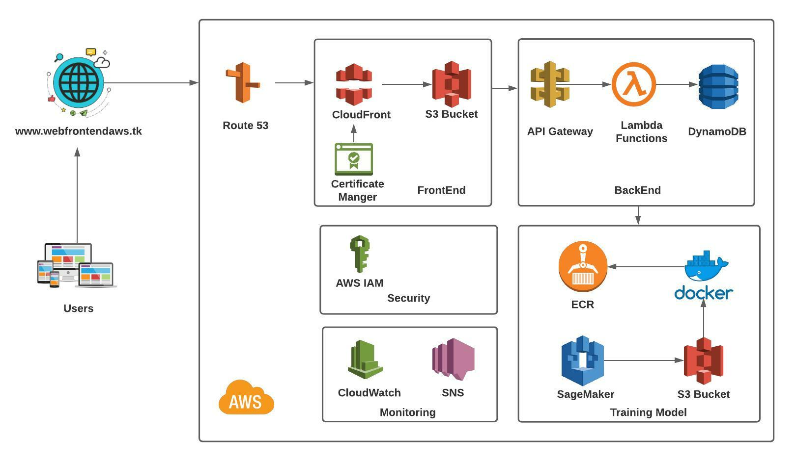

Slide 6
FrontEnd

Slide 7
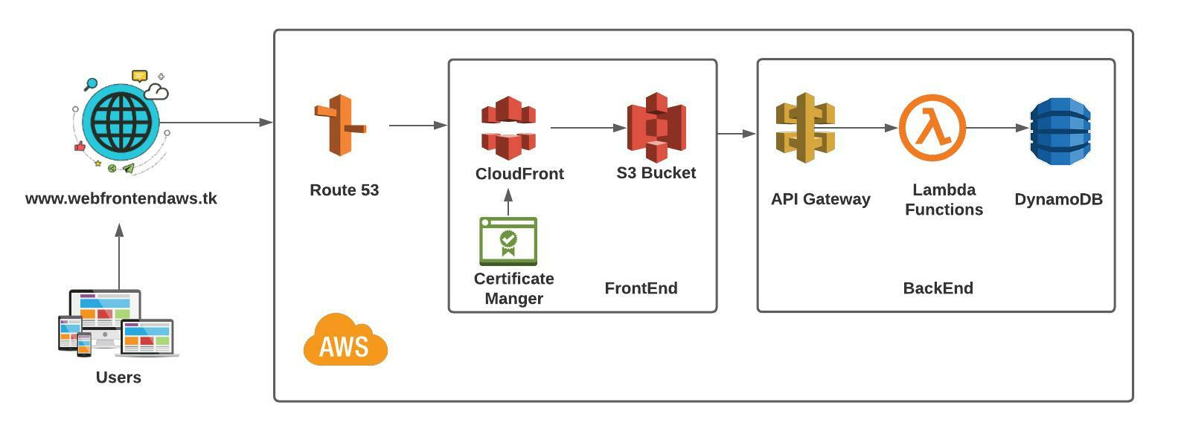
FrontEnd Architecture

Slide 8
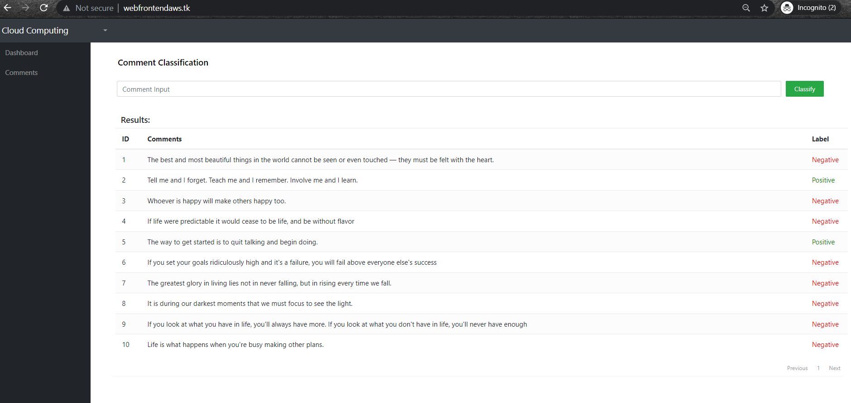
Website Interface

Slide 9
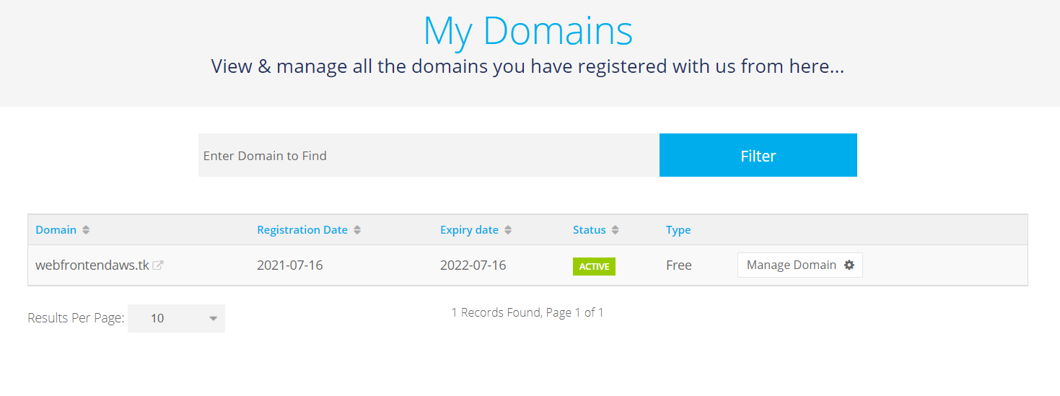
Domain Name System – webfrontendaws.tk

Slide 10
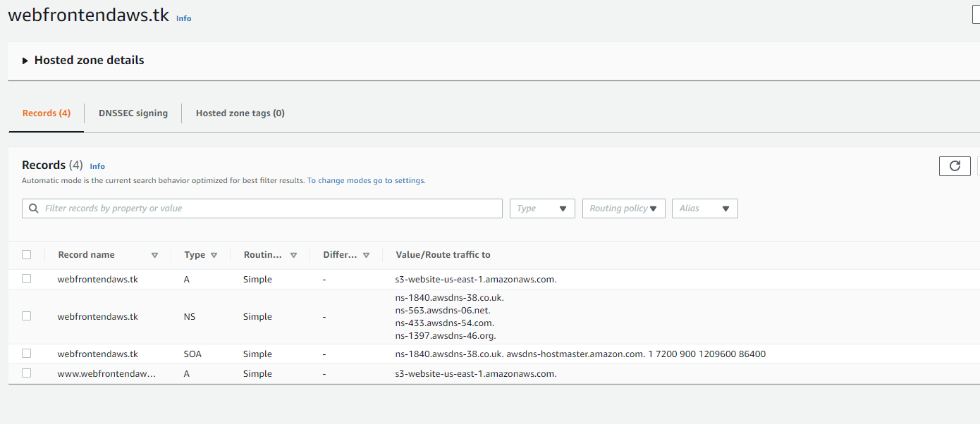
Route 53

Slide 11
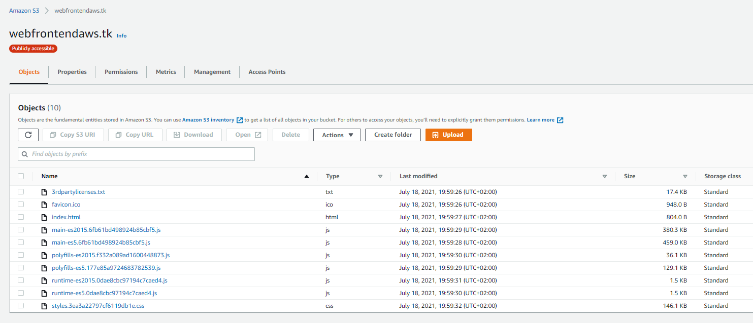
Amazon S3 Bucket

Slide 12
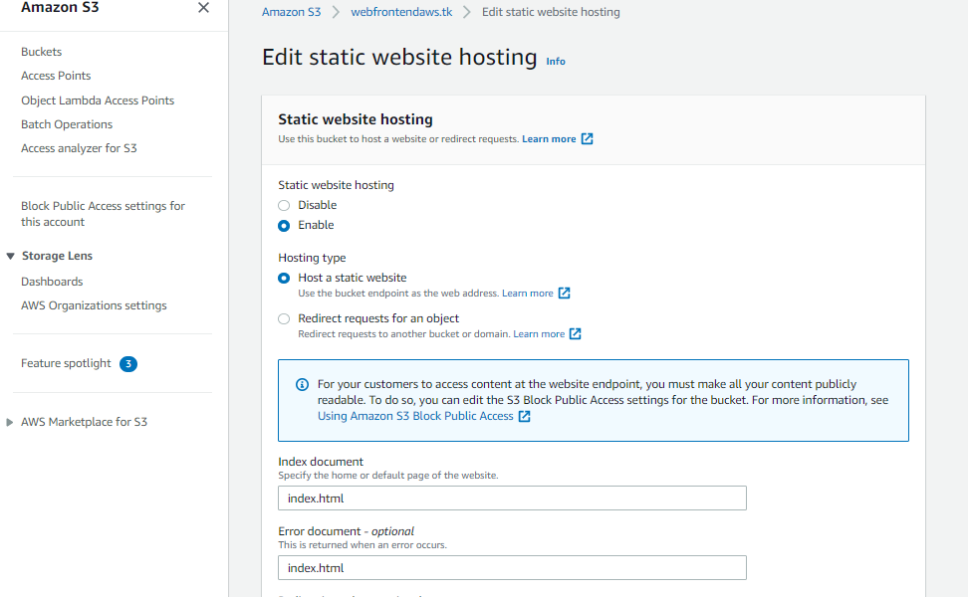
Amazon S3 Bucket

Slide 13
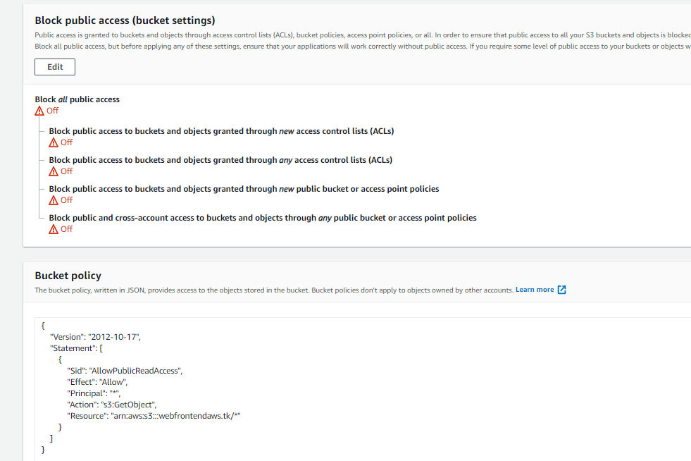
Amazon S3 Bucket

Slide 14
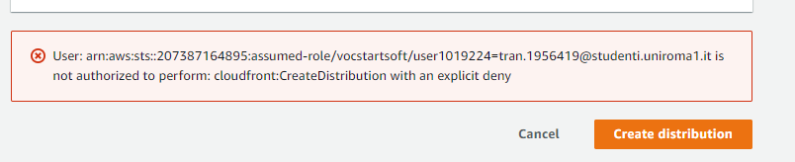
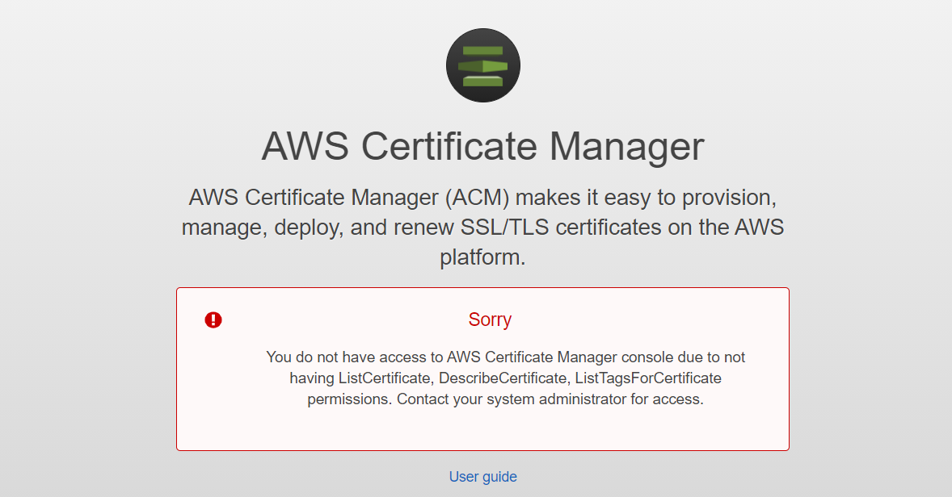
CloudFront
Certificate Manager

Slide 15
Backend

Slide 16
BackEnd Architecture

Slide 17
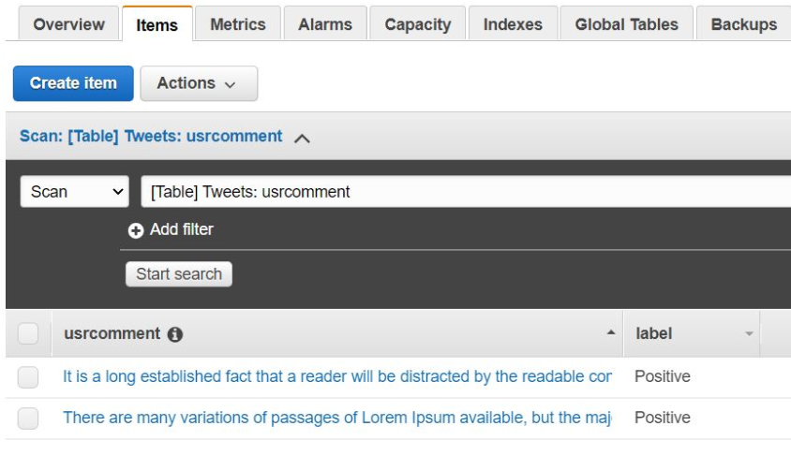
DynamoDB
One table, two columns (UserComment, Label) with UserComment as Primary key

Slide 18
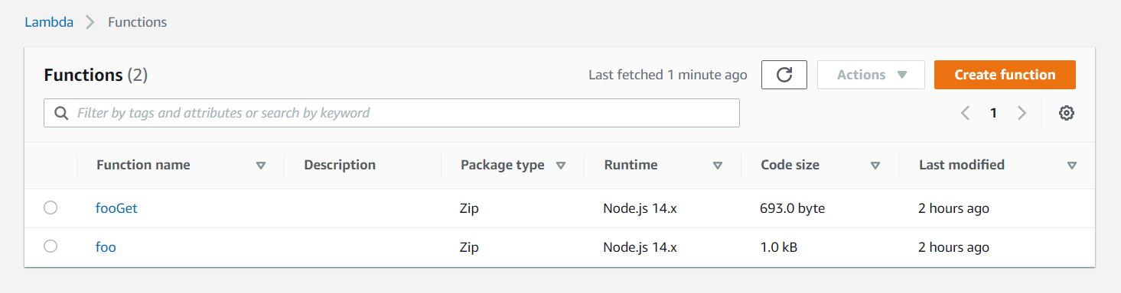
Lambda Fuctions
Two functions for GET and PTwo functions for GET and POST in NodeJS attached to an API Gateway and manages DynamoDB

Slide 19
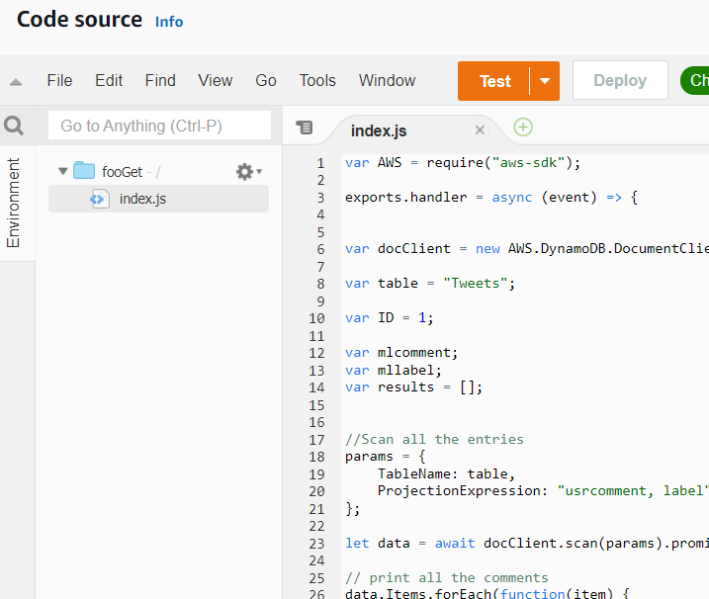
Lambda Funtions
Two functions for GET and POST in NodeJS attached to an API Gateway and manages DynamoDB

Slide 20
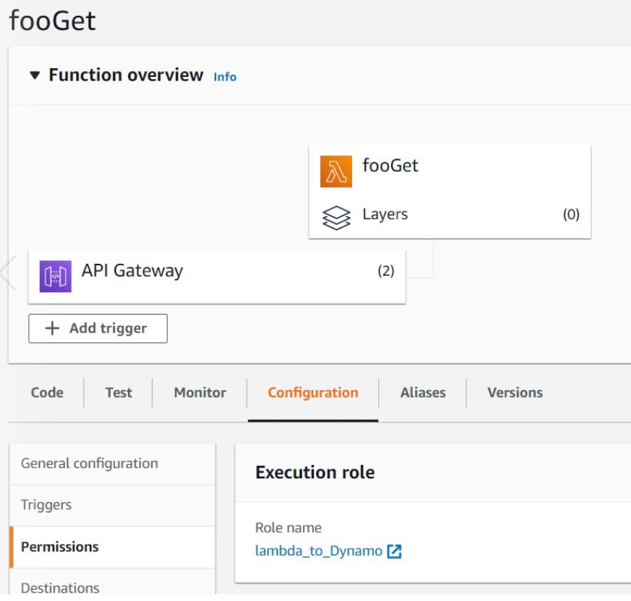
Lambda Functions
Two functions for GET and POST in NodeJS attached to an API Gateway and manages DynamoDB

Slide 21
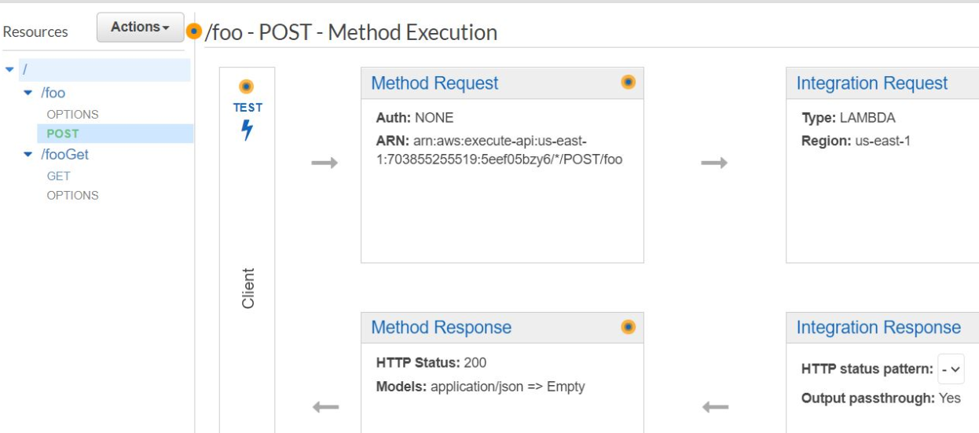
API Gateway
Two functions for GET and POST in NodeJS attached to an API Gateway and manages DynamoDB

Slide 22
Training Model – For Sentiment Analysis

Slide 23
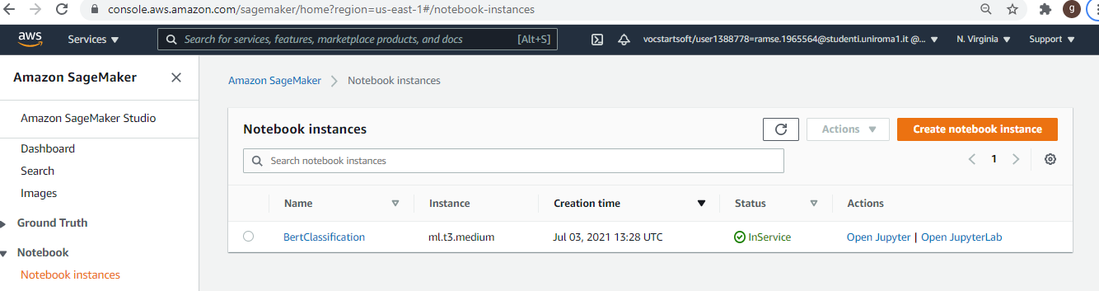
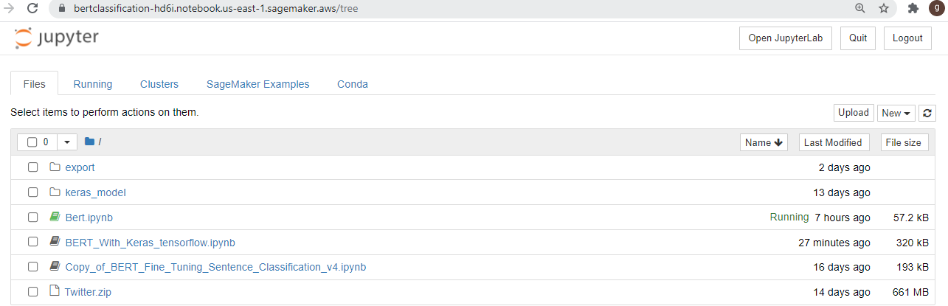
SageMaker

Slide 24
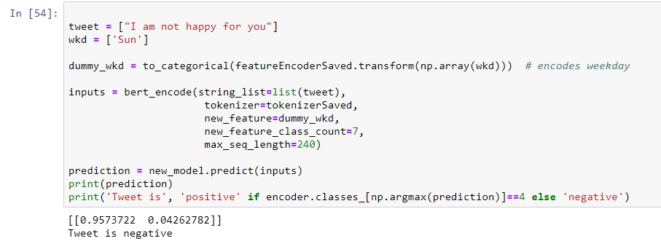
Model Output

Slide 25
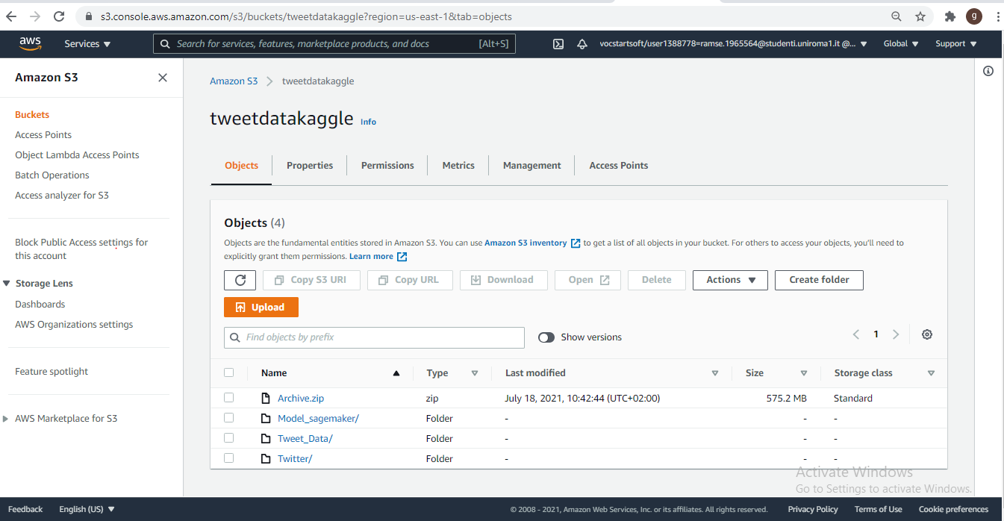
S3 Bucket

Slide 26
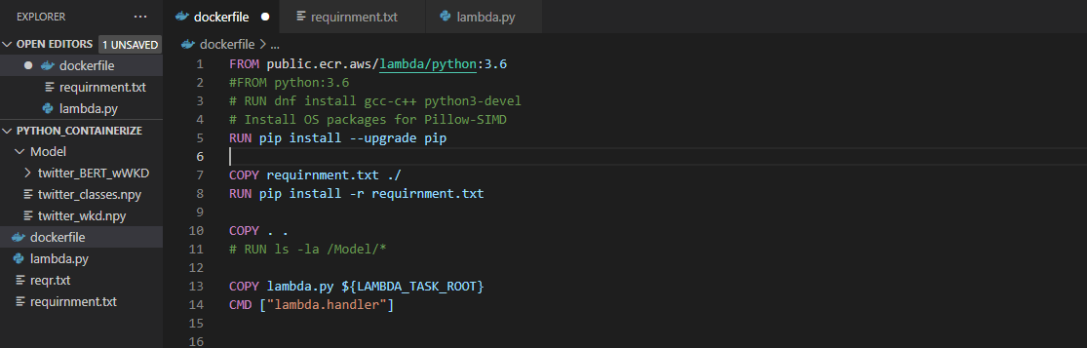
Docker

Slide 27
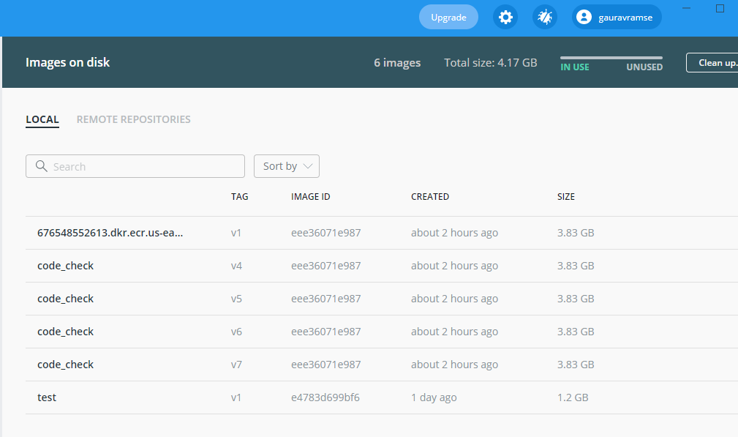
Docker Image

Slide 28
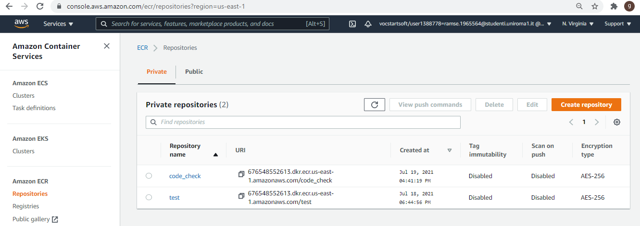
ECR

Slide 29
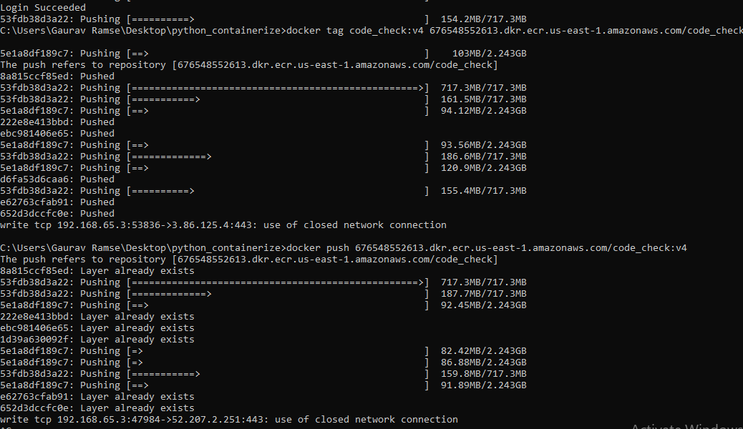
Issues while uploading model

Slide 30
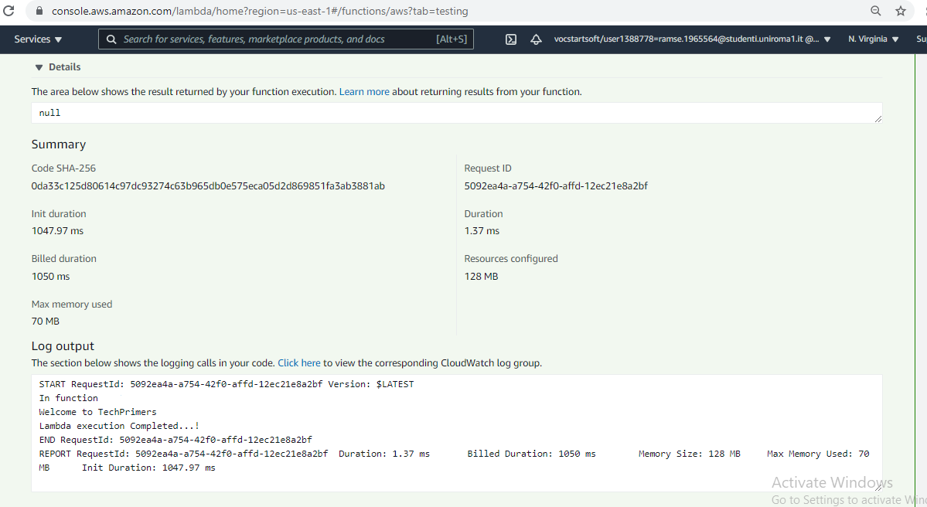
Lambda with Docker Container

Slide 31
Security

Slide 32

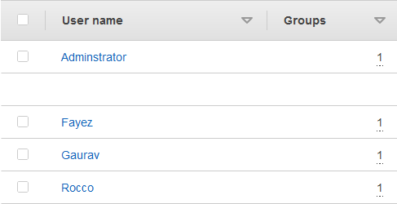
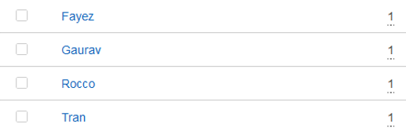
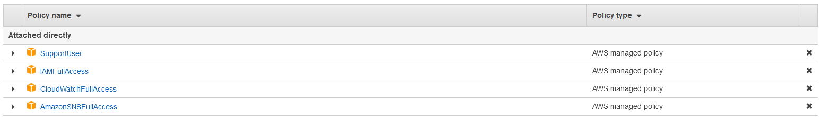
Security
IAM

Slide 33
Monitoring

Slide 34


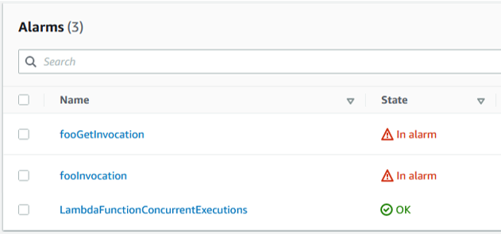
Monitoring

Slide 35
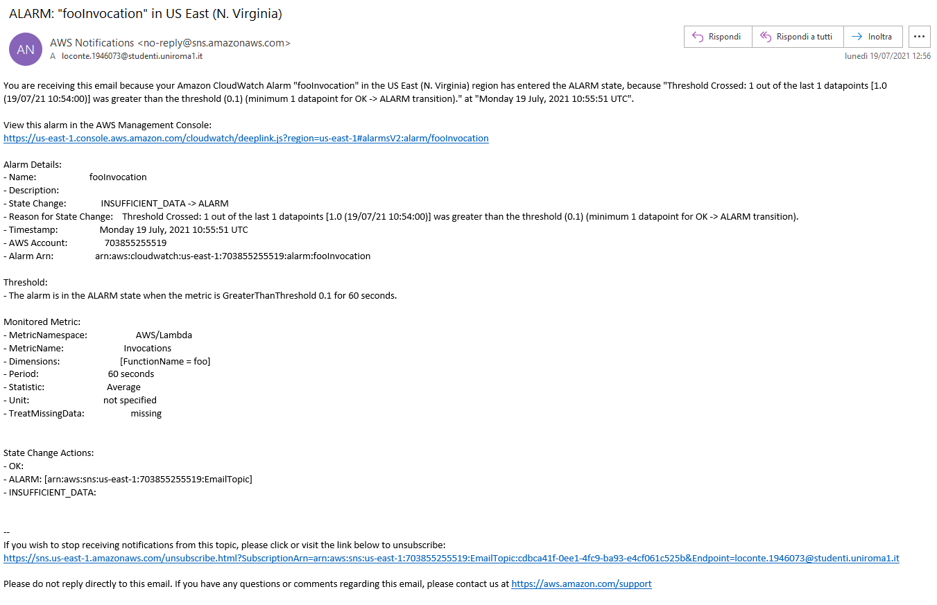
Monitoring

Slide 36
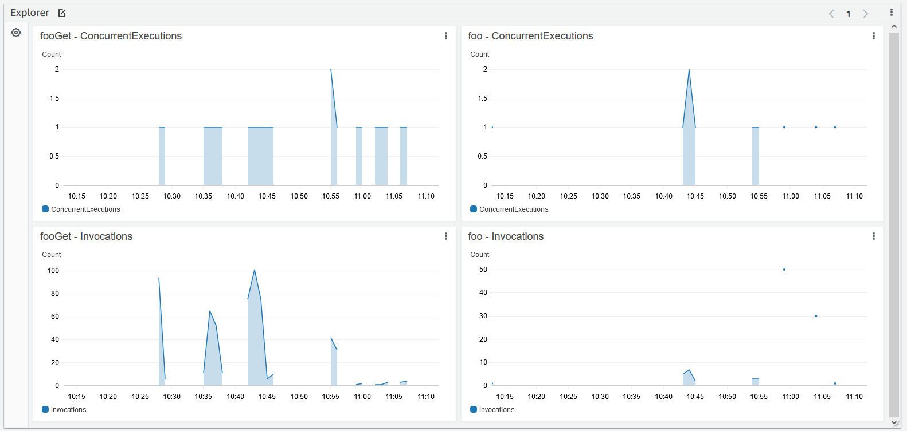
Monitoring

Slide 37
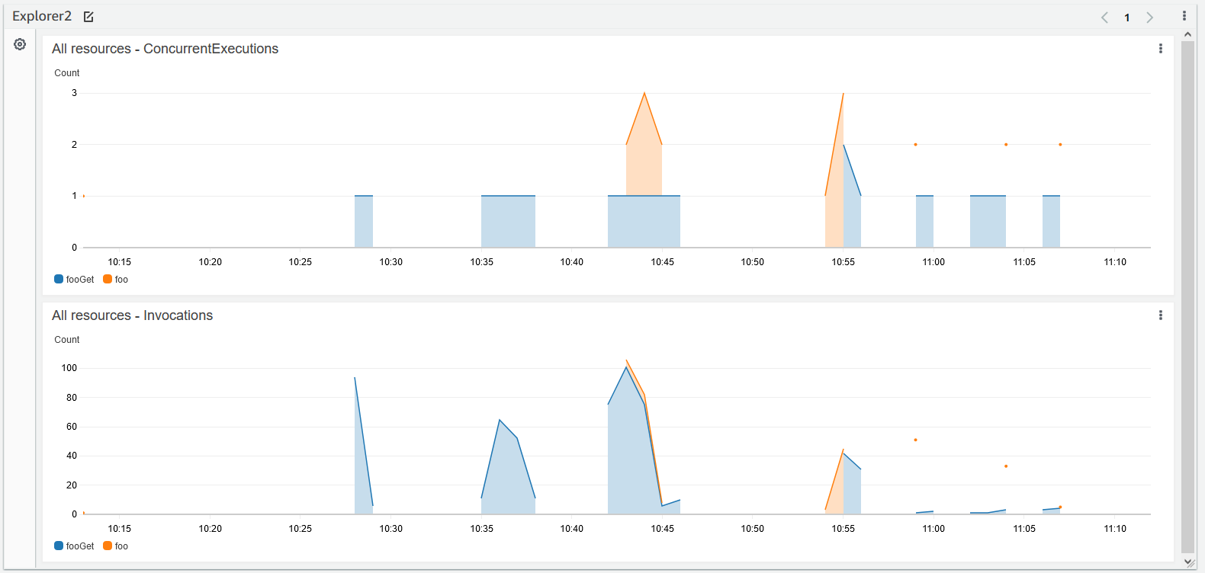
Monitoring

Slide 38
Test/Validation

Slide 39
Website Access – webfrontendaws.tk

Slide 40
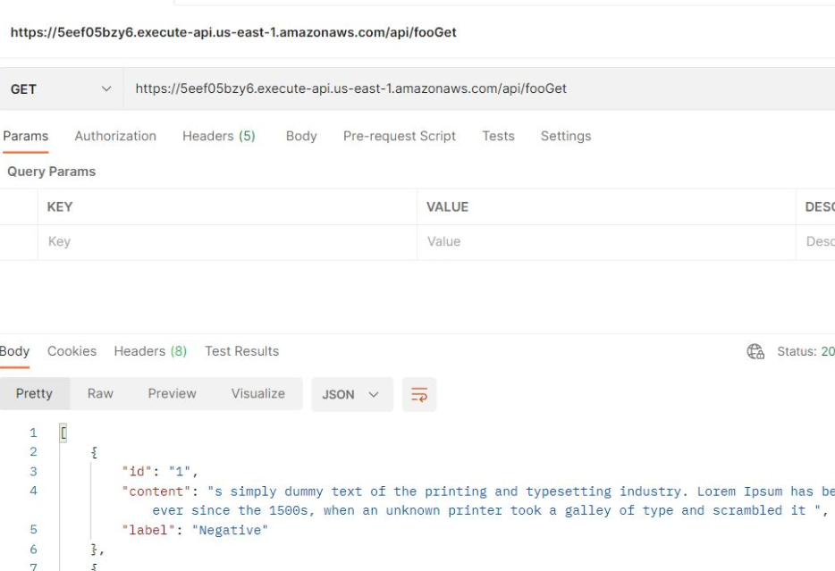
Validation (POSTMAN)
The API basic functionality is validated by sending GET and POST requests using postman, and the results are compared to the expected results

Slide 41
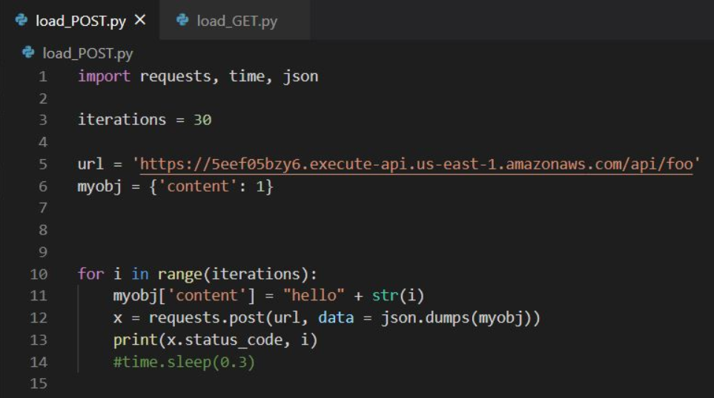
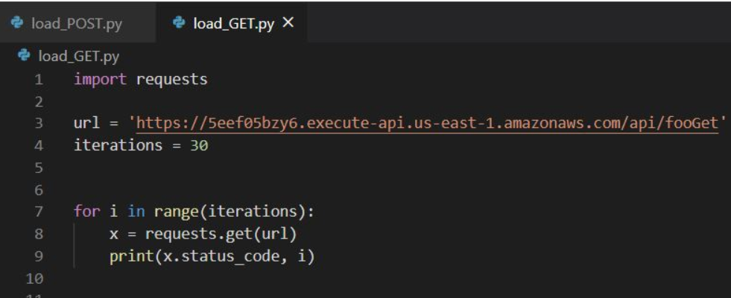
Test the system performance

