Slide 1
Lab Project - Networking for Big Data
Tran Luong Bang - 1956419
Gaurav Mohan Ramse - 1965564

Slide 2
Statistical Analysis

Slide 3
1) Extract 1 million of packets from the available data,
file_name = '../input/nbd-project/data.pcap'
new_file_name = './data_1m.pcap'
cmd('editcap -r ' + file_name +" "+ new_file_name+ ' '+ " 0-1000000")

Slide 4
1) Extract general info from trace using capinfos
Number of packets in capture file
! capinfos -c './data_1m.pcap'
The average data rate, in bit/sec
! capinfos -i './data_1m.pcap'
The average packet size
! capinfos -z './data_1m.pcap'
Generate all infos
! capinfos -A './data_1m.pcap'

Slide 5
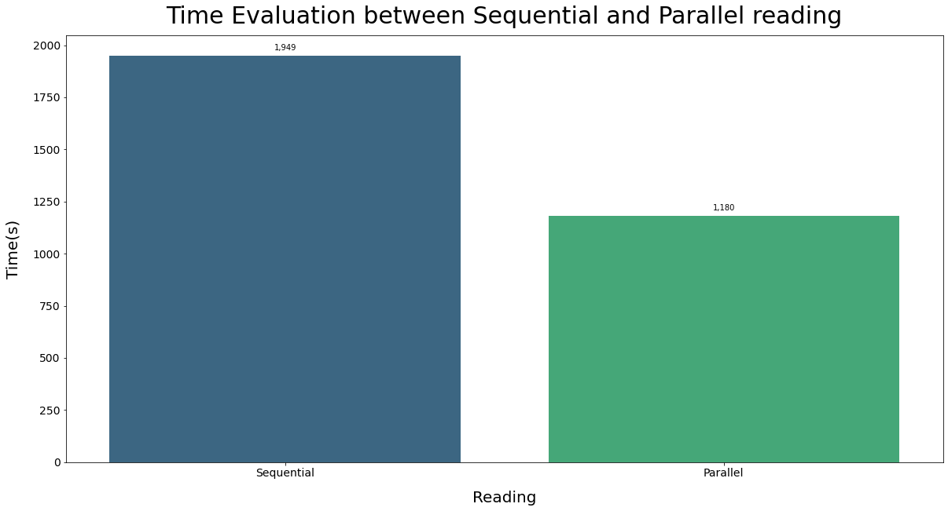
2) Time Evaluation between Sequential and Parallel reading - Evaluation by executing on Kaggle Notebook with 4 CPUs and 16GB RAM

Slide 6
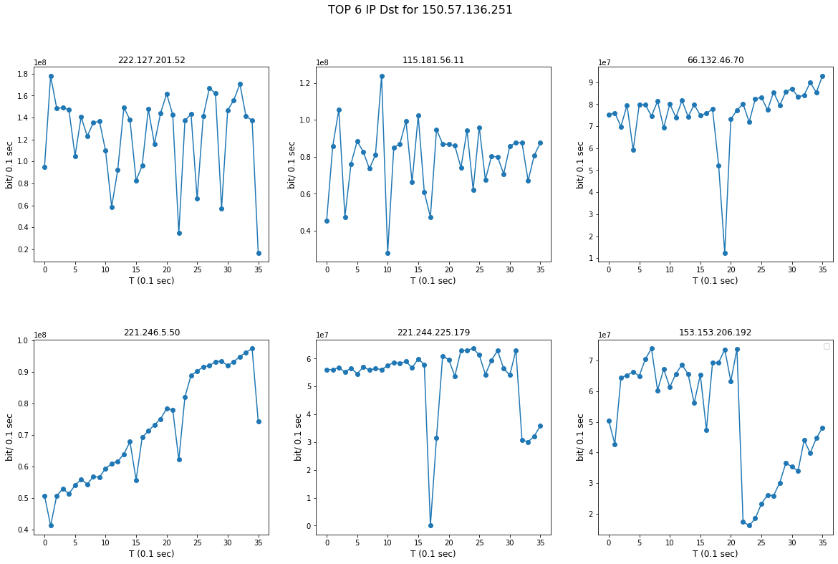
3) Extract the IP which generates the highest amount of sender traffic, evaluate the bit rate (0.1 sec) for the 6 IP addresses mostly used as endpoint

Slide 7
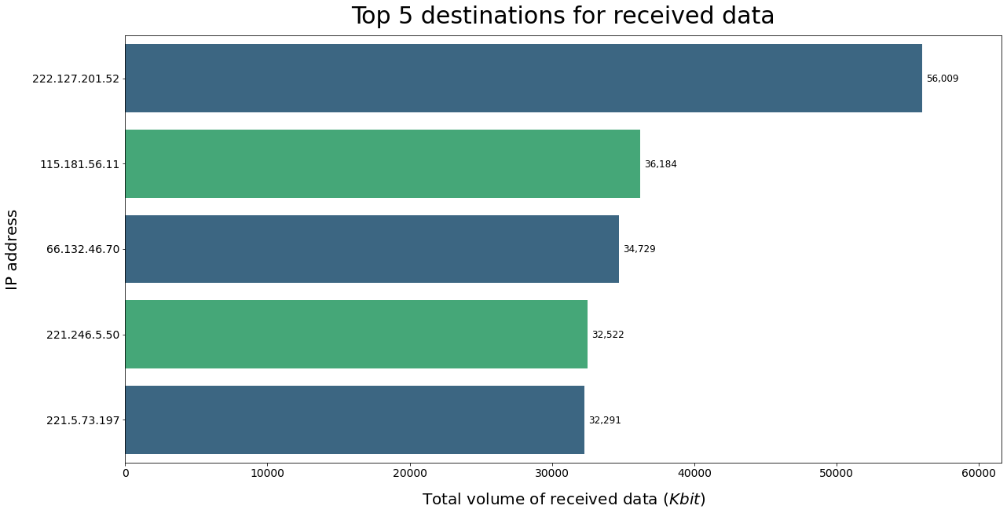
4) Top 5 Destination IP (received bytes)

Slide 8
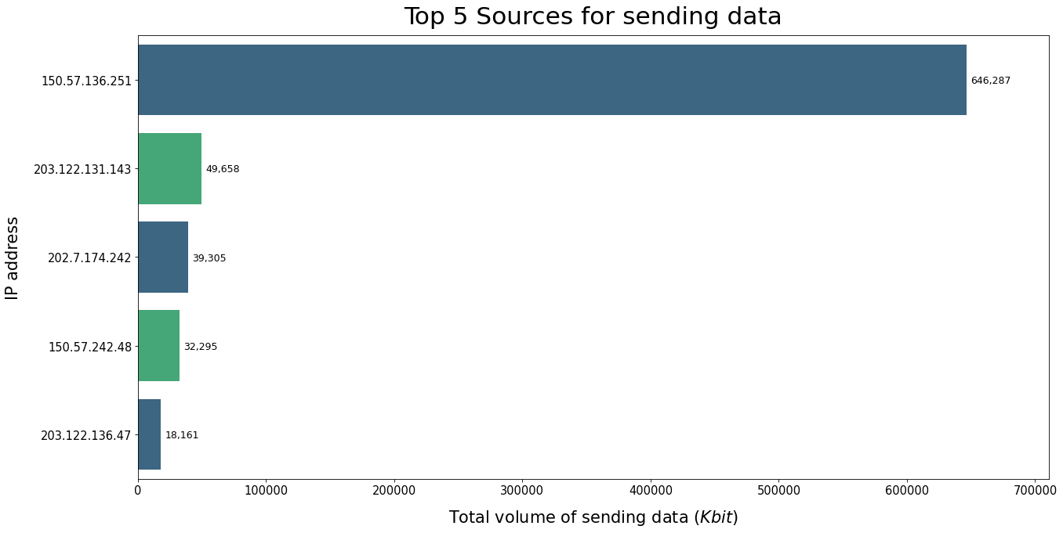
4) Top 5 Source IP (sent bytes)

Slide 9
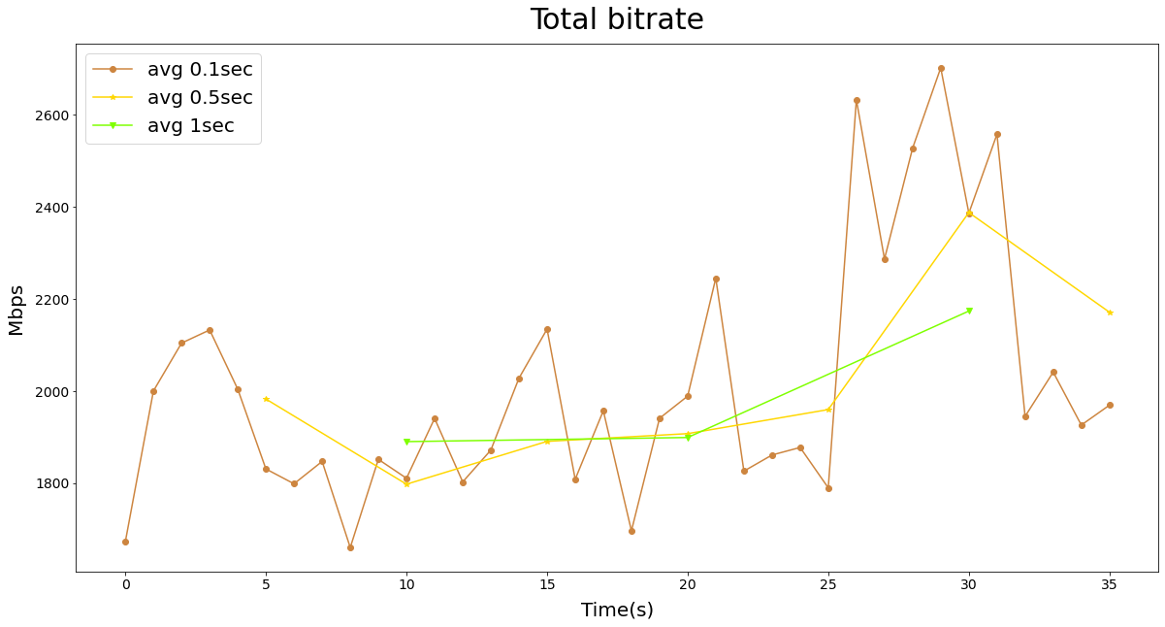
5) Evaluate bitRate considering all the trace with 3 different sampling rate

Slide 10
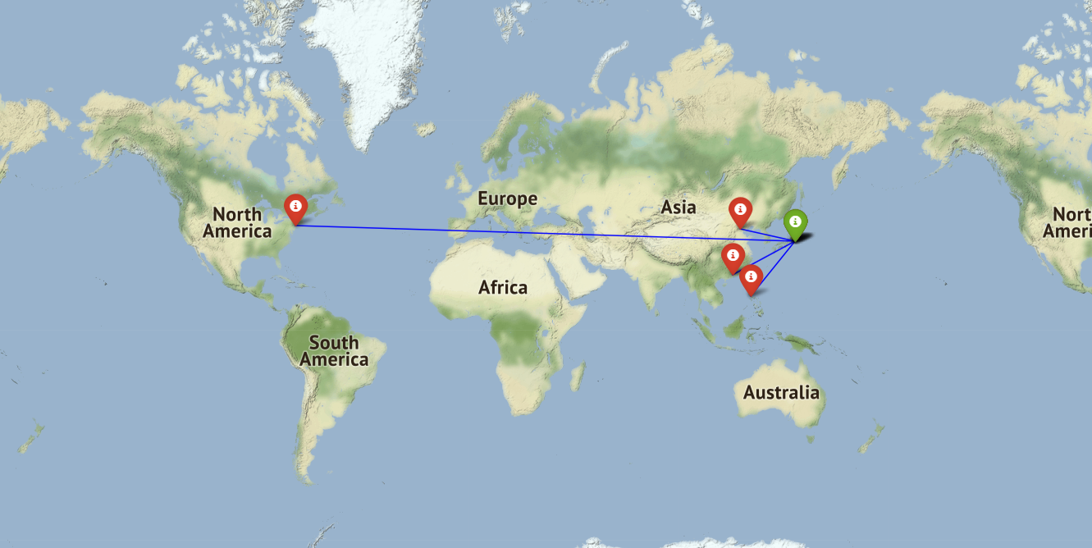
6) GeoLocal Referenciation of the 5 sessions with the highest amount of traffic generated

Slide 11
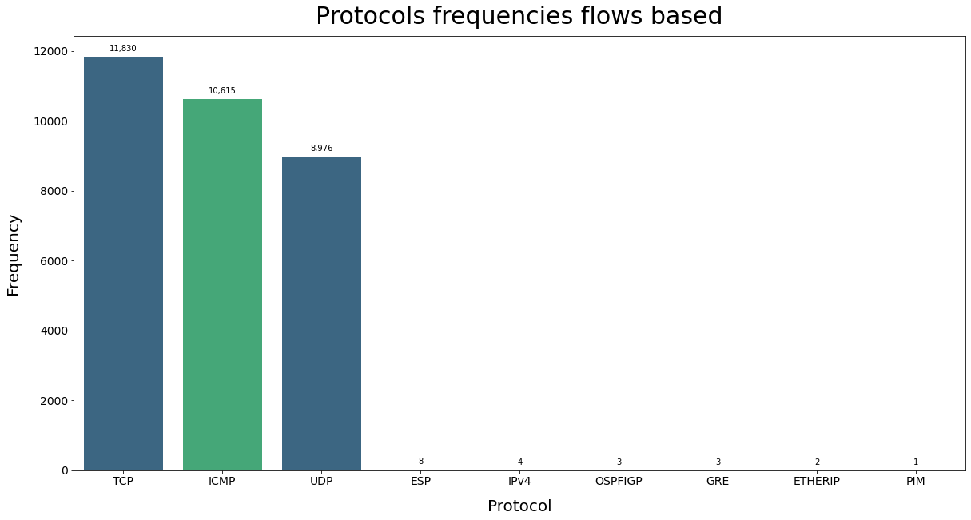
7) 10 Protocols mostly used

Slide 12
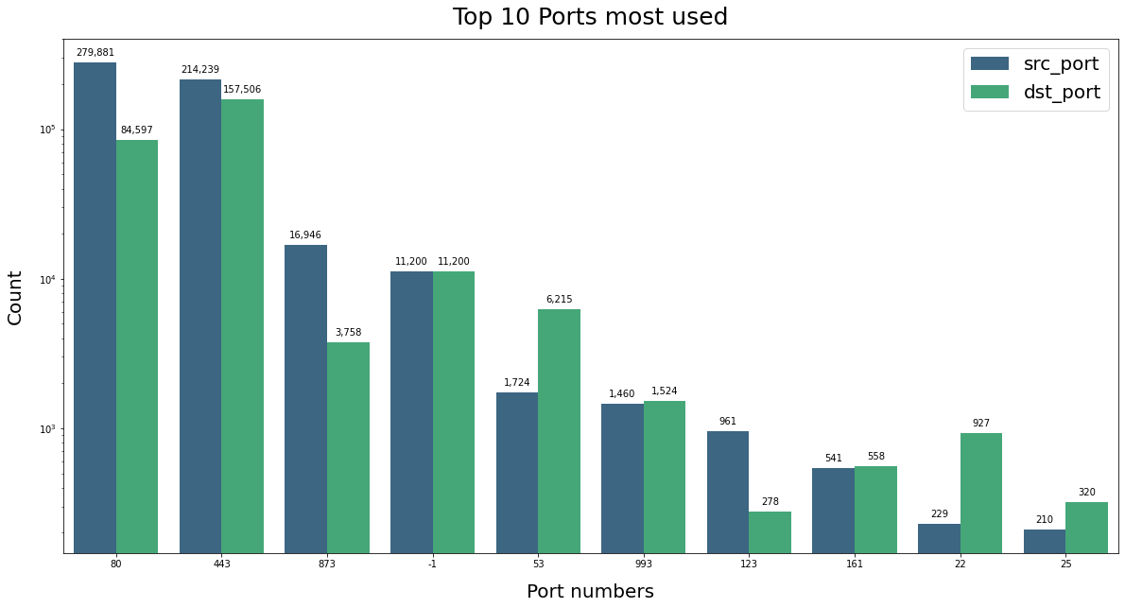
8) Port Scanner evaluation (10 Ports mostly used)

Slide 13
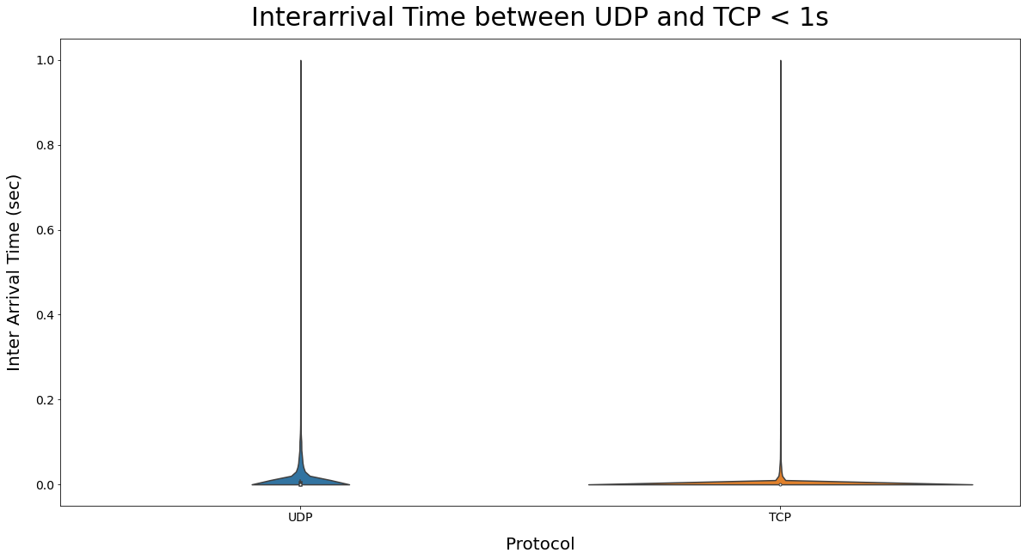
9) InterArrival Time boxplot between TCP and UDP Sessions

Slide 14
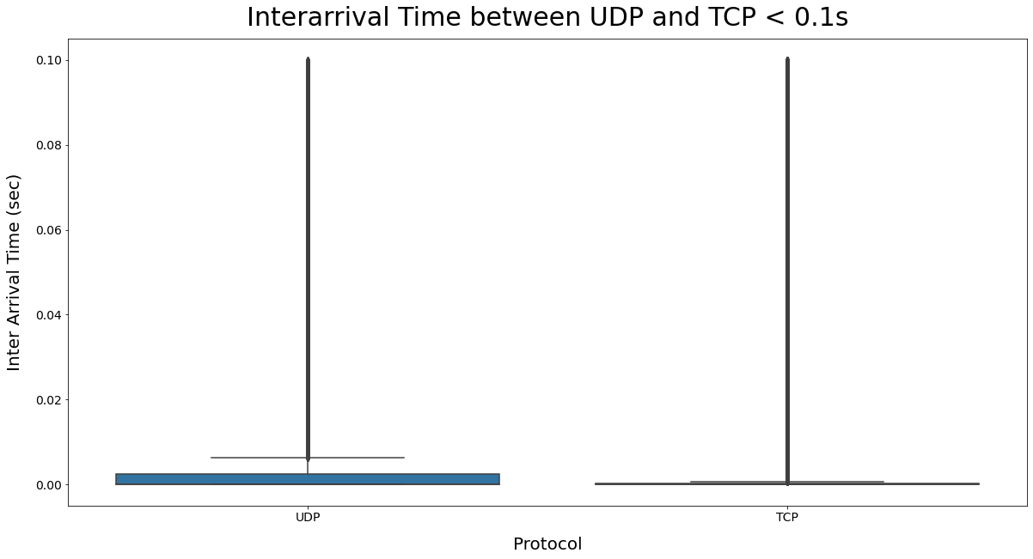
9) InterArrival Time boxplot between TCP and UDP Sessions

Slide 15
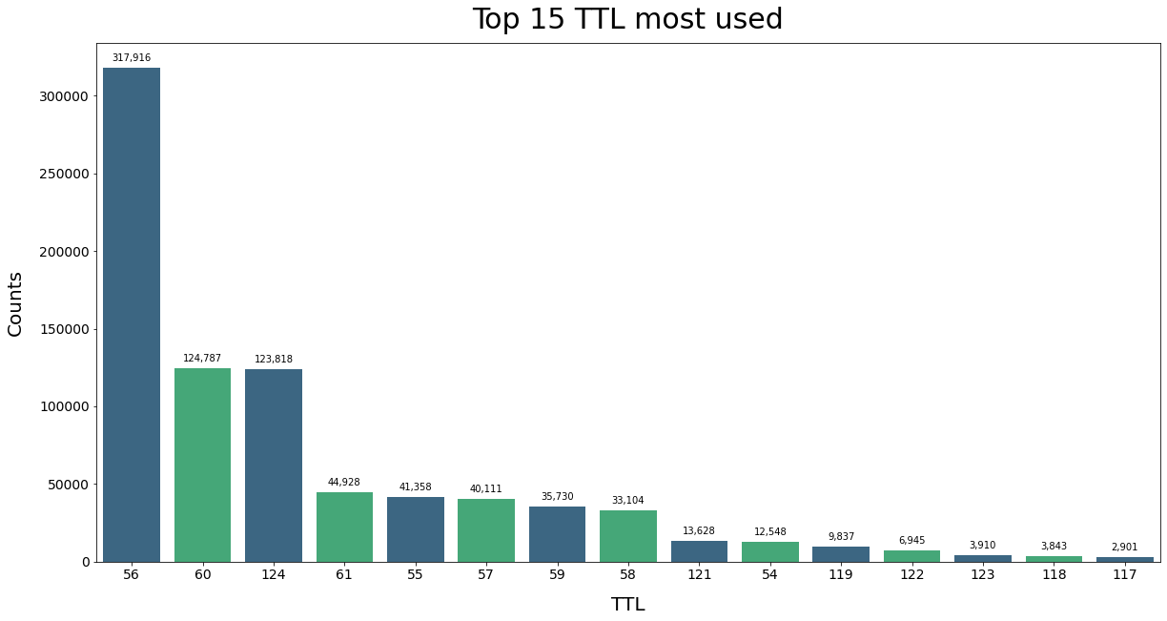
10) (Bonus) Top 15 TTL most used

Slide 16
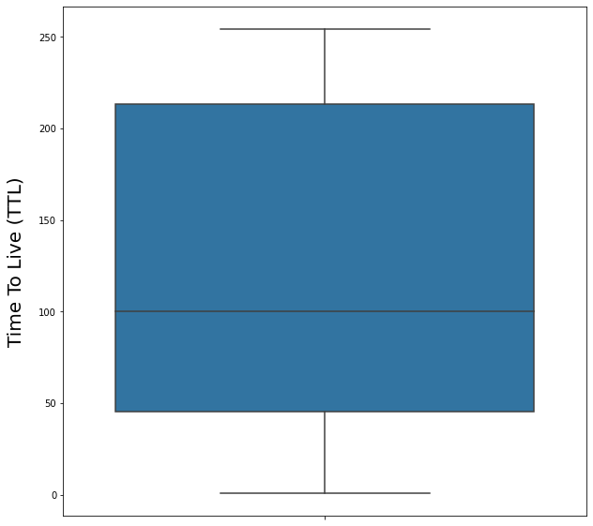
10) (Bonus) TTL

Slide 17
Machine Learning

Slide 18
Problem
Using data given to predict the protocol TCP, UDP and ICMP for each new packet.
Data
832,768 packets of the 1 million of packets from the available capture file.
Train and Validation data: 75% input data
Test dataset: 25% input data
Predictor Variables: {IP Src, IP Dst, Protocol, src-port, dst-port, length, ttl, time}
Target Variable: {Protocol}

Slide 19
Method
To sovle this classification problem, we’ve used 2 machine learning algorithms SVM and Random Forest.
Tuning the hyper-parameters by using RandomSearchCV and GridSearchCV
Data Preprocessing
Missing Values
Duplicate packets
One-hot Encode
Dimentionality Reduction
Class Imbalance

Slide 20
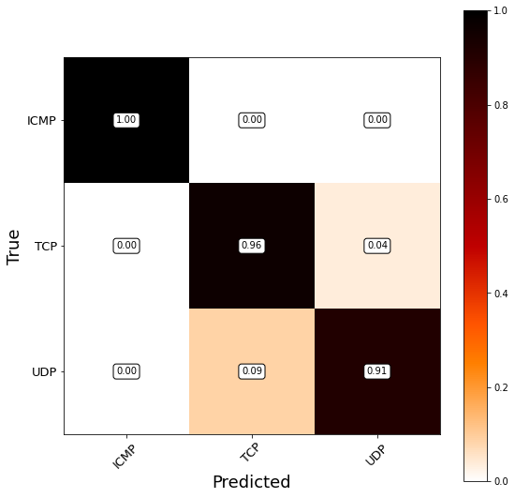
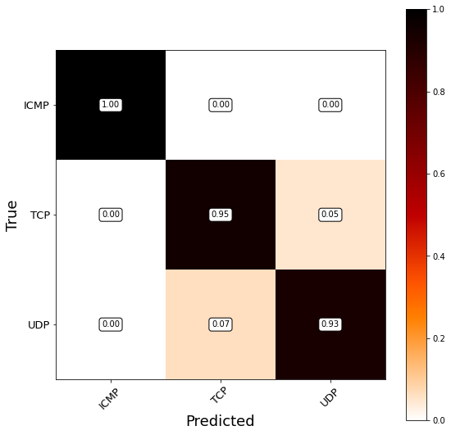
Evaluation Metrics
Confusion Matrix
Support Vector Machine
Random Forest

