Slide 1
Organic Drives Most Traffic but Not Most Conversions
Organic Search drives ~ 91% of traffic but only ~27% of conversions. Paid, Referral, and Social account for ~73% of conversions from just ~9% of traffic. Conversion efficiency differs significantly across channels.
Segment Organic keywords by search intent and focus conversion optimization on transactional terms
Add clear CTAs and internal links on high-traffic Organic pages
Use Paid and Remarketing to convert demand generated by Organic
Traffic vs. Conversions by Channel
Traffic
Conversions

Slide 2
Paid Delivers Strong Early Results but Reaches Saturation Quickly
Paid Traffic vs. Conversions Over Time
Paid campaigns show a learning phase with rapid conversion growth. Over time, they reach a saturation point where incremental traffic yields diminishing returns. Budget scaling beyond this point reduces efficiency.
Avoid increasing Paid budget post-saturation
Refresh audiences and creatives before scaling again
Leverage Organic traffic to expand Paid remarketing pools
Our campaign was finding an audience

Slide 3
Overall Campaign Efficiency Peaks and Declines Due to Cross-Channel Saturation
Overall Campaign Slope Over Time
From July, overall campaign efficiency increases rapidly in the early phase, indicating strong initial demand. The campaign then reaches a saturation point, after which marginal efficiency declines
Stop scaling spend on channels that have reached saturation
Refresh audiences, creatives, and funnel messaging across channels.
Shift focus from traffic growth to conversion quality optimization
Use Organic to generate new demand before re-scaling Paid
Saturation Point

Slide 4
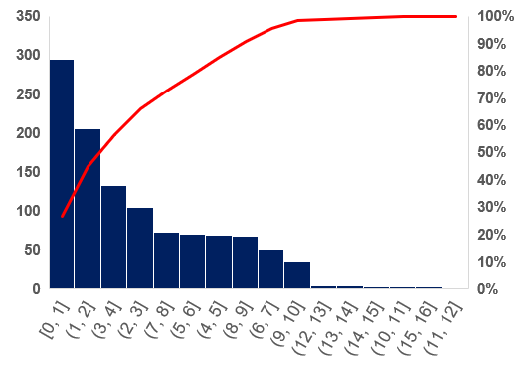
Only 14% Probability of Achieving 8+ Daily Conversions
Average daily conversions are 3.8, with a maximum of 16.
The distribution indicates that most days generate fewer than 7 conversions.
There is only a 14% probability of achieving 8 or more conversions, suggesting high-performance days are infrequent.
Distribution
Probability
14% Probability there will be 8 plus conversions

Slide 5
Rebalance Organic Strategy
Segment keywords by search intent
Optimize conversions only for transactions terms
Add CTAs & internal links on high-traffic pages
Recommendations
Control Paid Post-Saturation
Avoid budget scaling beyond saturation
Refresh audiences & creatives to reset learning
Prioritize high-intent & remarketing traffic
Align Organic → Paid
Use Organic to generate demand
Use Paid to convert demand

